Slide 1
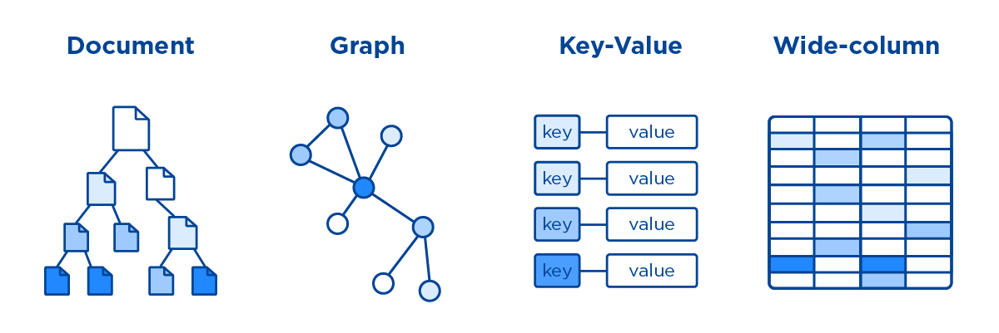
Types of NoSQL databases

Slide 2
Why NoSQL appeared?
Cost Efficiency: Storage costs dropped, reducing the need for complex data models to avoid duplication.
Developer Productivity & Flexible Schemas: Simplifies data management with schema models adaptable to business needs.
Scalability: Overcomes the limitations of SQL databases, enabling efficient horizontal scaling.
Big Data Ready: Optimized for handling large-scale data and high user loads effectively.

Slide 3
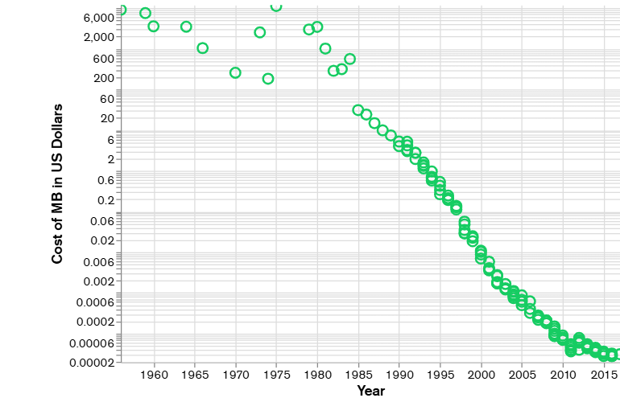
Why NoSQL appeared?

Slide 4
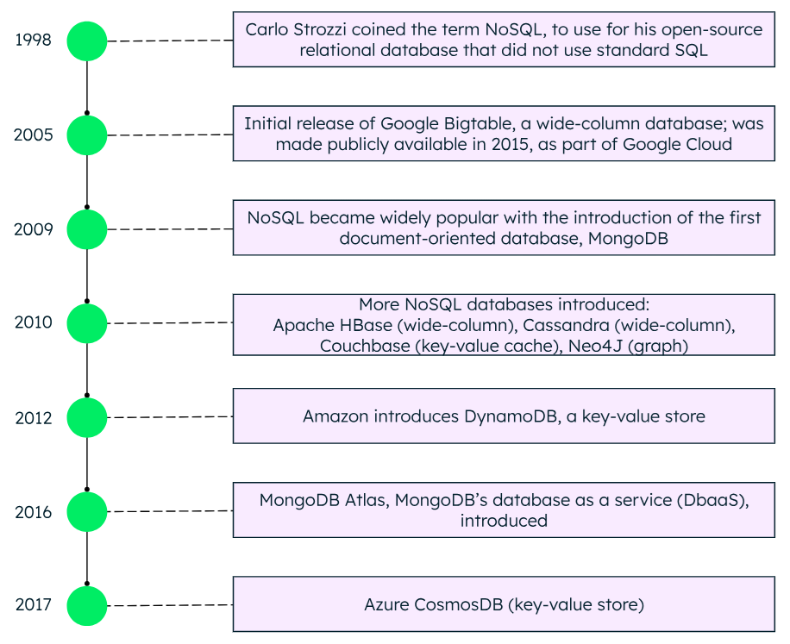

Slide 5
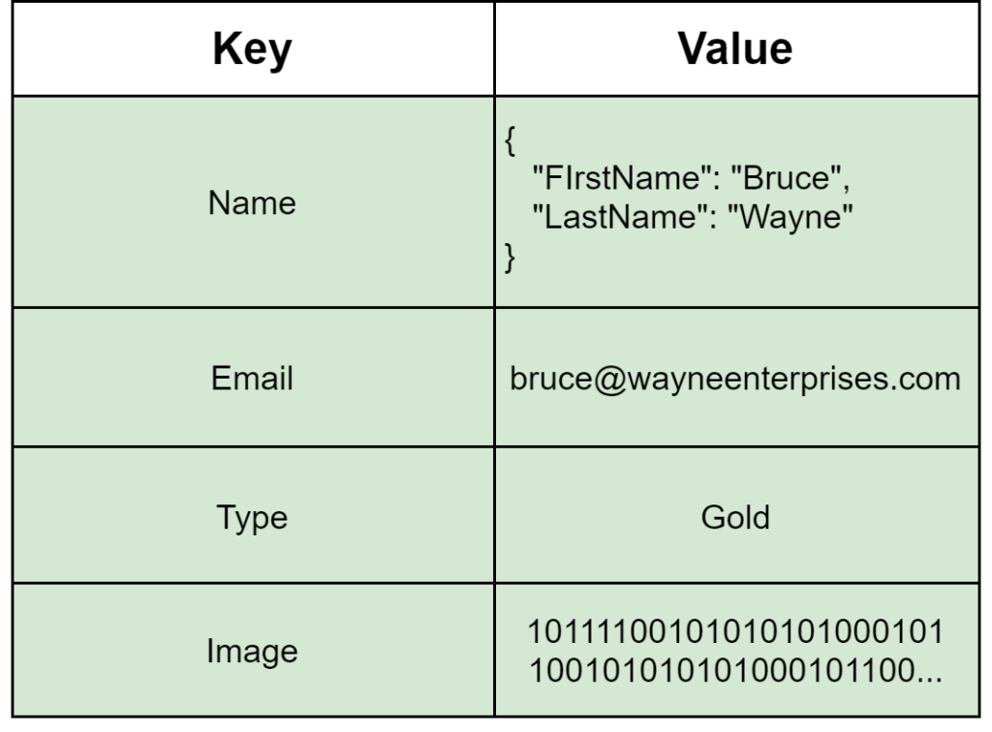
Key-Value
Key-value data store is a type of database that stores data as a collection of key-value pairs. In this type of data store, each data item is identified by a unique key, and the value associated with that key can be anything.
A key-value store is like a relational database with only two columns which is the key and the value.

Slide 6
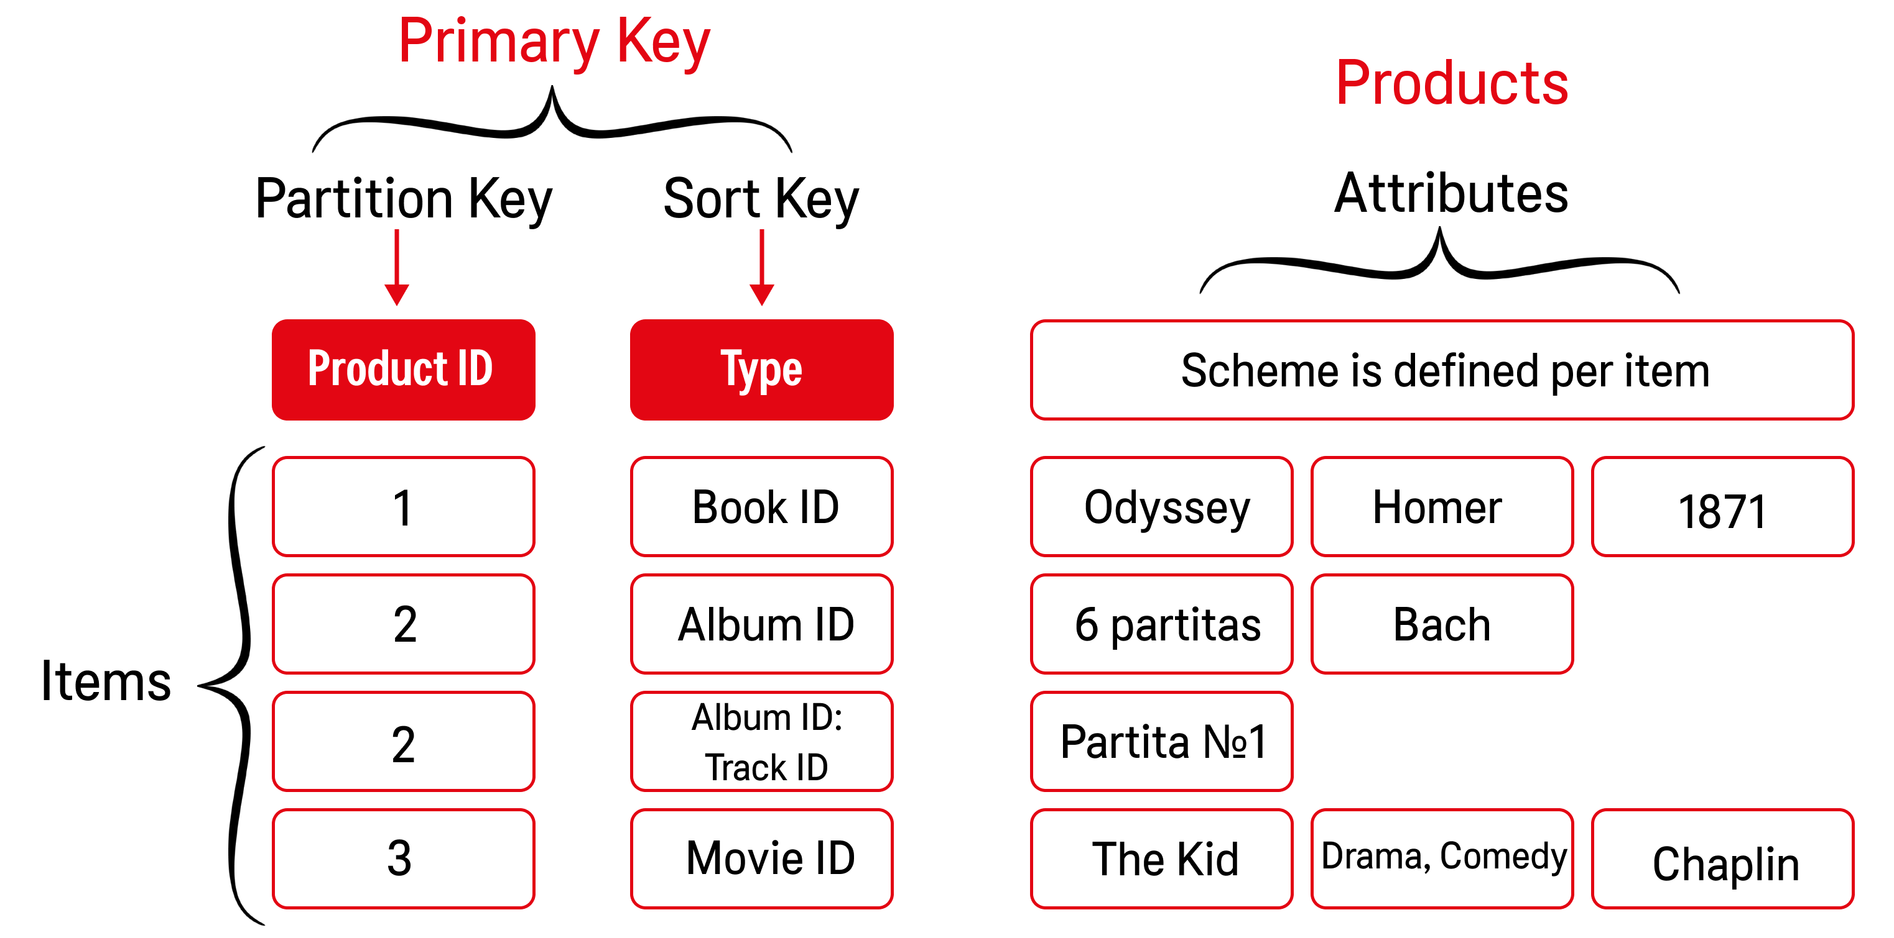
Key-Value

Slide 7

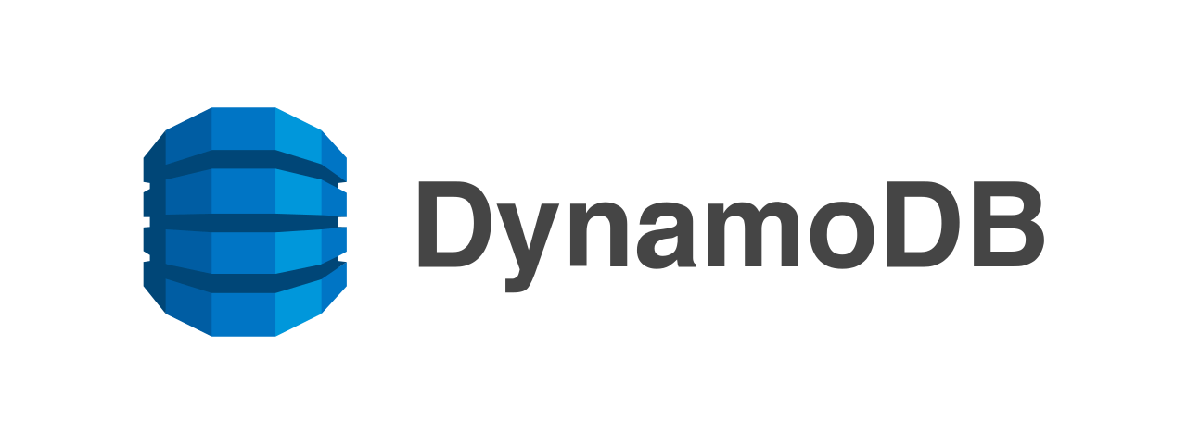

Key-Value. Use cases
Session management on a large scale
Cache to accelerate application responses
Shopping cart management
Leaderboards and rankings

Slide 8

Document
Document-oriented database is a type of NoSQL database that stores data as documents, typically in formats like JSON, BSON or XML.
Document-oriented database is like a key-value store, but with more complexity, as the value is a full document containing fields, arrays, and nested objects.

Slide 9
Document VS Key-Value
Data Structure:
Key-Value: Stores data as simple key-value pairs, where key and value can be of any type.
Document-Oriented: Stores data as documents, with the key typically as a string and the value as a structured or semi-structured document.
Query Capabilities:
Key-Value: Only supports retrieving the entire value associated with a key.
Document-Oriented: Allows retrieving specific parts of a document (fields, nested values).
Data Representation:
Key-Value: Values can be simple or complex objects and treated as blobs by the database.
Document-Oriented: Documents follow standard formats like JSON.

Slide 10
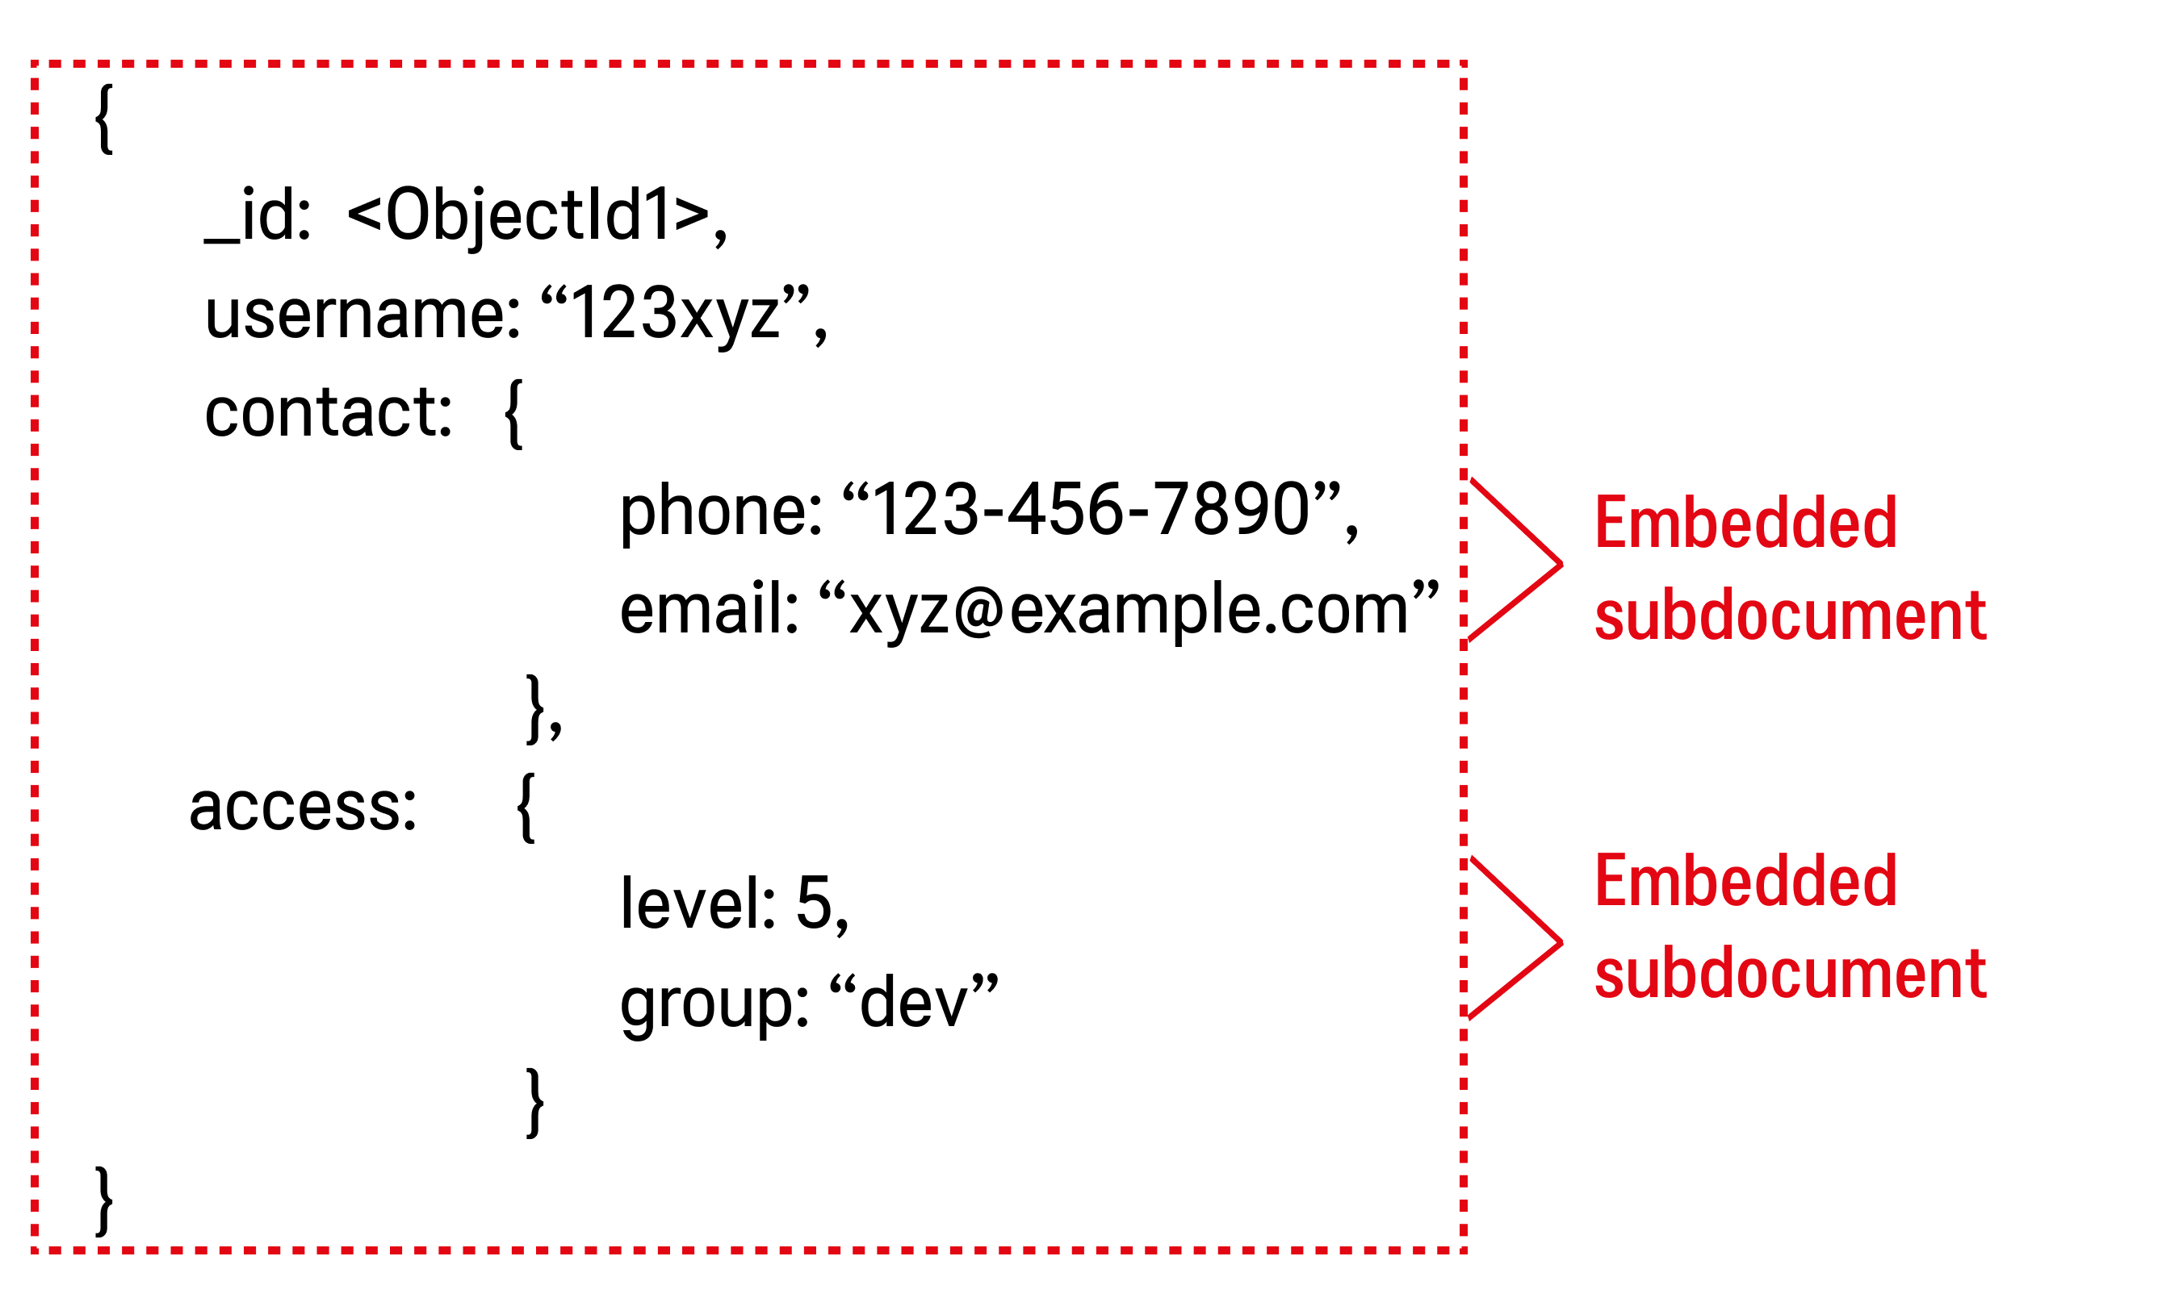
Document

Slide 11



Document. Use cases
Content Management Systems
E-commerce Platforms
User Profiles
Continuous Reads and Writes

Slide 12
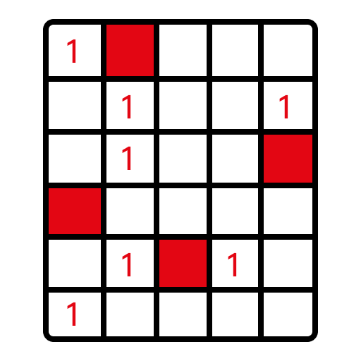
Wide-column
Wide-column database is a type of NoSQL database designed to handle large-scale, distributed data. It organizes data into tables, rows, and column families, where:
Rows are identified by a unique key (row key).
Columns are grouped into column families, which store related data together.
Each row can have a variable number of columns within the defined column families.

Slide 13
Row-Oriented Databases
Storage Model: Data for a single row is stored in contiguous blocks on disk.
Query Performance: Fast for retrieving entire rows or updating specific records since all data for a row resides in the same block.
Use Cases: Best for scenarios like e-commerce transactions, banking systems. Optimized for frequent updates and inserts.
Limitations: Not ideal for analytical queries involving aggregations across columns, as they require scanning through multiple rows and blocks.
Example: Traditional relational databases like PostgreSQL store data row by row.

Slide 14
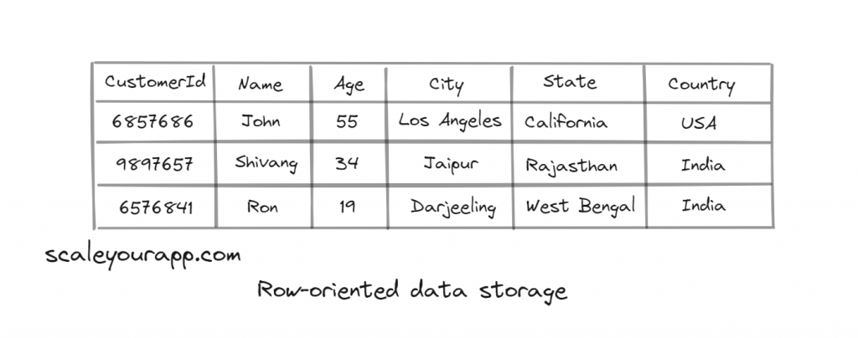
Row-Oriented Databases

Slide 15
Column-Oriented Databases
Storage Model: Each column is stored in a separate contiguous location on disk. Columns with similar data are grouped together, enabling efficient access.
Query Performance: Ideal for analytics, as queries can focus on specific columns without scanning entire rows. Compression techniques are applied effectively due to the similarity of columnar data.
Use Cases: Best for analytical workloads, large-scale data processing, and reports.
Limitations: Inefficient for frequent writes, such as inserting new rows, since all columns must be updated individually. Not well-suited for transactional operations.
Examples: Databases like Google BigQuery and Amazon Redshift store data by columns instead of rows.

Slide 16
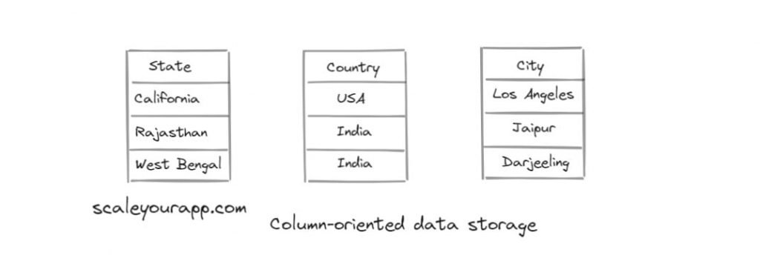
Column-Oriented Databases

Slide 17
Column-Family Databases
Storage Model: Data is stored as rows, with each row containing one or more column families. A column family groups related columns, which are stored together.
Query Performance: Combines the flexibility of row-based storage with the efficiency of columnar storage.
Use Cases: Suitable for large-scale, distributed applications with variable schemas.
Example: Google Bigtable, Apache Cassandra, Apache HBase.

Slide 18
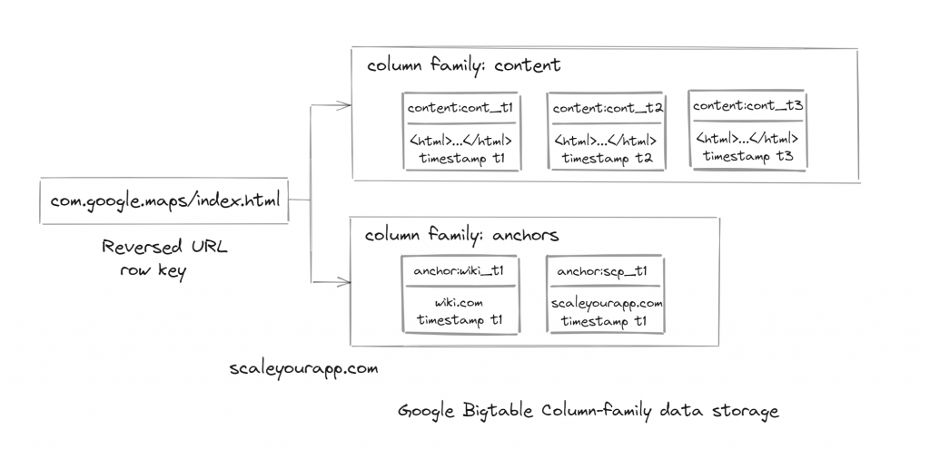
Column-Family Databases

Slide 19



Wide-column
Analytics
IoT (Internet of Things) Sensor Data
Log Data
Time Series

Slide 20
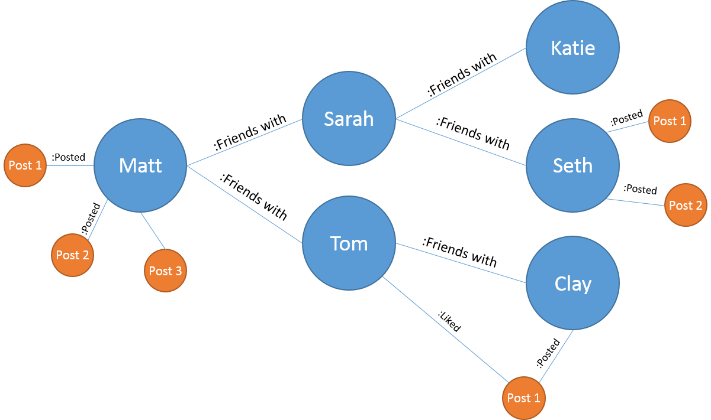
Graph
Graph databases are a type of NoSQL database that stores data in the form of nodes (vertices) and edges (links) that model relationships between entities.
They are optimized to perform complex relationship queries and allow you to efficiently process data with a high degree of connectivity.

Slide 21
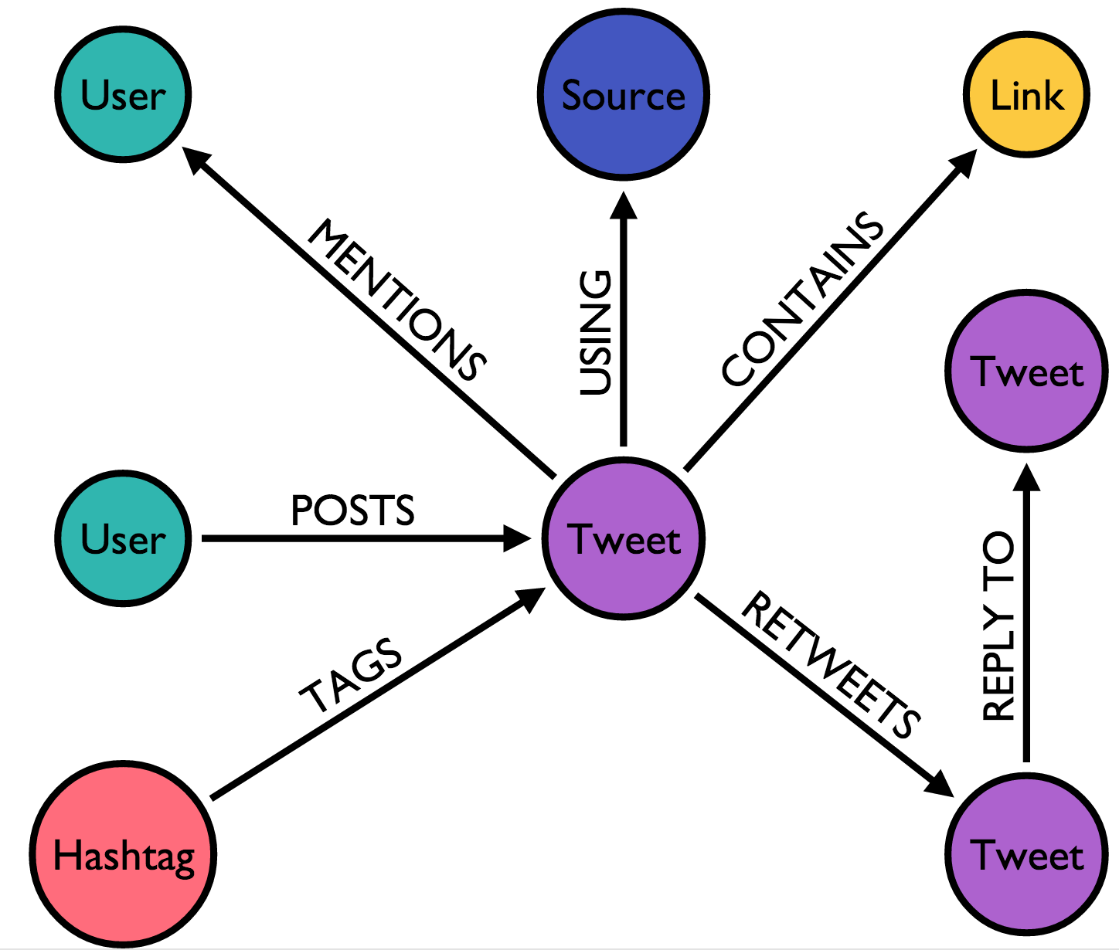
Graph
Data Structure:
Nodes (Vertices): Represent entities.
Edges (Links): Represent relationships between nodes.
Properties: Key-value pairs attached to nodes and edges to store additional data.
Key Features:
Relationships stored with data for fast, efficient queries.
Schema flexibility allows adaptation to changes.
Supports rich query languages like Cypher and Gremlin.
Strengths:
Efficient for relationship queries.
Intuitive representation of connected data.

Slide 22


Graph
Social Networks
Recommendation Systems
Knowledge Graphs
Biological and Healthcare Networks

