Slide 1
Java Memory Model

Slide 2
Types of Memory
Obj a = Obj@29391;
int a = 25;
long c = 1331L;
Stack
Heap
Both Stack and Heap are created in JVM and stored in RAM.

Slide 3
Stack Memory
Store temporary variables
Store primitive data types
Store separate memory blocks for methods

Slide 4
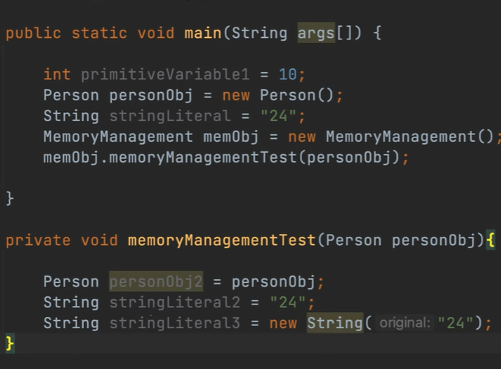
Stack Memory

Slide 5
Stack Memory
String Pool
“24”
memObj
memObj
personObj
stringLiteral
main
personObject
primitiveVariable1 = 10

Slide 6
Stack Memory
memory
Management
String Pool
“24”
personObject
memObj
memObj
personObj
stringLiteral
main
personObject
primitiveVariable1 = 10

Slide 7
Stack Memory
memory
Management
String Pool
personObject2
“24”
personObject
memObj
memObj
personObj
stringLiteral
main
personObject
primitiveVariable1 = 10

Slide 8
Stack Memory
stringLiteral2
String Pool
memory
Management
personObject2
“24”
personObject
memObj
memObj
personObj
stringLiteral
main
personObject
primitiveVariable1 = 10

Slide 9
Stack Memory
stringLiteral3
strLiteral3
stringLiteral2
String Pool
memory
Management
personObject2
“24”
personObject
memObj
memObj
personObj
stringLiteral
main
personObject
primitiveVariable1 = 10

Slide 10
Stack Memory
stringLiteral3
strLiteral3
stringLiteral2
String Pool
memory
Management
personObject2
“24”
personObject
memObj
memObj
personObj
stringLiteral
main
personObject
primitiveVariable1 = 10

Slide 11
Object Reference Types
Strong reference
Weak reference
Soft reference
Phantom reference

Slide 12
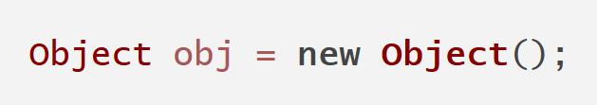
Object Reference Types. Strong reference
Default type of references in Java. Any object that is created and assigned to a variable is strongly referenced.
As long as a strong references to an object exists, the object will not be eligible for garbage collection.

Slide 13
Object Reference Types. Weak reference
Type of references that does not prevent its reference from being reclaimed by the garbage collector.
Object that has only weak references pointing to it can be collected by the garbage collector at any time. Weak references are often used in scenarios like caching.

Slide 14
Object Reference Types. Soft reference
Similar to weak references, but they provide more lenient approach to garbage collection.
An object referenced by a soft reference will only be collected if the JVM only needs memory.

Slide 15
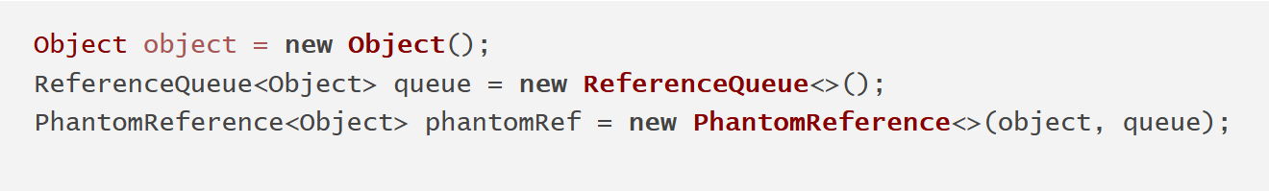
Object Reference Types. Phantom reference
Allow you to determine when an object was removed from memory.

Slide 16
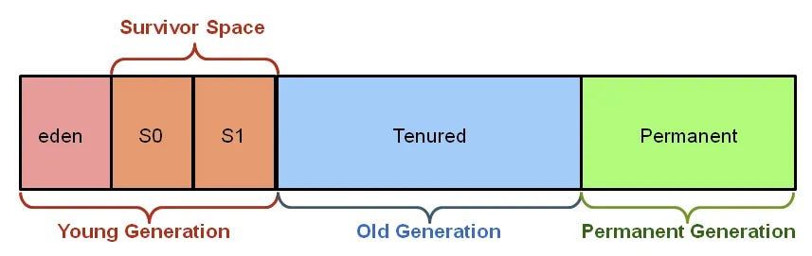
Heap
(Metaspace)

Slide 17
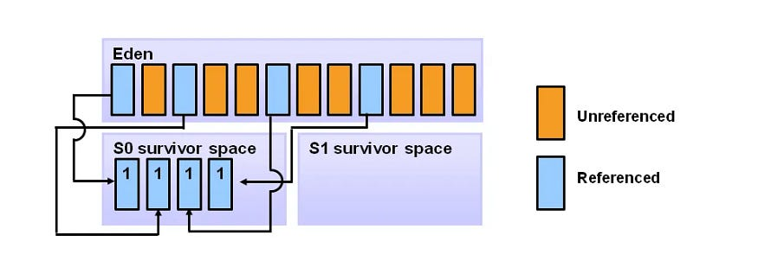
Minor Garbage Collection

Slide 18
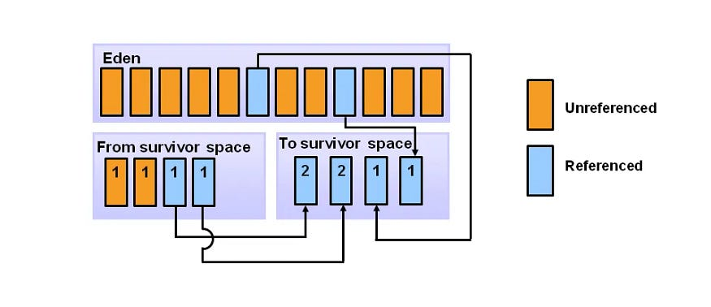
Minor Garbage Collection

Slide 19
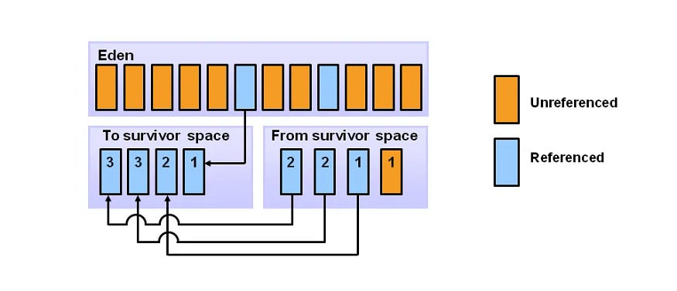
Minor Garbage Collection

Slide 20
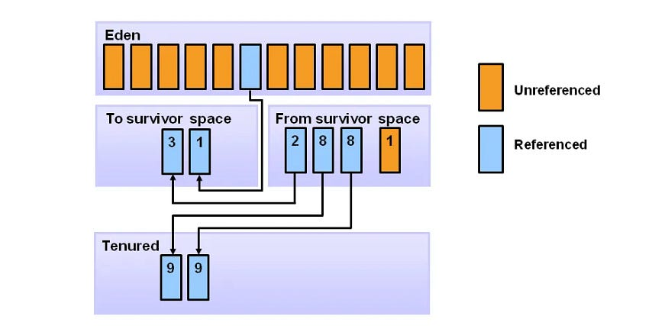
Promotion to Old Generation
Any objects that have survived a certain number of cycles in the survivor space are moved by the algorithm to the old generation.

Slide 21
Heap Metaspace
MetaSpace
Metadata
Class definitions
Constants
Static variables

Slide 22
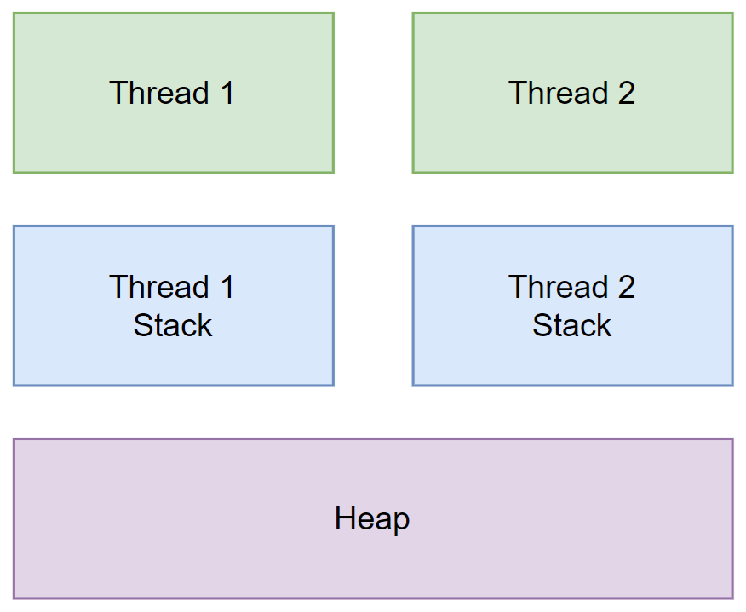
Memory and Threads
Each thread has its own Stack memory.

Slide 23
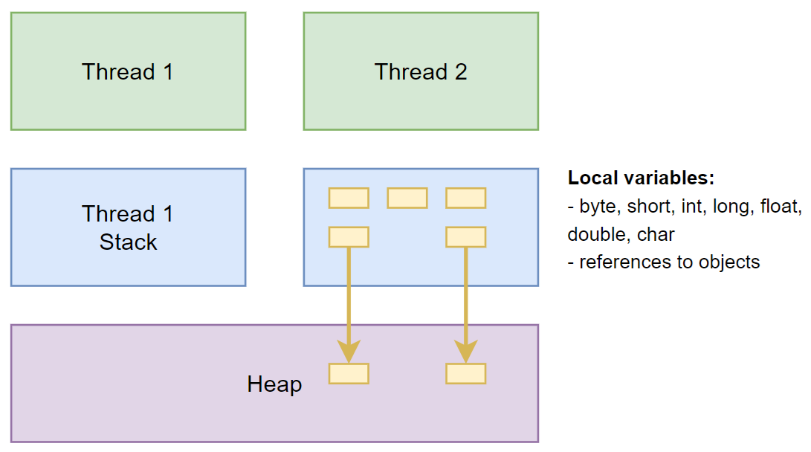
Memory and Threads

Slide 24
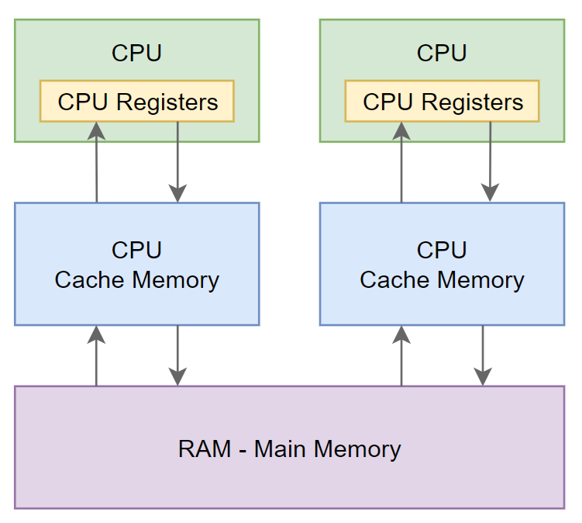
Memory and Threads

Slide 25
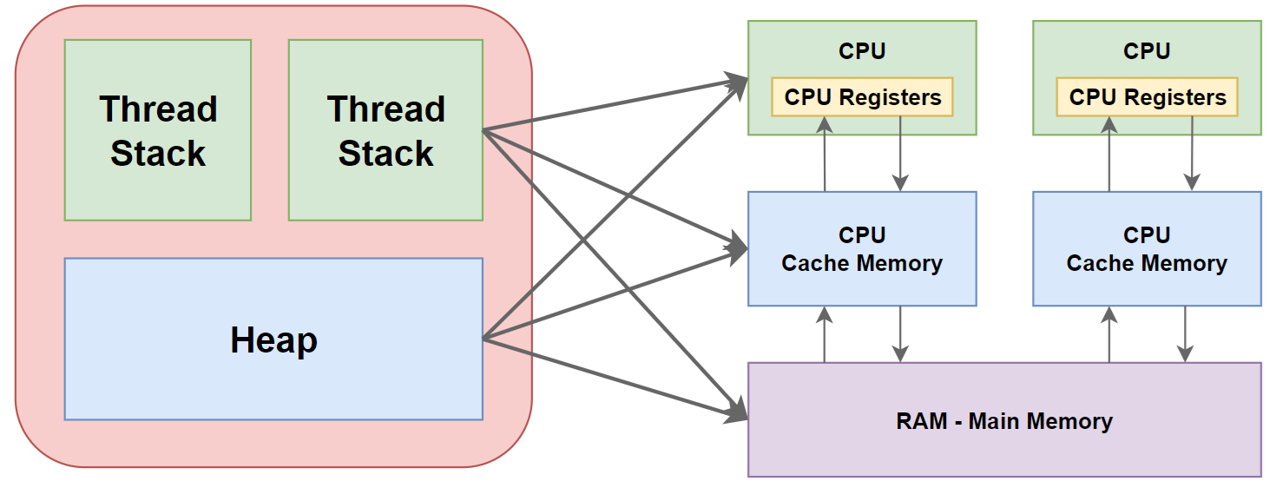
Memory and Threads

Slide 26
Memory and Threads
When objects and variables can be stored in various different memory areas in the computer, certain problems may occur.
The two main problems are:
Visibility of thread updates (writes) to shared variables.
Race conditions when reading, checking and writing shared variables.

Slide 27
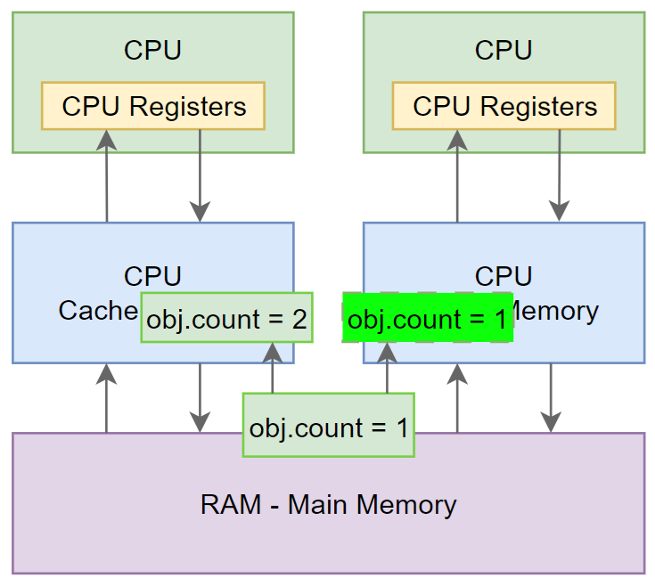
Visibility of Thread Updates
If two or more threads are sharing an object, without the proper use of either volatile declarations or synchronization, updates to the shared object made by one thread may not be visible to other threads.

Slide 28
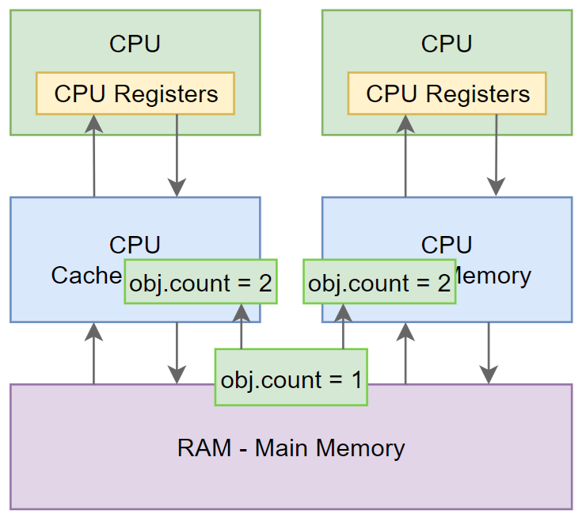
Race Conditions

Slide 29
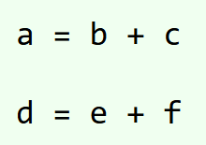
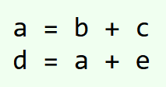
Instruction Reordering
Modern CPUs have the ability to execute instructions in parallel if the instructions do not depend on each other. The following two instructions do not depend on each other, and can be executed in parallel:
✓
X

Slide 30
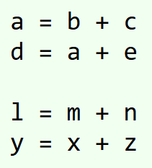
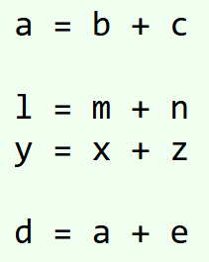
Instruction Reordering

Slide 31
Happens Before Rules. Volatile keyword
The Java volatile happens before guarantee sets some restrictions on instruction reordering around volatile variables.
Write to a non-volatile or volatile variable that happens before a write to a volatile variable is guaranteed to happen before the write to that volatile variable.
Read of a volatile variable will happen before any subsequent reads of volatile and non-volatile variables.

Slide 32
Happens Before Rules. Synchronized block
Java synchronized blocks provide visibility guarantees that are similar to those of volatile variables.
When a thread enters a synchronized block, all variables visible to the thread are refresh from main memory.
When a thread exits a synchronized block, all variables visible to the thread are written back to main memory.

