Slide 1
Types of Garbage Collectors

Slide 2
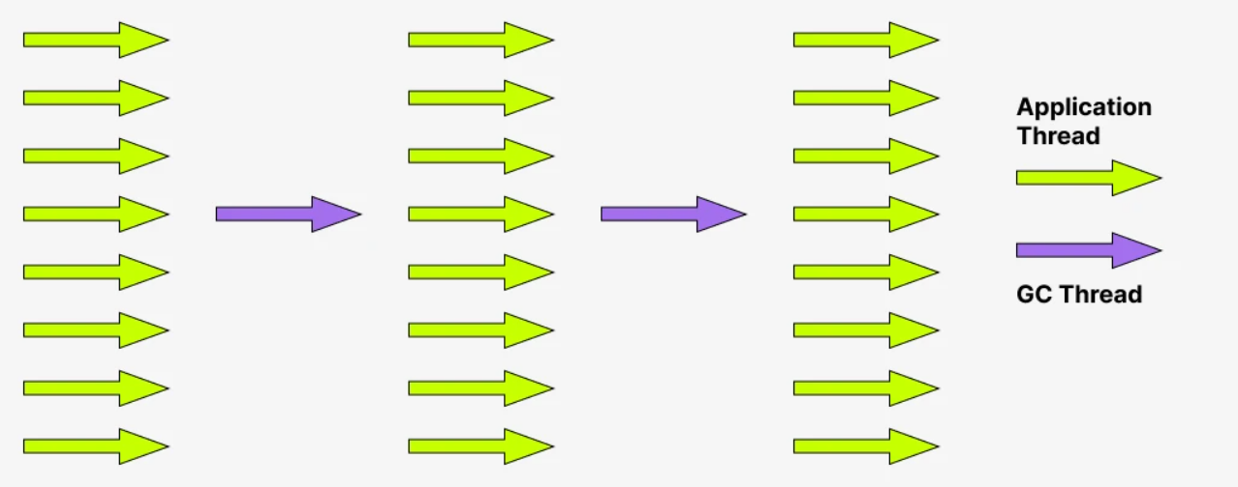
Serial GC
Uses a single thread for GC
Stops all application threads during GC (stop the world)
Suitable for small heaps and simple, single-threaded applications

Slide 3
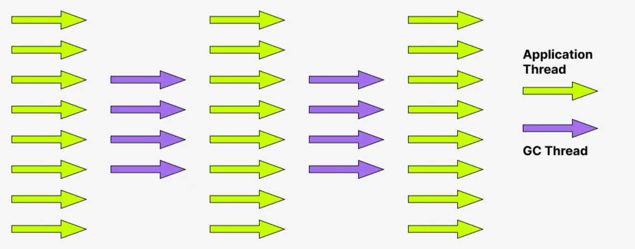
Parallel GC
Default garbage collector in Java 8
Uses multiple threads to perform minor and single for major GC
Stops all application threads during GC (stop the world)

Slide 4
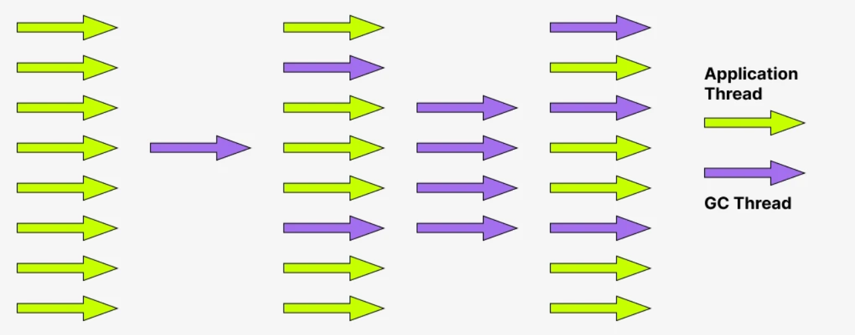
Concurrent Mark Sweep (CMS GC)
Designed to minimize pause times by doing most of its work while the application is still running

Slide 5
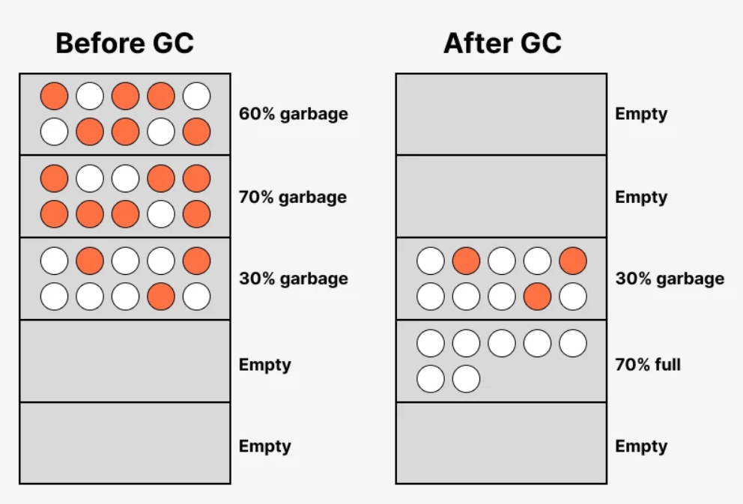
Garbage First (G1 GC)
Designed for applications with large heap sizes
Divides the heap into multiple equal-sized regions

Slide 6
Shenandoah GC
Introduced in JDK 12, designed for low-latency applications
Performs most garbage collection work concurrently with application threads
Unlike G1 GC, Shenandoah compacts objects and frees memory while the application continues running
Handles live objects and garbage simultaneously

Slide 7
ZGC
Ultra-low latency (pauses under 10 ms)
Applications with very large heaps (up to several terabytes)

