Slide 1
Kubernetes

Slide 2
Kubernetes Components
A Kubernetes cluster is made up of nodes. These nodes can be either physical machines, or virtual machines. You can have a cluster of one or more nodes, though ideally, you need at least two nodes.
A cluster typically has a master node, and a bunch of worker (minion) nodes.
The master node is responsible for watching the workers and performing the orchestration. The worker nodes are responsible for running the containers.

Slide 3
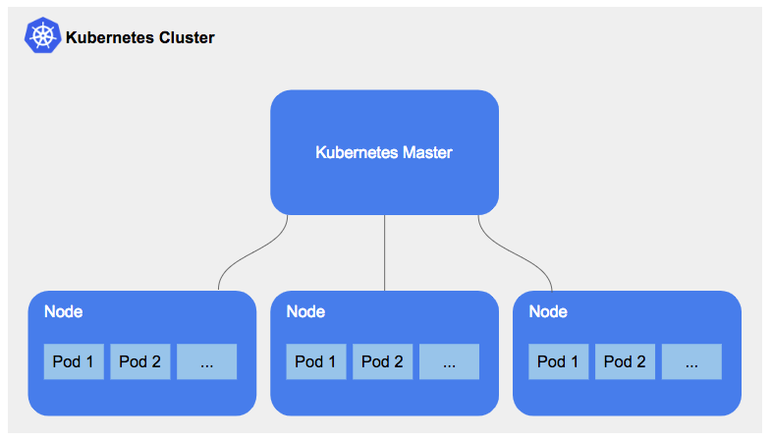
Kubernetes Components

Slide 4
Kubernetes Components. Master Node
Master node has quite a few components:
etcd
API Server
Controller Manager
Scheduler

Slide 5
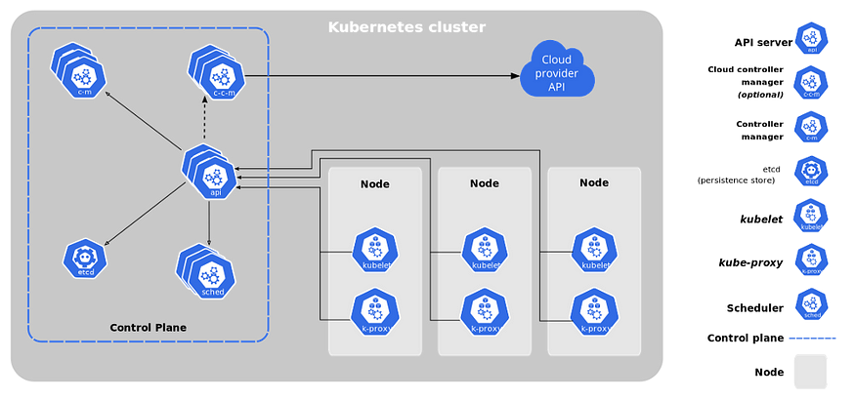
Kubernetes Components

Slide 6
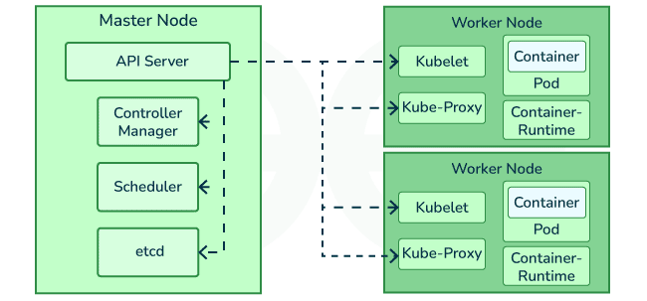
Kubernetes Components

Slide 7
Master Node. ETCD
etcd is a distributed key-value database. It is Kubernetes’ source of truth.
Every time you make a change to Kubernetes — by way of sending it YAML or JSON via k8s’ REST API or via the kubectl CLI tool — that change is stored in etcd as JSON.
It is also versioned, so you also have some serious version control action going on.

Slide 8
Master Node. API Server
The API server is responsible for serving up the Kubernetes API. The API Server is also what’s responsible for sending data to and pulling data from etcd.

Slide 9
Master Node. Controller Manager
The controller manager is the brain behind the orchestration. Kubernetes has multiple controllers, each responsible for different things. Controllers watch the state of your cluster, then make or request changes where needed.
There are controllers for:
Taking action when a pod goes down
Connecting services to pods
…

Slide 10
Master Node. Scheduler
The scheduler distributes work across multiple nodes. Its looks at resource requirements (CPU and memory requirements) to figure out when to run a pod, and what node to run it on.

Slide 11
Kubernetes Components. Worker Node
Worker nodes contain 2 main components:
Kubelet
Kube-proxy

