Slide 1
Kubernetes. Pod. ReplicaSet. Deployment

Slide 2
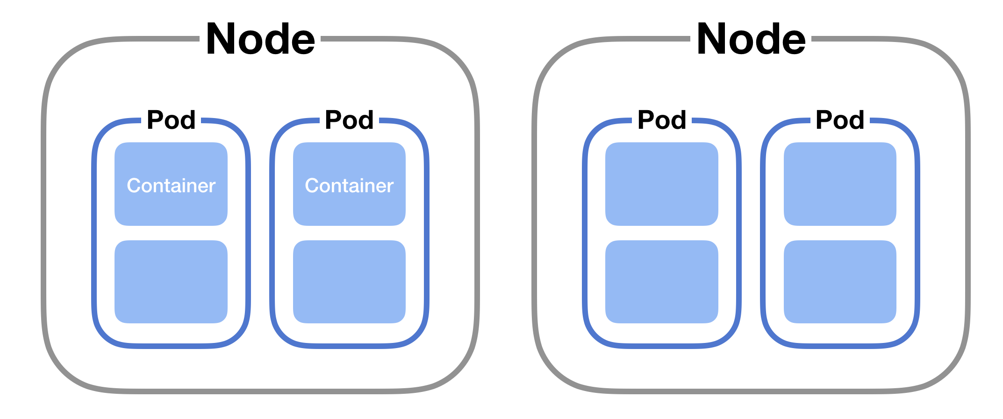
Kubernetes Components. POD
A Pod is the smallest deployable unit in Kubernetes. It represents a group of one or more containers that share the same storage, network, and lifecycle.

Slide 3
Kubernetes Components. ReplicaSet
A ReplicaSet is a Kubernetes controller whose primary responsibility is to maintain a stable set of replica Pods running at any given time. It does this by ensuring that a specified number of identical Pods are always running. If a Pod crashes or is deleted, the ReplicaSet automatically creates a new one to maintain the desired count.

Slide 4
Kubernetes Components. Deployment
A Deployment is a higher-level Kubernetes controller that builds on top of ReplicaSets. It not only manages a set of Pods (through ReplicaSets) but also provides advanced features such as declarative updates, rollbacks, and rolling updates.

Slide 5
