Slide 1
Linux Commands

Slide 2

What is Linux?
Linux is an open-source operating system kernel that was first released by Linus Torvalds in 1991.
Unlike proprietary operating systems, the source code of Linux is freely available for anyone to use, modify, and distribute.

Slide 3

Why is Linux used?
Open-Source Nature: The open-source nature of Linux allows developers to customize and optimize the OS for their specific needs. This has fostered a large and active community that continually improves and supports the system.
Stability and Reliability: Linux is known for its stability and reliability. It is less prone to crashes and can run for extended periods without the need for a reboot.
Security: Linux’s robust security features make it a preferred choice for environments where security is paramount.
Performance: Linux can be optimized for performance, making it suitable for high-performance computing tasks.

Slide 4
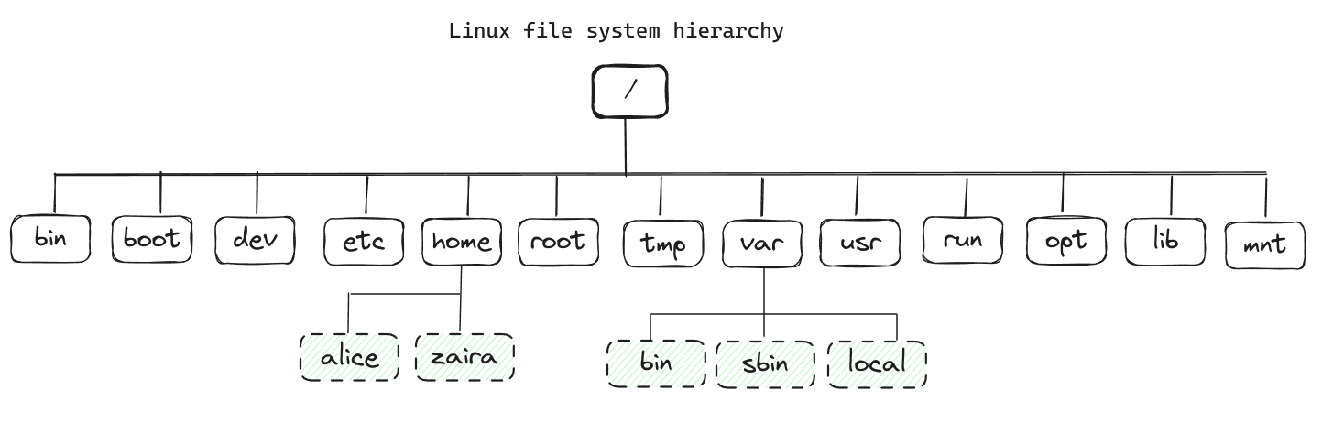
Linux. Folder Structure

Slide 5
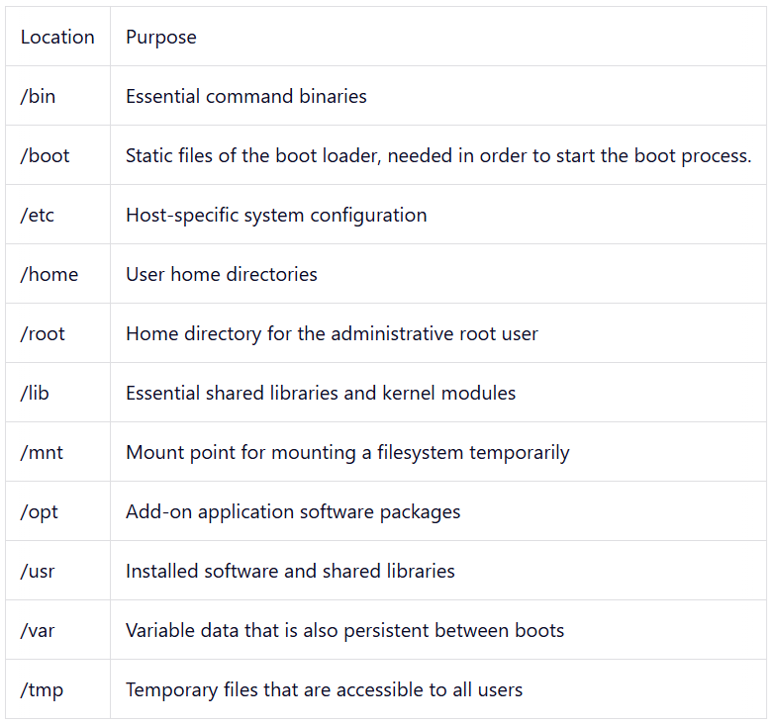
Linux. Folder Structure

Slide 6
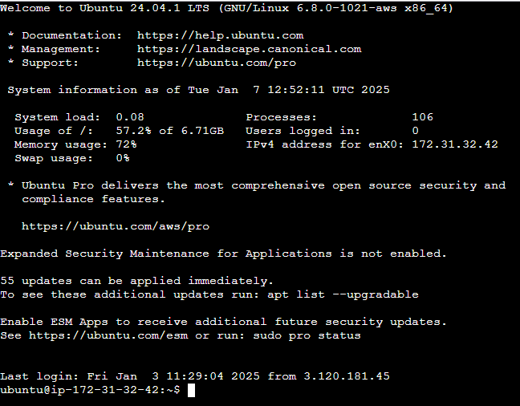
Linux

Slide 7

Linux
Waiting for command $
Under the root # displayed.
System name
Separator
Current catalog
(root catalog ~)
Current user
Separator

Slide 8
Linux. Command structure
command [options] [arguments]
command: Name of the command (ls, cp, rm)
[options]: Options, preceded by a hyphen (-) or double hyphen (--), modify the behavior of the command (ls -a)
[arguments]: Input for the commands (cat access.log)

Slide 9
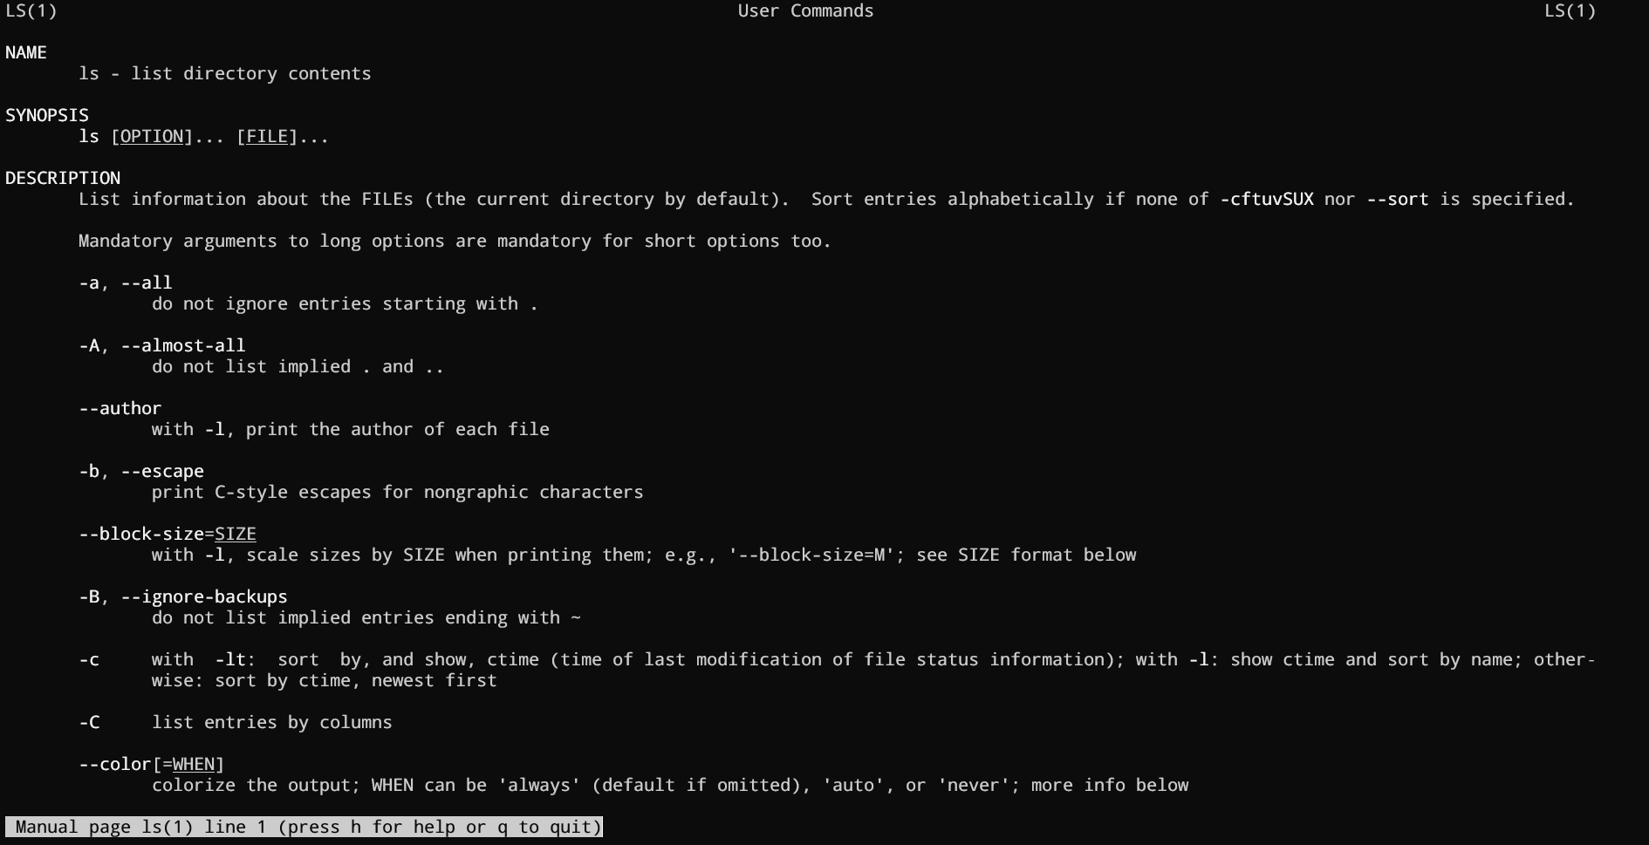
Linux. man

Slide 10



Linux. Basic commands
Navigating Directories
pwd – Show the current directory path.
ls – List files and subdirectories in the current directory.
cd [directory] – Change to the specified directory.
cd .. – Move up one directory level.

Slide 11
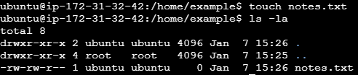
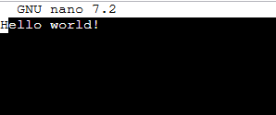

Linux. Basic commands
Managing Files
touch [filename] – Create an empty file.
cat [filename] – Display the contents of a file. nano [filename] – Edit a file using the Nano text editor. rm [filename] – Delete a file. mv [source] [destination] – Move or rename a file.

Slide 12


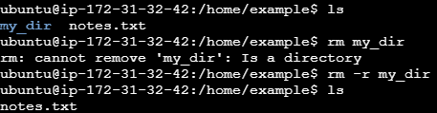
Linux. Basic commands
Managing Directories
mkdir [directory] – Create a new directory. rmdir [directory] – Delete an empty directory.
rm -r [directory] – Remove a directory and its contents recursively.

Slide 13
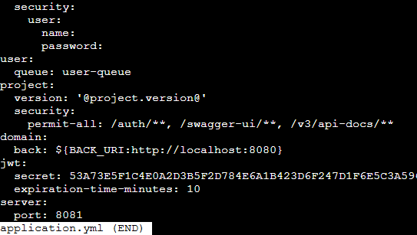
Linux. File viewing and search
cat: Display file contents.
less: Display file contents page by page.
head: Show the first few lines of a file.
tail: Show the last few lines of a file.
grep: Search for a string in a file or output.

Slide 14
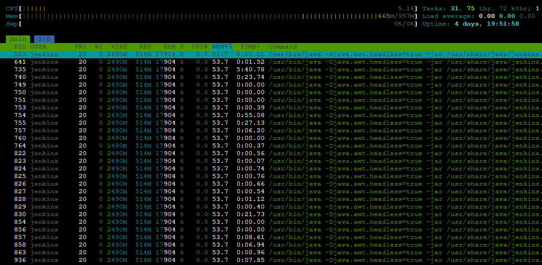
Linux. System and processes
uname: Display OS details. (uname -a)
whoami: Show the active username.
ps: Display active processes. (ps aux)
top / htop: Live view of active processes and system usage.
kill / killall: Terminate processes by ID or name.

Slide 15
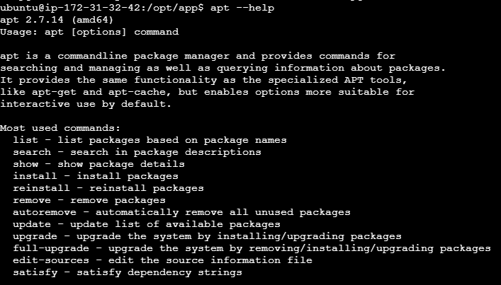
Linux. Network and Package management
wget: Download files directly from the internet.
ssh: Securely connect to remote servers. (ssh username@remote_server)
scp: Securely copy files between local and remote systems. (scp file user@host:/dest)
apt / yum / pacman: Manage software packages. (sudo apt install package)

Slide 16
Linux. Other commands
tar: Compress and extract files in Linux.
service: Manage system services in Linux.
df: Display disk space usage of file systems.
sed: Stream editor for parsing and transforming text.
diff: Compare the differences between two files line by line.
systemctl: Control the systemd system and service manager.
history: Display the history of previously executed commands.

Slide 17
Linux. File permissions
-rwxrw-r--
r | read
w | write
x | execute
Dir
User
(owner)
Group
Other

Slide 18
Linux. File permissions
-rwxrw-r--
r | 4
w | 2
x | 1
7
6
4
764

Slide 19
Linux. File permissions
664 – File Baseline
755 – Directory Baseline
400 – Key Pair

Slide 20

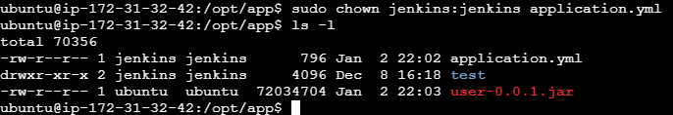
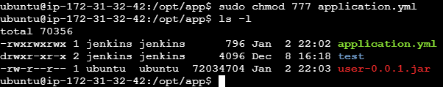
Linux. File permissions
chmod: Change file permissions
(chmod 755 file.sh)
chown: Change file or directory ownership
(chown user:group file.txt)

Slide 21

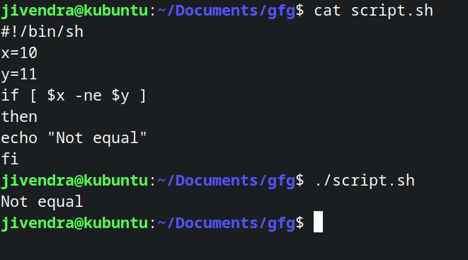
Linux. Bash scripts
A bash script is a series of commands written in a file. Which are read and executed by the bash program.

Slide 22
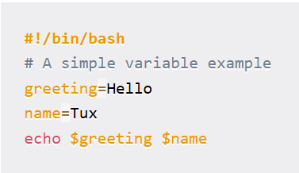
Linux. Bash scripts
bash shell path
comment
variable
command
variable usage

Slide 23
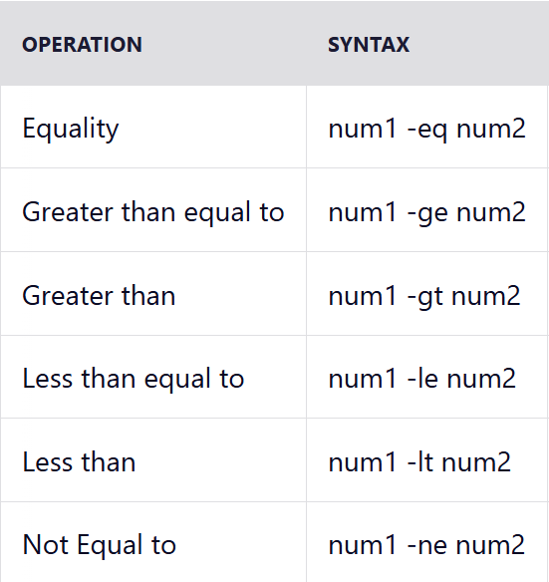
Linux. Bash scripts

Slide 24
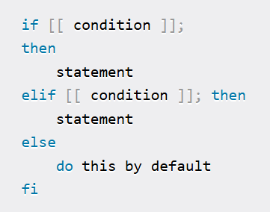
Linux. Bash scripts

Slide 25
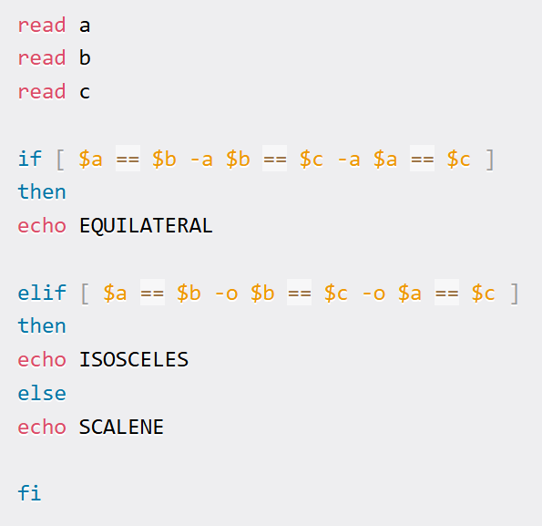
Linux. Bash scripts

Slide 26
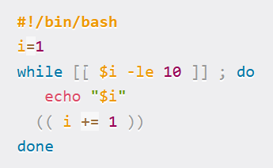
Linux. Bash scripts

Slide 27
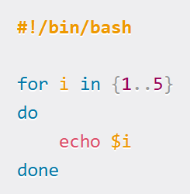
Linux. Bash scripts

Slide 28
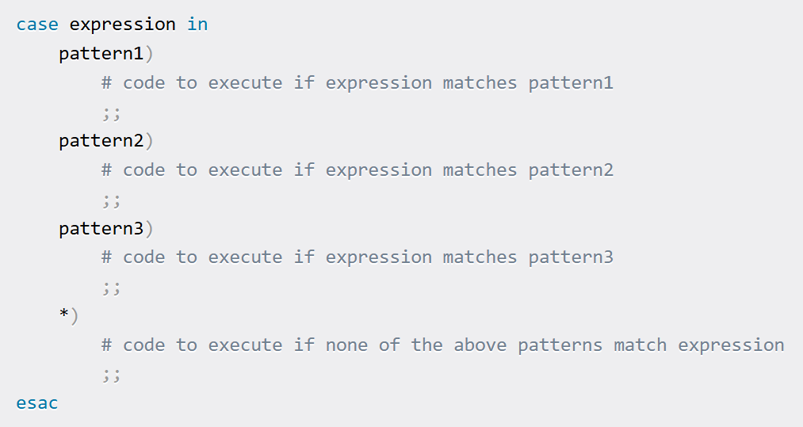
Linux. Bash scripts

Slide 29
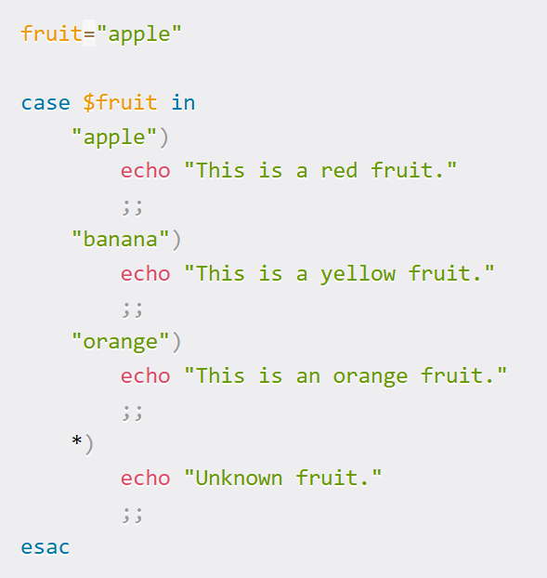
Linux. Bash scripts

Slide 30
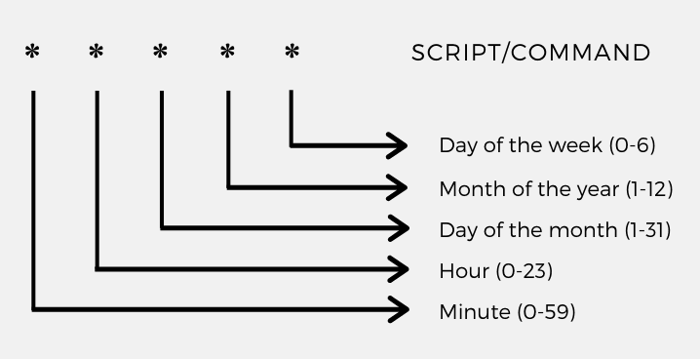
Linux. Crontab

Slide 31
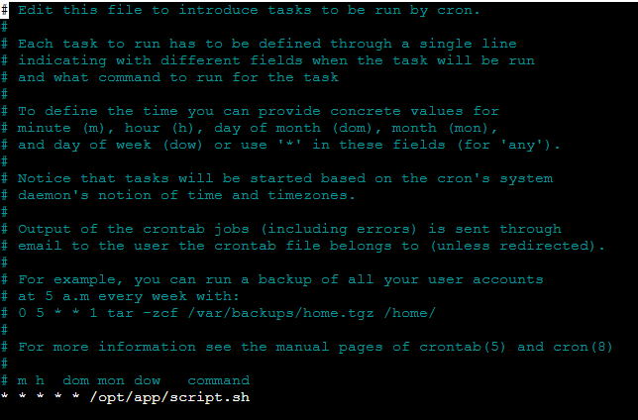
Linux. Crontab

Slide 32

Linux. Htop Load Average
Load average, as the name suggests, depicts the average load on a CPU for a set time interval. These values are the number of processes waiting for the CPU or using it in the given period.
Average load on the CPU for the last minute
Average load for the last 15-minute interval
Average load for the last 5-minute interval

Slide 33
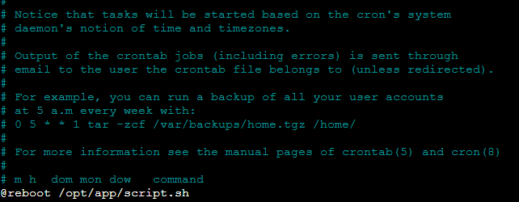
Linux. Crontab on reboot
@reboot
Other ways: https://www.baeldung.com/linux/run-script-on-startup
https://www.tutorialspoint.com/run-a-script-on-startup-in-linux

Slide 34
How to run program (jar) in separate process
nohup
Example: sudo nohup java –jar app.jar &

