Slide 1
Basic concepts of network security and authorization techniques

Slide 2
What is AAA?
Authentication
Authorization
Accounting

Slide 3
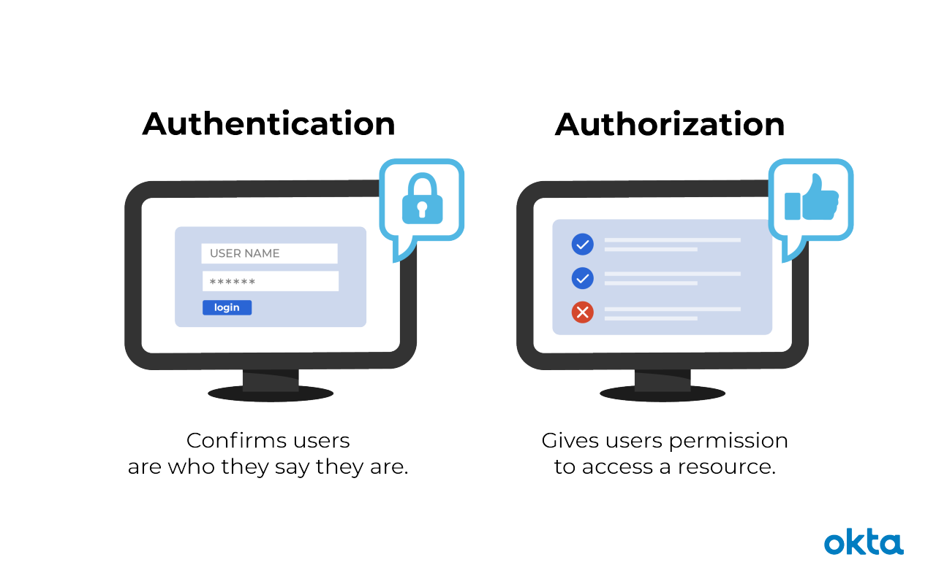

Slide 4
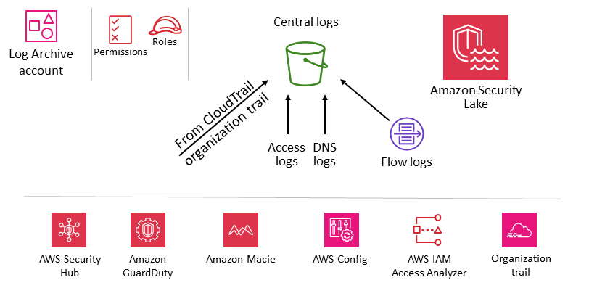

Slide 5
Authentication Methods
Basic
Token Based
JWT
Session
OAuth
Single-Sign On

Slide 6
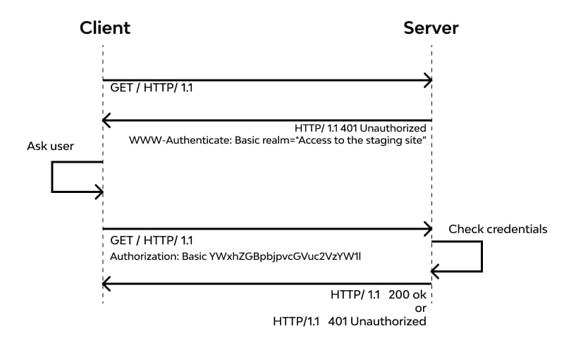
Http Basic

Slide 7
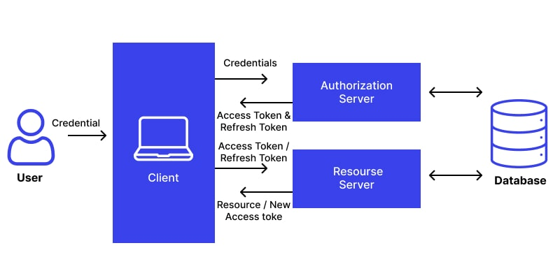
Token Based / JWT

Slide 8
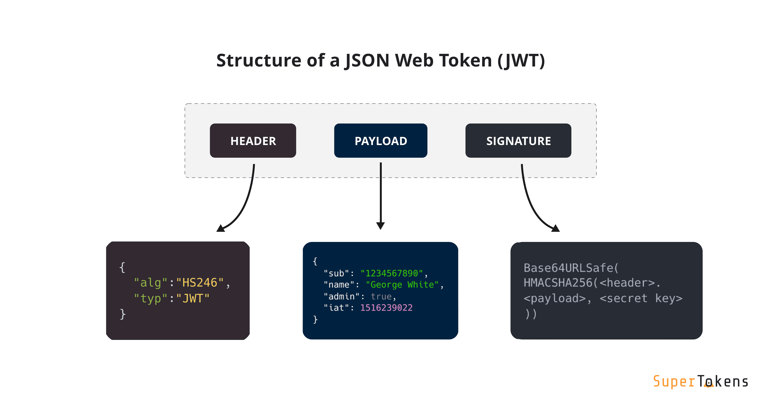

Slide 9
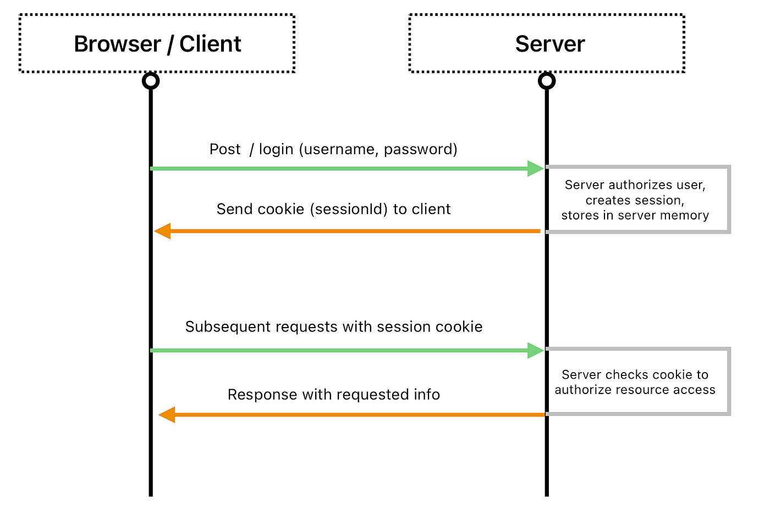

Slide 10
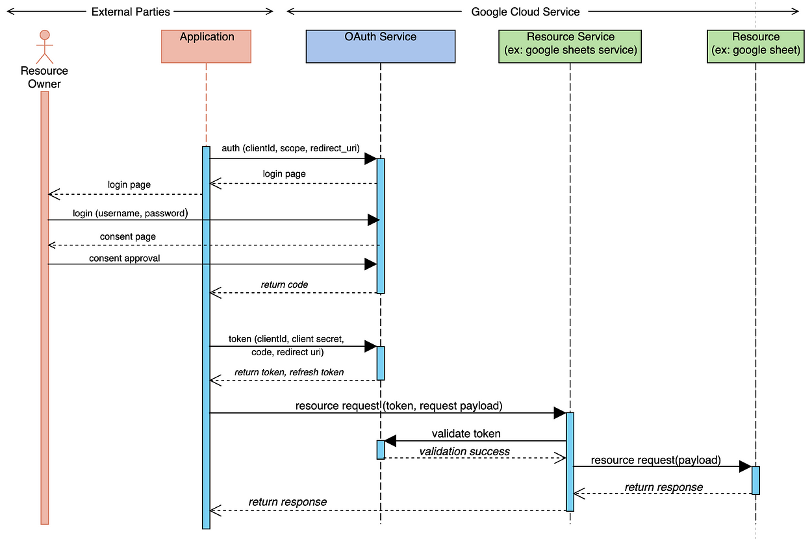
OAuth

Slide 11
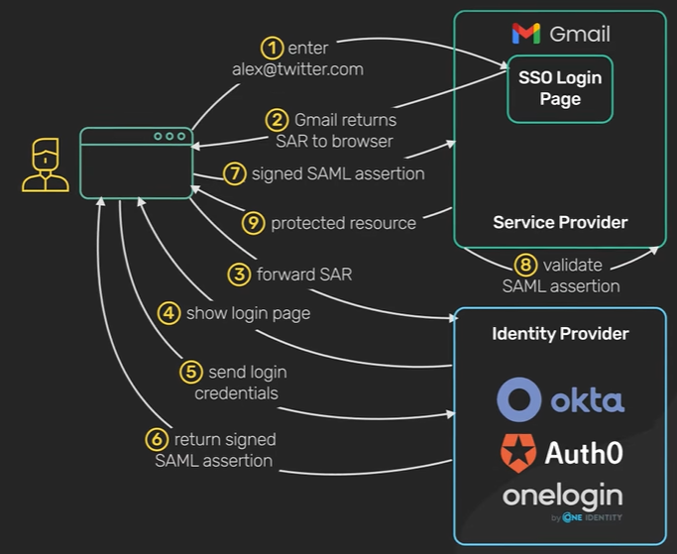
Single-Sign On

Slide 12
Authorization Methods
Role-Based
Attribute-Based
Rule-Based
Policy-Based

Slide 13
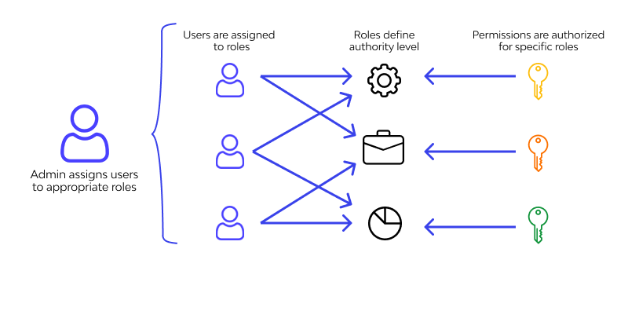
Role-Based

Slide 14
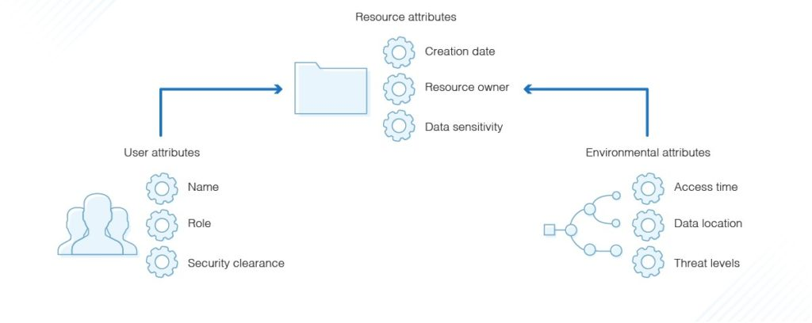
Attribute-Based

Slide 15
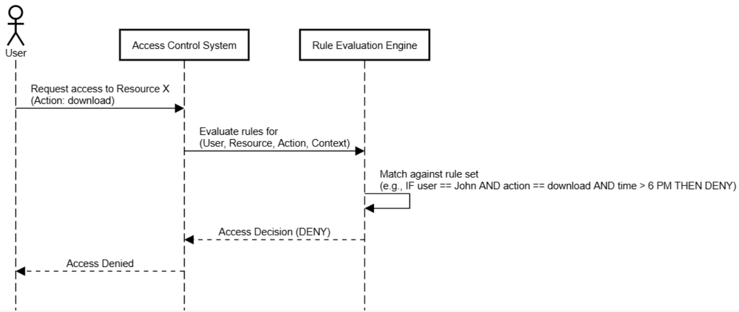
Rule-Based

Slide 16
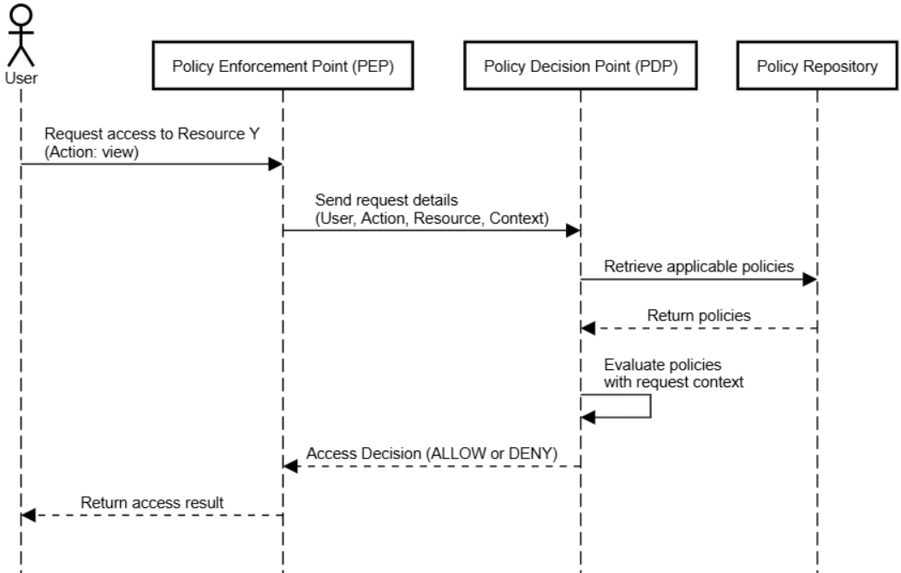
Policy-Based

Slide 17
Protocols
NTLM
Kerberos
Digest Authentication
Basic Authentication

Slide 18
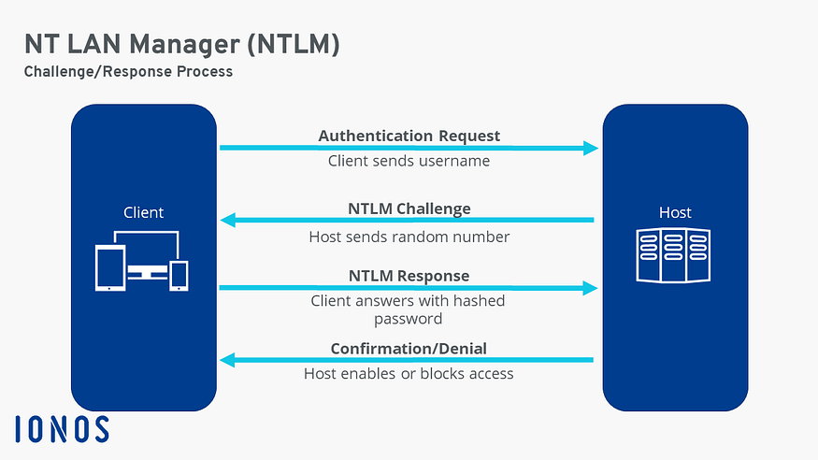
NTLM

Slide 19
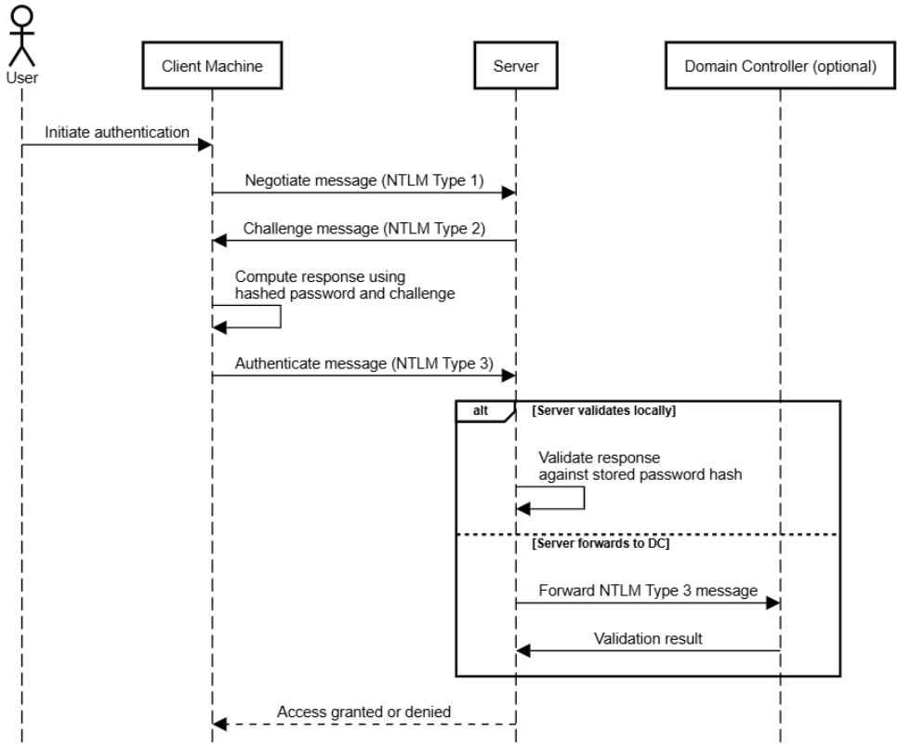

Slide 20
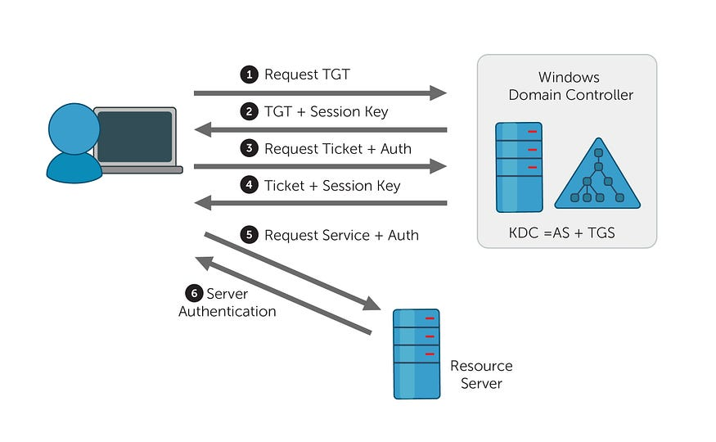
Kerberos

Slide 21
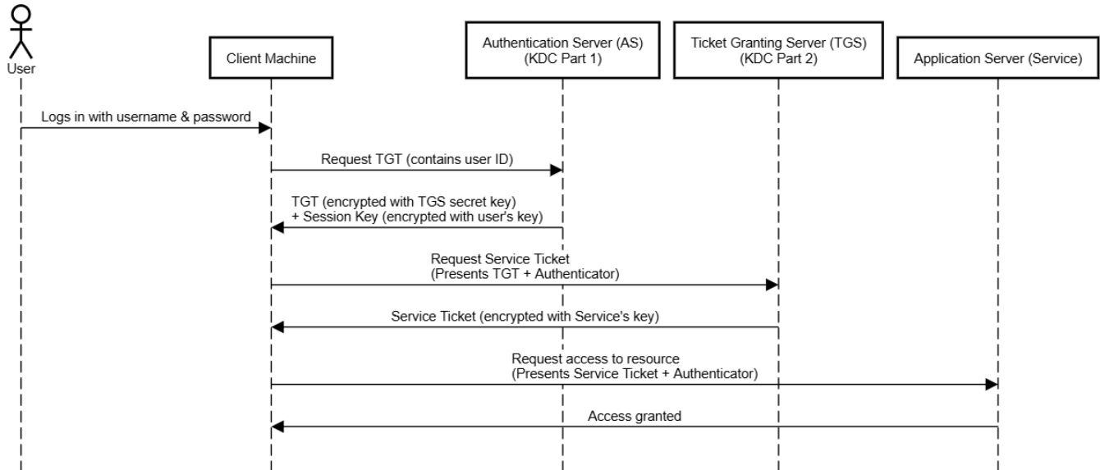
Kerberos

