Slide 1
IPv4, IPv6, DNS

Slide 2
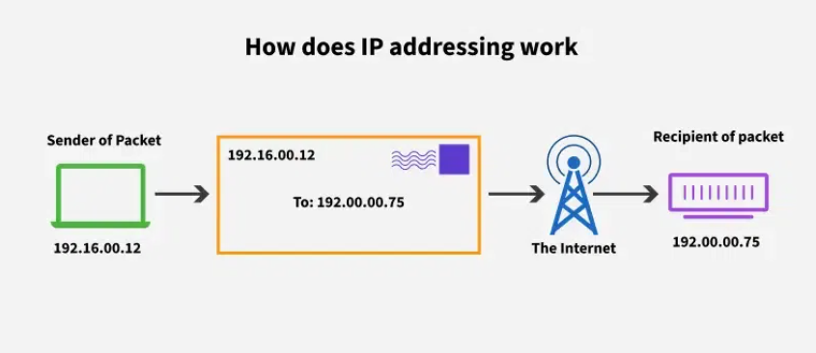
Internet Protocol
A set of rules for addressing and routing data packets across networks.
Part of the TCP/IP stack (the foundational protocols for the Internet).
Responsible for delivering packets from the source to the destination using IP addresses.

Slide 3
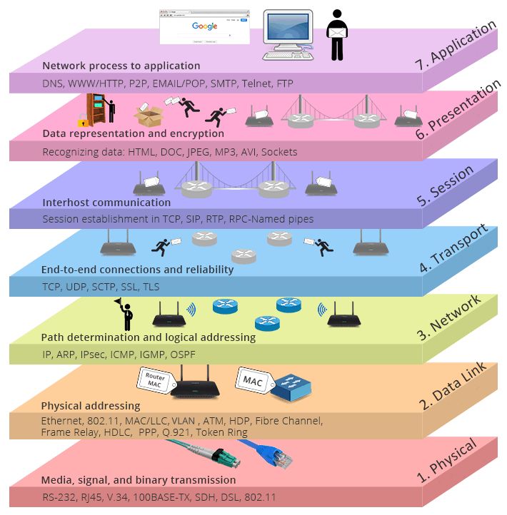
OSI

Slide 4
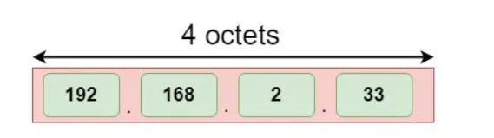
IPv4
IPv4 (Internet Protocol version 4)
The fourth version of the Internet Protocol, widely deployed and dominant.
Uses 32-bit addresses, allowing ~4.3 billion unique addresses.
Defined in RFC 791.

Slide 5
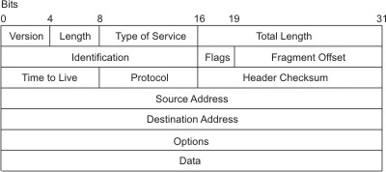
IP packet

Slide 6
Version | Specifies the version of the IP used. The current version of the IP protocol is 4.
Length | Specifies the datagram header length, measured in 32-bit words.
Type of Service | Contains five subfields that specify the type of precedence, delay, throughput, and reliability desired for that packet. (The Internet does not guarantee this request.) The default settings for these five subfields are routine precedence, normal delay, normal throughput, and normal reliability. This field is not generally used by the Internet at this time. This implementation of IP complies with the requirements of the IP specification, RFC 791, Internet Protocol.
Total Length | Specifies the length of the datagram including both the header and the data measured in octets. Packet fragmentation at gateways, with reassembly at destinations, is provided. The total length of the IP packet can be configured on an interface-by-interface basis with the ifconfig command, or the System Management Interface Tool (SMIT) fast path, smit chinet. Use SMIT to set the values permanently in the configuration database; use the ifconfig command to set or change the values in the running system.
Identification | Contains a unique integer that identifies the datagram.
Flags | Controls datagram fragmentation, along with the Identification field. The Fragment Flags specify whether the datagram can be fragmented and whether the current fragment is the last one.
Fragment Offset | Specifies the offset of this fragment in the original datagram measured in units of 8 octets.
Time to Live | Specifies how long the datagram can remain on the Internet. This keeps misrouted datagrams from remaining on the Internet indefinitely. The default time to live is 255 seconds.
Protocol | Specifies the high-level protocol type.
Header Checksum | Indicates a number computed to ensure the integrity of header values.
Source Address | Specifies the Internet address of the sending host.
Destination Address | Specifies the Internet address of the receiving host.

Slide 7
DHCP
Dynamic Host Configuration Protocol is a network protocol used to automate the process of assigning IP addresses and other network configuration parameters to devices.
Instead of manually configuring each device with an IP address, DHCP allows devices to connect to a network and receive all necessary network information, like IP address, subnet mask, default gateway, and DNS server addresses, automatically from a DHCP server.

Slide 8
Components of DHCP
DHCP Server (router)
DHCP Client (device)

Slide 9
DHCP Packet Exchange
DHCP Discover (Client → Broadcast)
DHCP Offer (Server)
DHCP Request (Client)
DHCP Acknowledgment (Server)

Slide 10
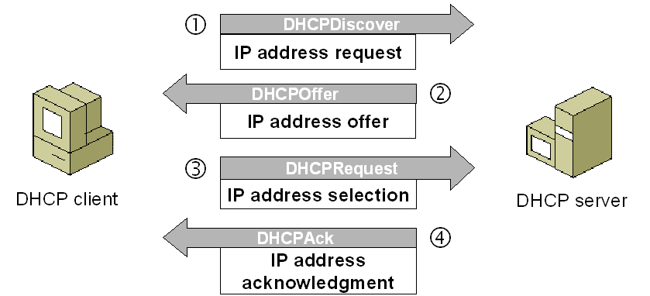
DHCP Packet Exchange

Slide 11
Subnets
A subnet (subnetwork) is a logical subdivision of an IP network.
It divides a larger IP network into smaller, manageable pieces.
Allows efficient IP address utilization and improves routing within networks.

Slide 12
Masks
A subnet mask defines which portion of an IP address is the network part and which is the host part.

Slide 13
Masks
IP address: 192.168.1.10 (binary: 11000000.10101000.00000001.00001010)
Subnet mask: 255.255.255.0 (binary: 11111111.11111111.11111111.00000000)
The first 24 bits (255.255.255) are network bits.
The last 8 bits (0) are host bits.
This means:
Network Address: 192.168.1.0
Broadcast Address: 192.168.1.255
Valid host range: 192.168.1.1 – 192.168.1.254 (usable for devices).

Slide 14
Reserved Addresses. Private Address Ranges
IP Range | Class | Subnet Mask | Usage
10.0.0.0 - 10.255.255.255 | A | 255.0.0.0 (/8) | Large private networks
172.16.0.0 - 172.31.255.255 | B | 255.240.0.0 (/12) | Medium-sized private networks
192.168.0.0 - 192.168.255.255 | C | 255.255.0.0 (/16) | Small private networks

Slide 15
Reserved Addresses. Loopback Addresses
IP Range | Purpose
127.0.0.0 - 127.255.255.255 | Testing internal network functions
127.0.0.1 (localhost)

Slide 16
Reserved Addresses. Loopback Addresses
IP Range | Purpose
127.0.0.0 - 127.255.255.255 | Testing internal network functions
127.0.0.1 (localhost)

Slide 17
Reserved Addresses. Link-Local Addresses
Link-local addresses are automatically assigned to a device when no IP address is provided via DHCP or manual configuration
IP Range | Subnet Mask | Purpose
169.254.0.0 - 169.254.255.255 | 255.255.0.0 (/16) | Automatic IP assignment (APIPA)

Slide 18
Reserved Addresses. Experimental Addresses
Link-local addresses are automatically assigned to a device when no IP address is provided via DHCP or manual configuration
IP Range | Purpose
240.0.0.0 - 255.255.255.254 | Experimental, not used publicly

Slide 19
Ports
A port is a logical endpoint (16-bit unsigned integer) used to identify a specific process or network service on a device.
Ranges from 0 to 65535.
Allows multiple services to run on the same IP address without conflict.
Analogy:
Port = apartment/unit number inside the building (IP address).
IP address + port = complete address to deliver data to the correct process.

Slide 20
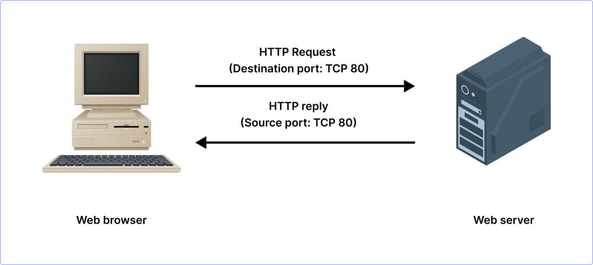
Ports

Slide 21
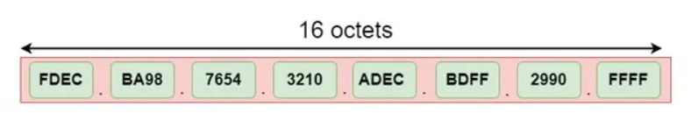
IPv6
IPv6 (Internet Protocol version 6)
Designed to replace IPv4 due to address exhaustion.
Uses 128-bit addresses, allowing ~3.4×10^38 unique addresses.
Defined in RFC 8200.

Slide 22
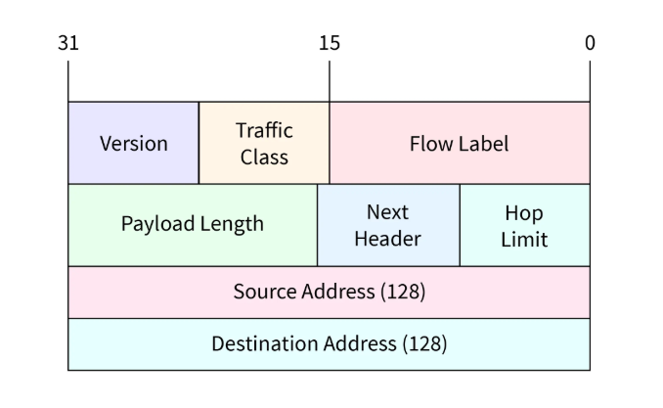
IPv6

Slide 23
SLAAC
SLAAC (Stateless Address Autoconfiguration) is a method for IPv6 hosts to automatically configure their own IP addresses without the need for a DHCPv6 server.

Slide 24
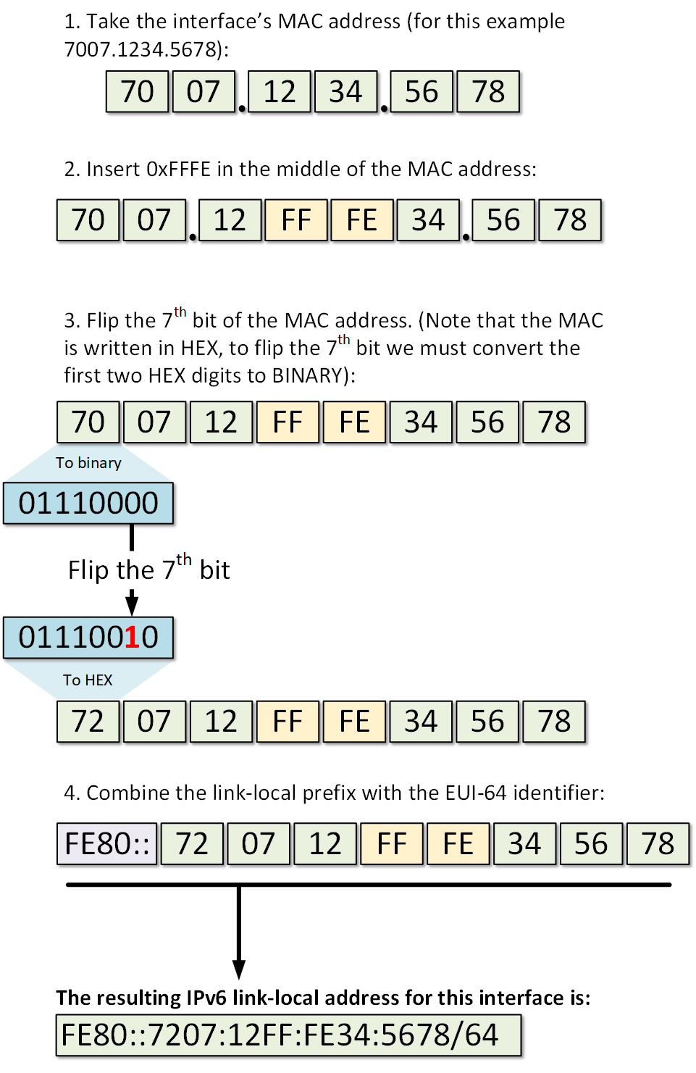

Slide 25
IPv4 vs IPv6
 | IPv4 | IPv6
Address Length | Uses 32-bit addresses, allowing for approximately 4.3 billion unique addresses | Uses 128-bit addresses, providing a virtually unlimited number of unique addresses (approximately 3.4×10³⁸)
Address Format | Addresses are written in decimal as four octets separated by periods (e.g., 192.0.2.1). | Addresses are written in hexadecimal and separated by colons (e.g., 2001:0db8:85a3:0000:0000:8a2e:0370:7334).
Header Complexity | Has a more complex header with 12 fields and additional options. | Simplifies the header with 8 fields, making processing by routers faster and more efficient
Address Configuration | Supports manual and DHCP-based address configuration | Supports auto-configuration capabilities (SLAAC) and DHCPv6
Fragmentation | Allows fragmentation by both the sender and routers along the path | Only the sender can fragment packets, which simplifies and speeds up the routing process

Slide 26
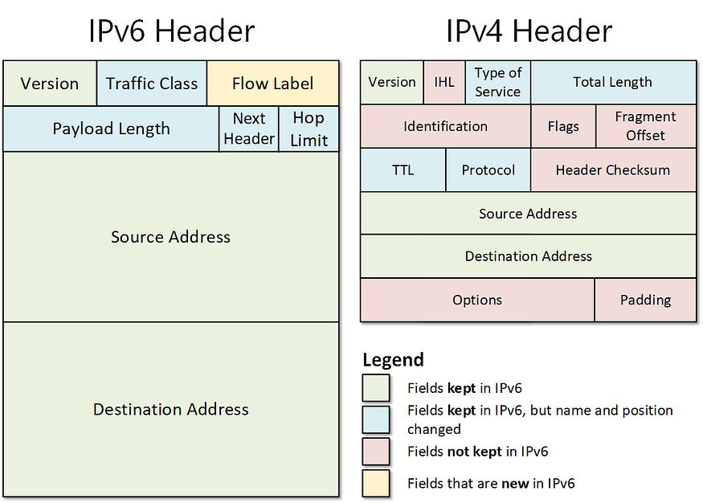
IPv4 vs IPv6

Slide 27
DNS
A distributed, hierarchical naming system for resolving human-readable domain names (www.amazon.com) into IP addresses (205.251.242.103).
Functions as the “phonebook of the Internet.”

Slide 28
DNS
1. DNS Resolver (Recursive Resolver):
Usually provided by your ISP or configured manually (e.g., 8.8.8.8 Google DNS).
Handles DNS queries from clients, performs the resolution process.
2. Root Name Servers:
13 logical root servers globally (a.root-servers.net, ...).
Know where to find TLD servers.
3️. TLD Name Servers:
Responsible for .com, .org, etc.
Know where authoritative servers for domains are.
4️. Authoritative Name Servers:
Hold DNS records for specific domains (amazon.com, openai.com).
Provide the final IP address or other DNS record.

Slide 29
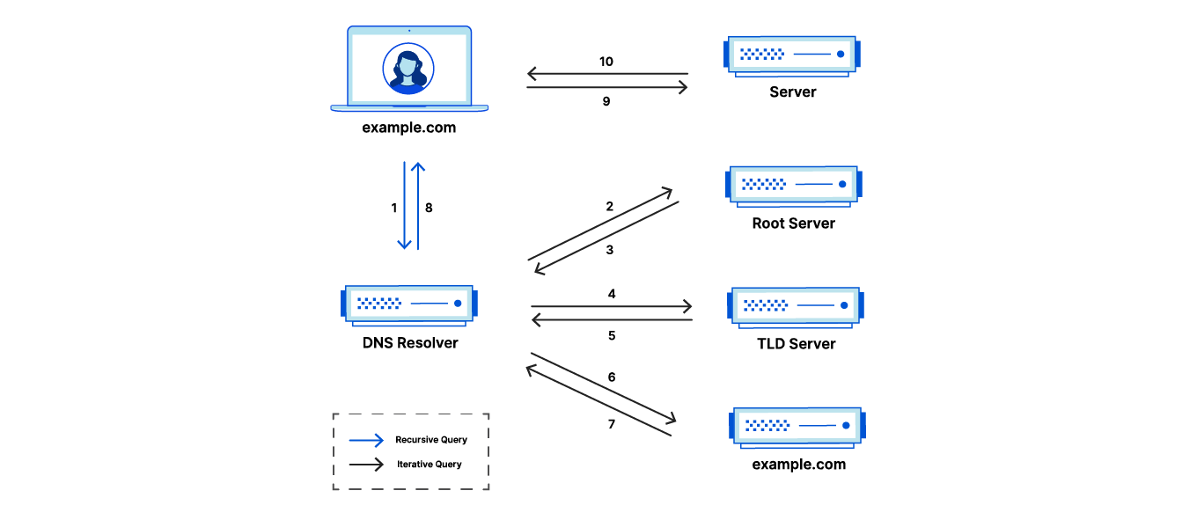
How it works

