Slide 1
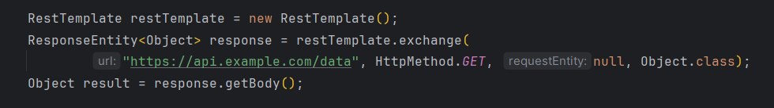
RestTemplate
Introduced in Spring 3.0, RestTemplate is a synchronous (blocking) client for performing REST calls. It has been widely used for years and supports various convenience methods like getForObject(), exchange(), and postForEntity().

Slide 2
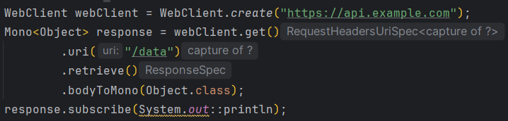
WebClient
WebClient was introduced in Spring 5 as part of the reactive WebFlux stack. It is designed for non-blocking, asynchronous communication and returns reactive types such as Mono and Flux. Best suited for reactive applications or scenarios where non-blocking I/O is critical.
Note: Although we can call .block() on a Mono to force synchronous behavior, doing so negates the benefits of non-blocking I/O.

Slide 3
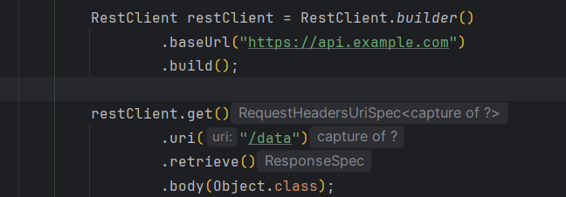
RestClient
With Spring Framework 6.1 (Spring Boot 3.2), RestClient was introduced as a modern, synchronous HTTP client that combines the best of both: the fluent API of WebClient with the familiar infrastructure of RestTemplate. It’s designed to be more concise and readable without requiring reactive dependencies.

Slide 4
RestClient
RestClient offers the fluent API of WebClient with the underlying components of RestTemplate, making it an excellent choice for new synchronous HTTP clients.
For new projects based on the Spring MVC stack, RestClient is the best choice as RestTemplate is now in maintenance mode.

Slide 5
Conclusion
Use RestTemplate if: – You’re maintaining a legacy system or your project already heavily uses it. – Blocking calls are acceptable and you don’t plan to leverage asynchronous processing.
Use WebClient if: – You need non-blocking, asynchronous HTTP calls or are building a reactive application. – You plan to handle streaming data or require advanced reactive composition.
Use RestClient if: – You’re starting a new project with Spring Boot 3.2 (or later) and prefer a modern, fluent API while using with synchronous calls. – You want cleaner code without introducing the extra libraries required by WebClient’s reactive nature.

Slide 6
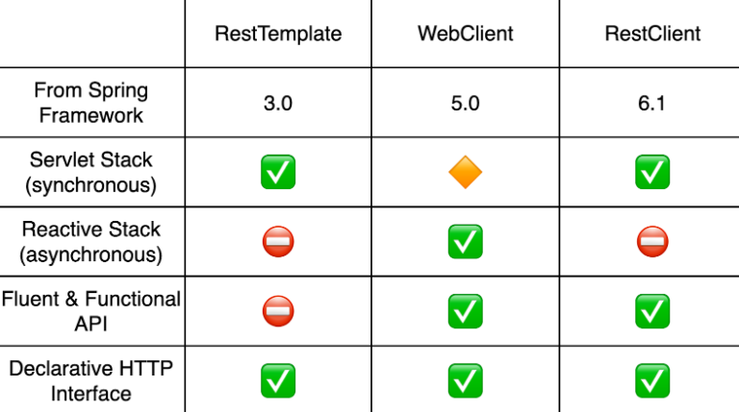
Conclusion

