Slide 1
Approaches to build network applications

Slide 2
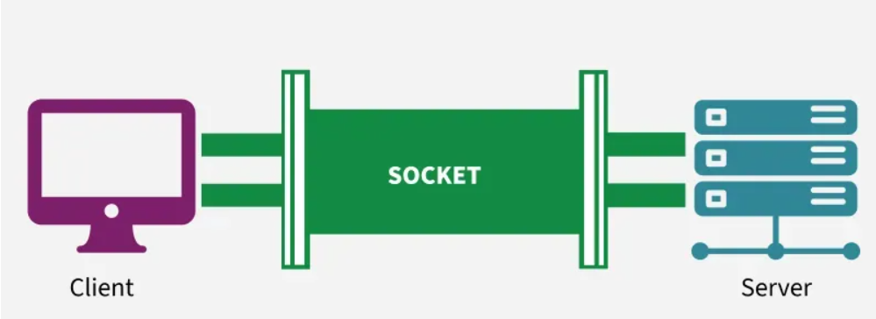
Concept of Socket
A socket is one endpoint of a two-way communication link between two programs running on the network.

Slide 3
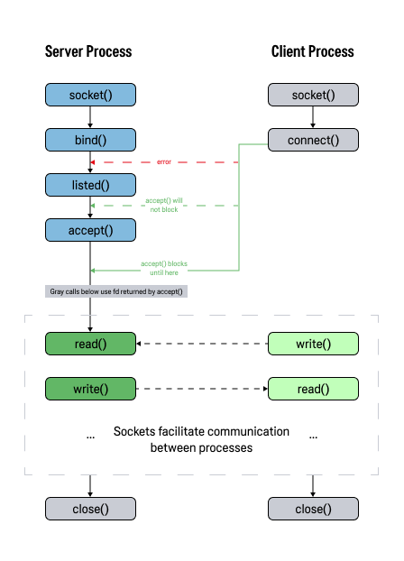

Slide 4
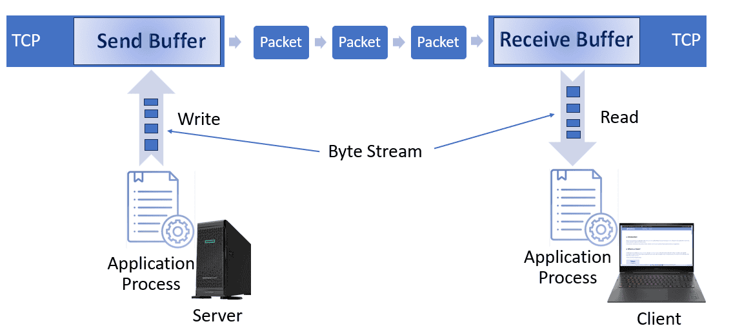
Stream Socket (TCP)

Slide 5
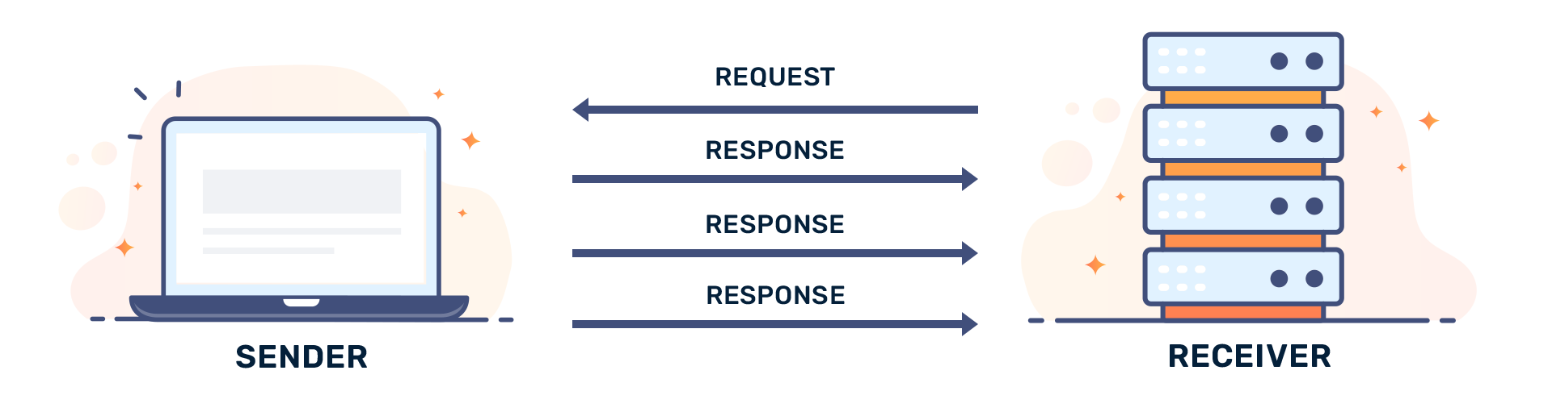
Datagram Socket (UDP)

Slide 6
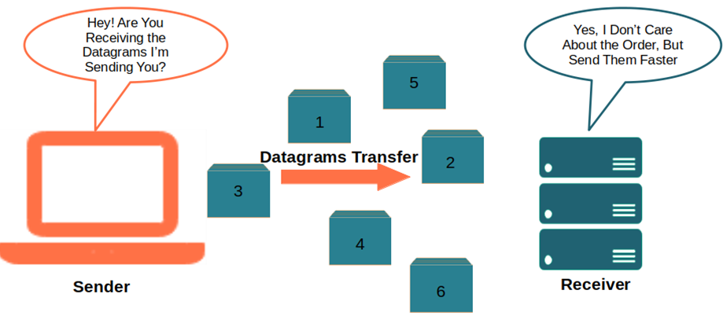
Datagram Socket (UDP)

Slide 7
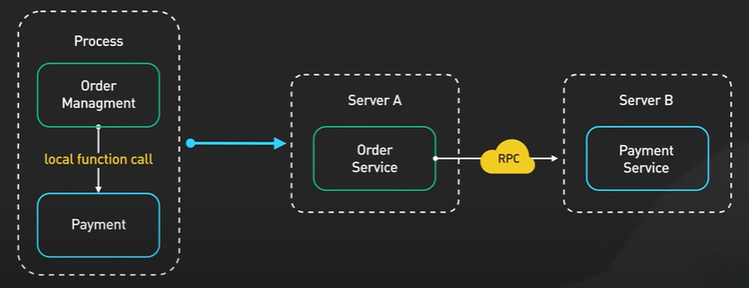
RPC
RPC (Remote Procedure Call) is a method that allows a program to execute a function on another computer over a network as if it were calling a local function.

Slide 8
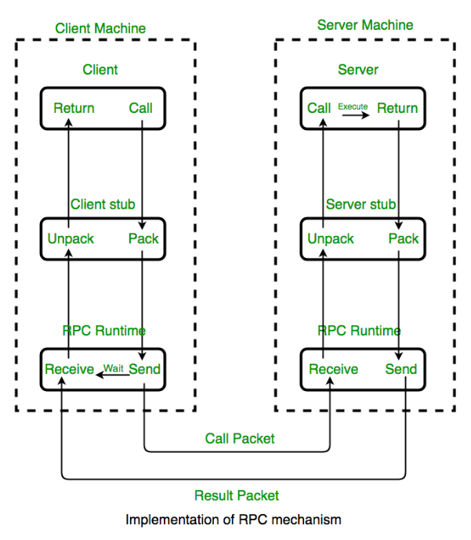

Slide 9
RPC
Function-oriented (Execute function with arguments)
Often use custom protocols (protobuf)

Slide 10
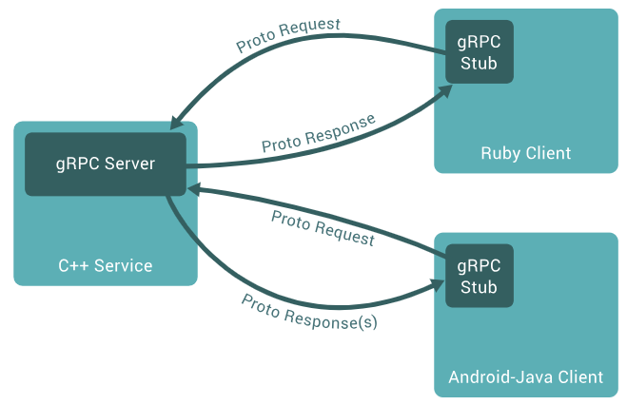
gRPC
gRPC is a high-performance, open-source framework for making remote procedure calls (RPC) using HTTP/2 for transport and Protocol Buffers for efficient, strongly-typed binary serialization.

Slide 11
gRPC
HTTP 2.0
Protocol buffers
Type-safe

Slide 12
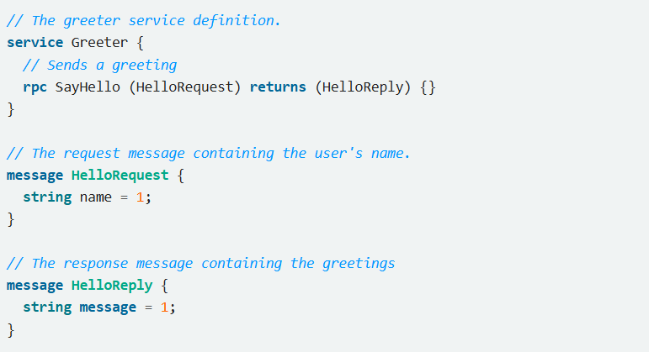
gRPC

Slide 13
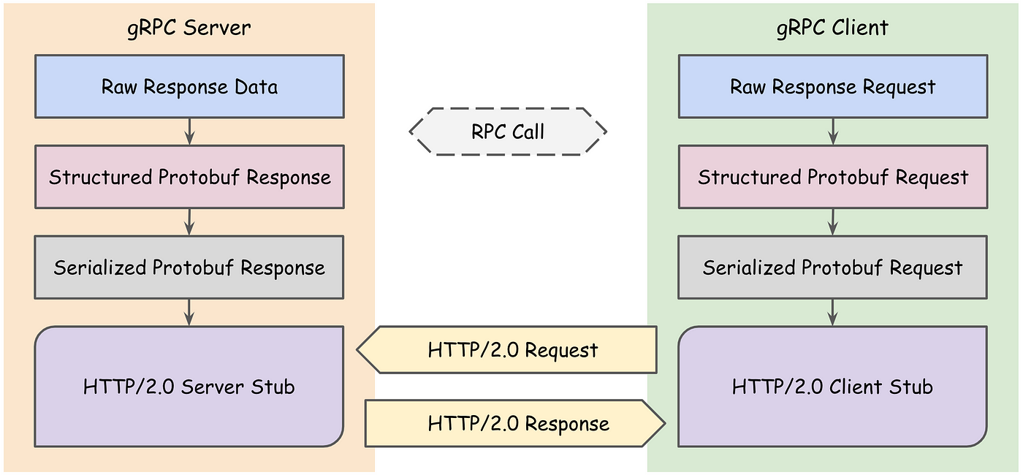
gRPC

Slide 14
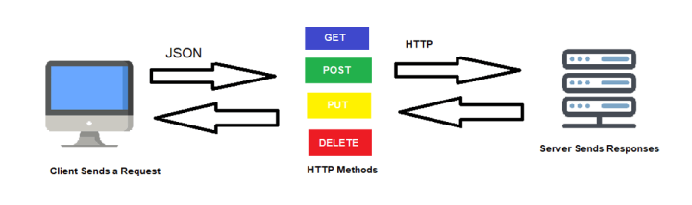
REST
REST (Representational State Transfer) is an architectural style for designing networked APIs based on HTTP semantics, resources, and stateless communication.

Slide 15
REST
Resource-Oriented
Uses Standard HTTP Methods
Stateless
Support Caching

Slide 16
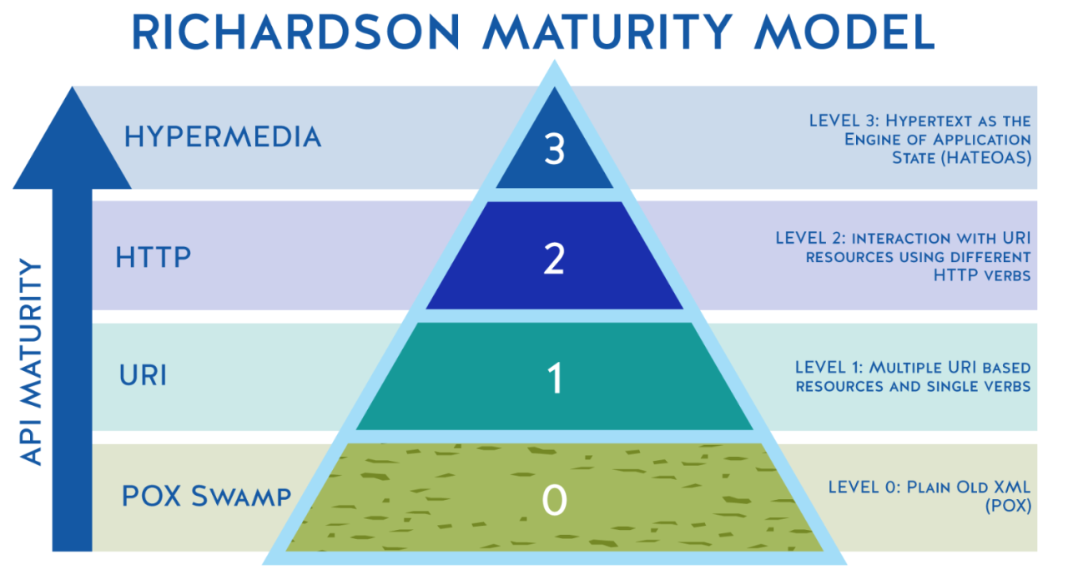
REST

Slide 17
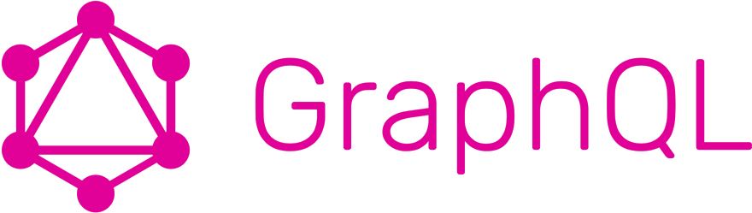
GraphQL
GraphQL is an API query language that defines specifications of how a client application should request data from a remote server. You can use GraphQL in your API calls without relying on the server-side application to define the request.

Slide 18
GraphQL
Resource-Oriented
Uses Standard HTTP Methods
Stateless

Slide 19
GraphQL
Strongly typed
Flexible data querying
Real-time updates

Slide 20
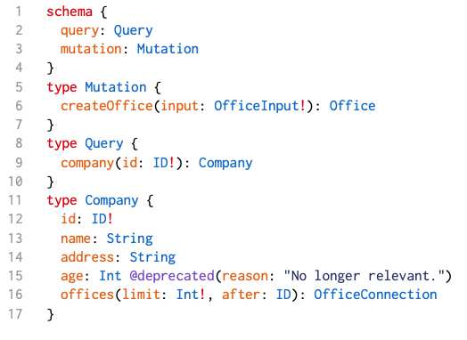
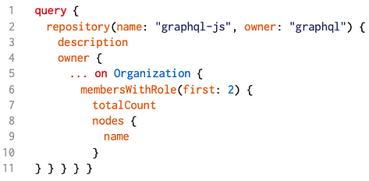
GraphQL

Slide 21
GraphQL. How to implement
Define a GraphQL schema
Implement resolvers
Set up a GraphQL server
Set up a GraphQL client

Slide 22
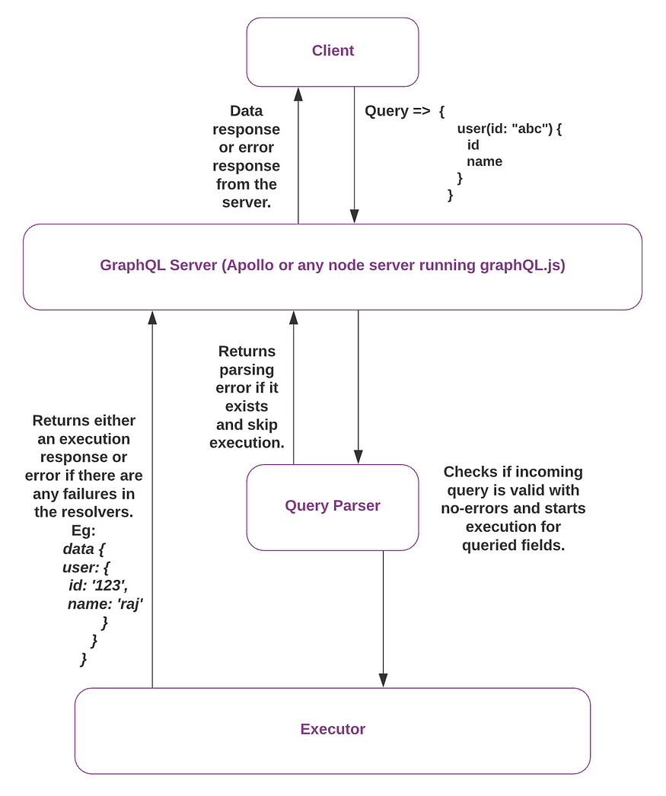

Slide 23
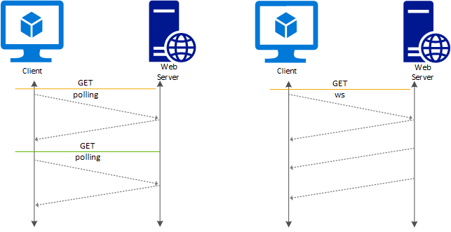
WebSocket
WebSockets are a network communication protocol that provides a full-duplex, persistent connection between client and server over a single TCP connection.

Slide 24
WebSocket
Bidirectional Communication
Low Latency (No repeated handshakes)
Real-Time Communication

Slide 25
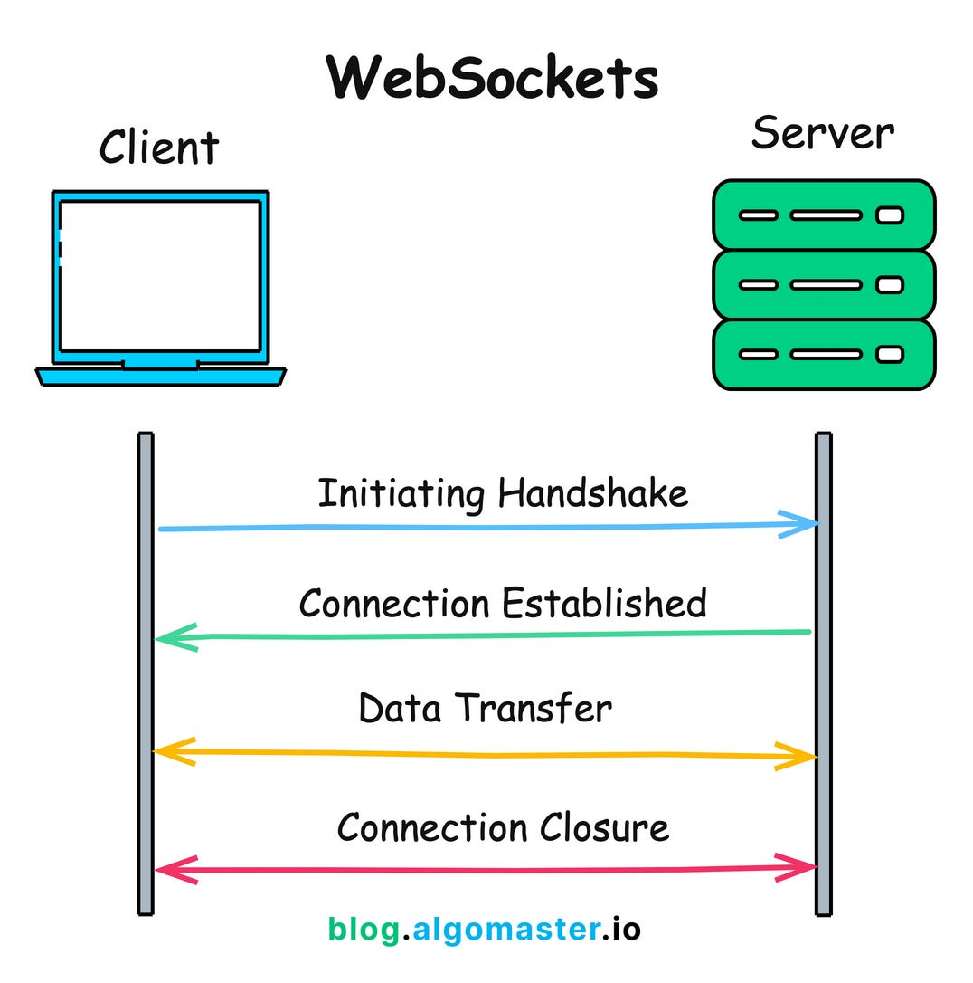

Slide 26
Architectural Approaches
Monolith
Microservices
SOA
Peer-to-Peer
Serverless

