Slide 1
Performance Optimization

Slide 2
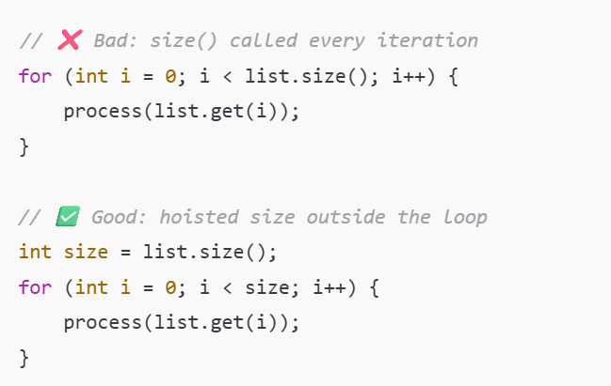
Loop hoisting
Move invariant computations outside of loops to avoid redundant work
JIT

Slide 3
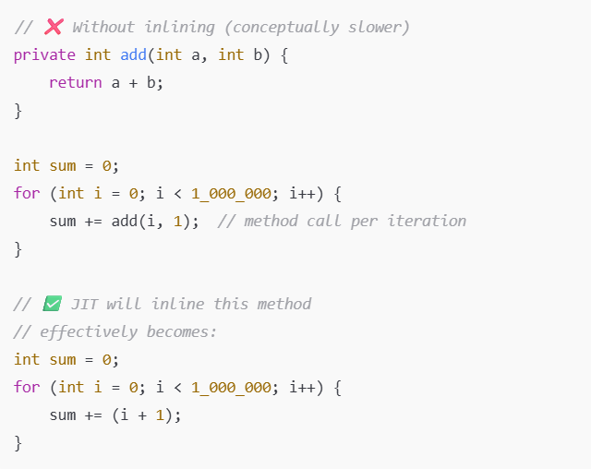
Inlining
Inlining replaces a method call with its body at compile or JIT time
By default, it works on methods where the compiled size is less than 35 bytes, or for hot methods smaller than 325 bytes
JIT

Slide 4
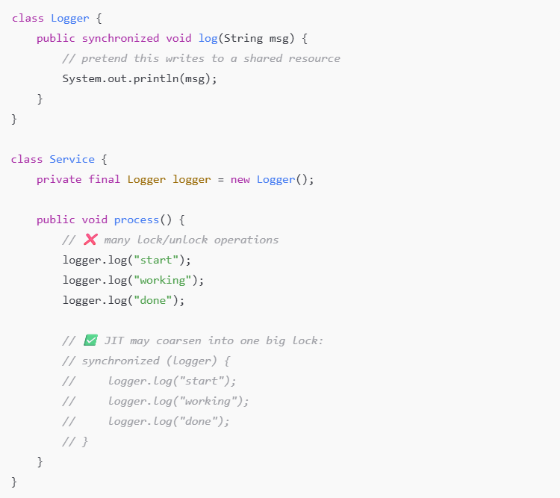
Lock Coarsening
JVM optimization that merges multiple adjacent synchronized blocks into one larger lock
Reduces lock/unlock overhead when locks are taken repeatedly in tight loops
JIT

Slide 5
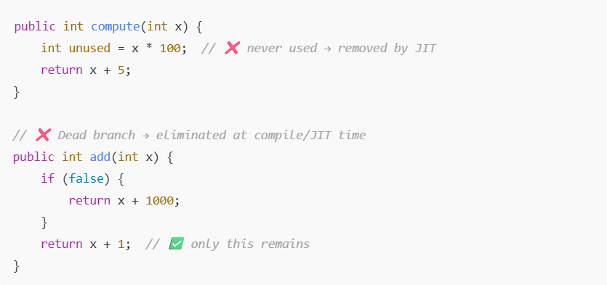
Dead Code Elimination
Compiler/JIT removes code that has no effect on program output
Eliminates unused variables, unreachable branches, redundant calculations
JIT

Slide 6
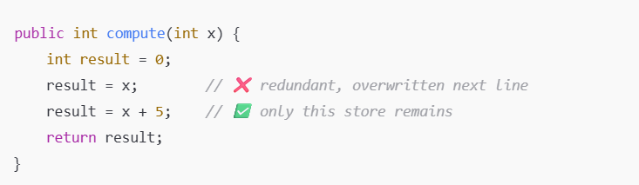
Redundant store elimination
Compiler/JIT removes stores (assignments) that are overwritten before use
Prevents unnecessary memory writes and reduces CPU work
JIT

Slide 7
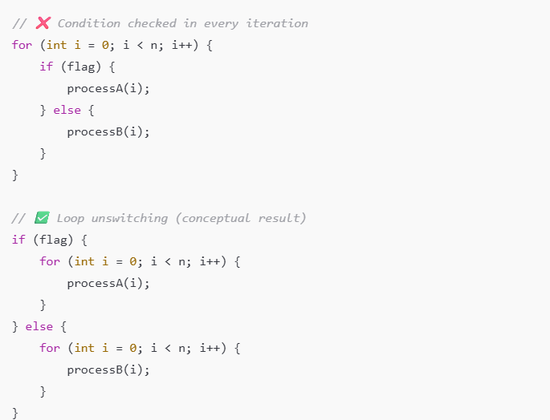
Loop unswitching
Moves invariant conditionals outside of loops
Avoid checking for the same if conditions on every iteration
Creates two specialized loops with fewer branches inside hot code
JIT

Slide 8
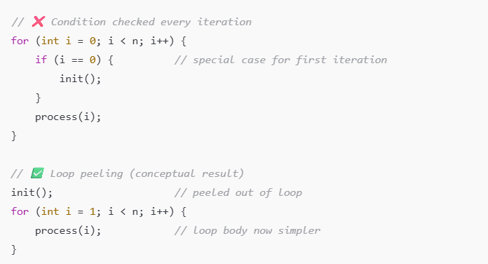
Loop peeling
Peels off the first (or last) iteration(s) of a loop
Simplifies loop body by handling edge cases outside the loop
Improves performance by reducing conditional checks inside hot loops
JIT

Slide 9
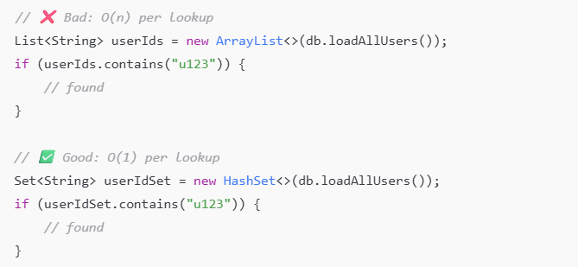
Algorithm & Data Structure Choice
Choosing the right algorithm/data structure often saves orders of magnitude more time than micro-optimizations
Wrong choice → hidden CPU cost (O(n²) lookups, cache misses, resizing)
Typical traps: LinkedList vs ArrayList, List.contains() vs HashSet, unindexed DB querries

Slide 10
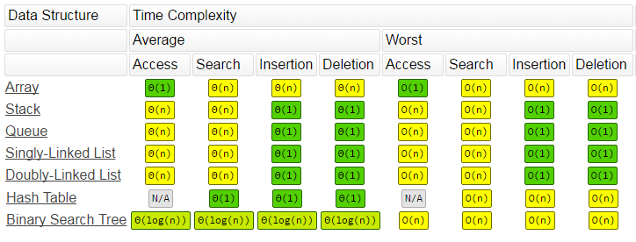
Algorithm & Data Structure Choice

Slide 11
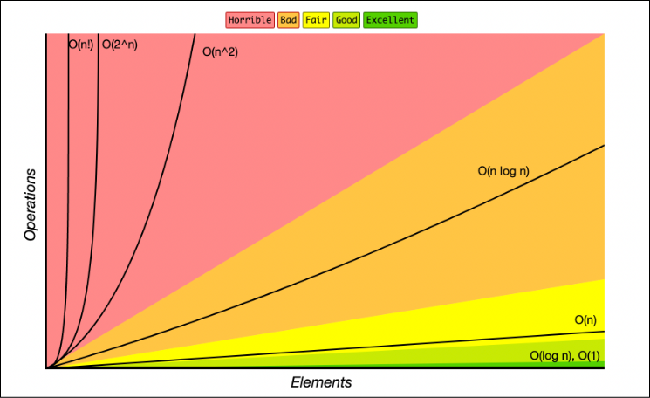
Algorithm & Data Structure Choice

Slide 12
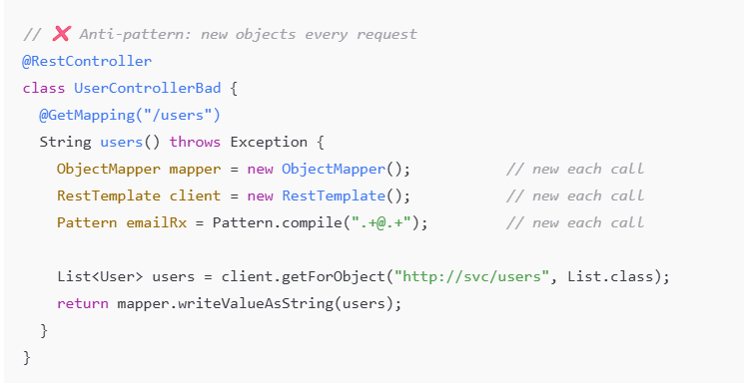
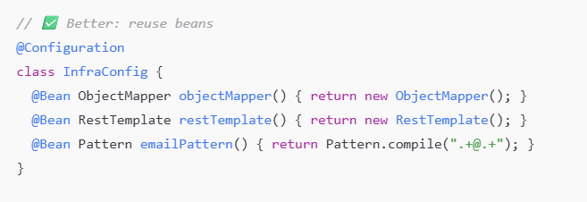
Avoid unnecessary object creation
Every new allocates memory -> creates GC pressure
Short-lived objects aren’t “free”
Prefer primitive types over Wrappers, reuse constants, cached object

Slide 13
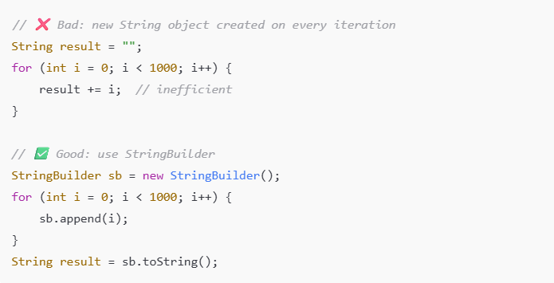
String Handling
Strings are immutable → every concatenation creates a new object
Naive + inside loops → thousands of temporary objects → GC pressure
Use StringBuilder (single-threaded) or StringBuffer (thread-safe) in loops

Slide 14
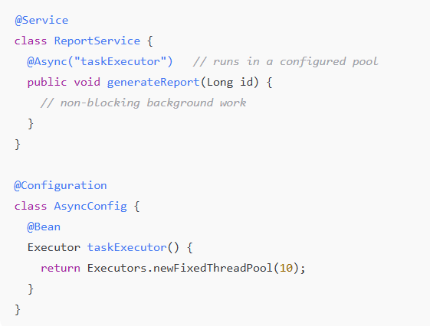
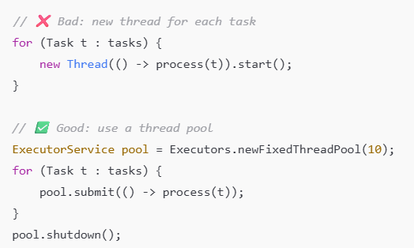
Concurrency Optimization
Locks and threads are expensive - too many cause contention & context switching.
Use thread pools (ExecutorService, ForkJoinPool) instead of creating new threads.
Prefer concurrent collections (ConcurrentHashMap, CopyOnWriteArrayList) over manual synchronized

Slide 15
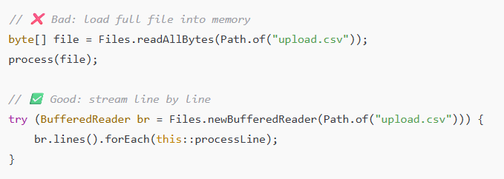
I/O
Disk and network I/O are orders of magnitude slower than CPU/RAM.
Always use buffered streams/readers/writers.
For large files, prefer streaming instead of loading everything into memory
In Spring leverage asynchronous APIs for high concurrency

Slide 16
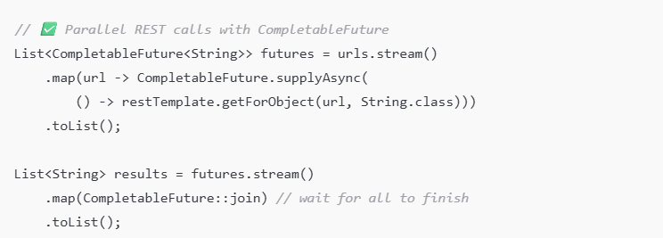
I/O
Disk and network I/O are orders of magnitude slower than CPU/RAM.
Always use buffered streams/readers/writers.
For large files, prefer streaming instead of loading everything into memory
In Spring leverage asynchronous APIs for high concurrency

Slide 17
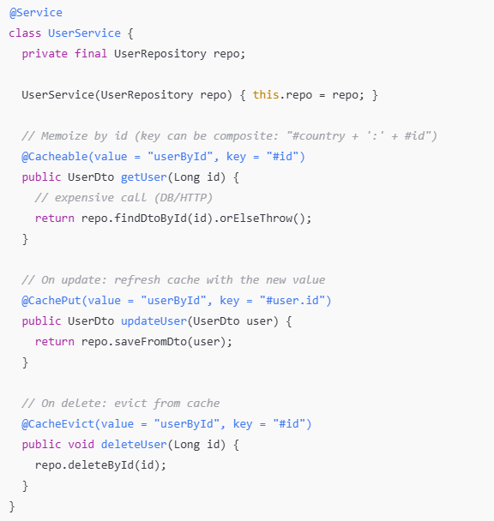
Caching
Use @Cacheable to memoize expensive, pure-ish service calls (DB/HTTP/CPU)

Slide 18
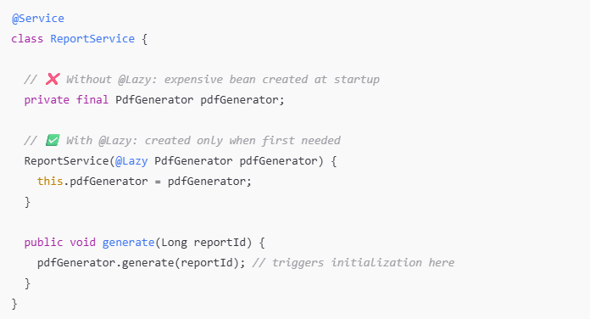
Lazy Initialization
Delay object creation until first actual use, not at startup
Saves memory and startup time, especially for rarely used beans or heavy resources
Spring: use @Lazy on beans or dependencies

Slide 19
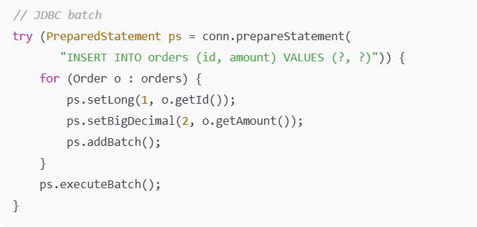
JDBC & Connection Management
Use connection pooling (HikariCP, default in Spring Boot).
Set pool size according to DB capacity (too high = thrashing, too low = thread starvation).
Use batch updates/inserts (hibernate.jdbc.batch_size, JDBC addBatch() + executeBatch()).

Slide 20
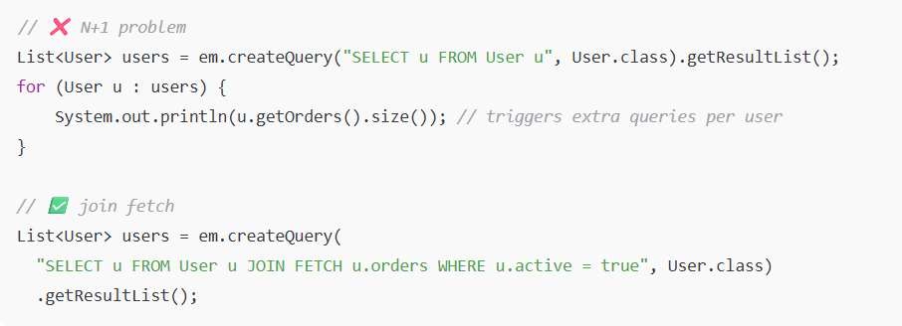
Hibernate Performance Basic
Default is lazy loading, but careless use can lead to N+1 queries.
Always profile SQL logs (hibernate.show_sql=true, p6spy/datasource-proxy).
Use join fetch or entity graphs for associations you really need.
Paginate results (Pageable) → avoid findAll() on big tables.

Slide 21
Language Specific Features

Slide 22
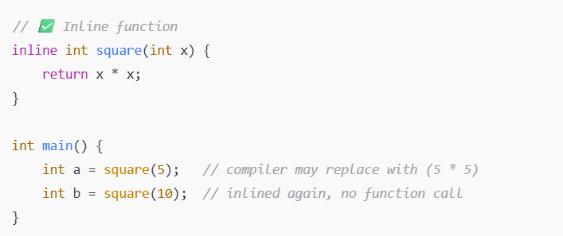
C++: inline functions
inline suggests to the compiler: replace a function call with its body
Removes call overhead (stack push/pop, jumps)
Useful for small, frequently called functions

Slide 23
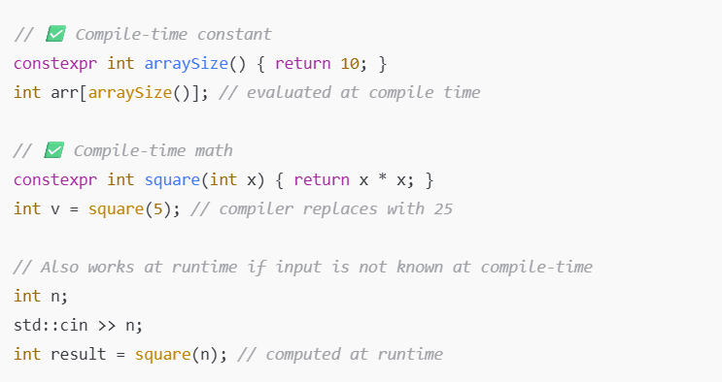
C++: constexpr
constexpr means the expression/function is evaluated at compile time (if possible)
Results in zero runtime overhead → value is “baked into” the binary
Great for constants, math formulas, lookup tables

Slide 24
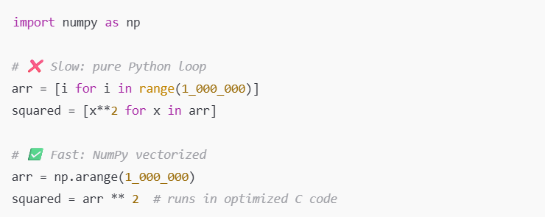
Python: NumPy
Pure Python is slow for loops (dynamic typing, interpreter overhead)
NumPy uses C under the hood → vectorized operations are 100–1000× faster

