Slide 1
Contract Report Performance Analysis
By Danylo Shlapak

Slide 2
Contract Report API
URL: {HOST}/contract_management/v3/contracts/reports
Description: Returns report of contracts matching specific criteria
Response: Excel file containing report

Slide 3
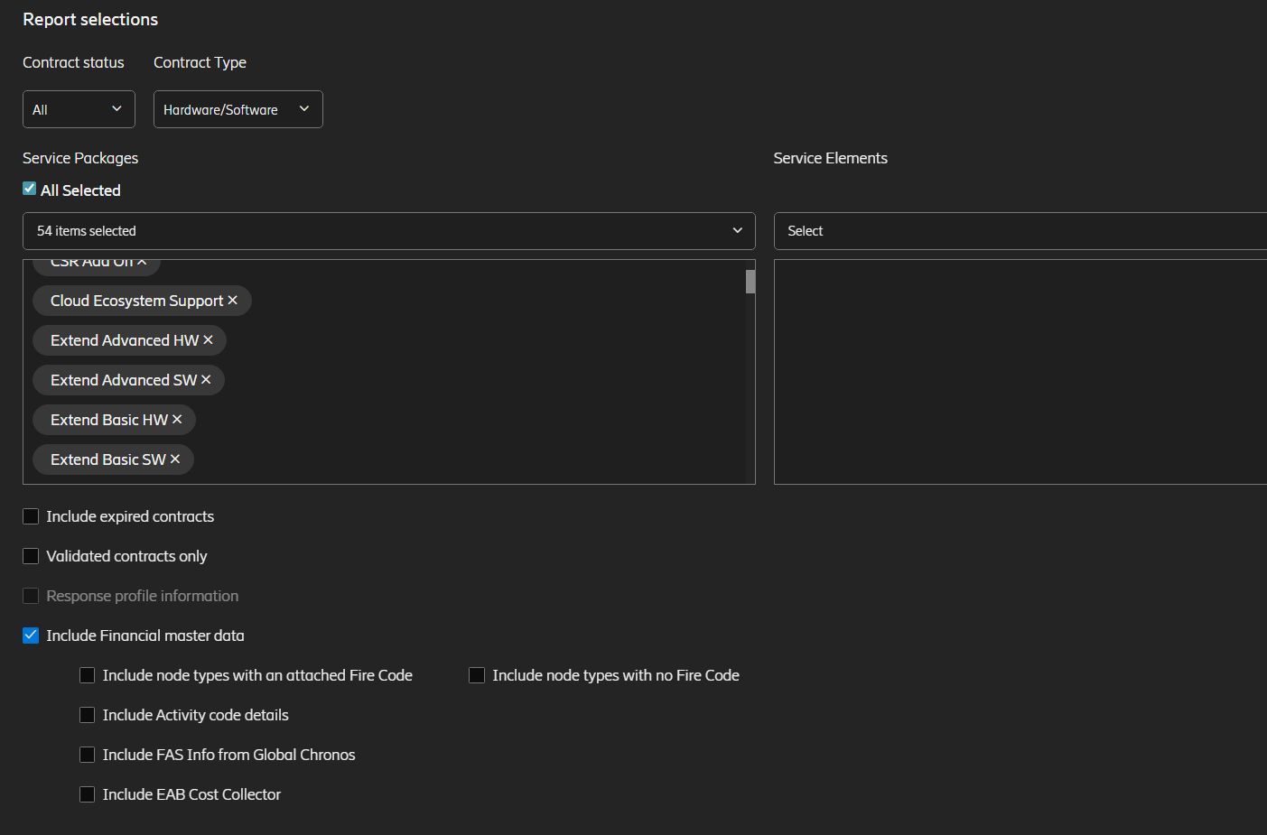
Most Common Case

Slide 4
JProfiler analysis

Slide 5
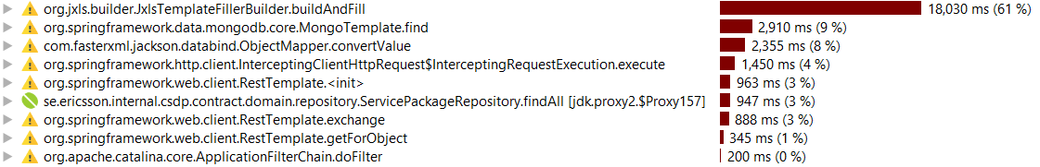
JProfiler analysis. Hotspots

Slide 6
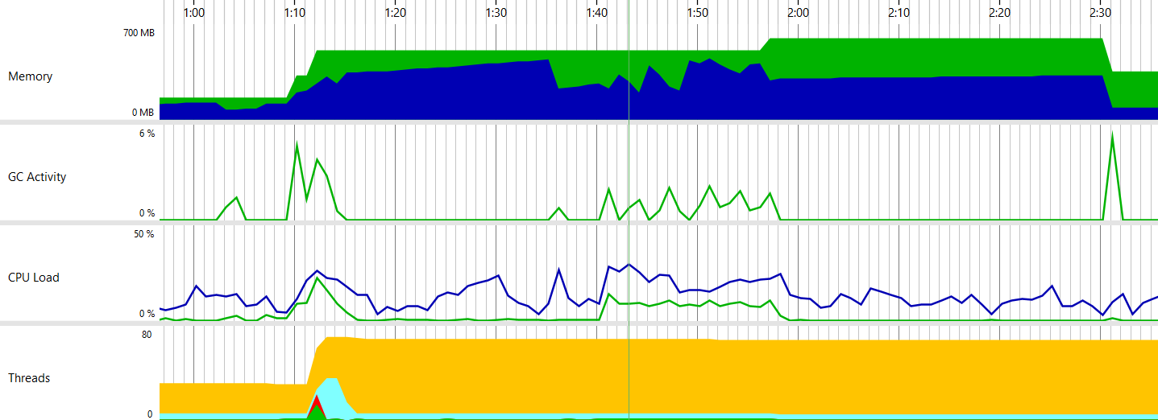
JProfiler analysis. Metrics

Slide 7
JProfiler analysis

Slide 8
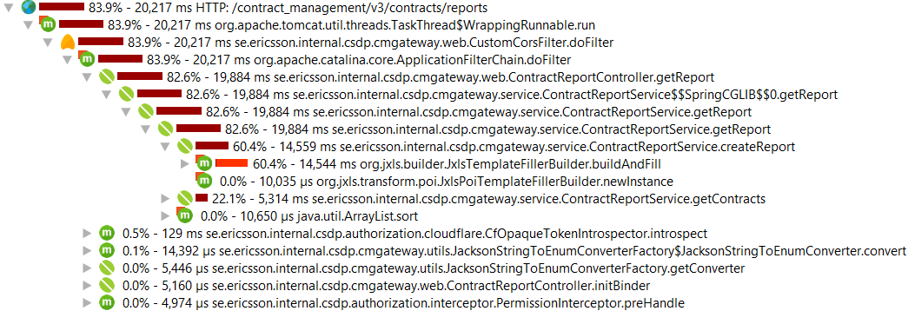
JProfiler analysis

Slide 9
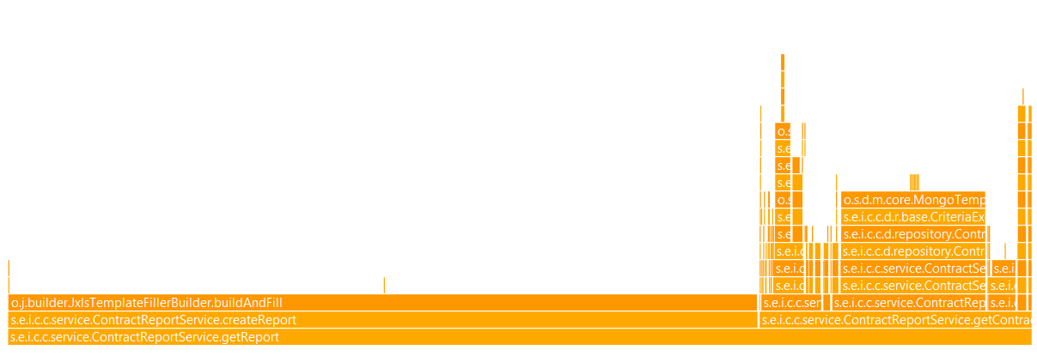
JProfiler analysis

Slide 10
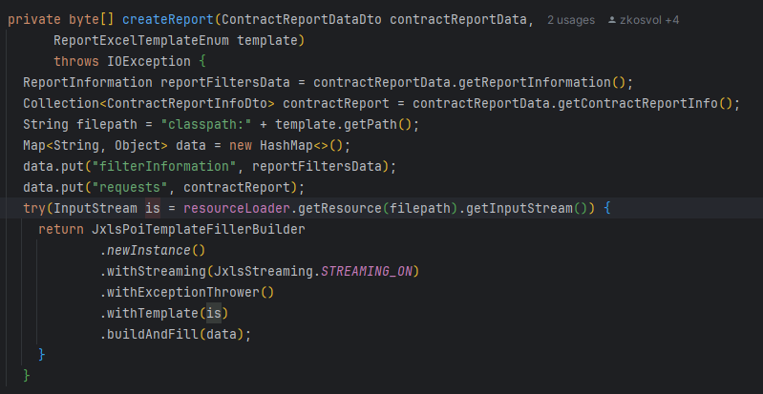
createReport method, most of the work is done by library

Slide 11
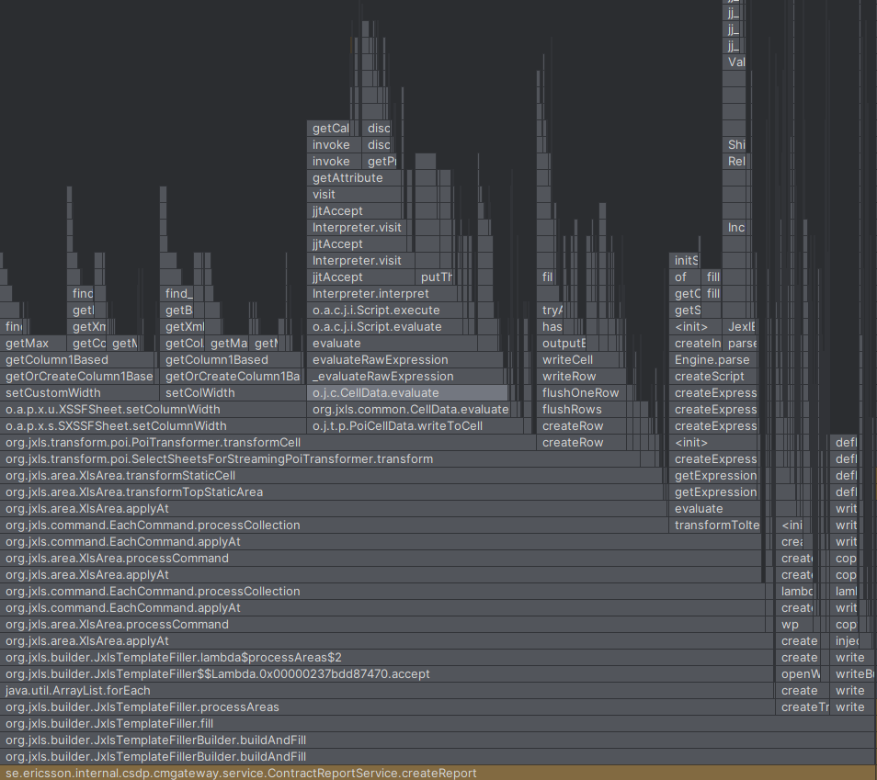
The only optimization we could do is to find a better approach for using this library

Slide 12
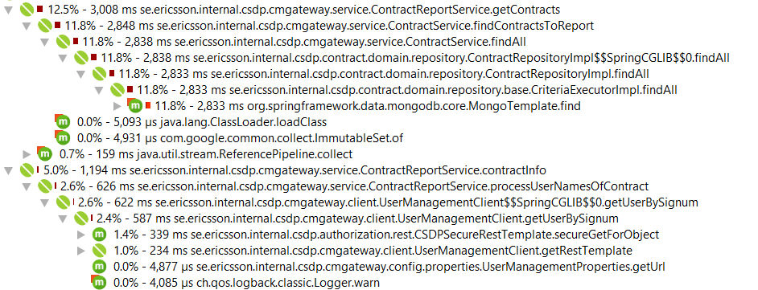
JProfiler analysis

Slide 13
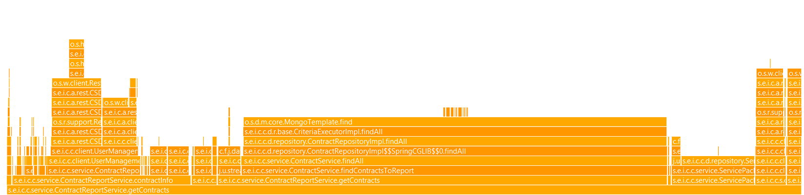
JProfiler analysis

Slide 14
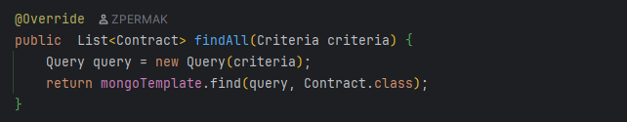
We’re using mongoTemplate to execute query, that means that we can try to optimize criteria, but it’s already pretty straightforward

Slide 15
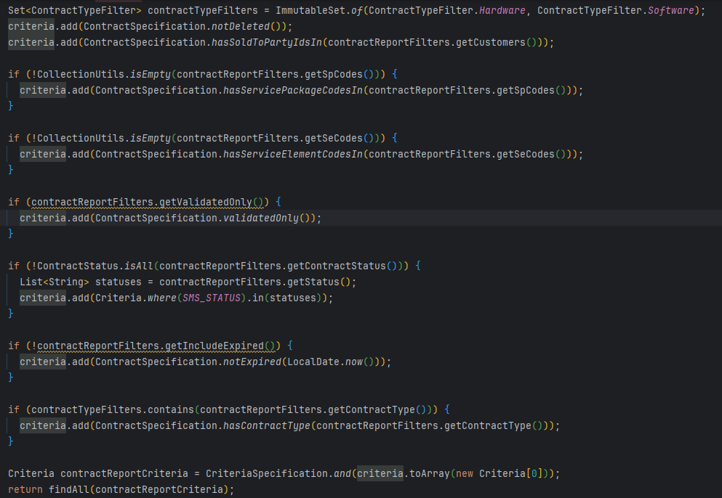

Slide 16
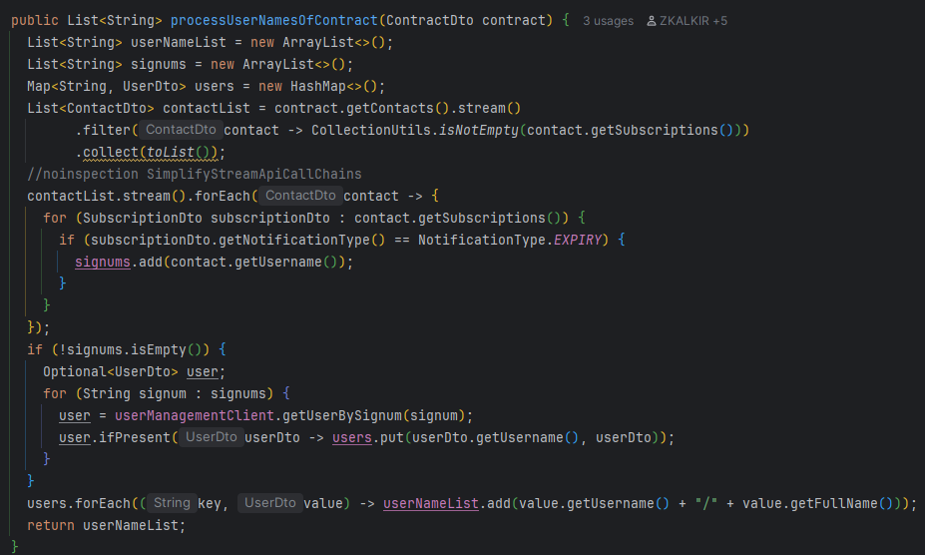
We can improve performance by making API calls async, or find corresponding API to fetch all at once

Slide 17
JProfiler analysis

Slide 18
JProfiler analysis

Slide 19
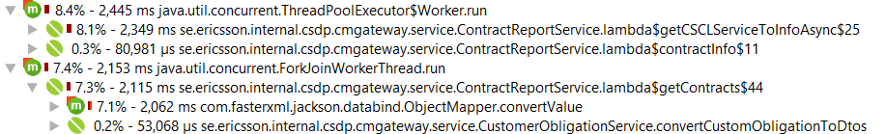
JProfiler analysis

Slide 20
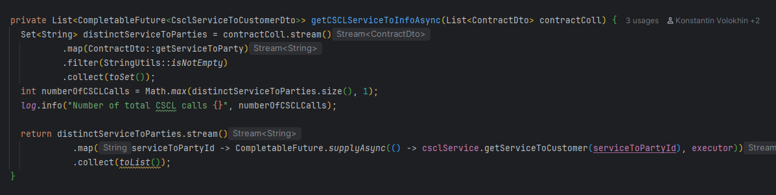
API calls are performed with async approach, the best we can do is check whether cscl service have an API to fetch all service to customers in one API call

Slide 21
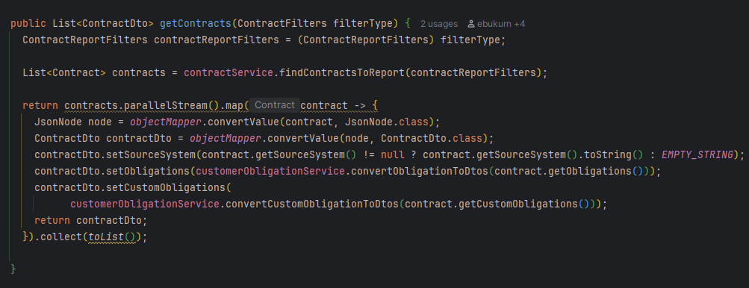
mapping of contracts is done via objectMapper which is not the best and optimized approach, can be refactored with the mapper

Slide 22
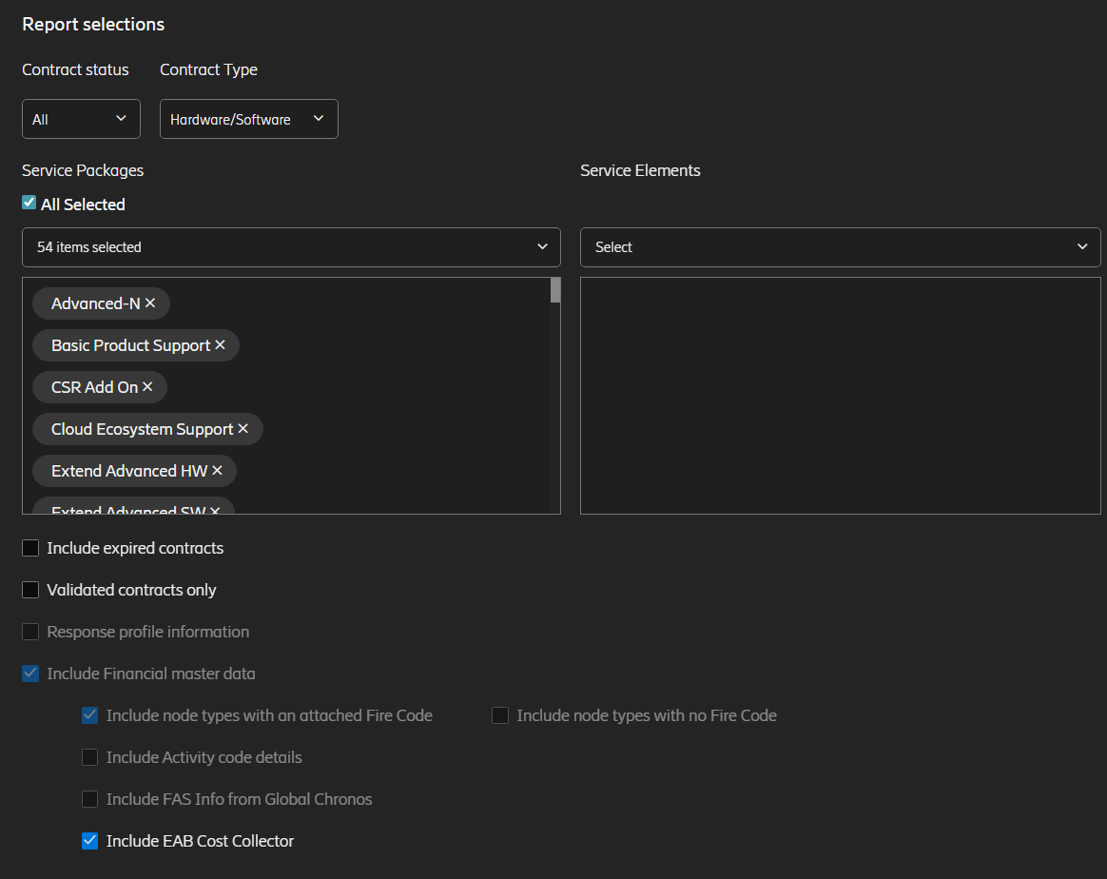
Report with Node Types

Slide 23
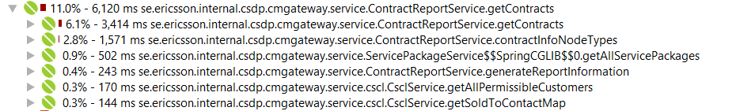
JProfiler analysis

Slide 24
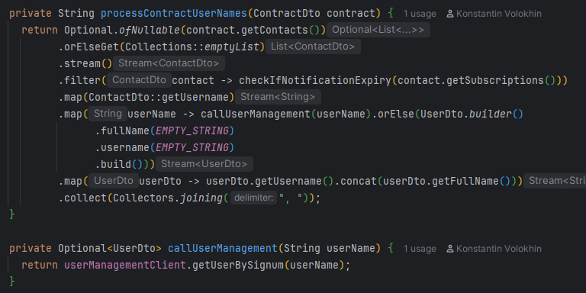
In this case we’re calling user management service each time, when contract have expiry notification, maybe we can cache or fetch all before processing the data

Slide 25
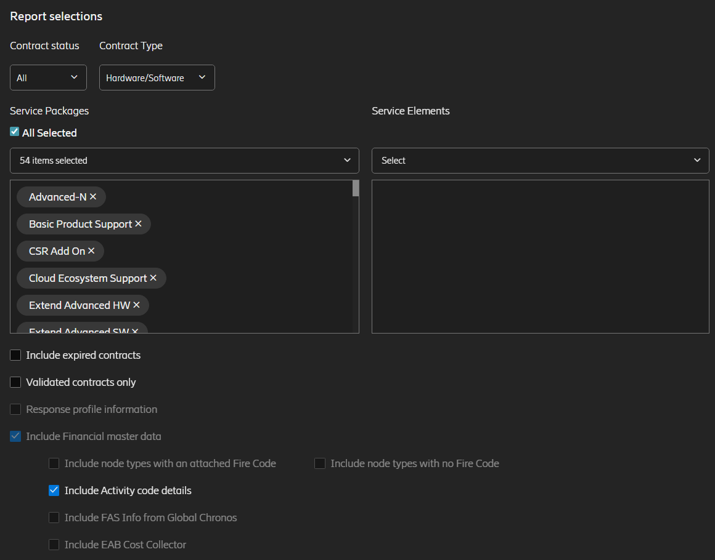
Report with Activity Code details

Slide 26
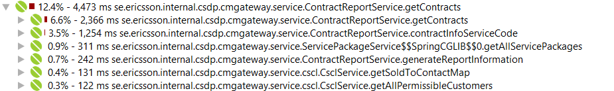
JProfiler analysis

Slide 27
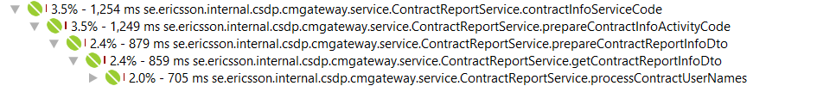
JProfiler analysis

