Slide 1
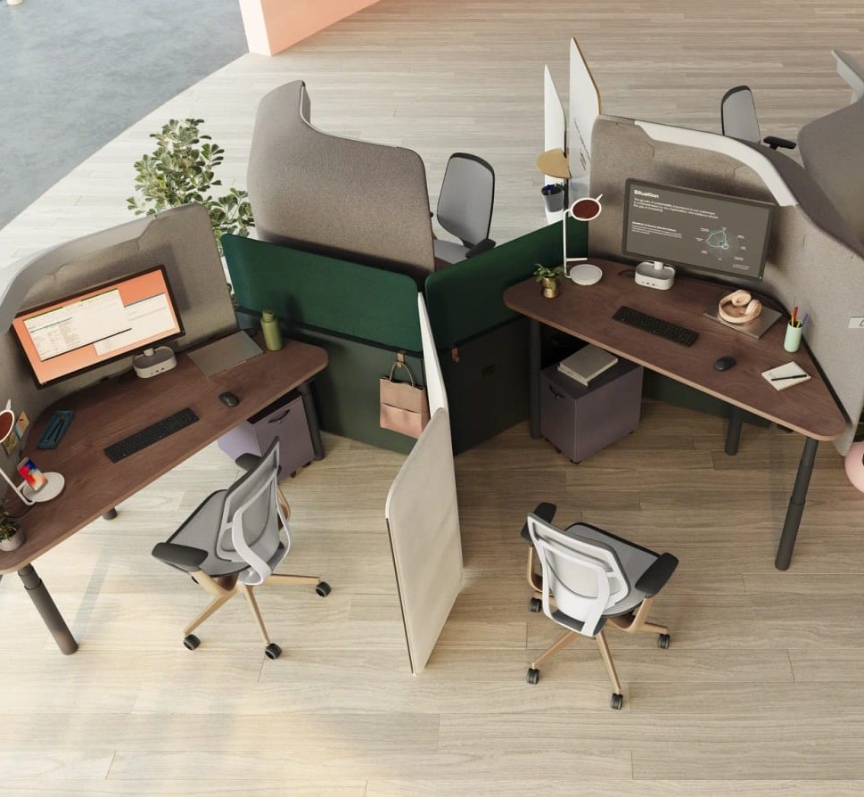


case study
Made by
Nagy Edina-Csilla
Nagy Boróka
Rafain Emőke
Sebestyén Anita

Slide 2

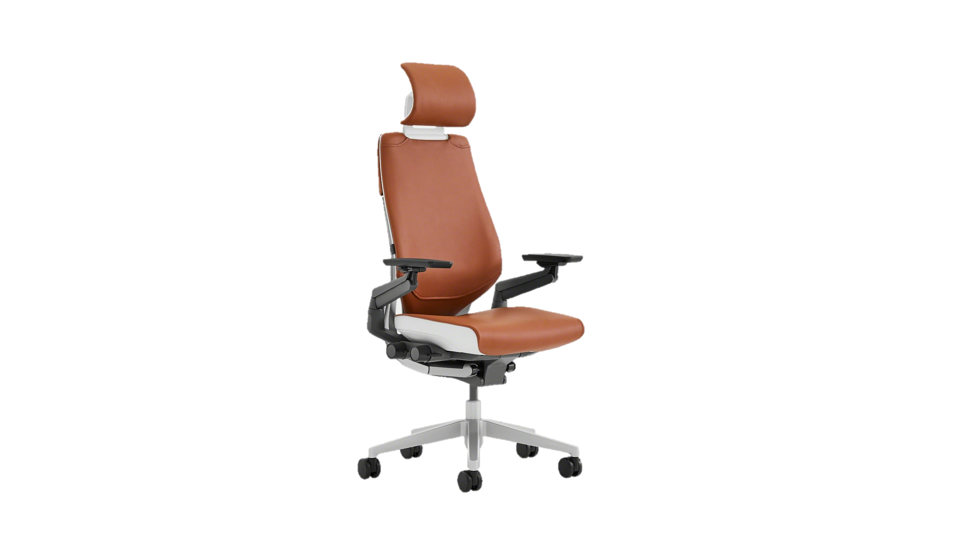

What is our goal with our solution?
To find a package delivery partner for the company, which, among other things, will deliver Eclipse and Gesture products to customers safely and quickly, in appropriate condition, maintaining the quality represented by Steelcase, adapting to the optimized packaging
Gesture by Steelcase
≈0.9 m
≈0.63 m
≈0.9 m
≈0.63 m
≈1.1 m
≈0.55 m
Packaging after the optimization (decreasing size by 50%)
Current packaging
≈ 35 kg
Források: amazon.com/Steelcase

Slide 3










1. Comparing the biggest delivery companies:
Gesture chair: weight: 35 kg 0.9m x 0.55m x 0.63m
Maximum weight | ≈68 kg | 70 kg | 40 kg | 31.5 kg | ≈68 kg
Maximum size (length, height, width) | 4m x 4m x 2.7m | 2.4m x 2.2m x 1.2m | 2m x 0.8m x 0.6m | 3m x 3m x 1.75m | 3.3m x 3.3 x 2.7m
Delivery time | 1-3 days | 4-10 days | 5-7 workdays | 2-3 workdays | 1-3 days
Back-and-forth delivery and package tracking
Delivery to all five target countries(FR, NL, ES, DE, AT)
Sources: Lead Office Furniture Companies - Statista, UPS official website, DHL official website, GLS Group official website, DPD official website, FedEx official website

Slide 4
2. Delivering the Gesture chair
it rivals UPS in many ways, let's see a comparison
FedEx Priority Express delivery price per Gesture chair (2022):
France: 27,7 EUR
Austria: 39,9 EUR
Netherlands: 30,8 EUR
Germany: 39,9 EUR
Spain: 39,9 EUR
In case of long/mid-term contracts, prices may vary.
Why FedEx?
Domestically, they are cheaper
More popular for smaller packages
Larger land fleet
They specialize in international, time-sensitive shipping
Shipping costs for larger packages are cheaper Air transport focal point: in Paris, 450 km from Steelcase's largest warehouse, they can even use air transport to Spain
Increase speed
Sources: FedEx Service & Rate Guide 2022, UPS vs. FedEx What’s The Difference? – Investopedia, FedEx vs. UPS Shipping Comparison – Easyship Blog, FedEx vs. UPS Difference And Comparison - Diffen

Slide 5
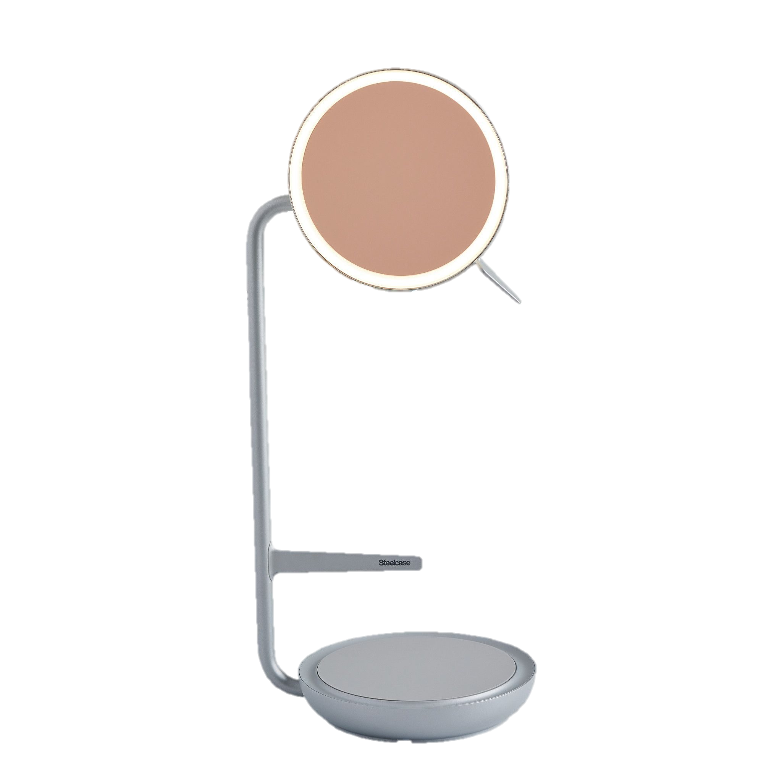


3. Delivering the Eclipse lamp
Benchmark:
Delivery of competitors in case of smaller packages/lamps:
45.72 cm
Although UPS delivers cheaper than FedEx, customer feedbacks indicate that FedEx is on average more careful with fragile packages
15.24 cm
17.78 cm
Since we are talking about a premium product, the cheaper shipping price is not worth the risk of any possible damage and negative customer experience
Sources: Herman Miller official website, Madison Seating official website, Steelcase official website

