Slide 1
Локализация задач по ТЗ:
Browse the catalog
method
Кнопка на заглавной странице
Вид каталога (MVP) и на развитие (макеты)
Ветки каталога – структура и минимальный каталог
Поиск – принцип поиска/алгоритм
Выдача результата поиска
Добавление метода
Добавление категории

Slide 2

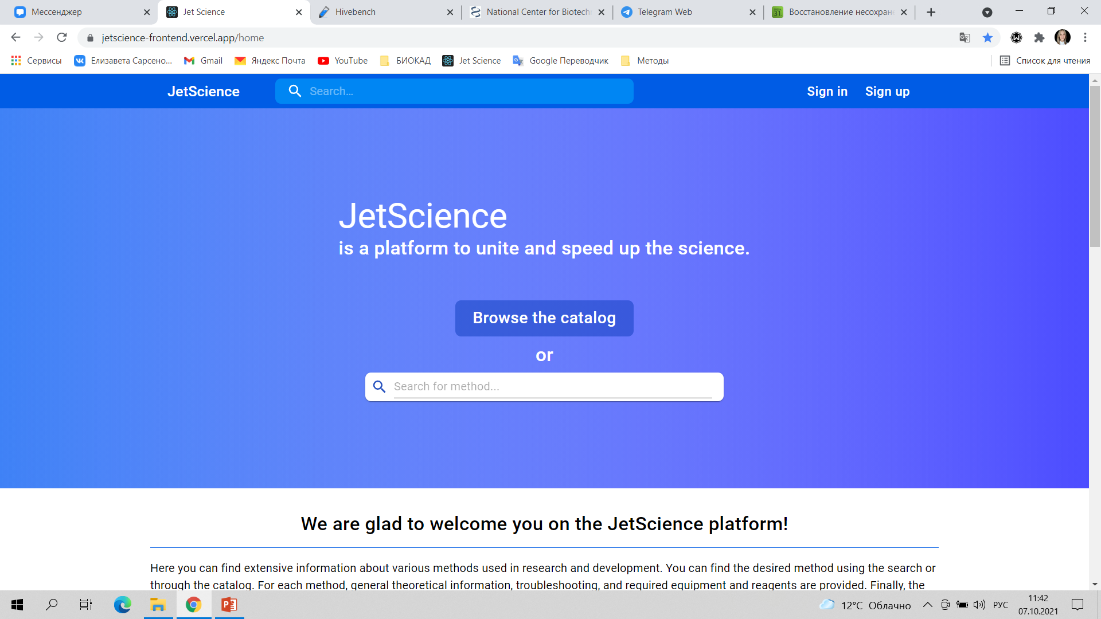


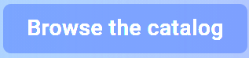
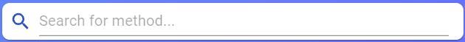
Video tour
About us
Sign in
Sign up
ELISA
Proteins and peptides
Chromatography
BIOTECHNOLOGY
Platform to unite the science
Transfection
OMICS TECHNOLOGIES
SDS-PAGE
or
GENETIC ENGINEERING
Microscopy
Search for method
Cytotoxicity
PCR
Subculturing
We are glad to welcome you on the UniScience platform!
Here you can find extensive information about various methods used in research and development. For each method, general theoretical information, troubleshooting, and required equipment and reagents are provided.
Our platform provides you the opportunity to search for specialists for collaboration and the opportunity to learn the techniques of your interest.
The information on the platform is regularly updated by the registered users - members of the scientific community.
Find
Search for methods and protocols
Personalize
protocols
Set your parameters and follow protocol made for your purpose
Exchange
Download existing protocol moderated by experts or upload a new one
Study
Watch videos and learn new methods
Our goal is to make scientific research more relevant, the process of finding and sharing information - easier, and make research more accessible!

Slide 3
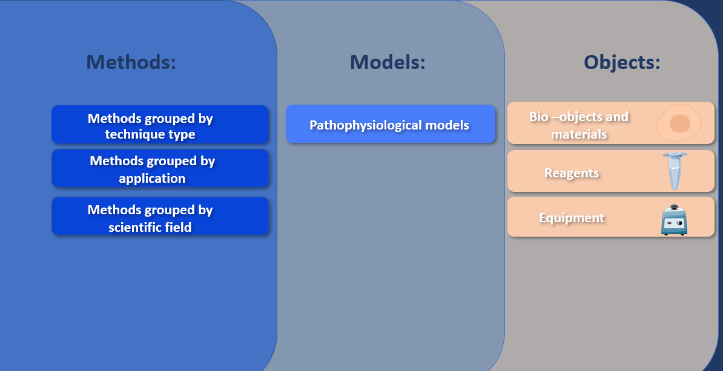
Video tour
About us
Sign in
Sign up

Slide 4
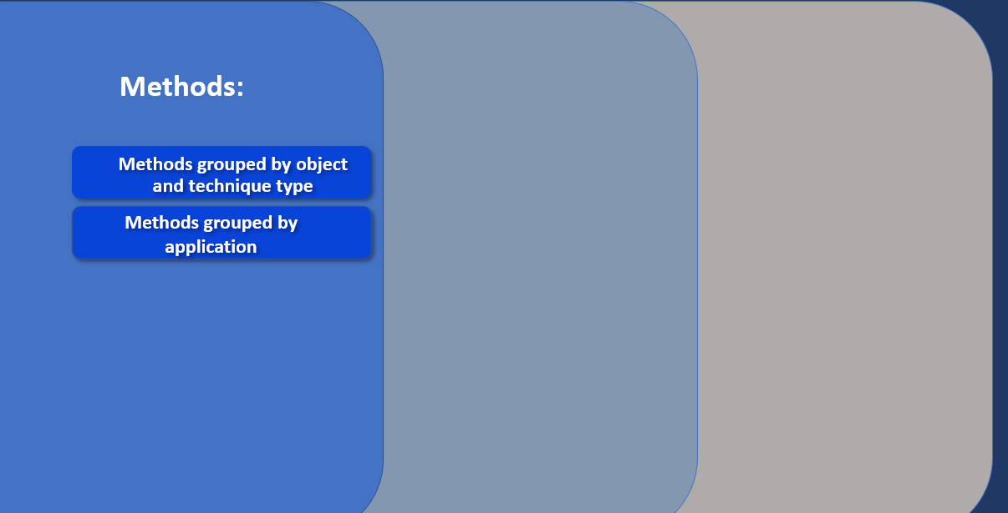
Video tour
About us
Sign in
Sign up
Method 1
Method 2
Method 3

Slide 5
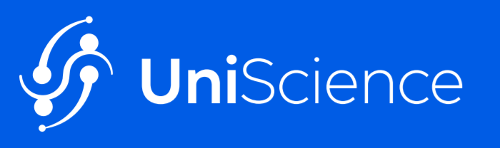
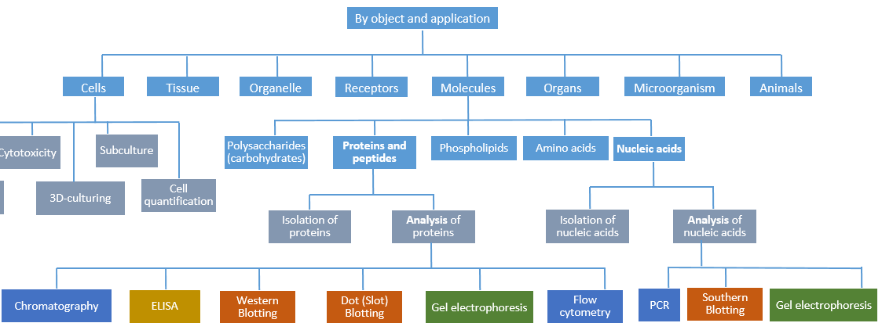
About us
Sign in
Sign up
Catalog:
In our catalog methods are grouped by objects. You can find a method of interest in a folder with an appropriate object.

Slide 6
Catalog:
By technique type
Immunochemical methods
Electrophoresis
Chromatography
Spectral methods
In silico
Microscopy
Methods of working with laboratory animals
Enzymatic methods
Physical and Physicochemical methods
Electrophysiological methods
Microbiological methods
Blotting techniques
Western blotting
Dot (Slot) Blotting
Flow cytometry
Gel electrophoresis
Capillary electrophoresis
Dot-Blotting
Southwestern blotting
Far Eastern blotting
Northern blotting
Eastern blotting
Electrophoretic mobility shift assay
Far-Western Blotting
Middle Eastern blotting
Western blotting
Southern blotting
Northwestern blotting

Slide 7





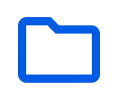


UNIScience
About us
Chromatography
Chromatography
Video tour
Video tour
About us
About us
Sign in
Sign in
Sign up
Sign up
Results: XX matches are found
Sort by
name
popularity
Filters
Object:
proteins
small molecules
Application:
analytical
peptides
amino acids
preparative
Chromatography
Chromatography is a laboratory technique for the separation of a mixture. The mixture is dissolved in a fluid (gas or solvent) called the mobile phase, which carries it through a system on which a material called the stationary phase is fixed.
Ion-exchange High-performance liquid chromatography of amino acids
High-performance liquid chromatography (HPLC), formerly referred to as high-pressure liquid chromatography, is a technique in analytical chemistry used to separate, identify, and quantify each component in a mixture. Ion exchange chromatography is based on the association of charged groups in a liquid that passes over a solid support or ion exchange resin. Amino acids at pHs below their isoelectric point are positively charged and will bind to a cation exchange resin.
Type of …..:
…..
……
Filters:
Fast protein liquid chromatography
Fast protein liquid chromatography (FPLC), is a form of liquid chromatography that is often used to analyze or purify mixtures of proteins. As in other forms of chromatography, separation is possible because the different components of a mixture have different affinities for two materials, a moving fluid (the mobile phase) and a porous solid (the stationary phase).
Type of …..:
…..
……
Immobilized metal affinity chromatography
Immobilized metal affinity chromatography (IMAC) is the most widely used method to purify the proteins according to their affinity to specific metal ions, which was first introduced by Porath (1989). This involves the use of phosphate affinity metals which are chelated on resin or beads and packed in a column.
Filters:
Thin Layer Chromatography of amino acids
Thin Layer Chromatography (TLC) is used to separate solids from a liquid. The most common use is to separate amino acids from a liquid and each other. The glass is then placed in a solvent that will travel up the absorbent surface and cause the solid to move out of the liquid with it.
Type of …..:
…..
……
Notes:
В общей папке «Chromatography» собраны все папки хроматографии из разных ветвей каталога по объекту и аппликейшн. Подобные папки формируются под составные запросы (когда много разных объектов) – хроматография, блоттинг, микроскопия и т.д. Большая категория – из ветки по типу анализа. Список методов – результат из каталога по объекту.

Slide 8
New method:
Name
+Add
Application
+Add
Object
+Add
Type
+Add

