Slide 1
JET Science
Join Experience and Technology
Platform to unite and speed up the science

Slide 2
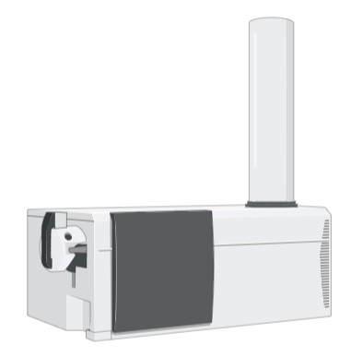
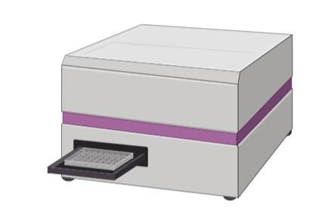
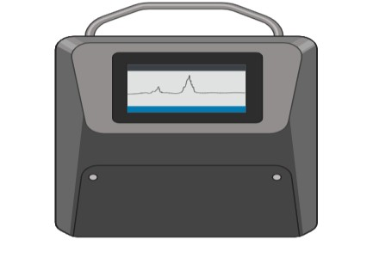
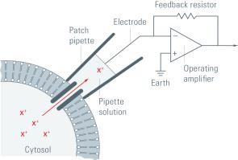
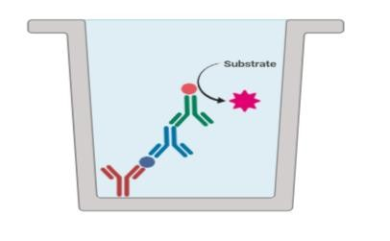
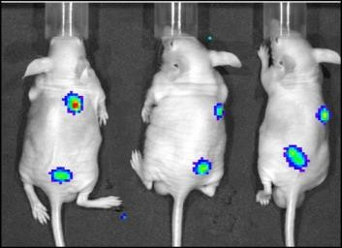
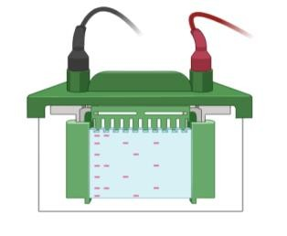
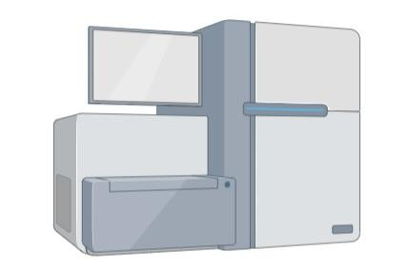
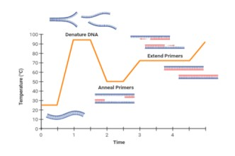
Цель:
Создание online – платформы, для поиска протоколов методов, упрощения организации экспериментальной работы, обучения в сфере наук о жизни.

Slide 3

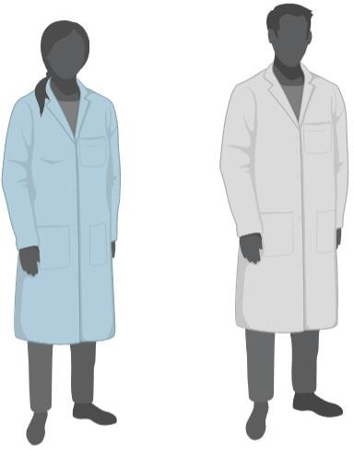



СУЩЕСТВУЮЩИЕ КЛАССИЧЕСКИЕ ПОДХОДЫ РЕШЕНИЯ
зависимость от компетентности
обучающего
сложность подбора альтернативных методов/ограниченность
актуальность
значительное время на поиск
сложность подбора альтернативных
методов/ограниченность
сложность подбора
альтернативных методов
низкая воспроизводимость

Slide 4


Slide 5
Catalog:
Type:
Topic:
Operand:
Methods grouped by technique type
Genetic engineering
Objects
Methods grouped by type of the object of interest
Biotechnology
Reagents
Pathophysiological
models
Omics technologis
Equipment

Slide 6
Catalog:
choose the method by type of technic
Physical and Physicochemical methods
Immunochemical methods
Enzymatic methods
Electrophysiological methods
In silico methods
Spectral methods
Chromatography

Slide 7
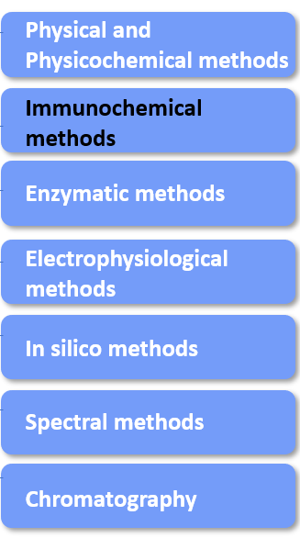
Catalog:
choose the method by type of technic
Immunochemical methods
Western Blot
ELISA
Flow cytometry

Slide 8
Catalog:
Type:
Topic:
Operand:
Methods grouped by technique type
Genetic engineering
Objects
Methods grouped by type of the object of interest
Biotechnology
Reagents
Pathophysiological
models
Biotechnology
Equipment

Slide 9
Catalog:
Methods grouped by type of the object of interest
Animals
Cell and cell culture
Microorganism
Organs
Tissue
Organelle
Molecules

Slide 10
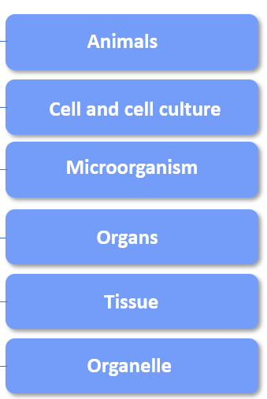
Catalog:
Methods grouped by type of the object of interest
Animals
Cell and cell culture
Nucleic acids
Microorganism
Proteins and peptides
Organs
Lipids
Tissue
…
Organelle
Molecules

Slide 11
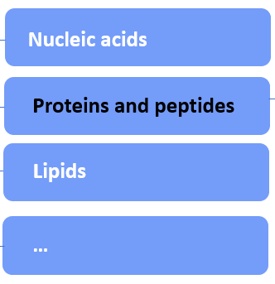
Catalog:
Methods grouped by type of the object of interest
Isolation and purification
Animals
Analysis
Cell and cell culture
Microorganism
Proteins and peptides
Organs
Tissue
Organelle
Molecules

Slide 12
Catalog:
Type:
Topic:
Operand:
Methods grouped by technique type
Genetic engineering
Objects
Methods grouped by type of the object of interest
Biotechnology
Reagents
Pathophysiological
models
Biotechnology
Equipment

Slide 13
Catalog:
Methods grouped by type of the object of interest
Circulatory System Diseases
Nervous system diseases
Endocrine Disorders
Infections
Oncological diseases
Blood diseases
…

Slide 14
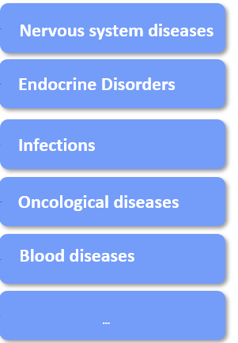
Catalog:
Methods grouped by type of the object of interest
Circulatory System Diseases
Animal models
Cell models
Hypertension
Hypotension
Coronary heart diseases
…

Slide 15
Catalog:
Type:
Topic:
Operand:
Methods grouped by technique type
Genetic engineering
Objects
Methods grouped by type of the object of interest
Biotechnology
Reagents
Pathophysiological
models
Biotechnology
Equipment

Slide 17

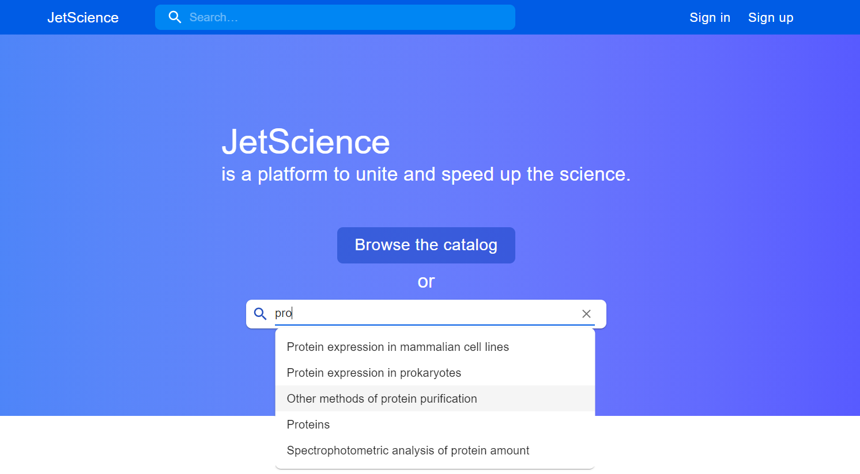
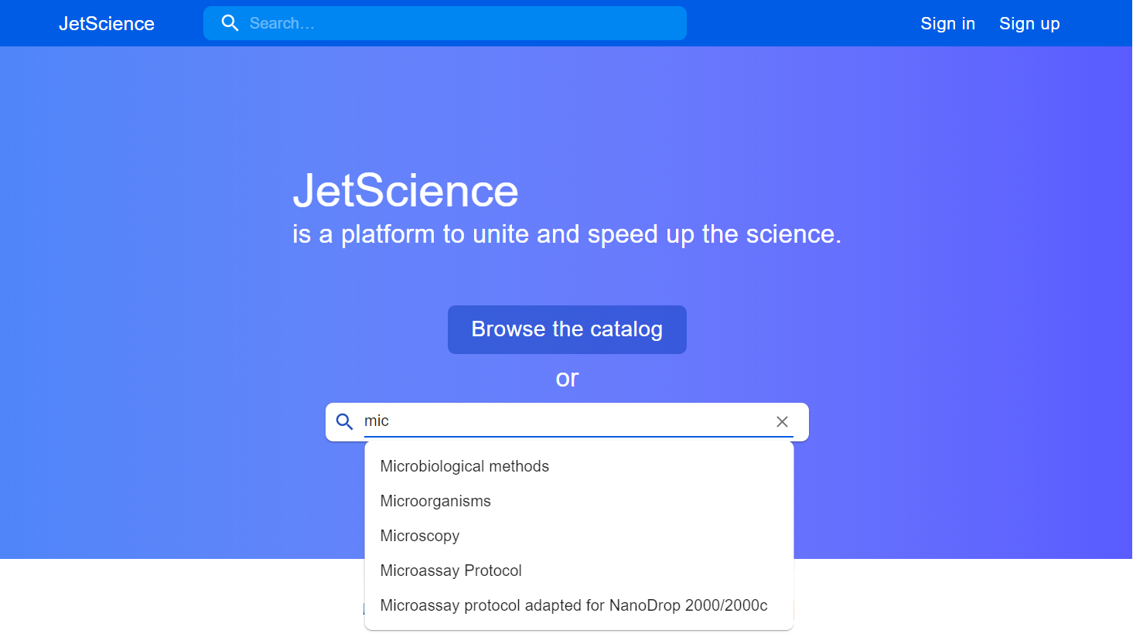

Slide 18
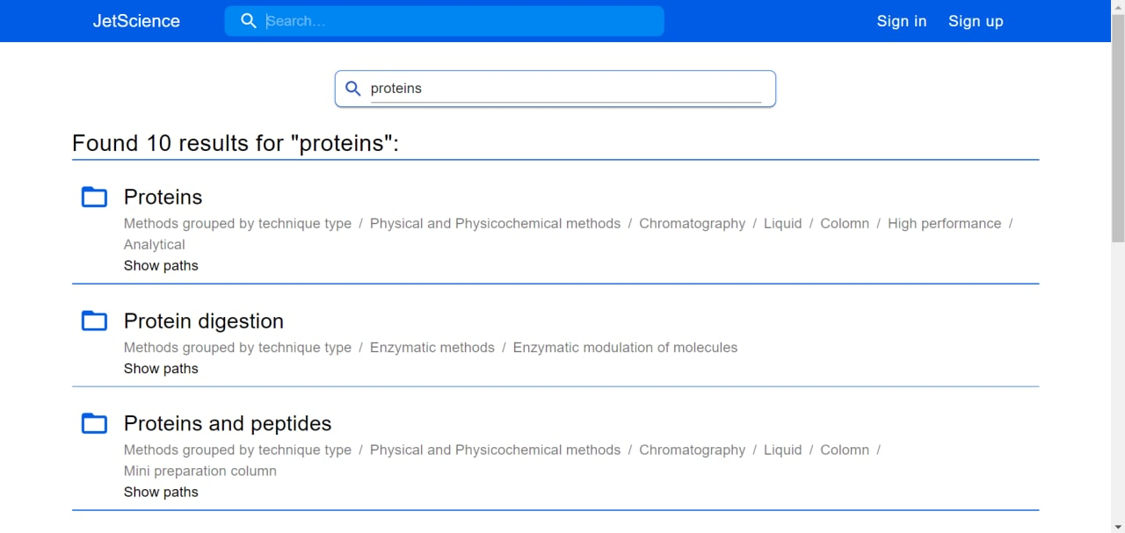
Search:
*вид результатов поиска

Slide 19
Search and catalog:
Позволяют найти нужный метод, его конкретную модификацию, относительно техники исполнения и объекта исследования
Позволяют находить группы методов, предназначенных для решения конкретных задач
Позволяют находить альтернативные методы, применяемые для решения той же задачи

Slide 20

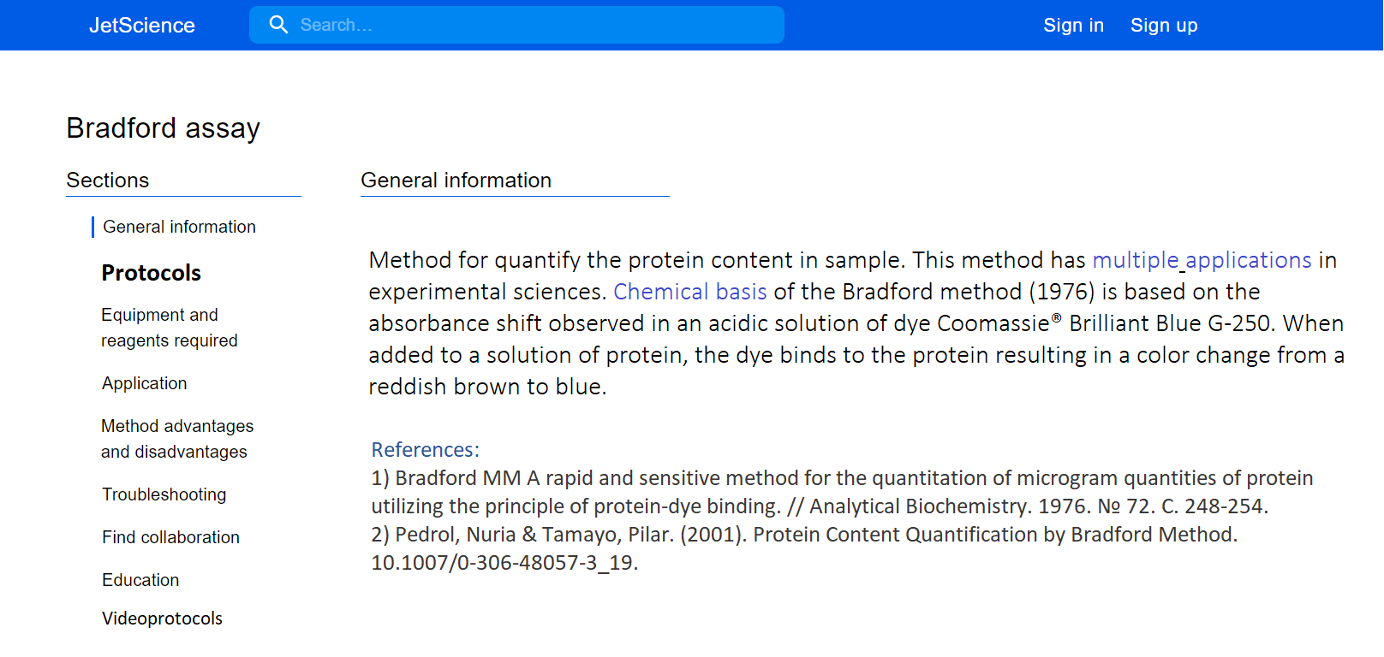
Method:

Slide 21
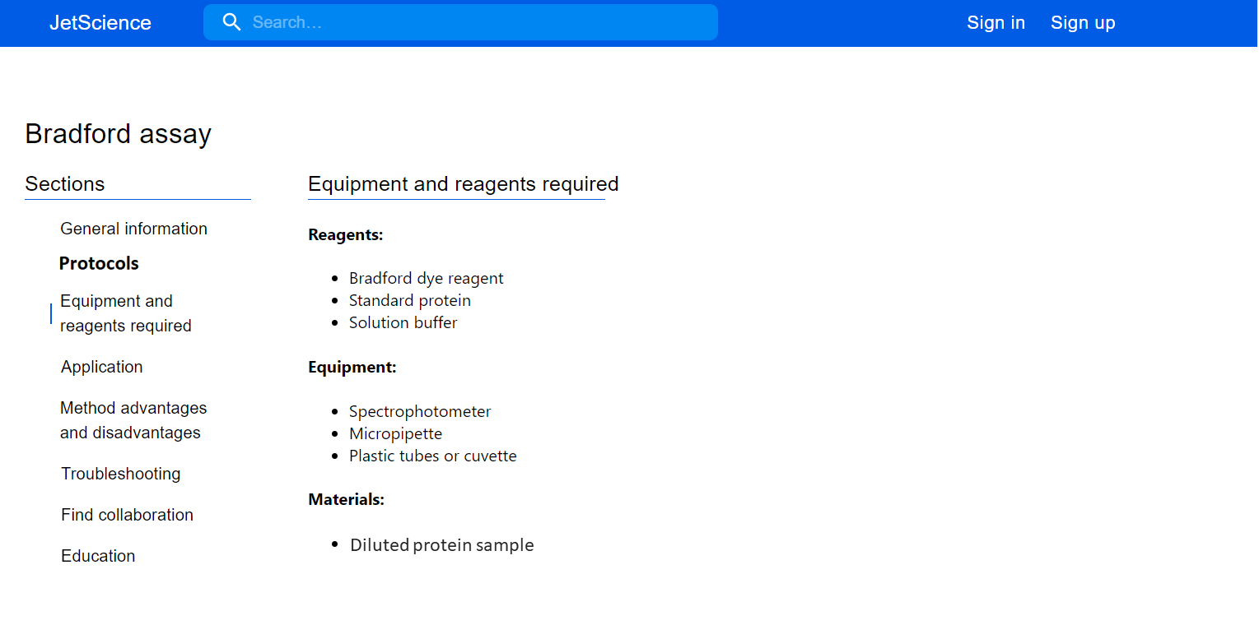
Method:

Slide 22
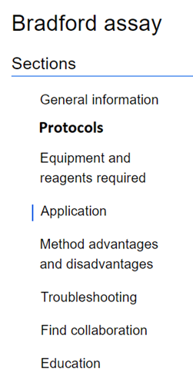

Slide 23
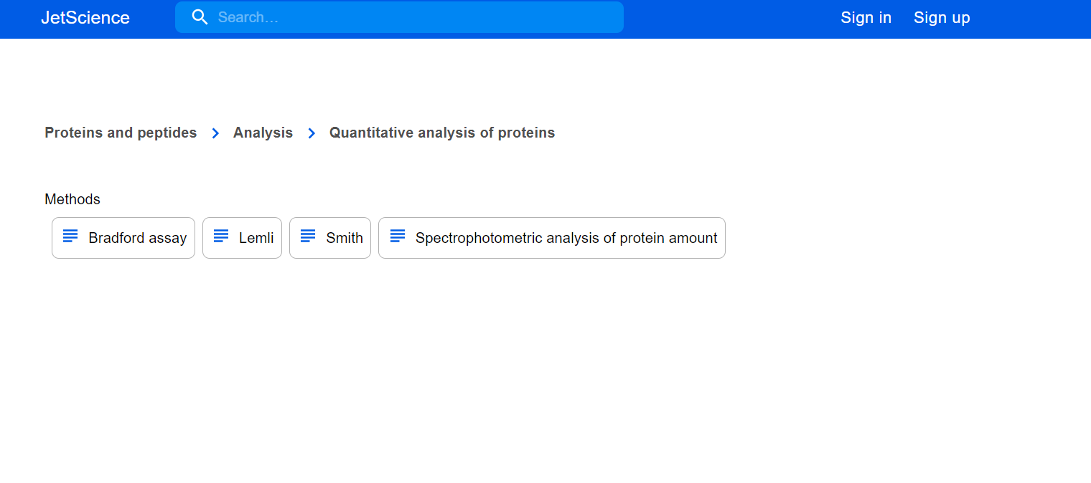

Slide 24
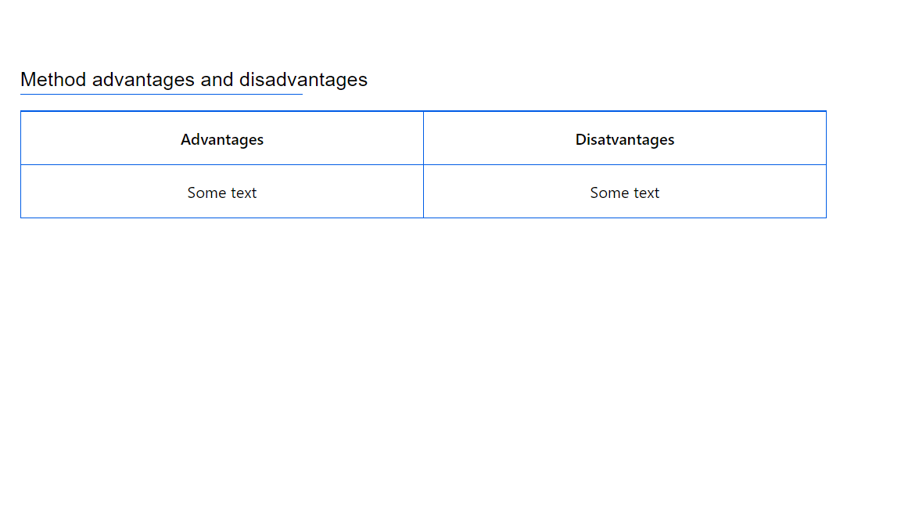
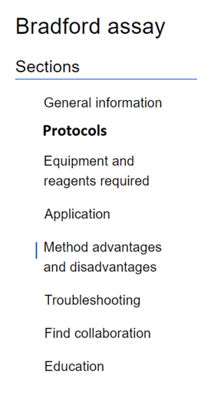

Slide 25
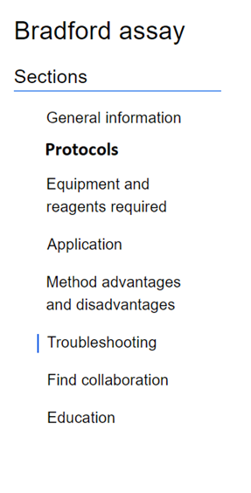
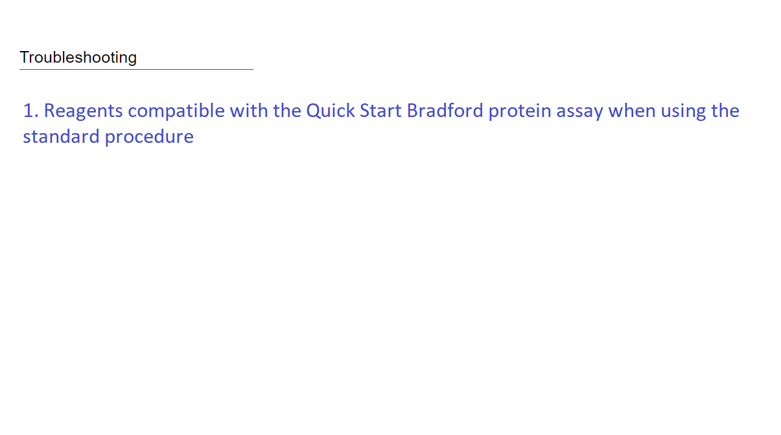

Slide 26
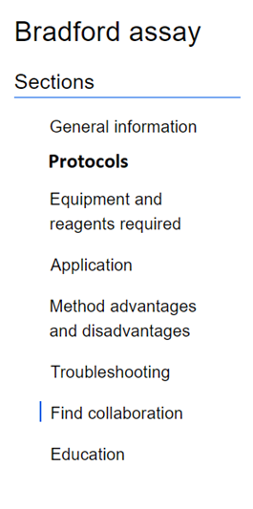


Country
City
Organization
Search

Slide 27
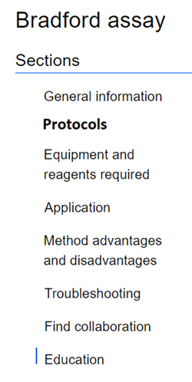
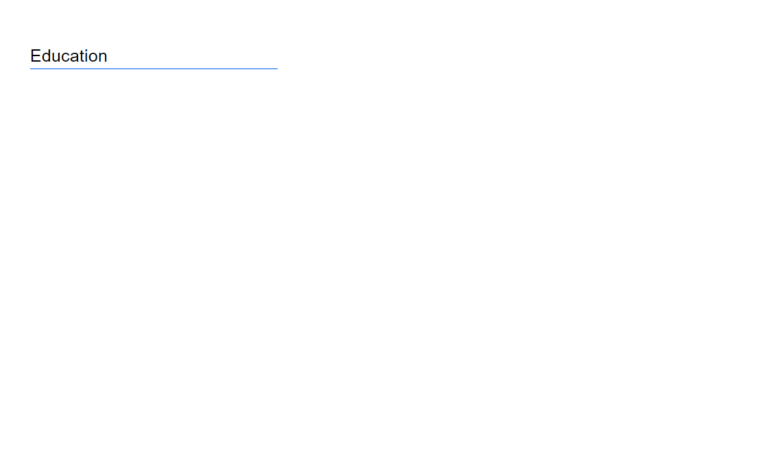
Country
City
Language
Search

Slide 28
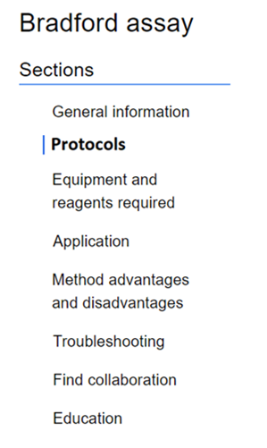

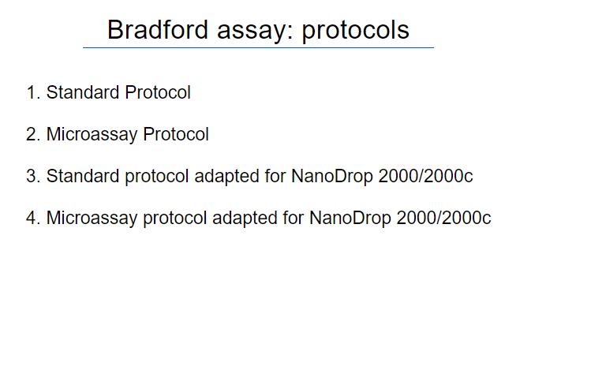

Slide 29
Standard Protocol
setting parameters:
Equilibrate all reagents and probes to room temperature and mix gently.
* Protein solutions are normally assayed in triplicate.
Use off-the-shelf (if provided) or prepare standard samples.
Pipet each standard and unknown sample solution (100 μl / 20 μl / 5 μl) into separate clean test tube/ disposable cuvette/ microplate well add (5ml / 1 ml / 250 μl) of 1x dye reagent to each tube (or cuvette) and mix it.
Incubate all probes at room temperature for at least 5 min (but not longer than 1 hour).
Measure the absorbance of the standards and samples at 595 nm.
Process the received data.
Standard
Sample volume

Slide 30
Standard Protocol
setting parameters:
Equilibrate all reagents and probes to room temperature and mix gently.
* Protein solutions are normally assayed in triplicate.
Use off-the-shelf (if provided) or prepare BSA Standard.
Pipet 100μl of each standard and unknown sample solution into separate clean cuvette and add 5ml of 1x dye reagent to each tube (or cuvette) and mix it.
Incubate all probes at room temperature for at least 5 min (but not longer than 1 hour).
Measure the absorbance of the standards and samples at 595 nm.
Process the received data.
Standard
BSA Standard
Sample volume
5 ml

Slide 31







Protocol review:
Protoc
publish !

Slide 32

User page:
Ivan Ivanov
SPCPU, Saint-Petersburg, Russia
messages
organization:
position:
Postdoc
projects
sphere of scientific interests:
protocols
Immunology, protein biology, oncology
owns methods:
publications
Bradford assay, Edman degradation,…
notifications
(267)
Research id: 1111 1111 1111 1111
reagents

Slide 33
Вопросы:
Реактивы и оборудование используемые в методах –
работа с производителями:
- списки на платформе – ссылка на заказ с платформы
видеозаписи протоколов совместно (оборудование/специалисты)
- протоколы от производителей

Slide 34

Platform to unite the science

Slide 35
Цель:
Создание online – платформы, для поиска протоколов методов, упрощения организации экспериментальной работы, обучения в сфере наук о жизни.

Slide 36
СУЩЕСТВУЮЩИЕ КЛАССИЧЕСКИЕ ПОДХОДЫ РЕШЕНИЯ
зависимость от компетентности
обучающего
сложность подбора альтернативных методов/ограниченность
актуальность
значительное время на поиск
сложность подбора альтернативных
методов/ограниченность
сложность подбора
альтернативных методов
низкая воспроизводимость

Slide 38
Catalog:
Type:
Topic:
Operand:
Methods grouped by technique type
Genetic engineering
Objects
Methods grouped by type of the object of interest
Biotechnology
Reagents
Pathophysiological
models
Omics technologis
Equipment

Slide 39
Catalog:
choose the method by type of technic
Physical and Physicochemical methods
Immunochemical methods
Enzymatic methods
Electrophysiological methods
In silico methods
Spectral methods
Chromatography

Slide 40
Catalog:
choose the method by type of technic
Immunochemical methods
Western Blot
ELISA
Flow cytometry

Slide 41
Catalog:
Type:
Topic:
Operand:
Methods grouped by technique type
Genetic engineering
Objects
Methods grouped by type of the object of interest
Biotechnology
Reagents
Pathophysiological
models
Biotechnology
Equipment

Slide 42
Catalog:
Methods grouped by type of the object of interest
Animals
Cell and cell culture
Microorganism
Organs
Tissue
Organelle
Molecules

Slide 43
Catalog:
Methods grouped by type of the object of interest
Animals
Cell and cell culture
Nucleic acids
Microorganism
Proteins and peptides
Organs
Lipids
Tissue
…
Organelle
Molecules

Slide 44
Catalog:
Methods grouped by type of the object of interest
Isolation and purification
Animals
Analysis
Cell and cell culture
Microorganism
Proteins and peptides
Organs
Tissue
Organelle
Molecules

Slide 45
Catalog:
Type:
Topic:
Operand:
Methods grouped by technique type
Genetic engineering
Objects
Methods grouped by type of the object of interest
Biotechnology
Reagents
Pathophysiological
models
Biotechnology
Equipment

Slide 46
Catalog:
Methods grouped by type of the object of interest
Circulatory System Diseases
Nervous system diseases
Endocrine Disorders
Infections
Oncological diseases
Blood diseases
…

Slide 47
Catalog:
Methods grouped by type of the object of interest
Circulatory System Diseases
Animal models
Cell models
Hypertension
Hypotension
Coronary heart diseases
…

Slide 48
Catalog:
Type:
Topic:
Operand:
Methods grouped by technique type
Genetic engineering
Objects
Methods grouped by type of the object of interest
Biotechnology
Reagents
Pathophysiological
models
Biotechnology
Equipment

Slide 51
Search:
*вид результатов поиска

Slide 52
Search and catalog:
Позволяют найти нужный метод, его конкретную модификацию, относительно техники исполнения и объекта исследования
Позволяют находить группы методов, предназначенных для решения конкретных задач
Позволяют находить альтернативные методы, применяемые для решения той же задачи

Slide 53
Method:

Slide 54
Method:

Slide 59
Country
City
Organization
Search

Slide 60
Country
City
Language
Search

Slide 62
Standard Protocol
setting parameters:
Equilibrate all reagents and probes to room temperature and mix gently.
* Protein solutions are normally assayed in triplicate.
Use off-the-shelf (if provided) or prepare standard samples.
Pipet each standard and unknown sample solution (100 μl / 20 μl / 5 μl) into separate clean test tube/ disposable cuvette/ microplate well add (5ml / 1 ml / 250 μl) of 1x dye reagent to each tube (or cuvette) and mix it.
Incubate all probes at room temperature for at least 5 min (but not longer than 1 hour).
Measure the absorbance of the standards and samples at 595 nm.
Process the received data.
Standard
Sample volume

Slide 63
Standard Protocol
setting parameters:
Equilibrate all reagents and probes to room temperature and mix gently.
* Protein solutions are normally assayed in triplicate.
Use off-the-shelf (if provided) or prepare BSA Standard.
Pipet 100μl of each standard and unknown sample solution into separate clean cuvette and add 5ml of 1x dye reagent to each tube (or cuvette) and mix it.
Incubate all probes at room temperature for at least 5 min (but not longer than 1 hour).
Measure the absorbance of the standards and samples at 595 nm.
Process the received data.
Standard
BSA Standard
Sample volume
5 ml

Slide 64
Protocol review:
Protoc
publish !

Slide 65
User page:
Ivan Ivanov
SPCPU, Saint-Petersburg, Russia
messages
organization:
position:
Postdoc
projects
sphere of scientific interests:
protocols
Immunology, protein biology, oncology
owns methods:
publications
Bradford assay, Edman degradation,…
notifications
(267)
Research id: 1111 1111 1111 1111
reagents

