Slide 1
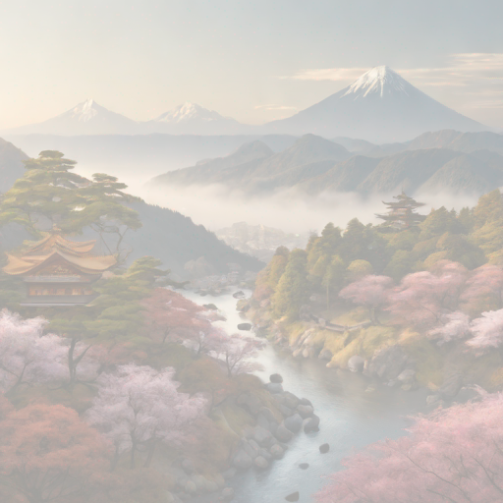
Introduction
Discover the beauty of Japan on your next vacation. From bustling cities to serene temples, Japan offers a unique blend of tradition and modernity. Are you ready to immerse yourself in the rich culture and stunning landscapes of this fascinating country?

Slide 2

Popular Destinations
1. Tokyo: Explore the bustling city life, visit the iconic Tokyo Tower, and indulge in authentic Japanese cuisine in the capital of Japan.

Slide 3

Cultural Experiences
Experience traditional tea ceremonies in Kyoto with a tea master guiding you through the rituals. Learn about the history and significance of this ancient practice. How does the serene atmosphere enhance the tea-drinking experience?

Slide 4
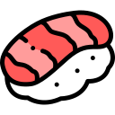
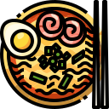
Cuisine
Japanese cuisine is diverse and delicious, featuring sushi, ramen, tempura, and more. Have you ever tried authentic Japanese dishes like sashimi or takoyaki? What makes Japanese cuisine unique compared to other cuisines around the world?

Slide 5



Transportation
Transportation in Japan is efficient and diverse, with options like Shinkansen bullet trains, local trains, buses, and subways. How can different transportation modes enhance your vacation experience in Japan?

Slide 6
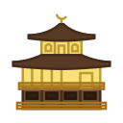

Tips for a Great Vacation
Plan ahead to make the most of your vacation in Japan. Research popular attractions, book accommodations early, and learn basic Japanese phrases for a smoother experience. What are some must-visit places in Japan? How can language barriers be overcome during the trip?

