Slide 1
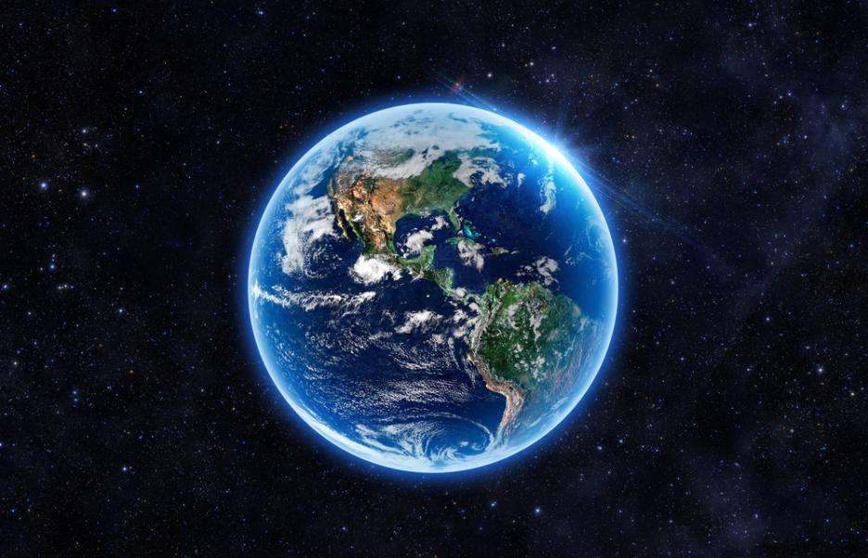
Saving the world – Trello board
https://trello.com/b/H7Si1VN8/saving-the-world

