Slide 1
Grandma’s Password Generator in Python
Evan Strait / Damian Borsiak
v 1.0 17/10/2022
Paris / France

Slide 2
Background
We were sad to learn that Grandma’s recent password to the Internet was hacked!
To help her in better securing her online accounts, we decided to create Strong Passwords Generator, based on below input coming from her (user):
1 word that is familiar to her (max 8 characters)
1 important year from her life (max 4 characters, in example 1989)
Based on above and with addition of some tasty coding spicing, we did MAGIC !!!

Slide 3
European Union password guidelines
Complexity requirements for "strong passwords" are based on the following rules:
The password is between 8-18 characters long
The password contains characters from 3 of the following 4 categories:
standard uppercase characters (A - Z)
standard lowercase characters (a - z)
numbers (0 - 9)
symbols: only from among ! % - _ + = [ ] { } : , . ? < > ( ) ;
The password does not contain your account name or any part of your full name
Source: https://eui.eu/ServicesAndAdmin/ComputingService/PolicyDocuments/StrongPasswordPolicy

Slide 4
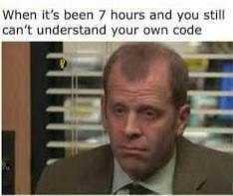
Algorithm we used
Automated check if input follow format
Randomised capitalisation of word letters
Alternation of the string following format:
1 letter of word
1 digit of number
1 additional special character (depending on the lengths of the word might be more by the end)

Slide 5
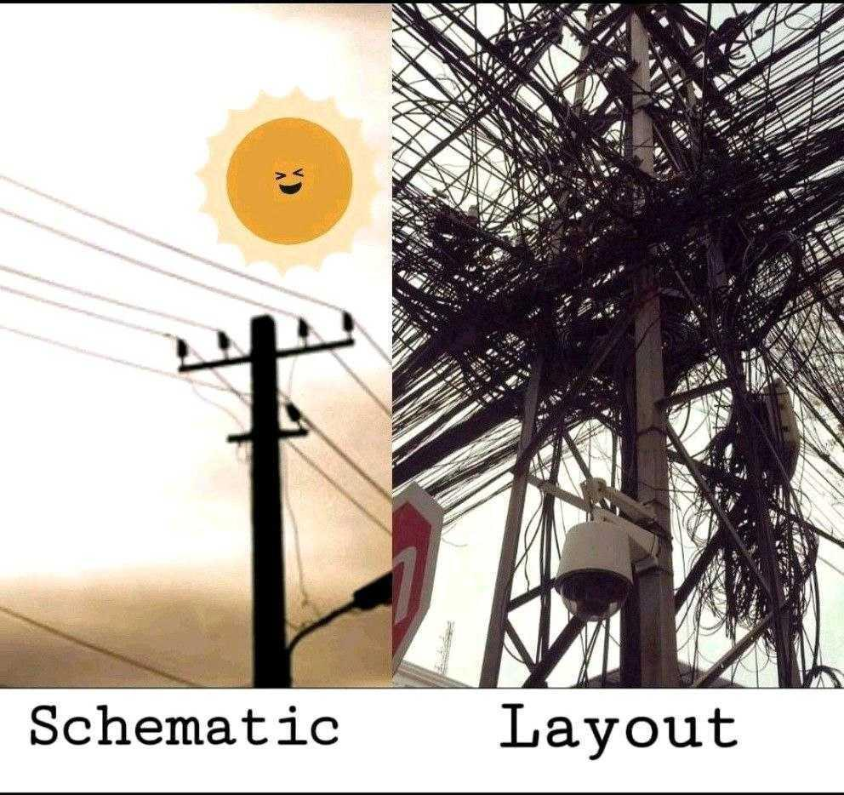
Input / Output
User INPUT:
Word : damian
Year : 1989
Python OUTPUT (password):
D 1 \ A 9 / M 8 : I 9 *a ? N < >

Slide 6
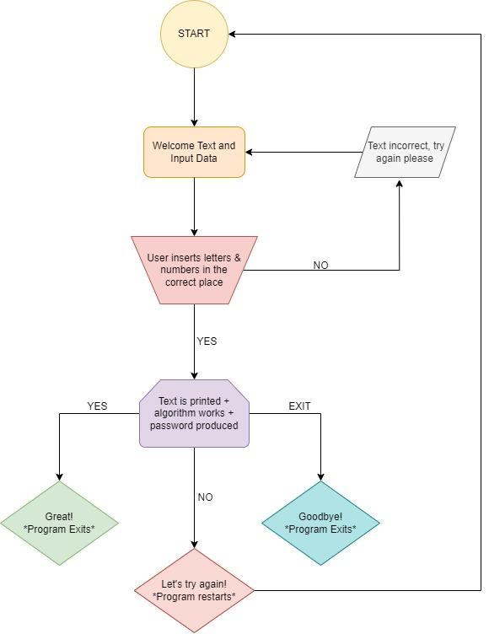

Slide 7
Pseudocode
User provide input of Word and Year
At the point of input, is.alpha and is.digit check if input is correct
If not correct, message asking to put correct data
After input is confirmed as correct
Our code capitalise random letters in the Word
We are adding new variable with special characters
Creation of 1 alternating string made up of Word+Year+special characters
Output: After Password is generate, 3 options for user to decide -> Yes, No, Exit

