Slide 1
Grandma’s Password Generator in Python
Evan Strait / Damian Borsiak
v 1.0 17/10/2022
Paris / France

Slide 2
Background
We were sad to learn that Grandma’s recent password to the Internet was hacked!
To help her in better securing her online accounts, we decided to create Strong Passwords Generator, based on below input coming from her (user):
1 word that is familiar to her (max 8 characters)
1 important year from her life (max 4 characters, in example 1989)
Based on above and with addition of some tasty coding spicing, we did MAGIC !!!

Slide 3
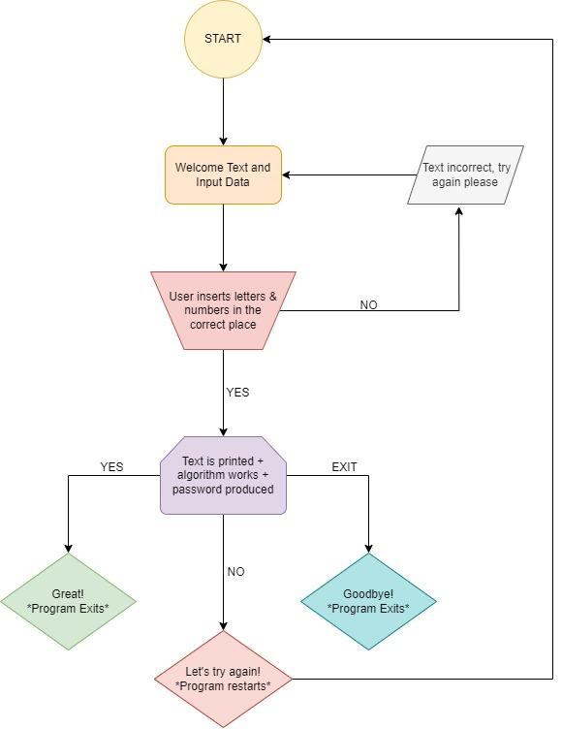
How does our code works?
User INPUT:
Word : damian
Year : 1989
Python OUTPUT (password):
D 1 \ A 9 / M 8 : I 9 *a ? N < >
Functions:
Automated check if input follow format
Randomised capitalisation of word letters
Alternation of the string following format:
1 letter of word
1 digit of number
1 additional special character (depending on the lengths of the word might be more by the end)

Slide 4
Pseudocode
User provide input of Word and Year
Our code capitalise

