Slide 1
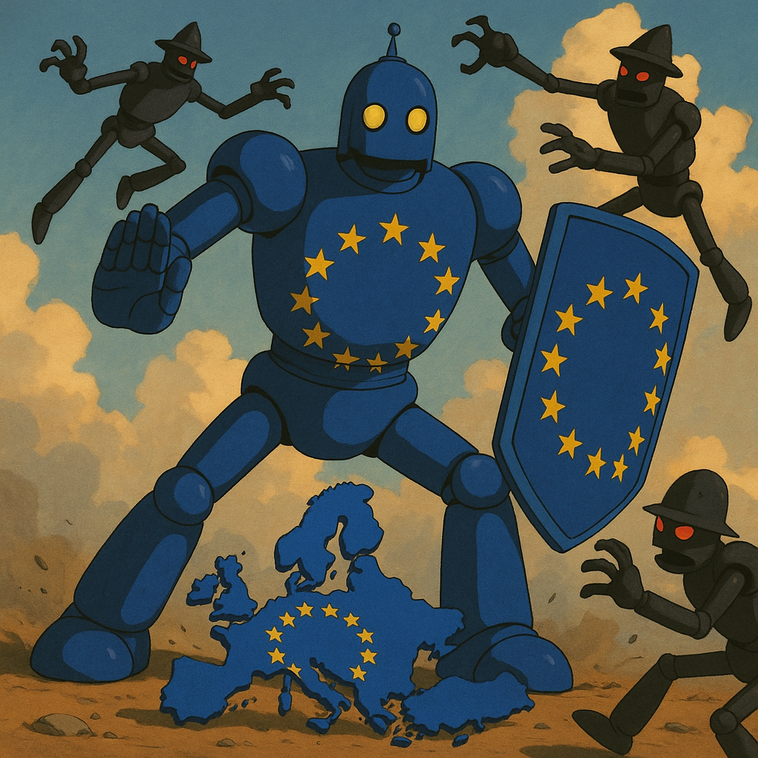
AI Code Guard
12h Agentic Hackathon June 24-25 Team “Guardians of the EU”
Jonathan Schiefer
Stefan Selariu
Filip Stankovic
Dennis Hilgert
Olaf Geibig

Slide 2


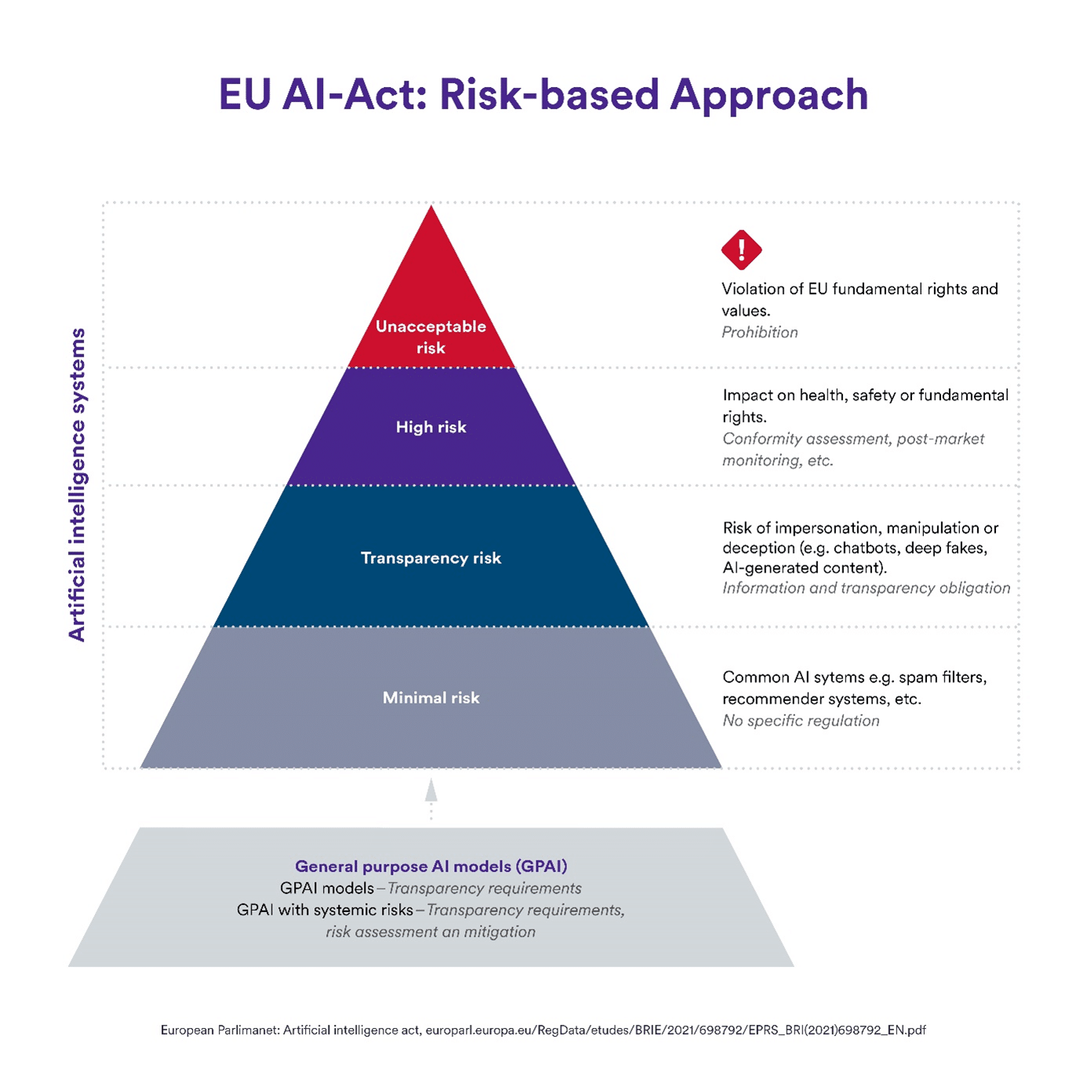
Is the EU AI Act relevant for the project?
Relevant?
The AI Act is based on abstract legal principles such as privacy and safety
Detailed policies within the AI Act translate these principles into concrete risks associated with specific AI use cases.
AI use cases are extracted from the source code and matched against the relevant policies.

Slide 3
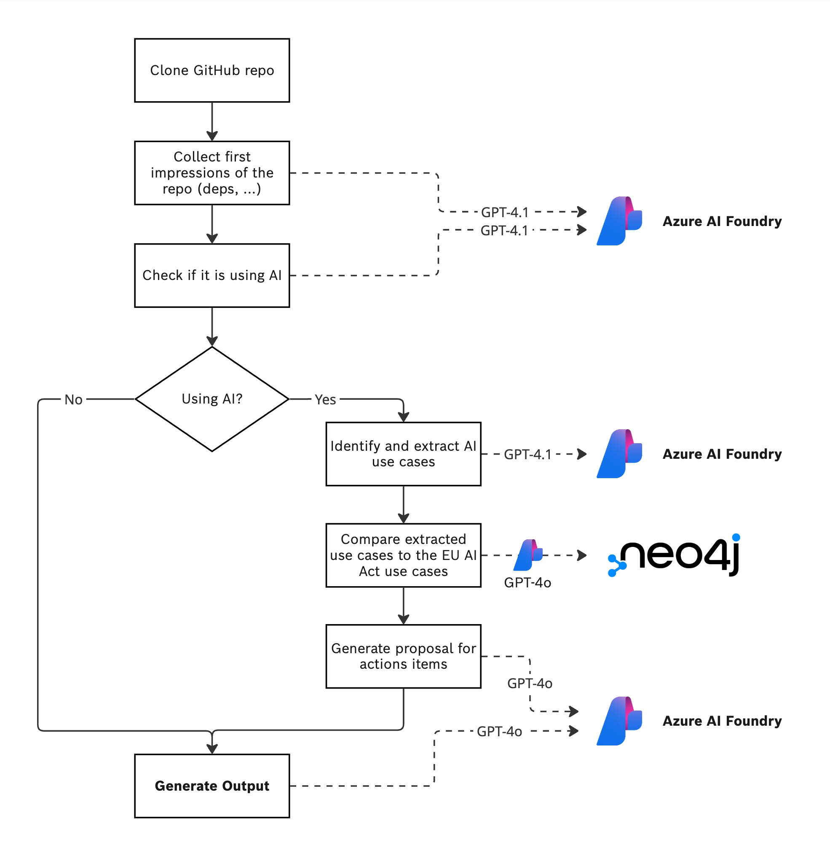
Process Flow

Slide 4
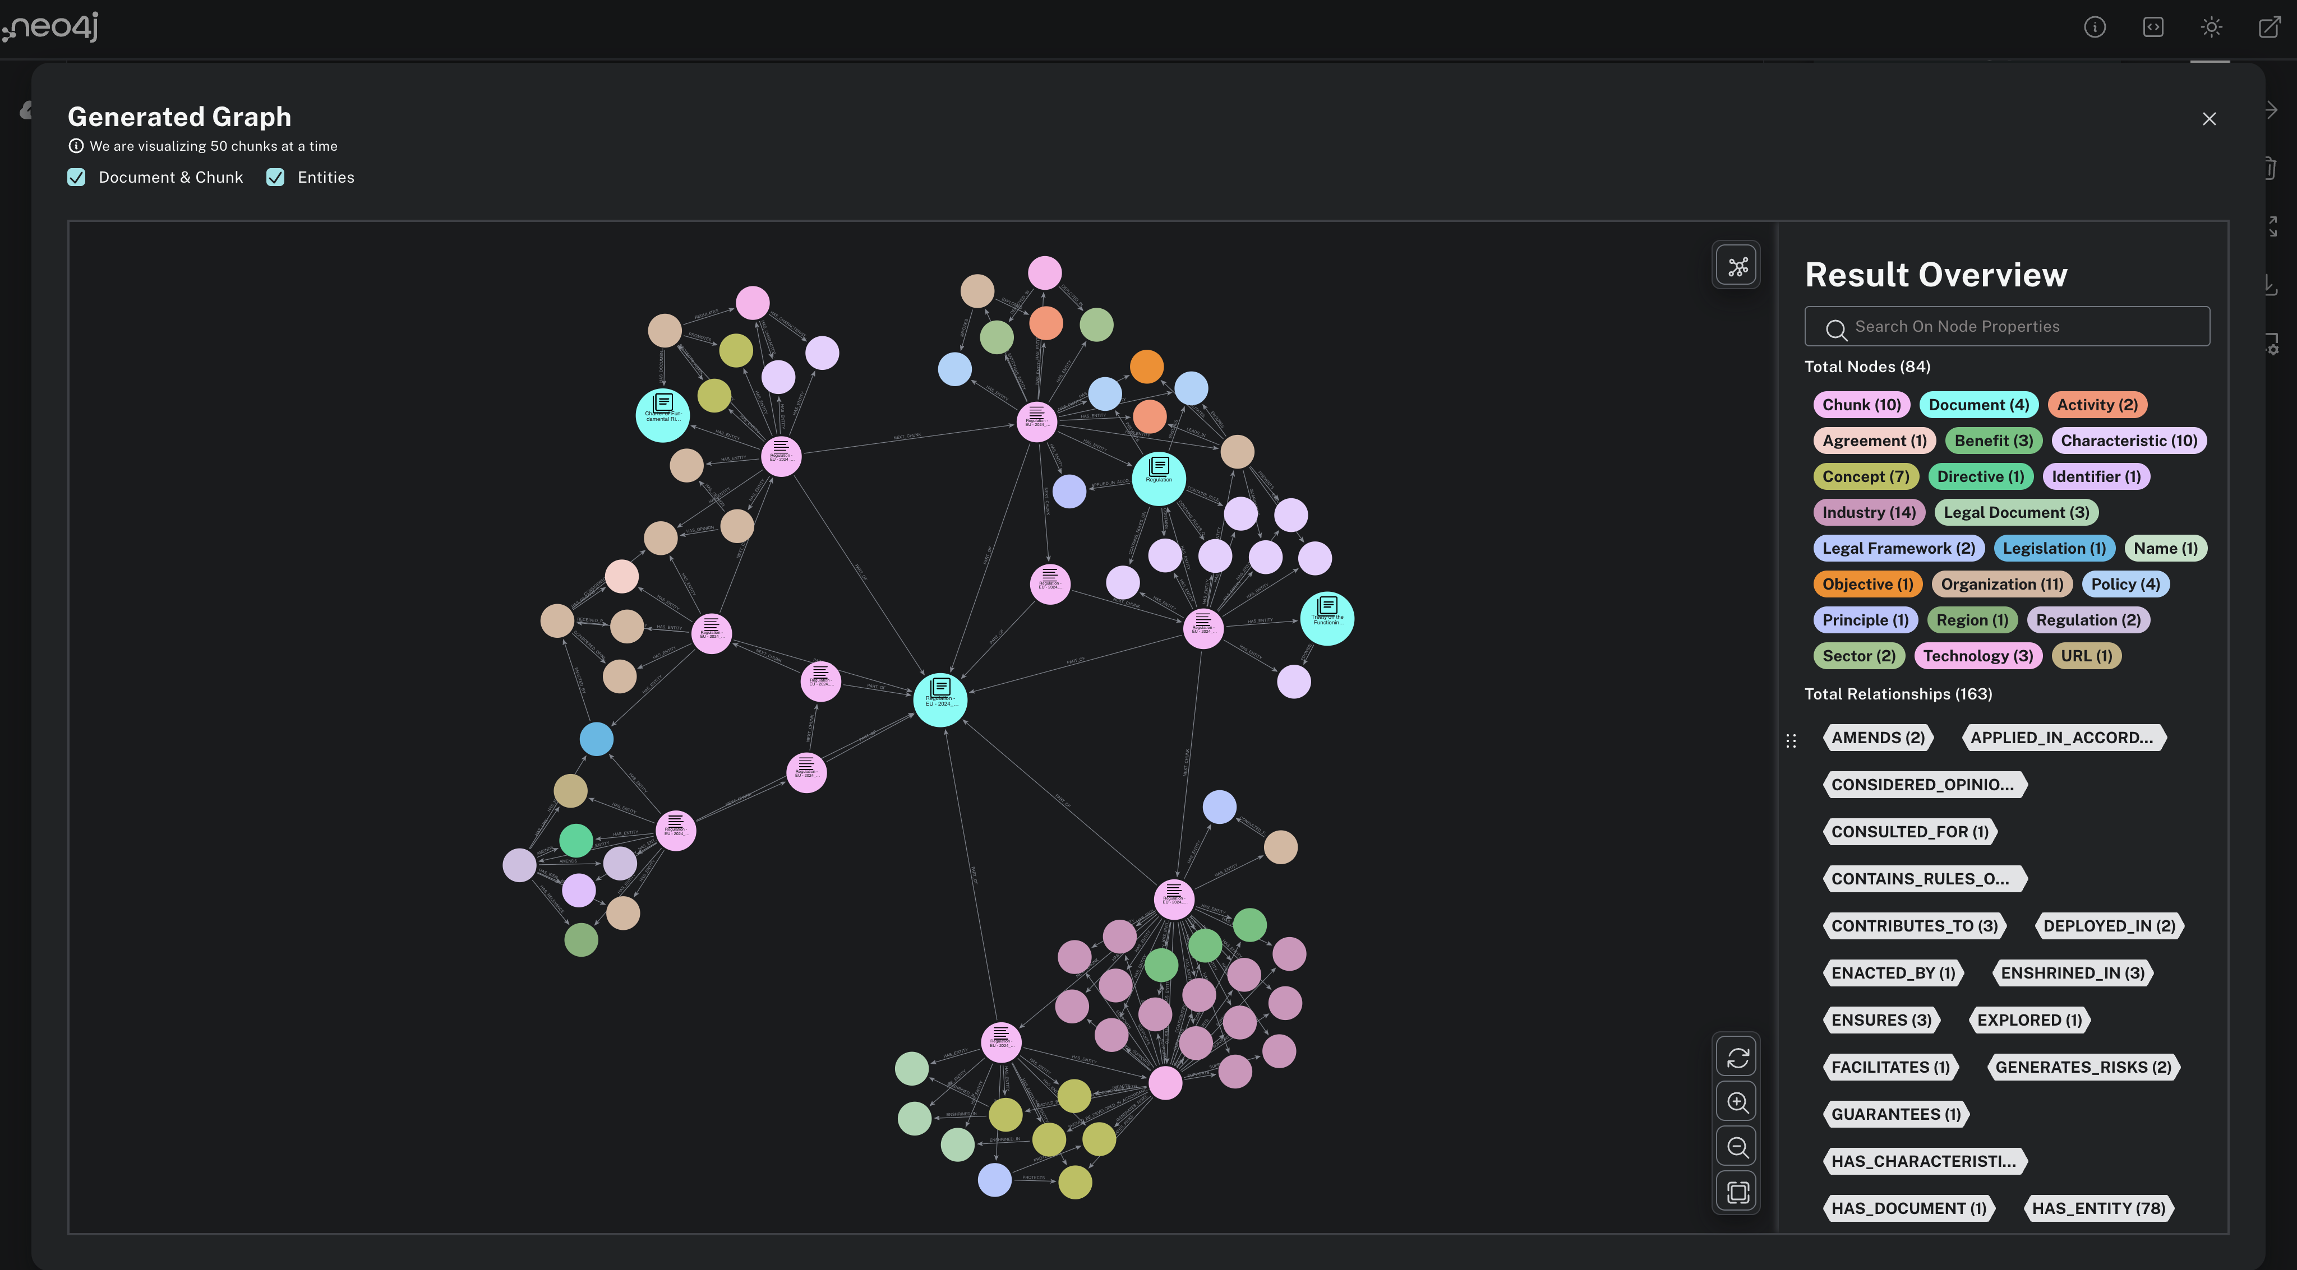

Slide 5
Backup-Slides

Slide 6
Coarse grained Concept
The AI Act is based on abstract legal principles such as privacy and safety
Detailed policies within the AI Act translate these principles into concrete risks associated with specific AI use cases.
These use cases are extracted from the source code and matched against the relevant policies.

