Slide 1

KKBOX Churn PREDICTION
CZ4041 Machine Learning Course Project
Huangfu Qingchuan
Xiong Hengjie
Zhang Yuance
Zhang Xinye

Slide 2
Agenda
Introduction
Datasets
Technical Challenges
Feature Engineering
Data Preparation/Cleaning
Relabelling
SMOTE(Address imbalanced datasets)
Modelling
Results
Future Extension
Conclusion
Notes:
TODO: Convert to diagram.

Slide 3


Introduction
Objective
Predict whether a user will ‘churn’ after the subscription expires
Evaluation Metrics
Log loss, L
L = (−1)/𝑁 ∑1_(𝑖=1)^𝑁▒〖(𝑦𝑖 𝑙𝑜𝑔(𝑝𝑖)+(1− 𝑦𝑖 )𝑙𝑜𝑔(1− 𝑝𝑖))〗
Notes:
Client: KKBOX is Asia’s leading music streaming service, supported by advertising and paid subscriptions.
Business Impact: Since the music streaming service providers are becoming more competitive， one of the major problem these companies are facing is customer retention. This predictive model aims to help the business by predicting the customers who are going to churn.

Slide 4
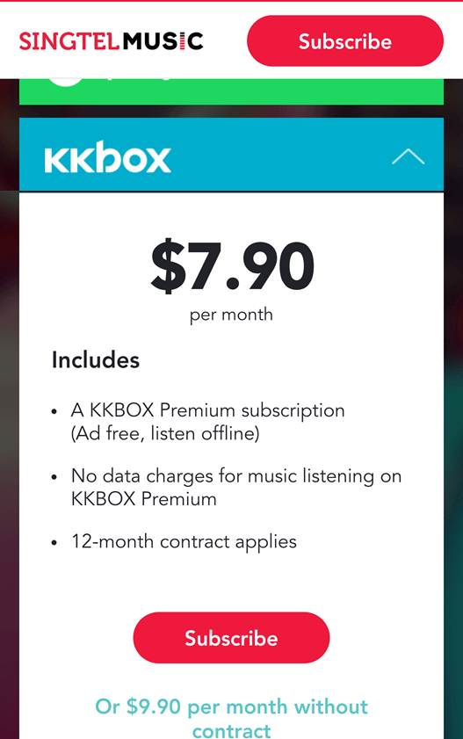
What is “churn”?
Dictionary definition: When users end their subscriptions to services.
KKBox’s subscription model: 30 days per period, users need to re-subscribe every month
“Churn” criteria: User chose not to re-subscribe 30days after the last subscription expires.

Slide 5
Datasets
Original datasets provided by Kaggle
train.csv: User ids (msno) and whether they have churned.
transactions.csv: Payment details till feb-2017.
transactions_v2csv: Payment details of march-2017.
members_v3.csv: User information.
user_logs.csv: User behaviors till feb-2017.
user_logs_v2.csv: User behaviors for the month march-2017.

Slide 6
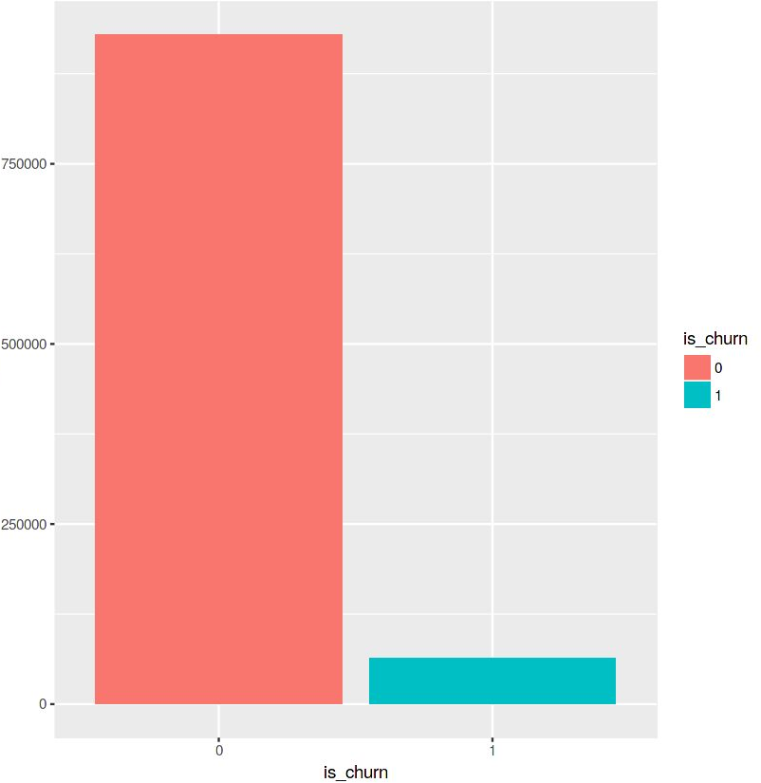
Technical Challenges
Highly imbalanced datasets churn/no churn rate is 1:15.5
Very Large Datasets
32G(2 user_logs files combined)
Challenging for data processing and model training due to limitations in computational resources
Careful data preparation needed for better efficiency.
Notes:
Imbalanced data – predictions lean towards not churn. (Do we consider this? Use methods like auto-encoder/SMOTE)

Slide 7
Technical Challenges (Cont’d)
Discrepancies in given data
Some users have multiple transaction and user log records
Missing values such as gender, transaction dates
Outliers/Anomalies
Data provided are contradictory to common sense
Birthday -> 1000 years old user
Amount paid: negative values
Transaction date: beyond the scope
Notes:
Data cleaning is hence needed.(Covered later)

Slide 8
Feature Engineering
 | Given | Added
User behaviour/information related | ‘num_unq_mean', ‘total_secs_mean’, 'count', 'city', 'bd', 'gender', 'registered_via', 'registration_init_time | num_25_mean', 'num_50_mean', 'num_75_mean', 'num_985_mean', 'num_100_mean’
Transaction related | 'payment_method_id’, 'payment_plan_days, 'plan_list_price’, 'plan_list_price’, 'actual_amount_paid’, 'is_cancel’, 'is_auto_renew’ | 'discount’, 'is_discount’ 'total_list_price’, 'transaction_span’, 'is_cancel_sum’, 'trans_count’, 'total_amount_paid’, 'difference_in_price_paid’ , 'amount_paid_perday’ , ‘last_is_churn’,’churn_rate’

Slide 9
Data Preparation/Cleaning
Use PySpark to process User_log files which significantly reduces the file sizes and therefore memory required
Use lambda expressions to ‘correct’ non-sensible data
Use Pandas ‘fillna’ method to address empty and NaN blocks
Label Encoding & Changing data-types: We are changing the data types of the features making sure the categorical features and continuous features are converted to category, integer & float respectively.
Data Splitting: Finally, before building the machine learning models the dataset is split into ‘train’ and ‘test’ sets. Here we have split the train and test sets in 80:20 ratio.

Slide 10
Relabelling
When studying the training set, we found about 14000 users who were apparently renewal, yet labelled as churn incorrectly
User/msno | Transaction Date | Expire Date | is_cancel
A | 2017/01/09 | 2017/03/09 | 0
A | 2017/03/07 | 2017/04/08 | 0
A | 2017/03/28 | 2017/07/07 | 0
User/msno | Is_churn
A | 1/Yes

Slide 11
SMOTE(Address imbalanced datasets)
Synthetic Minority Oversampling (SMOTE) works by creating synthetic observations based upon the existing minority observations.
Since our dataset is highly imbalanced, we applied SMOTE on the training set.
At a high level, SMOTE creates synthetic observations of the minority class (Churn-users) by:
1.Finding the k-nearest-neighbours for minority class observations (finding similar observations)
2.Randomly choosing one of the k-nearest-neighbours and using it to create a similar, but randomly tweaked, new observation.

Slide 12
Modelling/Stacking
XGBoost
CatBoost
LightGBM
Paralleled XGBoost
5-fold stacking XGBoost model
Model Ensemble
Weighted average ensemble of 3 base models
Parameter Tuning

Slide 13
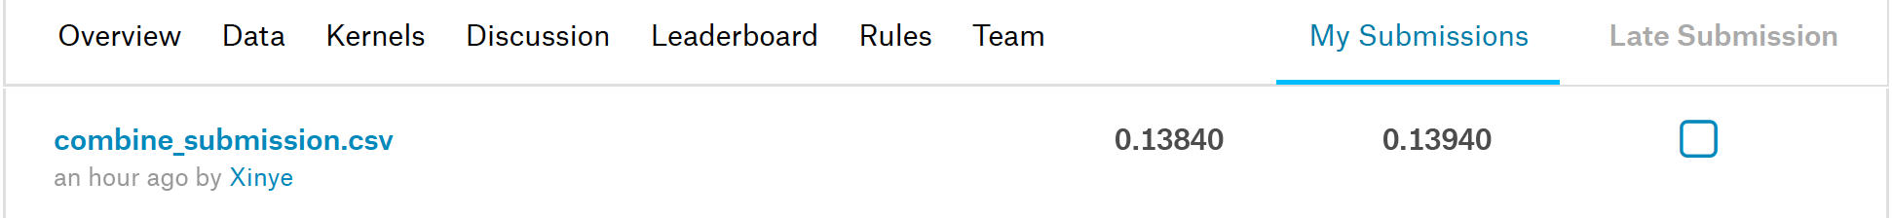
Result
Current Log Loss: 0.138(Private) 0.139(Public)
146/575 (25.3%)

Slide 14
Future Extension/Improvements
Data Augmentation
Parameter optimization
Further data cleaning
Non- linear features – Denoising Auto-encoder
Additional feature engineering

Slide 15

Conclusion
Features are key
Data may not be very accurate
Preprocessing is equally important
Exposure to common ML models

Slide 16
Q&A
Thank you!

