Slide 1

Laravel
Vineet Maurya
23000068, BCA-B

Slide 2
What is laravel
Application framework
Built on top of PHP
Composer for package management
Blade for server-side templates
Eloquent ORM for database

Slide 3
Why laravel
Elegant and expressive syntax
Removes boilerplate, simplifies development
Pre-built components, libraries, tools
Routing, authentication, caching, session management built-in
Notes:
Elegant and expressive syntax
Simplification to allow focus on development and removing boilerplate
Provides pre-built components, libs and tools to avoid starting from scratch
Provides routing, auth, caching, session

Slide 4
Advantages
Architecture (MVC) promotes separation of concerns for scalability and maintainability
Large extensions ecosystem for development (Laravel Bundles)
Modern tooling
Vibrant community
Notes:
MVC (Model-View-Controller) arch, promoting separation of concerns for scalability and maintainability reasons
Large ecosystem of extensions (Laravel Packages/Bundles)
Vibrant community
Modern tooling (Eloquent ORM, Blade templates, Artisan CLI, testing utilities)

Slide 5
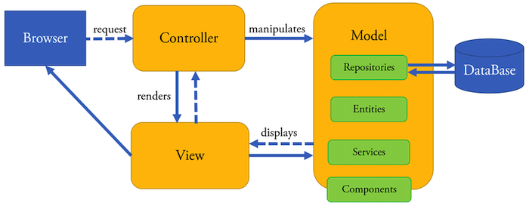
MVC Architecture
Model
Data Classes, DB Interactions
Business Rules
View
PHP/Blade Templates
Controller
User requests, Inputs
HTTP Requests
Notes:
Model:
Data & Business logic
--
DB interaction, data access, data manipulation, data validation
Classes/Models: DB Tables (CRUD, Business rules)
View:
Data presentation (HTML/CSS/JS for UI)
--
Plain PHP/Blade templates (Dynamic, reusable)
Controller:
Intermediate between Model & View
Handles user requests, processes inputs
--
Responsible for HTTP requests

Slide 6
Why MVC
Separation of Concerns
Code Reusability
Scalability and Maintainability
Easy Testing
Notes:
Separation of Concerns: MVC promotes a clear separation of concerns. Models handle data manipulation, Views handle presentation logic, and Controllers manage the application flow. This separation enhances code organization, readability, and maintainability.
Code Reusability: Each component in MVC can be developed independently. Views can be reused with different Controllers, and Models can be used across various application parts. This reusability reduces duplication and enhances efficiency.
Scalability and Maintainability: By separating components based on their roles, MVC makes applications easier to maintain and scale. Changes in one component (e.g., updating the database schema in the Model) don't directly impact other components.
Supports Testing: The separation of concerns facilitates unit testing. Developers can independently test Models, Views, and Controllers, ensuring each component functions correctly.
Example:
Model:
namespace App;
use Illuminate\Database\Eloquent\Model;
class User extends Model
{
public function posts() {
return $this->hasMany(Post::class);
}
}
View:
<!-- resources/views/users/show.blade.php -->
<h1>User Profile</h1>
<p>Name: {{ $user->name }}</p>
<p>Email: {{ $user->email }}</p>
Controller:
namespace App\Http\Controllers;
use App\User; use Illuminate\Http\Request;
class UserController extends Controller
{
public function show($id) {
$user = User::find($id);
return view('users.show', ['user' => $user]);
}
}

Slide 7
Setup
Done using Composer
Create:
composer create-project --prefer-dist laravel/laravel laravel-project
php artisan key:generate
Dev server
php artisan serve

Slide 8
Directory Structure
resources
views
routes
storage
tests
vendor
app
console
exceptions
http
jobs
listeners
mail
models
notifications
policies
providers
rules
traits
bootstrap
config
database
migrations
seeds
public
Notes:
app: This directory is the heart of your application. It contains folders like:
- Console: Contains artisan commands.
- Exceptions: Manages exception handling.
- Http: Contains controllers, middleware, form requests, and route definitions.
- Models: Houses your application's data models.
- Providers: Manages service providers.
bootstrap: This directory holds the files responsible for bootstrapping the Laravel application and loading the necessary components.
config: Contains configuration files for different parts of your application, such as database connections, cache settings, and more.
database: Houses the database-related files:
- migrations: Contains database schema changes using migration files.
- seeds: Holds seed files to populate the database with test data.
public: The entry point of your application. This folder contains the index.php file and publicly accessible assets like CSS, JavaScript, and images.
resources: This directory stores non-PHP resources like views, language files, and frontend assets:
views: Contains the Blade templates for your application's UI.
lang: Holds language files for internationalization.
routes: Contains route definitions for your application, organizing how HTTP requests should be handled.
storage: Holds temporary files generated by your application, including logs, cache, and session files.
tests: Contains test cases for your application.
vendor: This directory holds Composer dependencies, including the Laravel framework itself and other libraries/packages used in your project.
app:
Console: Contains artisan commands and console-based functionality.
Exceptions: Houses custom exception classes.
Http: Contains the controllers, middleware, and form requests for handling HTTP requests.
Jobs: Stores queued job classes.
Listeners: Holds event listener classes for handling events and broadcasting.
Mail: Contains classes responsible for building and sending emails.
Models: The home for Eloquent model classes that represent database tables.
Notifications: Contains classes for defining notification messages.
Policies: Holds policy classes for handling authorization.
Providers: Contains service providers that bootstrap and configure various aspects of the application.
Rules: Stores custom validation rule classes.
Traits: A place for reusable traits that can be applied to multiple classes.

Slide 9
Model/Database
Uses an Active Record design pattern
Each model class represents a table
Implemented as the Eloquent ORM
Create migration
php artisan make:migration <table_name>
Apply migration
php artisan migrate
Create model
php artisan make:model <model_name>
Notes:
Active Record is a design pattern that provides an object-oriented interface for accessing and manipulating data stored in a database. This pattern encapsulates the business logic of an application within the model, allowing developers to interact with the database using a simple and intuitive API. Laravel's Eloquent ORM (Object-Relational Mapping) is an implementation of the Active Record pattern.
Model Representation
In Active Record, a model class represents a table in the database. Each instance of the model class corresponds to a record in the table.
CRUD Operations
Active Record simplifies database interactions by providing methods for Create, Read, Update, and Delete operations. Models typically have methods like create, find, update, and delete for these operations.
Relationships
Active Record simplifies handling relationships between tables. Eloquent models define relationships such as one-to-one, one-to-many, and many-to-many using methods like hasOne, hasMany, belongsTo, etc.
Validation
Active Record models often include validation rules. Laravel's Eloquent allows you to define validation rules for model attributes.
In the Laravel, Eloquent Models stand as the backbone of database interaction, providing an elegant and expressive way to interact with databases. Eloquent Models serve as an abstraction layer between your application and the database. They represent tables in your database, allowing you to interact with the data in a highly intuitive and object-oriented manner. With Eloquent, the tedious tasks of writing raw SQL queries and managing database connections are replaced with a clean, expressive syntax.
Eloquent Models are typically placed in the app/Models directory by convention. However, it's important to note that you are not strictly required to follow this convention, and you can customize the location if needed.

Slide 10
Views/Templates
Uses Blade templates (*.blade.php) by default
Has directives to implement control structures
@section, @show, @yield, @extends, @include, @for, @foreach, @if, @else
Notes:
Views in Laravel serve as the user interface components of your web application. They allow you to organize and display information to the user. Blade, Laravel's templating engine, makes the process of creating these views both efficient and clear. Blade files typically have a .blade.php extension, and they are stored in the resources/views directory. The template can be used in the controller by view helper.
@extends('layouts.app')
@section('content') <p>This is the content of the child view.</p> @endsection
@foreach($users as $user) <p>{{ $user->name }}</p> @endforeach
@if($condition)
<p>Condition is true.</p>
@elseif($anotherCondition)
<p>Another condition is true.</p>
@else
<p>Neither condition is true.</p>
@endif

Slide 11
Controller
Handles incoming HTTP requests and manages application logic to return a response
Create
php artisan make:controller UserController
Fields are populated automatically
Notes:
In the context of the Laravel PHP framework, a controller is a class that handles the incoming HTTP requests and manages the application's logic to produce an appropriate HTTP response. Controllers act as an intermediary between the model (which represents the data and business logic) and the view (which displays the user interface).
namespace App\Http\Controllers;
use Illuminate\Http\Request;
class UserController extends Controller {}

Slide 12
Routing
Defined in routes/web.php
Expresses mapping between a route and a closure/method
Can optionally be named to allow easier access
Notes:
Show the named route as the URL in the view template:
<a href="{{ route('users') }}">Go to Users Page</a>
Also, you can use your named route in the controller. After fulfilling some operation in the action, we can redirect the user to the "users" route:
public function update() {
// performing some update operations and then
return redirect()->route('users');
}

Slide 13
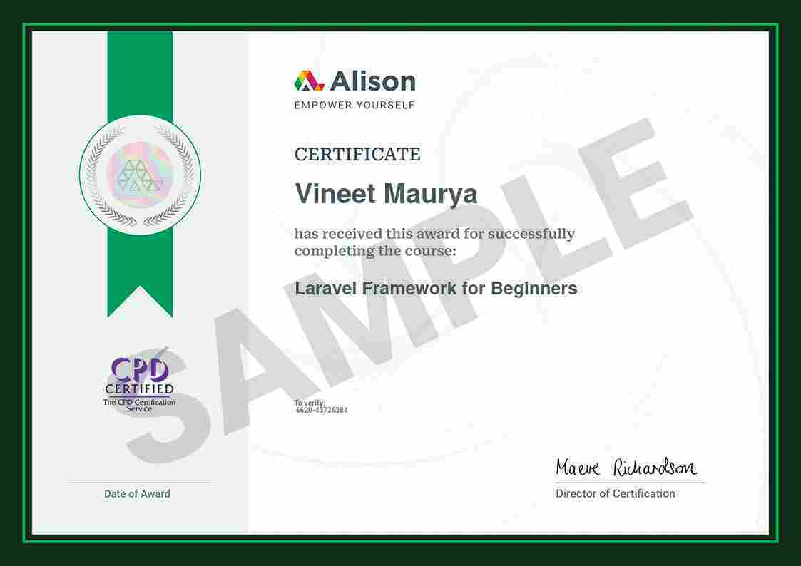

Slide 14
Thank You

