Slide 1

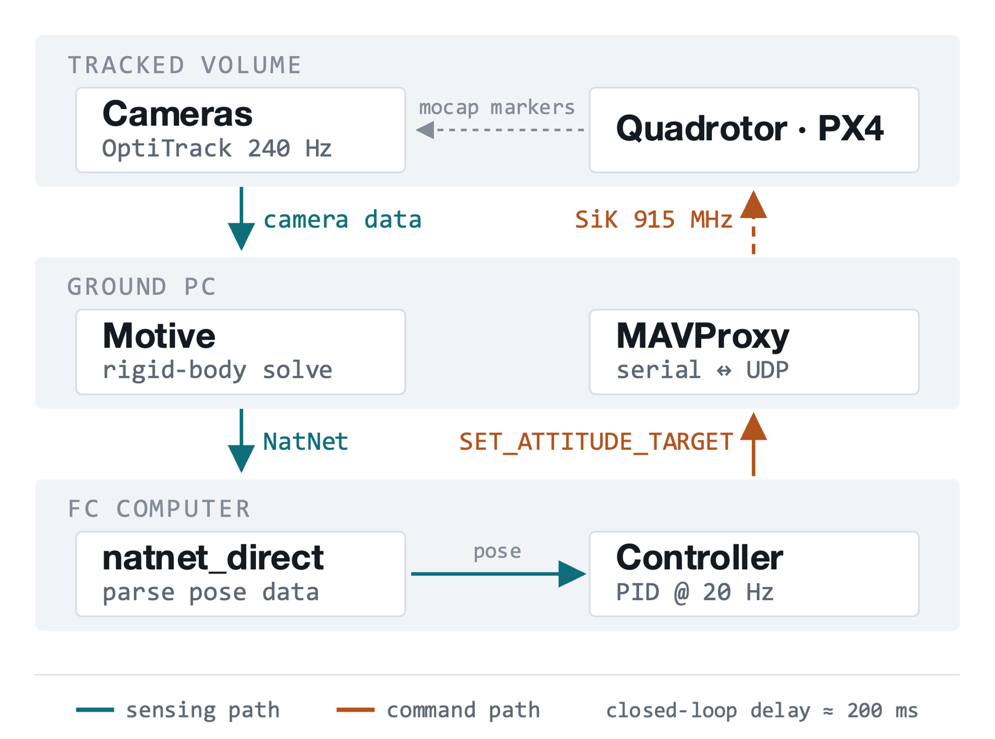
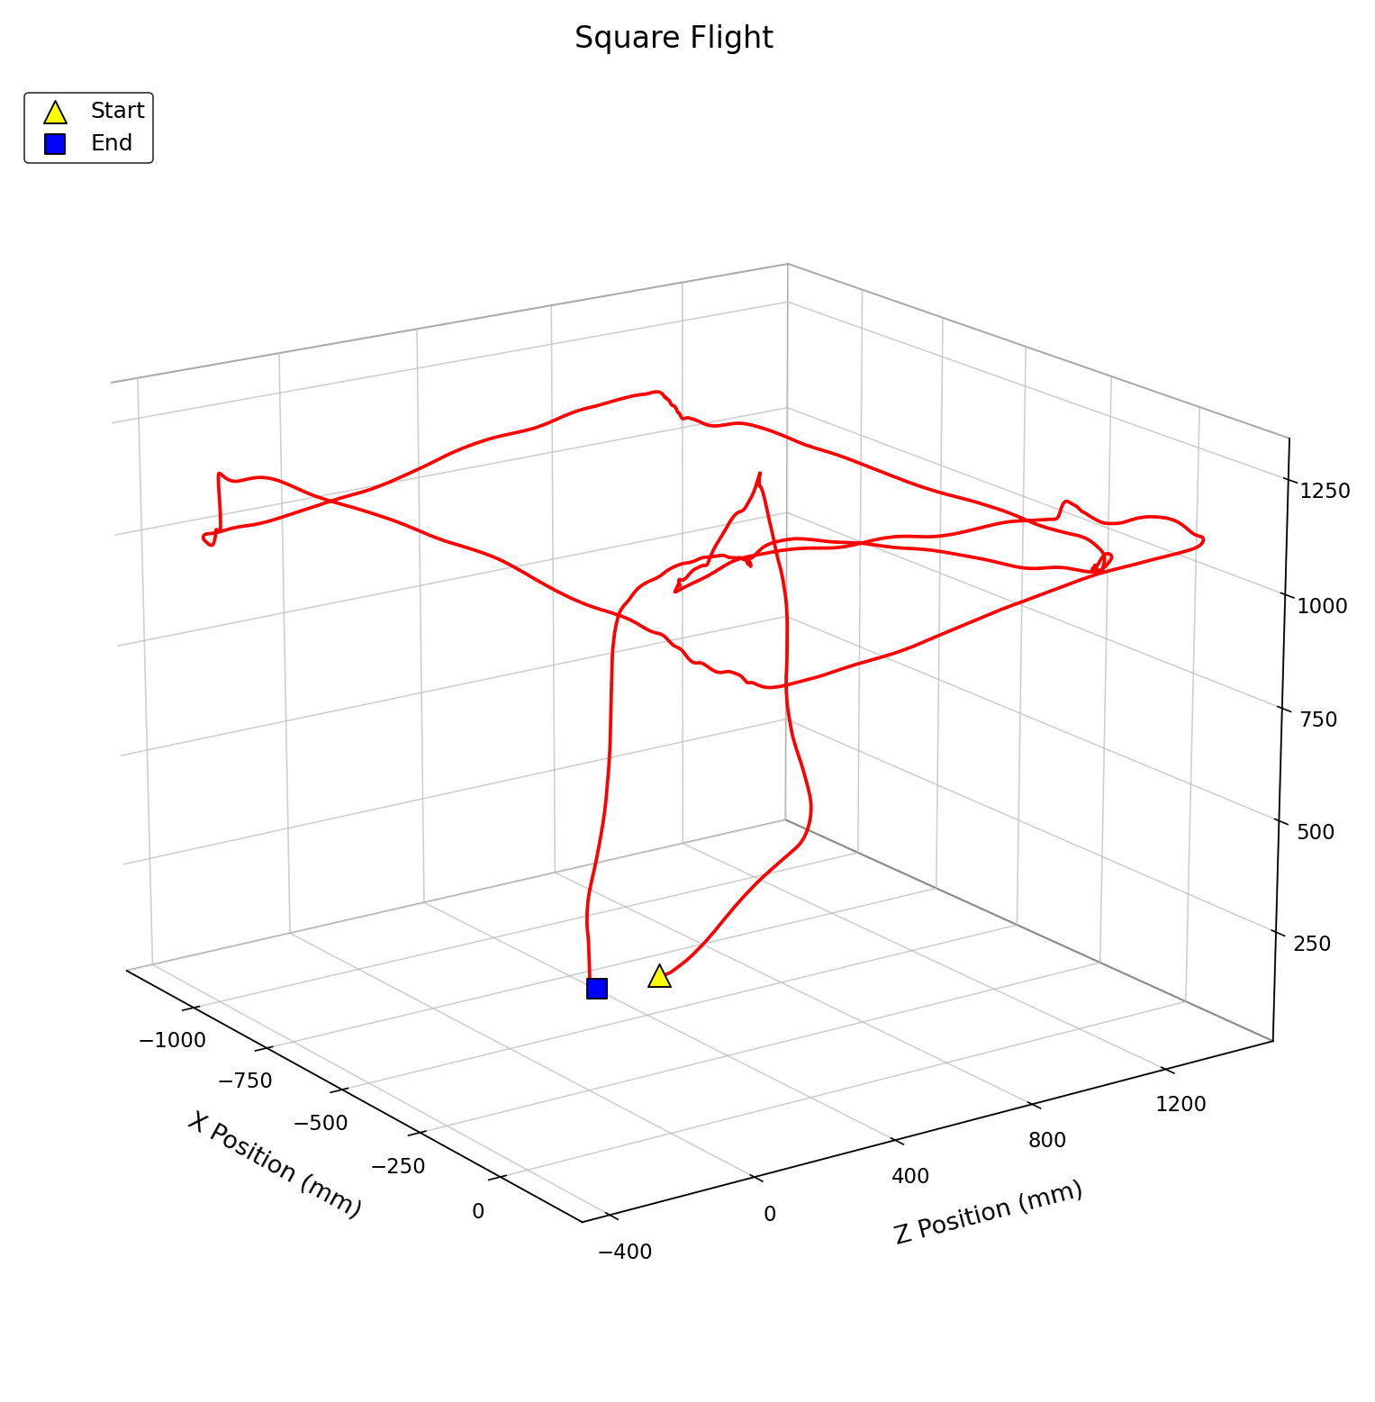
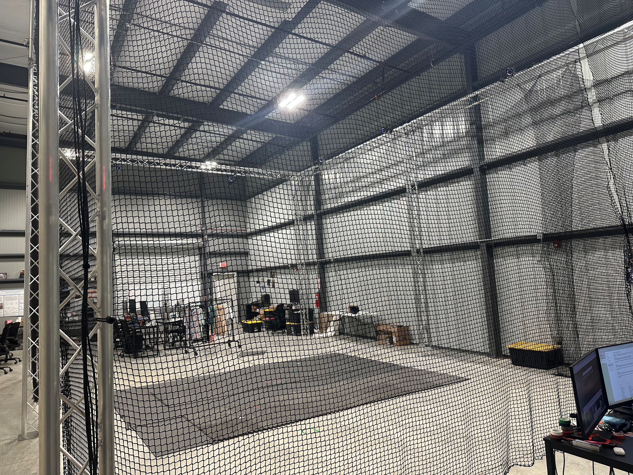
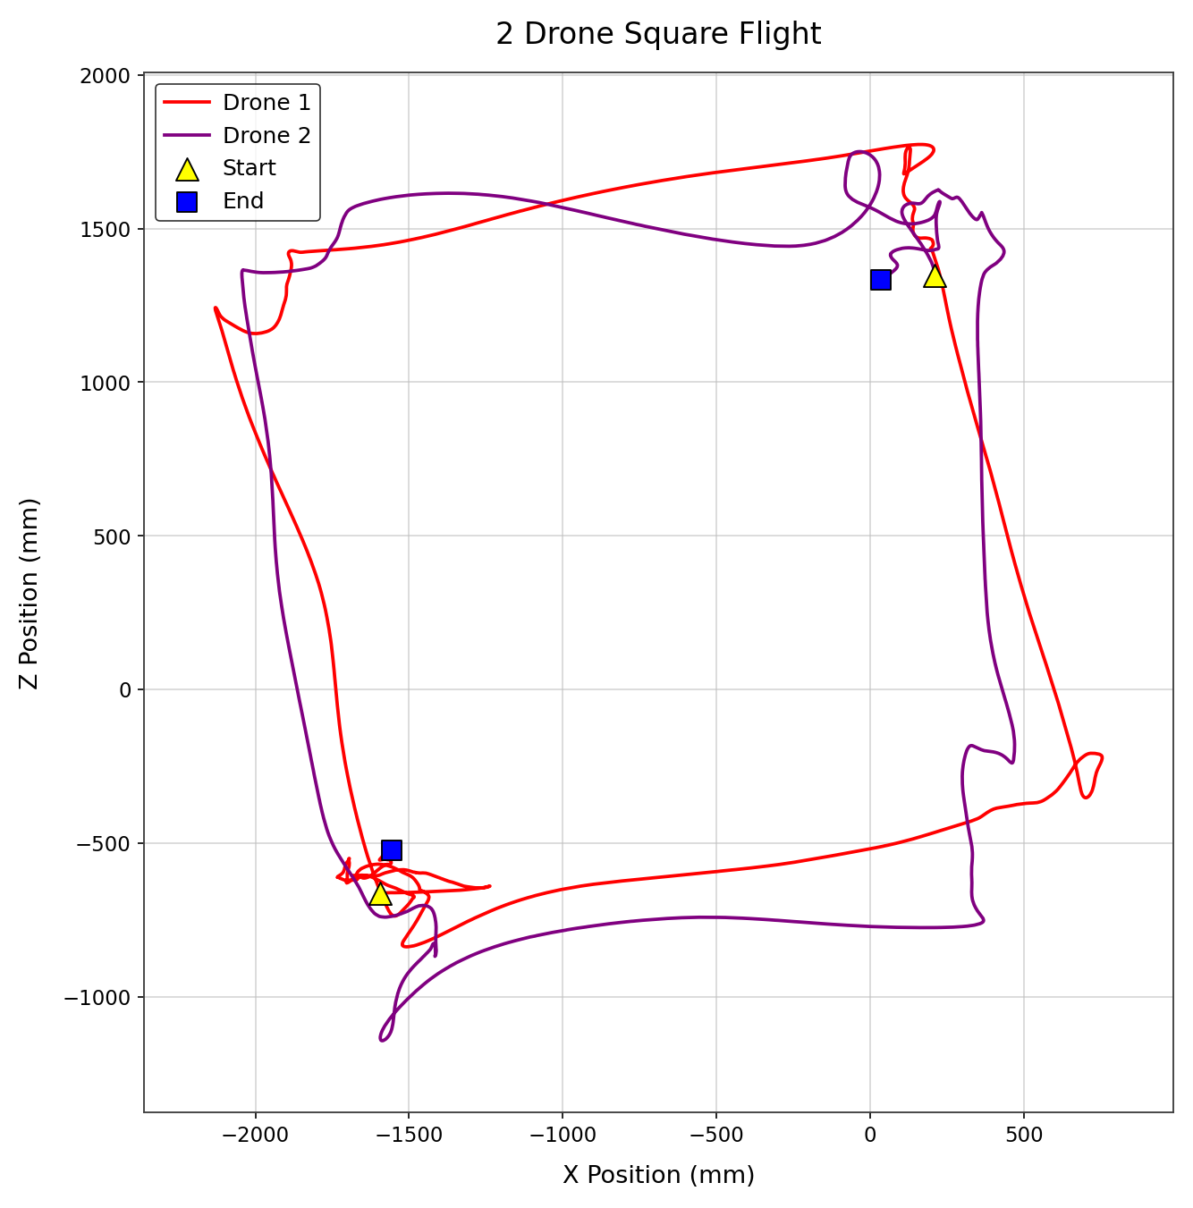
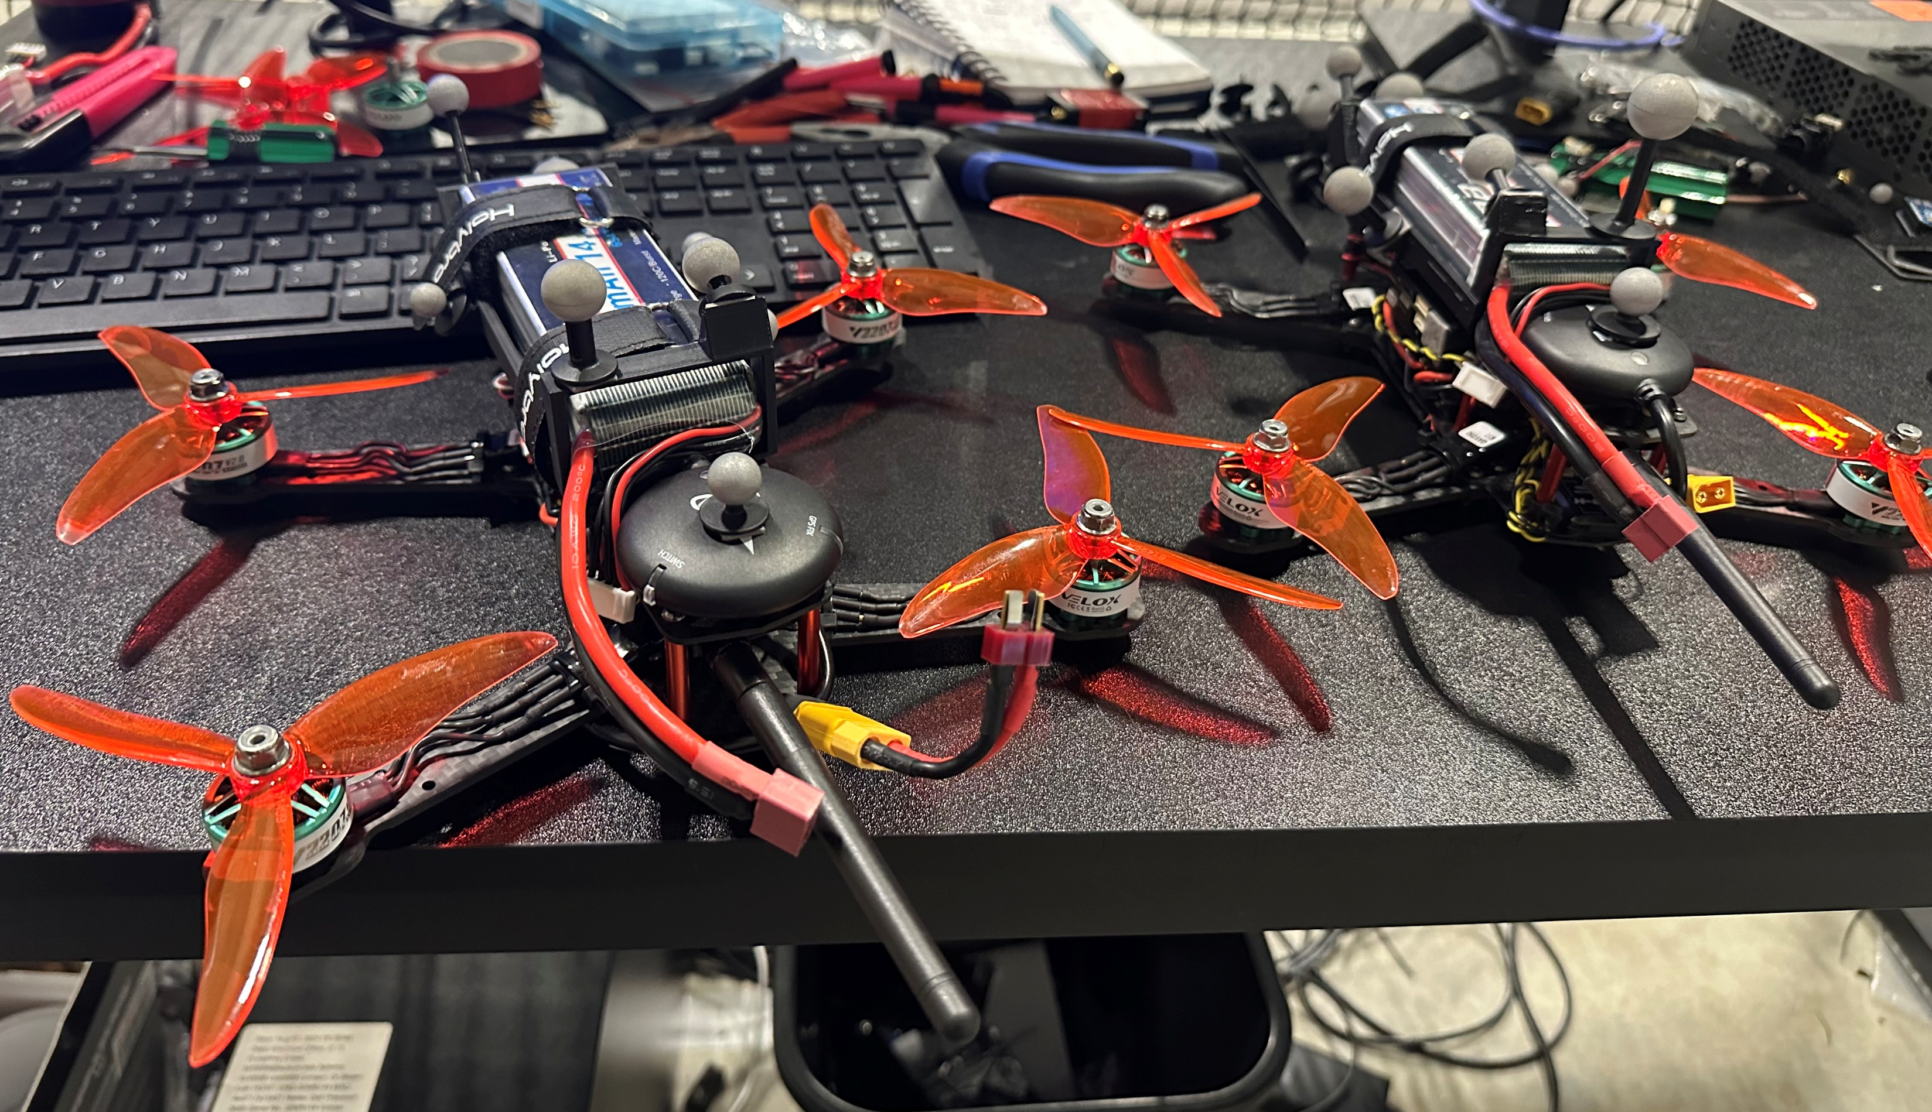
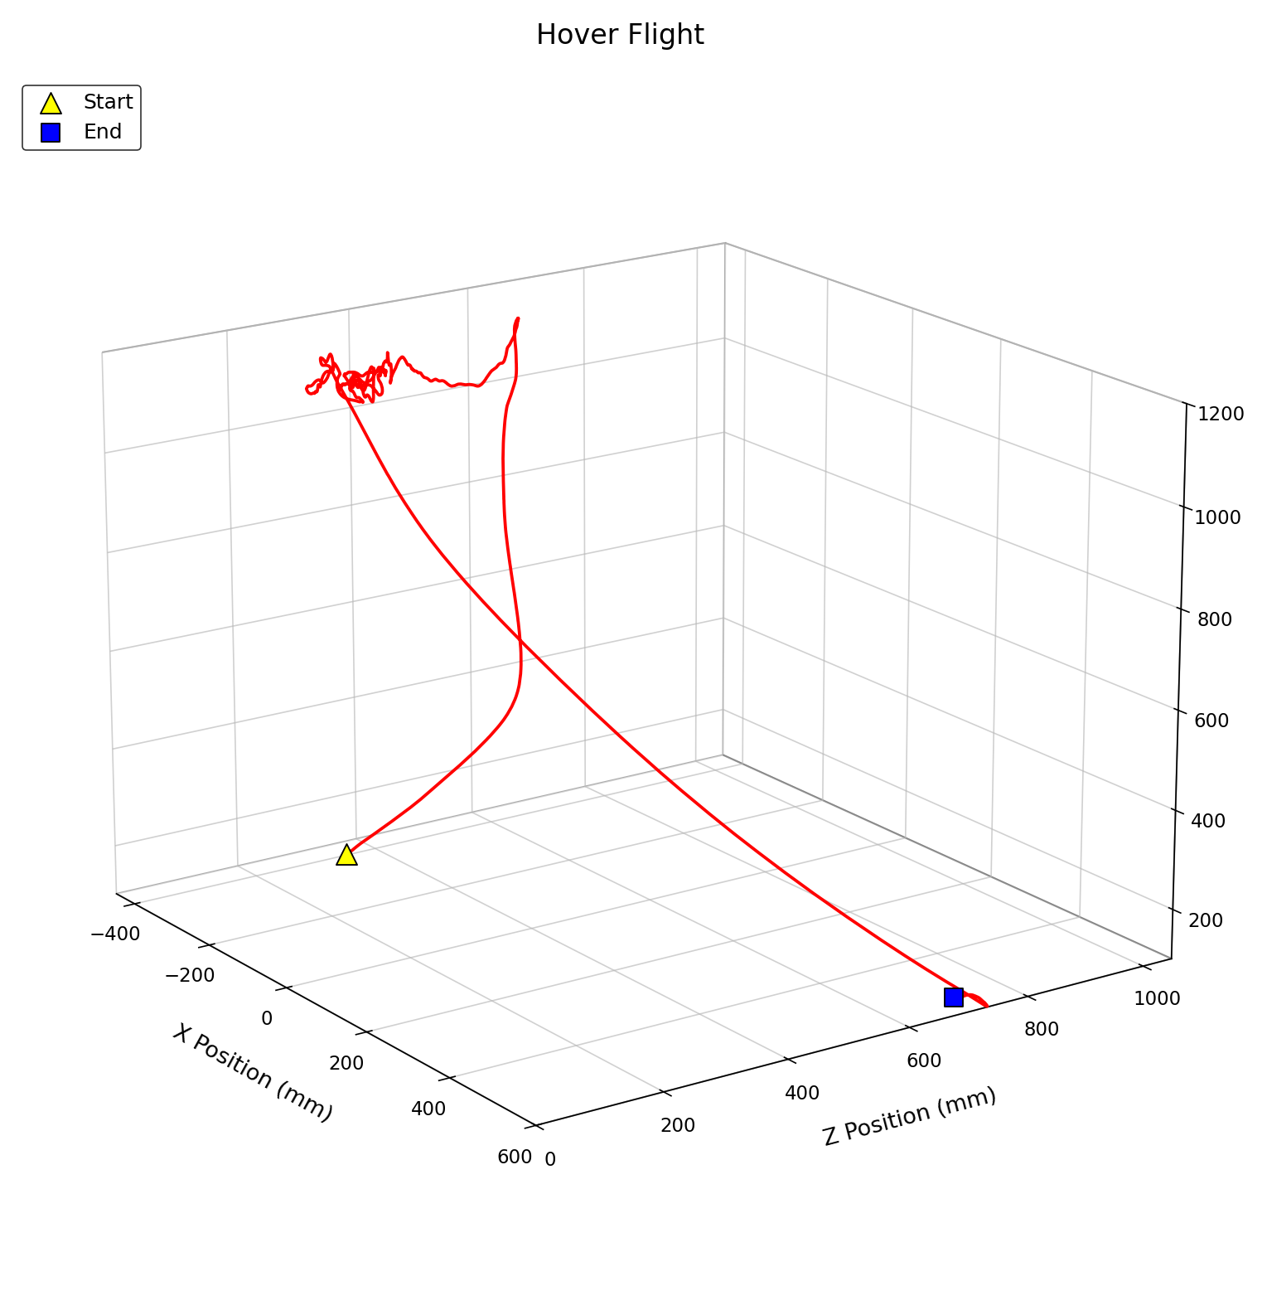
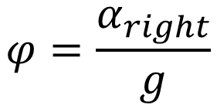
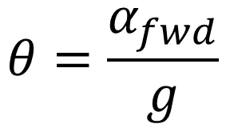
Autonomous Drone Collaboration Control
Colin Bucey and Dr. Bosen Lian
Department of Electrical and Computer Engineering, Auburn University
Abstract
System Architecture
Flight Paths
Multirotor drones rely on GPS to know where they are. Indoors that signal is unavailable, so a stock flight controller has no position estimate and cannot hold a location, follow a path, or recover itself if the pilot lets go. This collaboration with another student was to remove that limitation for the lab's aircraft by using an OptiTrack motion-capture system as the position source for indoor flight. That capability enables autonomous task flights and flying multi-drone formations.
The drone flies a commanded square path. Each straight leg is anchored to the drone's actual position and glides between corners with a smooth velocity profile.
With a second drone operational, both fly a commanded square flight together. The size of the square is based off the initial position of the drones.
Fusing motion capture into the drone's onboard estimator because the estimator was never designed to run without GPS. Running the position loop off-board sidesteps that estimator completely, so mocap truth drives the aircraft directly.
Position Hold Results
The best flights held stable within ±65 mm in altitude and laterally. The hover held for ~30 seconds and ended only when the safety pilot chose to take over to land.
Control Approach
Due to the onboard flight controller’s IMU bias, an offboard controller was added to ensure a correct flight. These equations are used to estimate that offset.
Safety Design
Landing Trips:
Drone tries to enter a corner when another drone is occupying and haven’t left it.
If any drone doesn’t enter corner during square flights
Any drone gets within 0.8 m of another drone
Any drone goes above 2.5 m in altitude
OptiTrack or MavProxy lose connected to any drone
$$θ=\frac{α_{fwd}}{g}$$
$$φ=\frac{α_{right}}{g}$$
$$i_{x0}=g(δ_{fwd}cosψ−δ_{right}sinψ)$$
$$i_{y0}=g(δ_{fwd}sinψ+δ_{right}cosψ)$$

