Slide 1
Clasificator de imagini
Bosie Ionut-Andrei

Slide 2
Descrierea problemei
Avem un set de date cu pozele a doua persoane.
Vrem sa le distingem.

Slide 3
Metode:
Neural network((stochastic) gradient descent)
Regresia logistica(newton, gradient)

Slide 4

Neural network
W
b
V
c
P
d
…
…
…
POZE
64x64 px
INPUT
4096 neuroni
STRAT 1
128 neuroni
STRAT 2
64 neuroni
OUTPUT
1 neuron

Slide 5
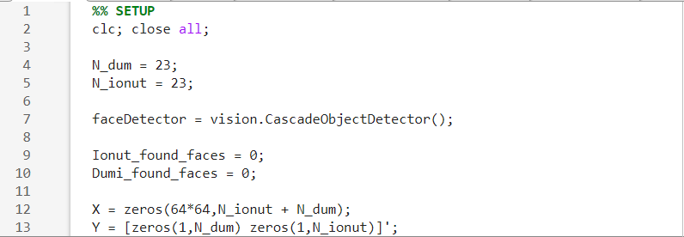
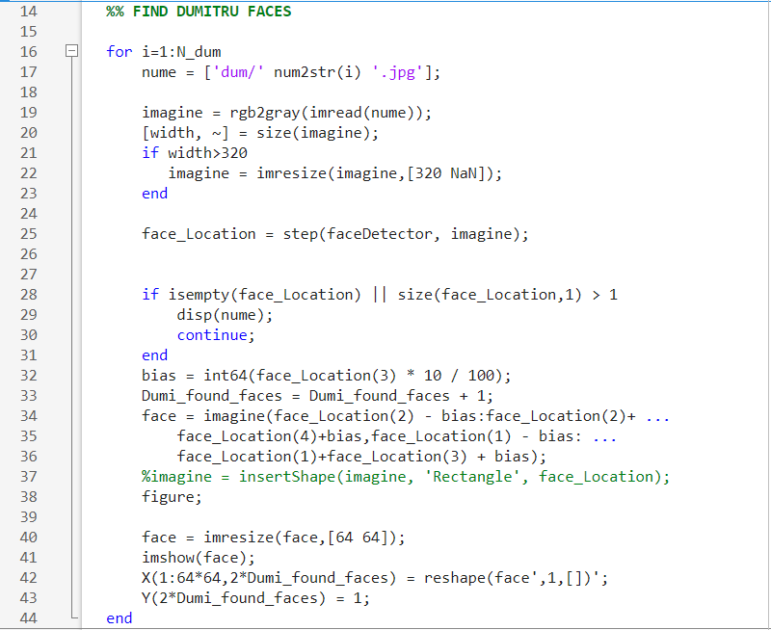
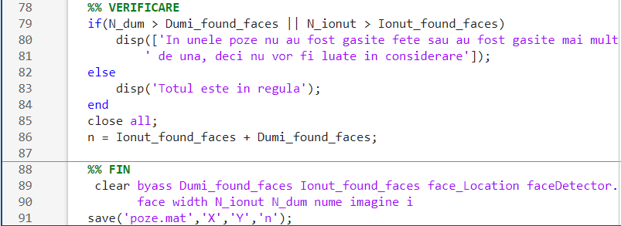
Preparare date intrare

Slide 6

Forward Propagation
${output}_{i}={sigmoid(w}_{i,1}x_{1}+w_{i,2}x_{2}+w_{i,3}x_{3 }$+ … +$b_{i})$
1
2
3
1
2
Sub forma matriceala:
$$output=sigmoid(W∗x +b)$$
$$x,output: vectori coloana$$
$$W: matrice$$

Slide 7
Forward propagation
W
b
V
c
P
d
…
…
…
output = $sigmoid(P∗sigmoid\left(V∗sigmoid\left(W∗input+b\right)+c\right)+d)$

Slide 8
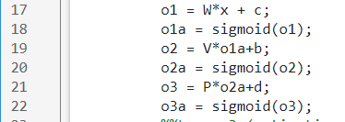

Forward propagation

Slide 9

Functia de cost
$$COST=\sum{{(output −y)}^{2}}$$
output = $sigmoid(P∗sigmoid\left(V∗sigmoid\left(W∗input+b\right)+c\right)+d)$

Slide 10

Gradient descent
Vom aplica algoritmul gradient descent stochastic pentru a gasi weight-urile si bias-urile
$$\left[ \begin{matrix}W & \\ \begin{aligned}b \\ V \\ c \\ P \\ d\end{aligned} & \begin{aligned} \\ \end{aligned}\end{matrix}\right]=\left[ \begin{matrix}W & \\ \begin{aligned}b \\ V \\ c \\ P \\ d\end{aligned} & \begin{aligned} \\ \end{aligned}\end{matrix}\right]−alfa ∗ ∇Cost$$

Slide 11












BACK PROPAGATION
$$X$$
$$Y$$
$$X$$
$$Y$$
$$X$$
$$Y$$
$$\frac{∂Cost}{∂x}$$
$$\frac{∂Cost}{∂y}$$
$$\frac{∂Cost}{∂x}$$
$$\frac{∂Cost}{∂y}$$
$$\frac{∂Cost}{∂x}$$
$$\frac{∂Cost}{∂y}$$
LAYER 1
LAYER 2
LAYER 3

Slide 12



BACK PROPAGATION
Ecuatiile pentru fiecare layer:
$$\frac{∂Cost}{∂W}=\frac{∂Cost}{∂y}⊙{sigmoid}^{′}(z)∗x^{t}$$
$$\frac{∂Cost}{∂b}=\frac{∂Cost}{∂y}⊙{sigmoid}^{′}(z)$$
$$\frac{∂Cost}{∂x}{=W}^{t}∗\frac{∂Cost}{∂y}⊙{sigmoid}^{′}(z)$$
$$W=W−alfa∗\frac{∂Cost}{∂W}$$
$$b=b−alfa∗\frac{∂Cost}{∂b}$$
$$z=W∗x+b$$
$$y=sigmoid(z)$$

Slide 13
Definirea functiilor
% Sigmoid
function g = sigmoid(z)
g = 1.0 ./ (1.0 + exp(-z));
end
% Derivata functiei sigmoid
function g = sigmoid_derivat(z)
s = sigmoid(z);
g = s - s.^2 ;
end
% Functia de cost
function [Loss] = loss(z_true,z)
Loss = mean(z-z_true)^2;
end
% Derivata functiei de cost
function [Loss] = loss_derivat(z_true,z)
Loss = 2 * (z - z_true) / length(z);
end

Slide 14
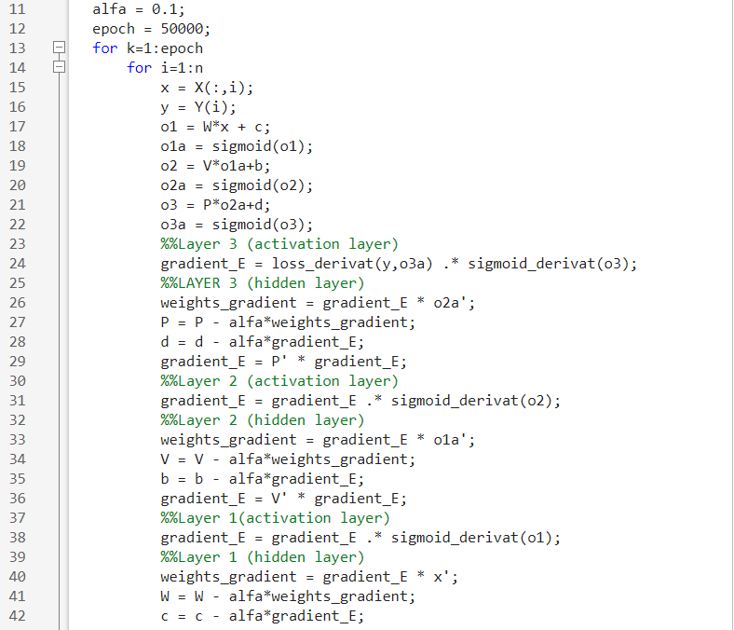
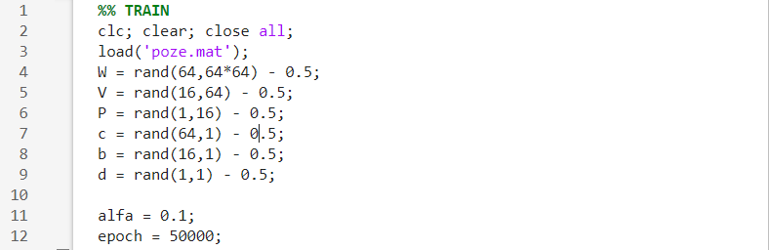
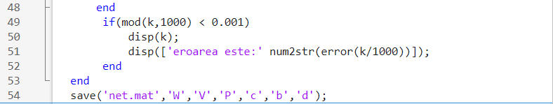
Algoritm Stochastic

Slide 15
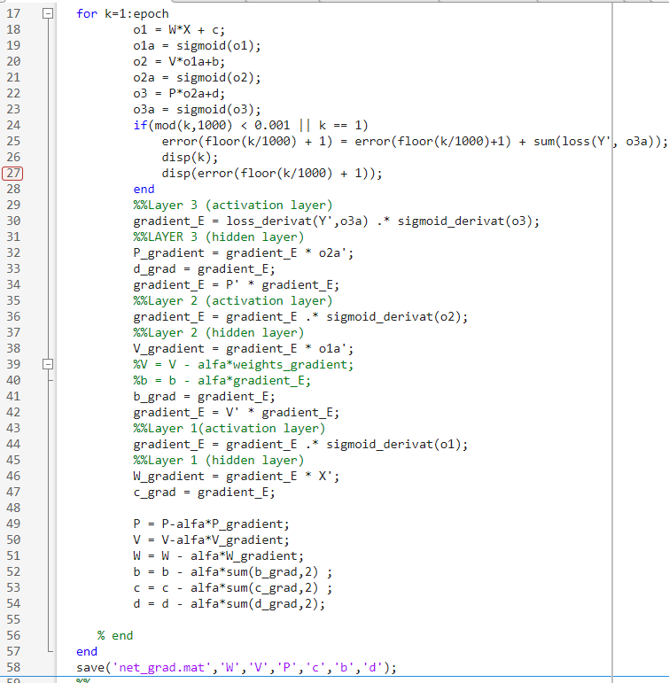
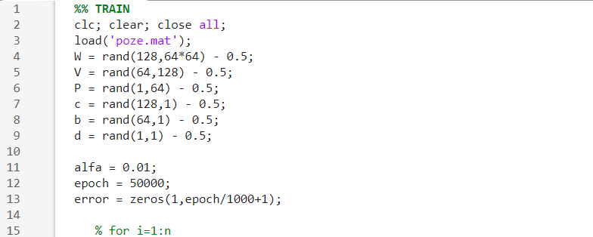
Algoritm Normal

Slide 16

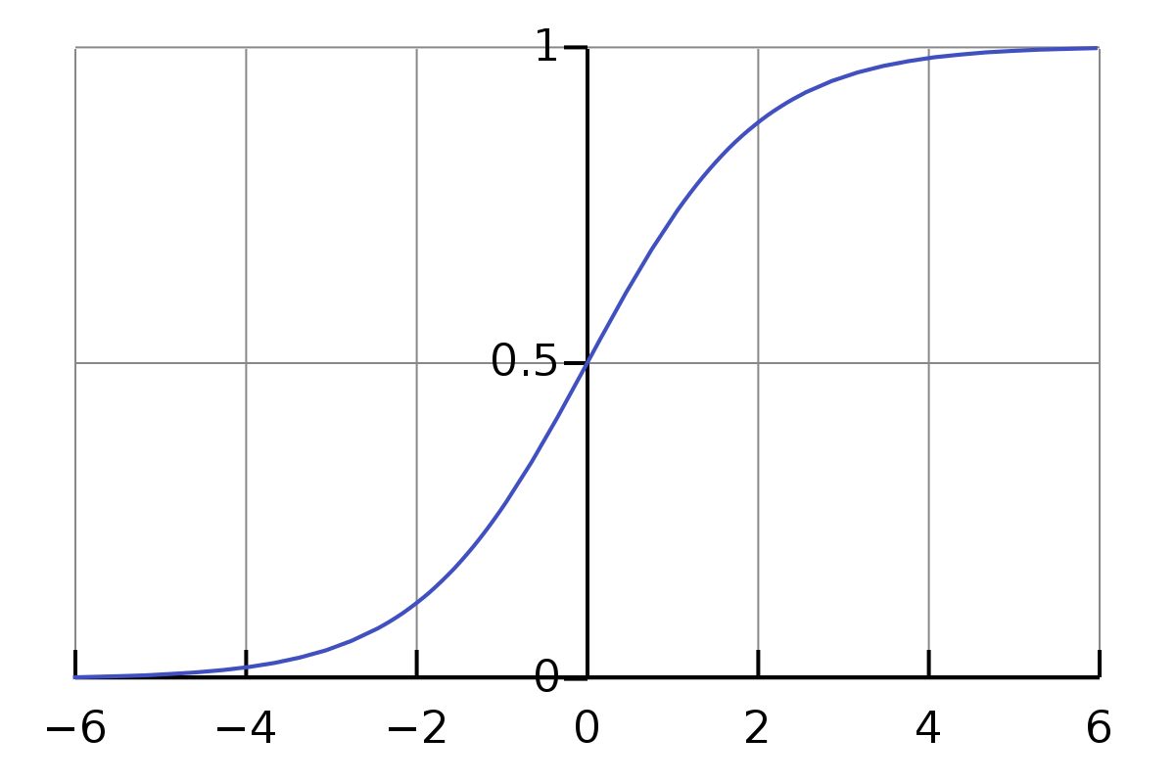
Regresia logistica
FUNCTIA SIGMOID
Ea face maparea intre valoarea de predictie (o valoare reala)
si probabilitate (o valoare intre 0 s, i 1), a se observa Figura 1.

Slide 17


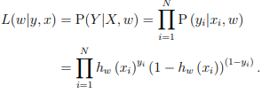
Regresia logistica
Functia de probabilitate(likelihood)

Slide 18
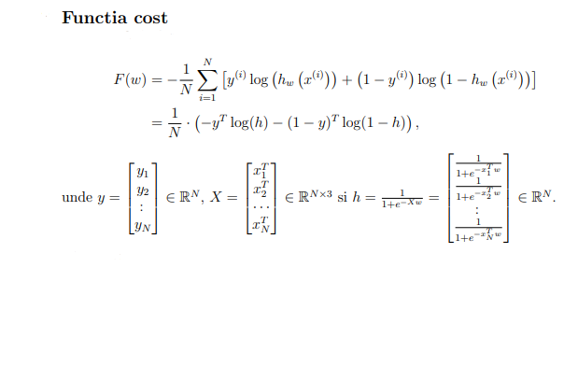

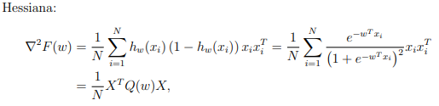


Slide 19
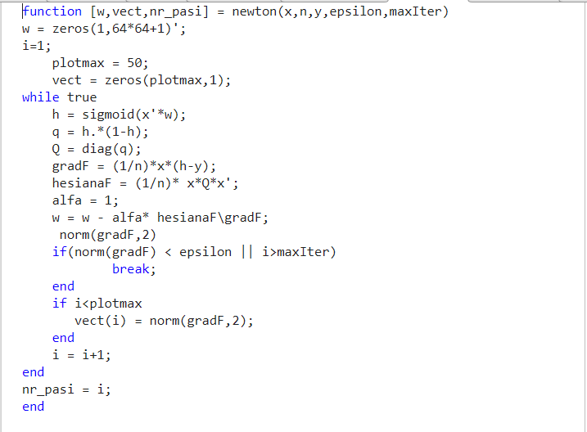
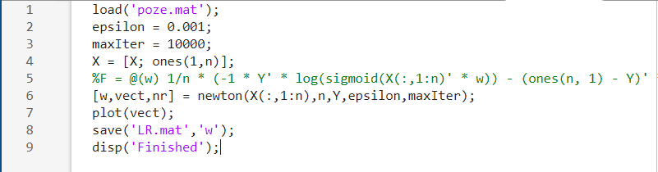
Algoritm Newton

Slide 20
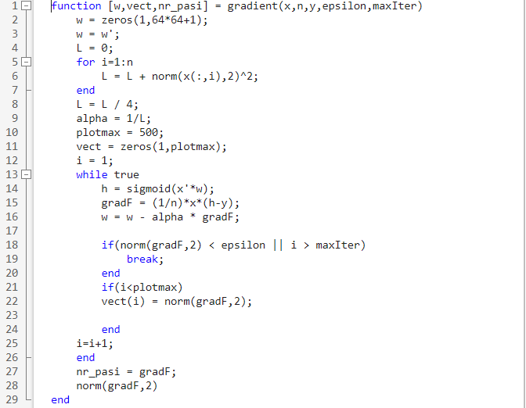
Algoritm Gradient

Slide 21
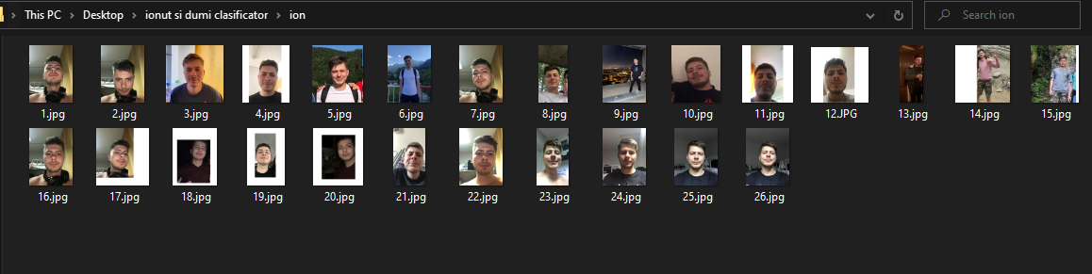

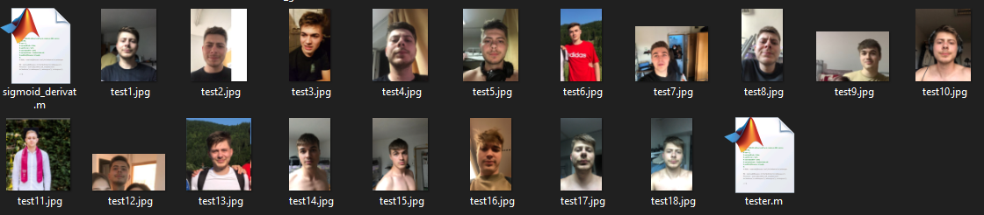
Testare

Slide 22
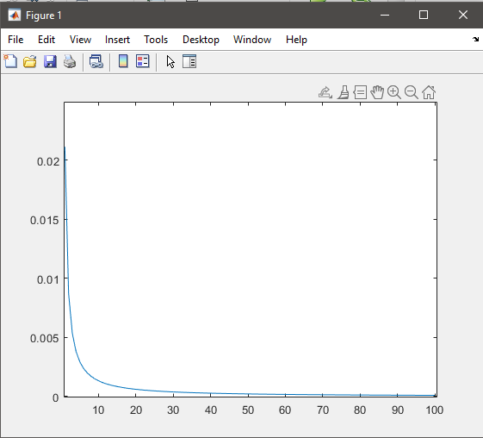
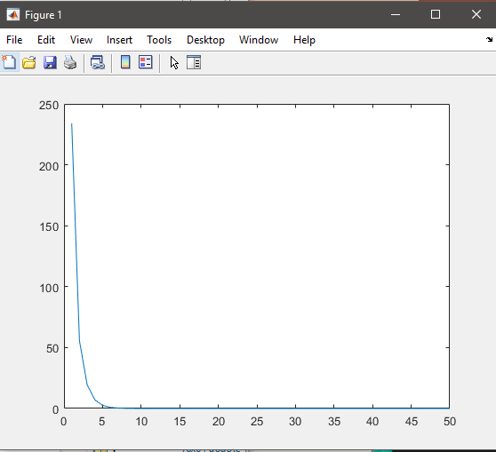
Testare
Neural network(stochastic)
Logistic regression(metoda newton)
Eroare
gradF
x1000
x1000

Slide 23
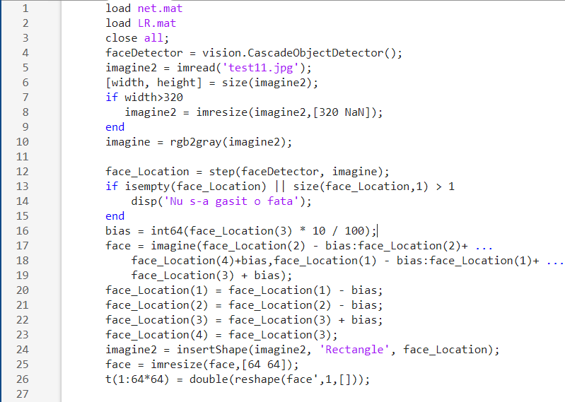
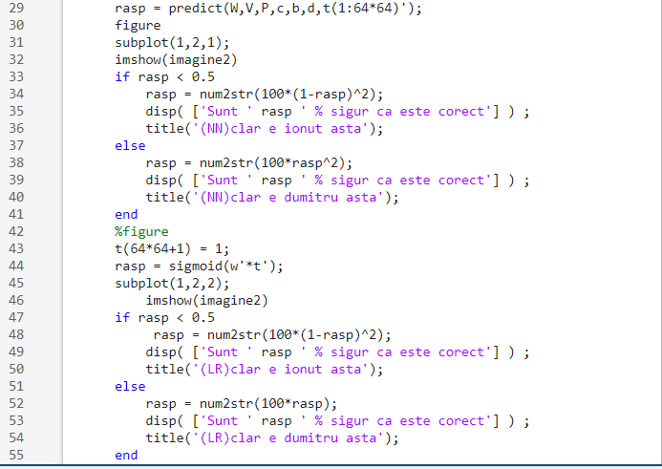

Slide 24
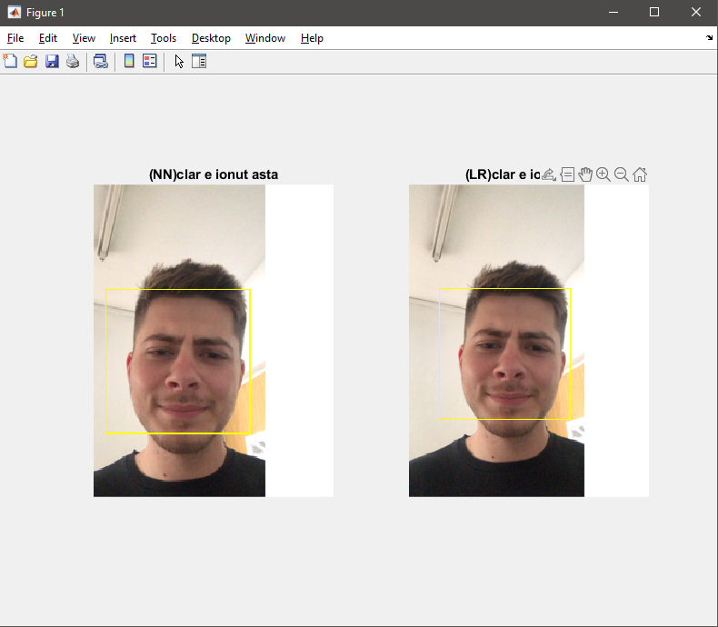
Testare
NN : 16/17 clasificari corecte
LR : 15/17 clasificari corecte
Timp training:
NN: aprox 45 minute (stochastic), 10 minute (grad normal)
LR: aprox 1-2 minute
Cele mai bune rezultate au fost obtinute pentru:
NN: SGD
LR: GD

Slide 25
Sfarsit
https://www.codeproject.com/Articles/1237026/Simple-MLP-Backpropagation-Artificial-Neural-Netwo
https://stats.stackexchange.com/questions/218542/which-activation-function-for-output-layer
https://towardsdatascience.com/understanding-backpropagation-algorithm-7bb3aa2f95fd
http://colah.github.io/posts/2015-08-Backprop/
https://blog.demofox.org/2017/03/09/how-to-train-neural-networks-with-backpropagation/
https://www.youtube.com/watch?v=tIeHLnjs5U8&t
https://www.youtube.com/channel/UC1OLIHvAKBQy3o5LcbbxUSg/videos
https://www.coursera.org/learn/convolutional-neural-networks

