Slide 1
Road Sign Detection
By: Kush Chopra, Bosit Anvarov, and Hanat Samatar
Notes:
hanat

Slide 2
Reasoning for our Selection
We decided to focus on detecting road objects from an image source in order to intertwine our collective interest for technologies related to vehicles and traffic safety.
Auto detection of critical road signs (Traffic Light, Stop Sign, Pedestrian Sign, and Speed Limit Sign) allows for the operator to make quick and important decisions that are relevant to their safety.
Automatic detection of traffic signs can also help improve a drivers comfortability overall, similar to a blind spot indicator on side-view mirrors nowadays.
Notes:
hanat

Slide 3
Structure of System
Use HSV color system (more accurate for detecting color than RGB)
Use inRange() function to detect the color within a given color code range. For example, color RED in hsv is (0, 100, 100)
Use findCountours() function to detect the external contours which approximately outlines the object
Use the boundingRect() function to approximated a rectangle for the largest contours, and draw it on the result image using rectangle() function
Name the object
Notes:
Bosit

Slide 4
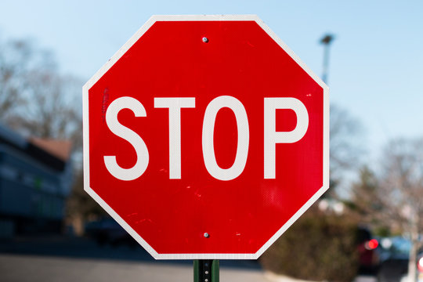

Process
Given the input image, we first converted the image from RGB -> HSV color space to allow for any colors within a given range
Similar to thresholding, we masked the image according to the color of given range. In this case it was red
Notes:
Bosit

Slide 5
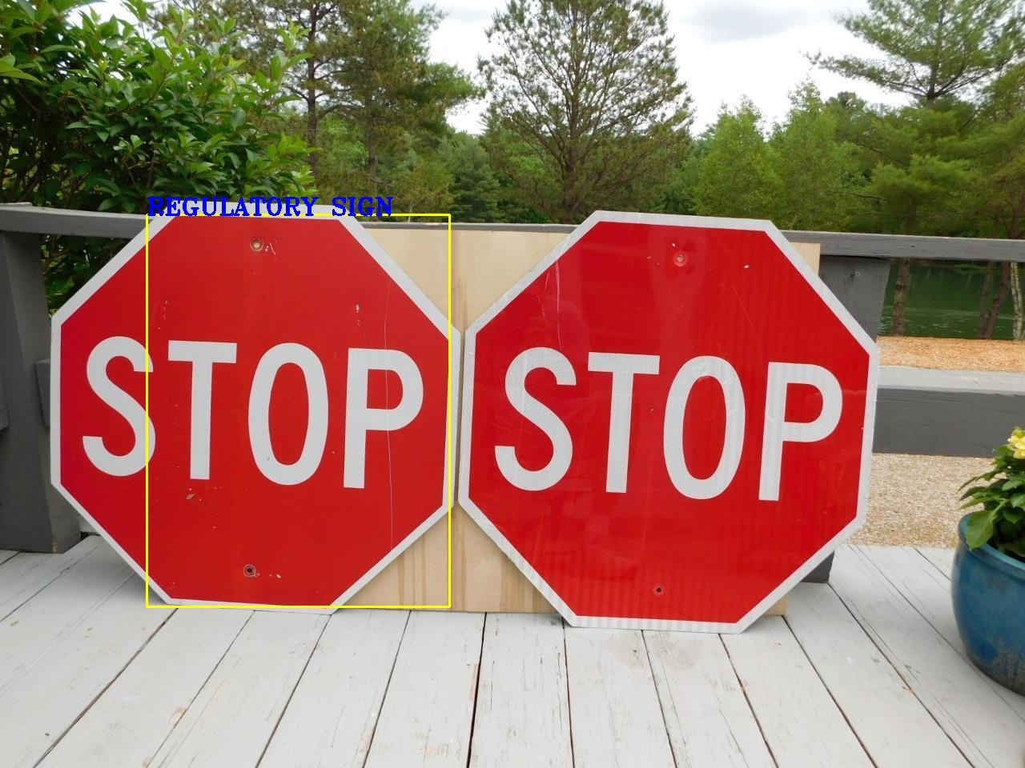
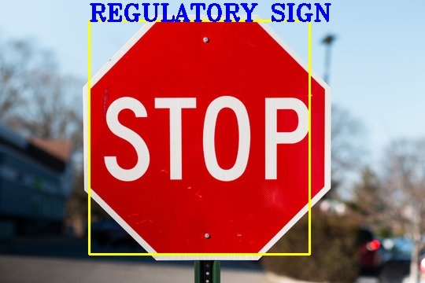
Results
Good result:
Example Margin of Error: More than one same colored sign, only detects one
Notes:
hanat

Slide 6
Blockers/Challenges
Being unable to detect specifically which road sign type it is from the given image; went around this by utilizing the signs color
To achieve this, dataset training using machine learning could be used
Being unable to detect more than one of same color road signs within the same frame or image
Different sign shapes can cause variety in the detections outlining accuracy
Notes:
hanat

Slide 7
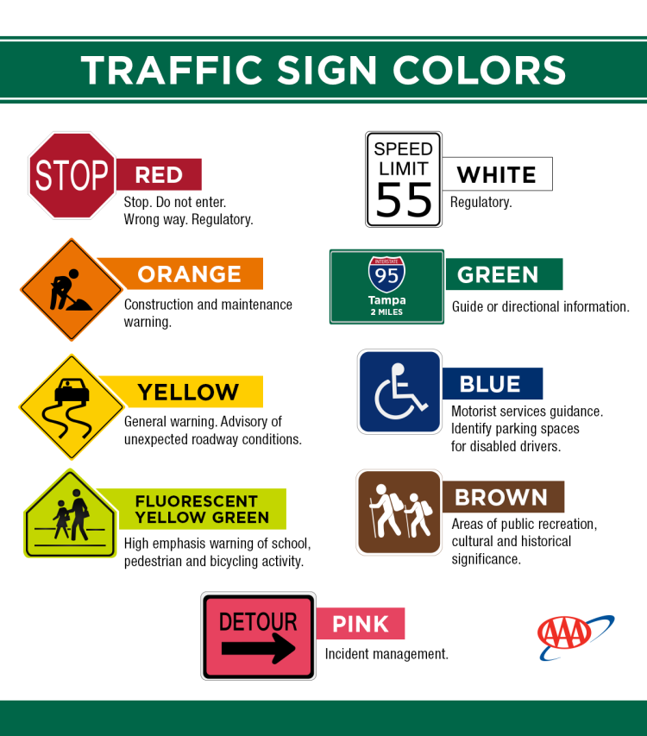
Advancements
At the moment, we have been successful for detecting multiple
traffic signs according to their HSV values; however it does not fully
specify the type of sign.
In the future, we can broaden the program so that it is able to
detect the traffic lights (opencv YOLO) , the number of pedestrians
on the sidewalk, and the number of cars in a particular image/video.
We can also make the program to detect cars changing lanes.
Notes:
kush

Slide 8
Conclusion
We were able to configure the road sign detection software to be able to detect signs and identify their purpose through image recognition
Our approach led to a few blockers, mainly due to the challenge of integrating other datasets into what we wanted to be identified (foreign street signs).
Questions?
Notes:
kush

