Slide 1
MANE 4240 & CIVL 4240
Introduction to Finite Elements
Prof. Suvranu De
Constant Strain Triangle (CST)

Slide 2
Reading assignment:
Logan 6.2-6.5 + Lecture notes
Summary:
Computation of shape functions for constant strain triangle
Properties of the shape functions
Computation of strain-displacement matrix
Computation of element stiffness matrix
Computation of nodal loads due to body forces
Computation of nodal loads due to traction
Recommendations for use
Example problems

Slide 3
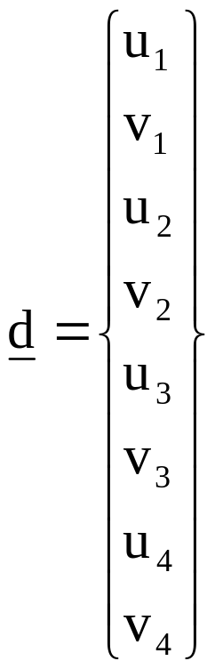
Finite element formulation for 2D:
Step 1: Divide the body into finite elements connected to each other through special points (“nodes”)
p_{y}
3
v₃
p_{x}
4
3
u₃
v₄
v
2
Element ‘e’
v₂
1
4
u
S_{T}
u₄
u₂
v₁
2
y
x
y
S_{u}
u₁
1
x
v
x
u

Slide 4
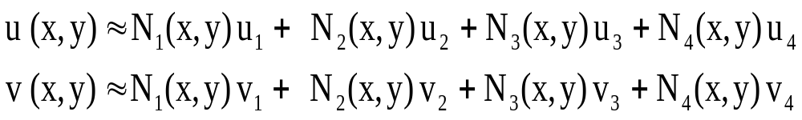
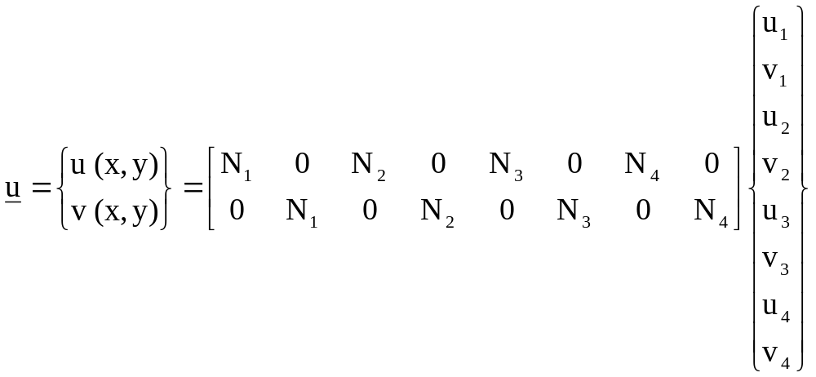


Slide 5
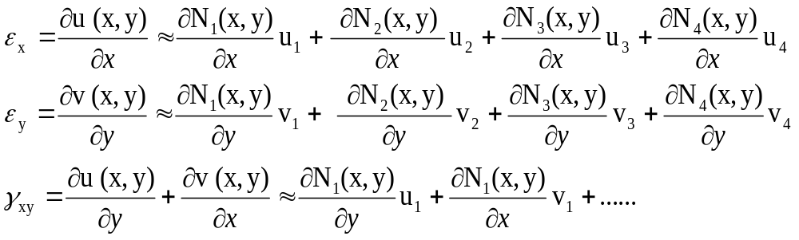
TASK 2: APPROXIMATE THE STRAIN and STRESS WITHIN EACH ELEMENT
Approximation of the strain in element ‘e’

Slide 6
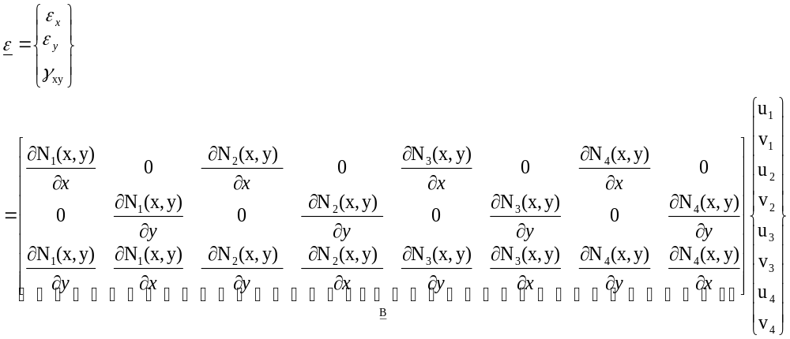


Slide 7

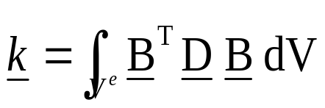
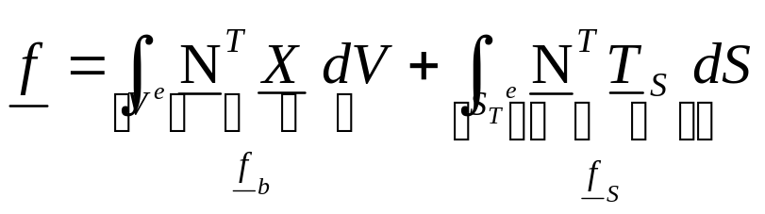
Summary: For each element
Displacement approximation in terms of shape functions
Strain approximation in terms of strain-displacement matrix
Stress approximation
Element stiffness matrix
Element nodal load vector

Slide 8
Constant Strain Triangle (CST) : Simplest 2D finite element
v₁
v₃
1
u₁
(x₁,y₁)
(x₃,y₃)
v₂
v
u₃
u
3
y
(x,y)
u₂
2
(x₂,y₂)
x
3 nodes per element
2 dofs per node (each node can move in x- and y- directions)
Hence 6 dofs per element

Slide 9


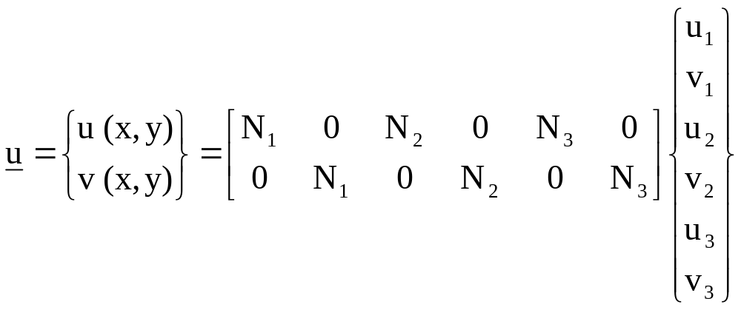
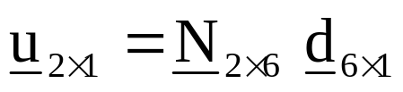
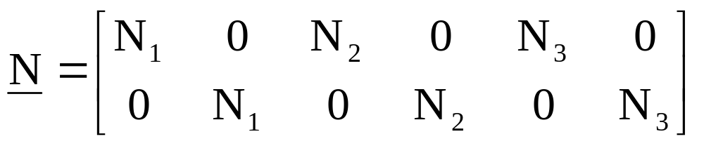
The displacement approximation in terms of shape functions is

Slide 10
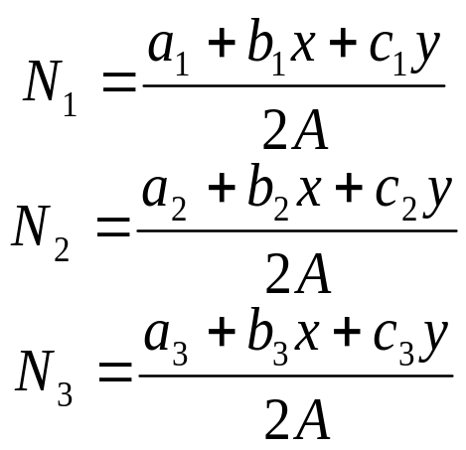
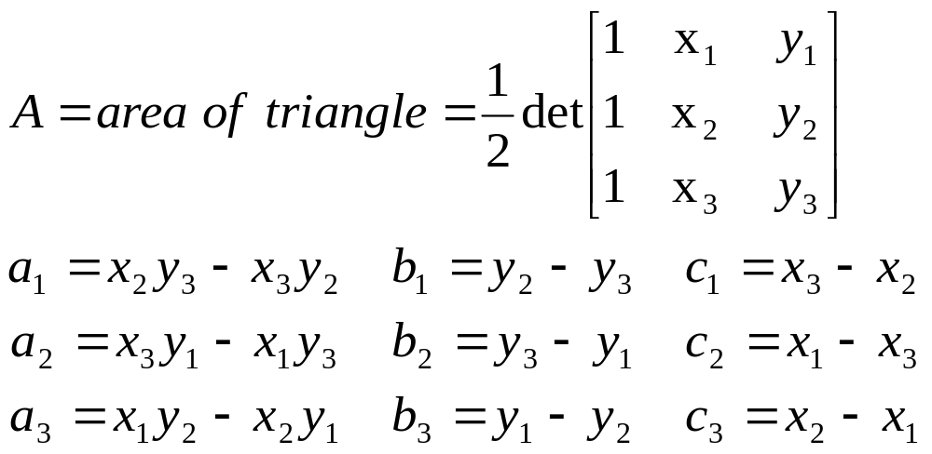
Formula for the shape functions are
v₁
v₃
1
u₁
(x₁,y₁)
(x₃,y₃)
v₂
v
u₃
u
3
y
(x,y)
where
u₂
2
(x₂,y₂)
x

Slide 11
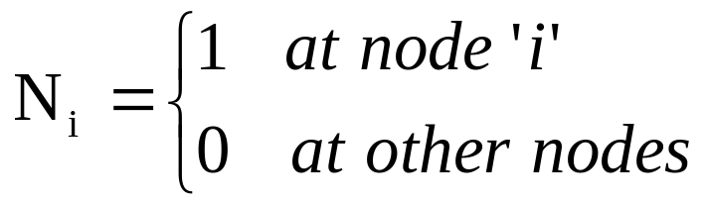
Properties of the shape functions:
1. The shape functions N₁, N₂ and N₃ are linear functions of x and y
N₂
N₁
N₃
1
1
1
1
3
1
y
3
2
3
2
1
2
x

Slide 12
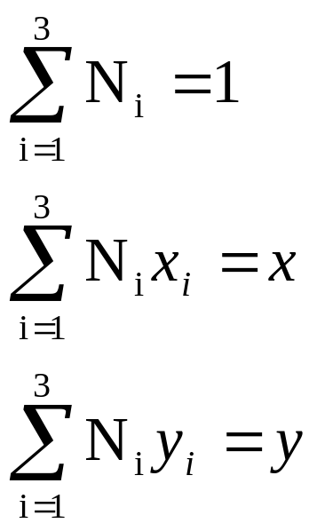
2. At every point in the domain

Slide 13
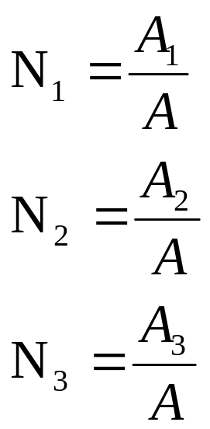
3. Geometric interpretation of the shape functions
At any point P(x,y) that the shape functions are evaluated,
P (x,y)
1
A₂
A₃
A₁
y
3
2
x

Slide 14
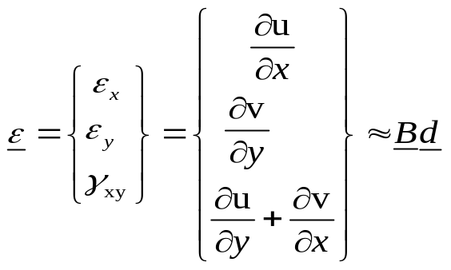
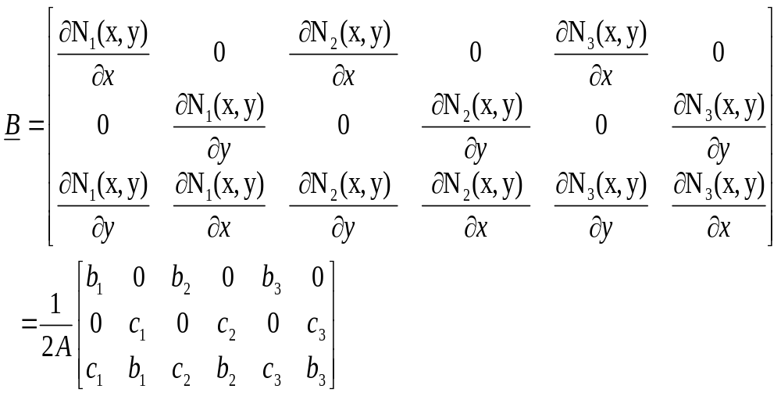
Approximation of the strains

Slide 15
Inside each element, all components of strain are constant: hence the name Constant Strain Triangle
Element stresses (constant inside each element)

Slide 16
IMPORTANT NOTE:
1. The displacement field is continuous across element boundaries
2. The strains and stresses are NOT continuous across element boundaries

Slide 17
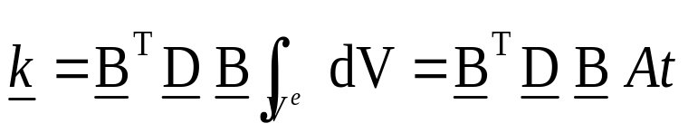
Element stiffness matrix
t
Since B is constant
A
t=thickness of the element
A=surface area of the element

Slide 18
Element nodal load vector

Slide 19
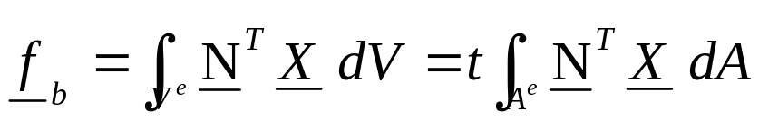
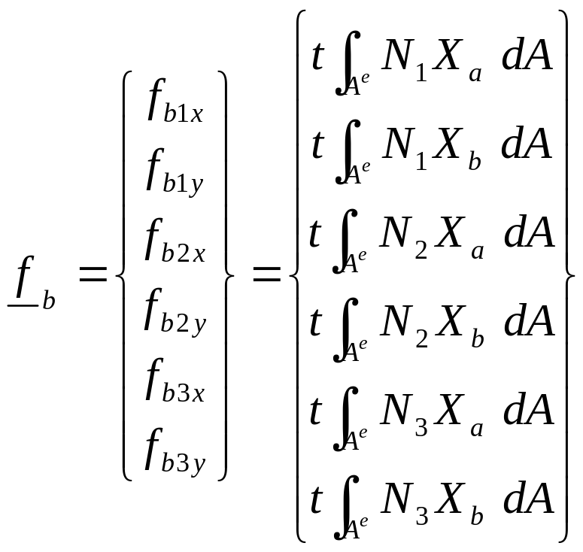
Element nodal load vector due to body forces
f_{b1y}
f_{b3y}
1
f_{b1x}
X_{b}
f_{b3x}
f_{b2y}
X_{a}
y
3
(x,y)
f_{b2x}
2
x

Slide 20
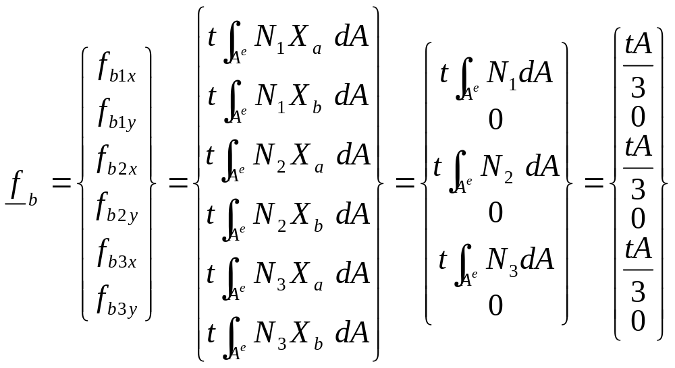
EXAMPLE:
If X_{a}=1 and X_{b}=0

Slide 21
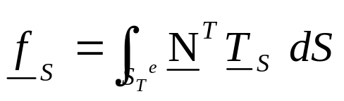
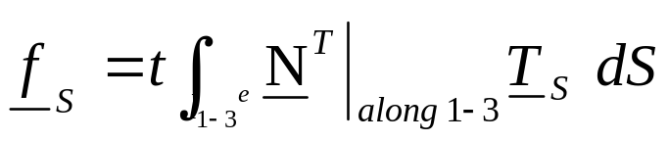
Element nodal load vector due to traction
EXAMPLE:
f_{S1y}
f_{S3y}
1
f_{S1x}
f_{S3x}
y
3
2
x

Slide 22

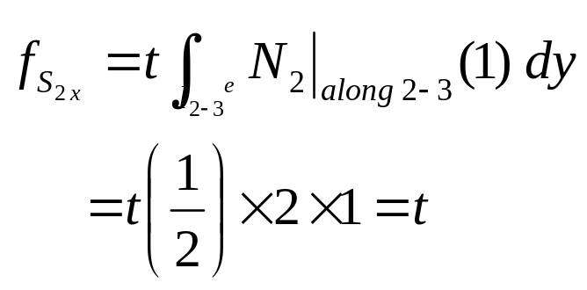
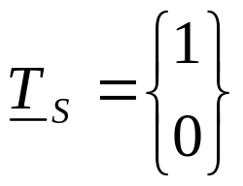
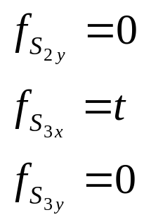
Element nodal load vector due to traction
EXAMPLE:
f_{S2y}
(2,2)
2
f_{S2x}
y
1
f_{S3y}
2
1
3
f_{S3x}
x
(0,0)
(2,0)
Similarly, compute

Slide 23
Recommendations for use of CST
1. Use in areas where strain gradients are small
2. Use in mesh transition areas (fine mesh to coarse mesh)
3. Avoid CST in critical areas of structures (e.g., stress concentrations, edges of holes, corners)
4. In general CSTs are not recommended for general analysis purposes as a very large number of these elements are required for reasonable accuracy.

Slide 24
Example
1000 lb
y
300 psi
3
2
El 2
Thickness (t) = 0.5 in
E= 30×10⁶ psi
ν=0.25
2 in
El 1
1
4
x
3 in
Compute the unknown nodal displacements.
Compute the stresses in the two elements.

Slide 25
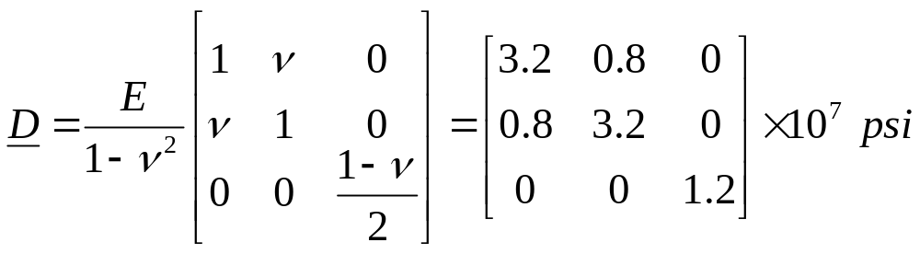
Realize that this is a plane stress problem and therefore we need to use
Step 1: Node-element connectivity chart
ELEMENT | Node 1 | Node 2 | Node 3 | Area (sqin)
1 | 1 | 2 | 4 | 3
2 | 3 | 4 | 2 | 3
Node | x | y
1 | 3 | 0
2 | 3 | 2
3 | 0 | 2
4 | 0 | 0
Nodal coordinates

Slide 26
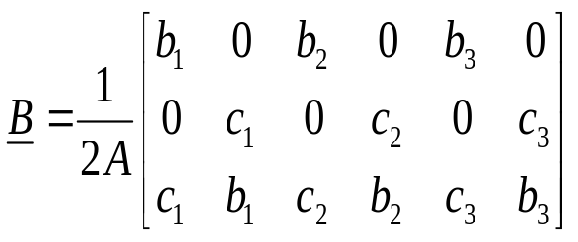
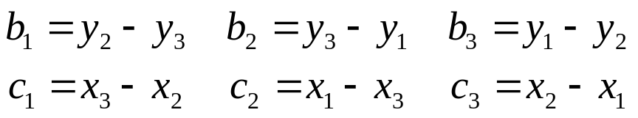
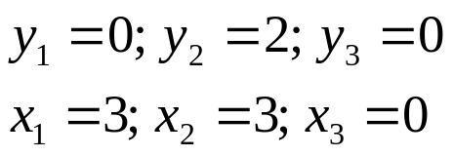
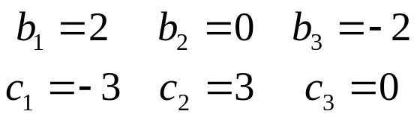
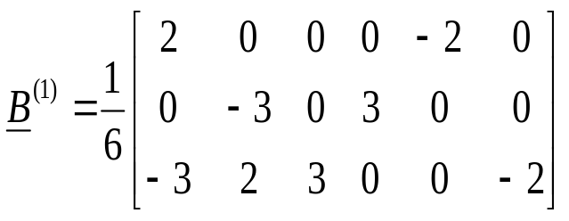
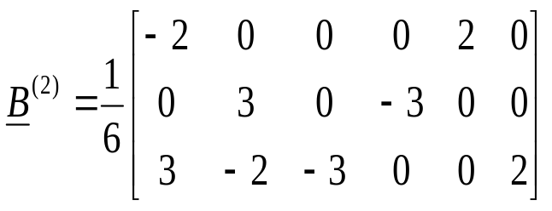
Step 2: Compute strain-displacement matrices for the elements
Recall
with
For Element #1:
2(2)
Hence
4(3)
1(1)
Therefore
(local numbers within brackets)
For Element #2:

Slide 27
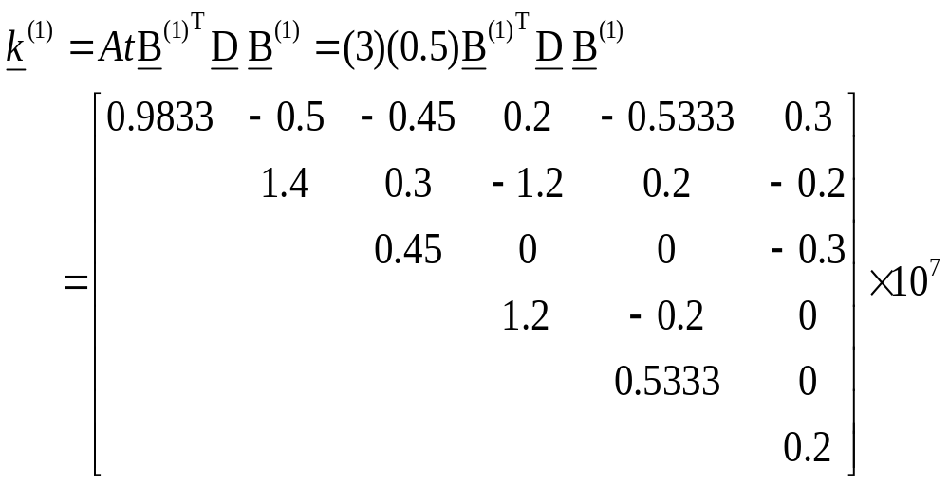
Step 3: Compute element stiffness matrices
u₁
v₁
u₂
v₂
u₄
v₄

Slide 28
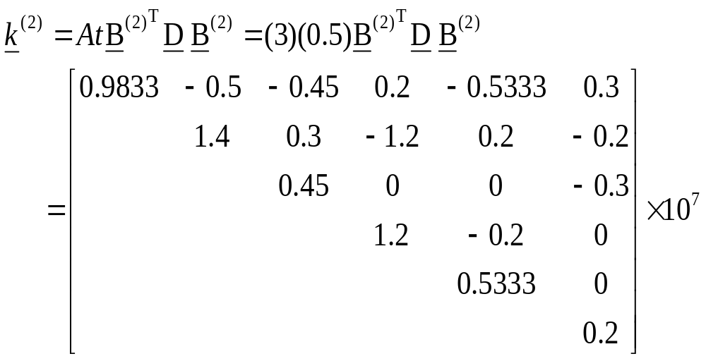
u₃
v₃
u₄
v₄
u₂
v₂

Slide 29

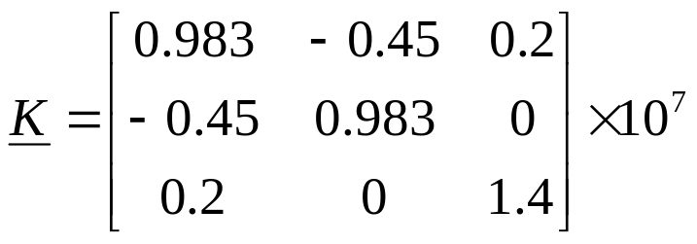
Step 4: Assemble the global stiffness matrix corresponding to the nonzero degrees of freedom
Notice that
Hence we need to calculate only a small (3x3) stiffness matrix
u₁
u₂
v₂
u₁
u₂
v₂

Slide 30
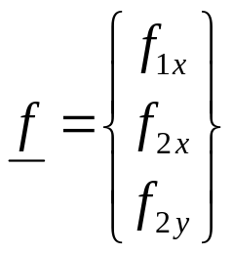
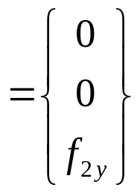

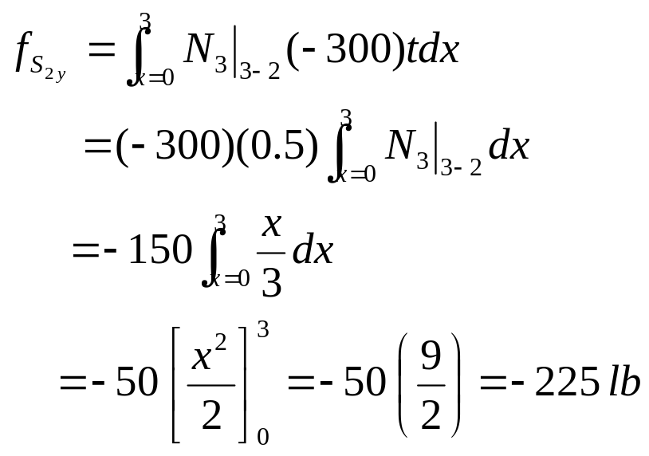
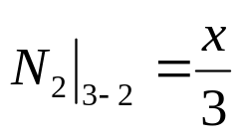
Step 5: Compute consistent nodal loads
The consistent nodal load due to traction on the edge 3-2
3
2

Slide 31
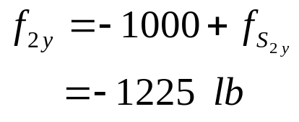

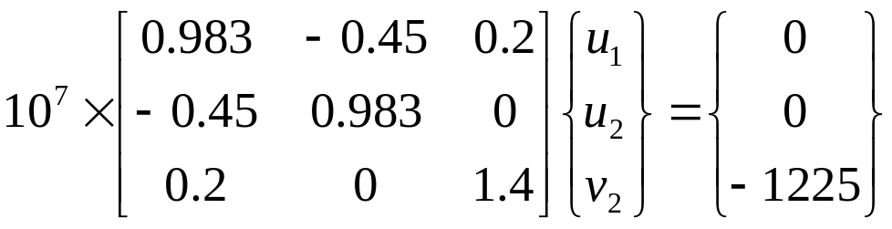
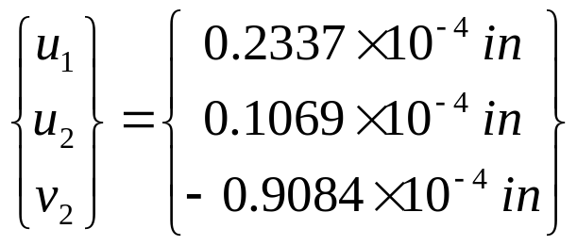
Hence
Step 6: Solve the system equations to obtain the unknown nodal loads
Solve to get

Slide 32

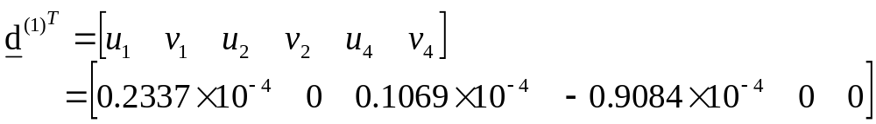
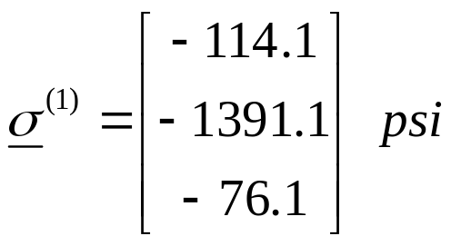
Step 7: Compute the stresses in the elements
In Element #1
With
Calculate

Slide 33

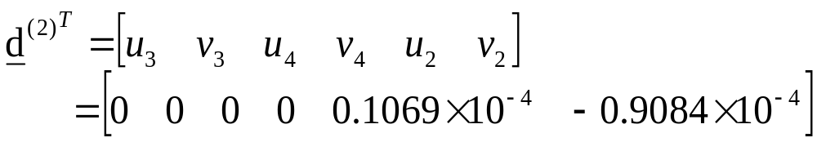
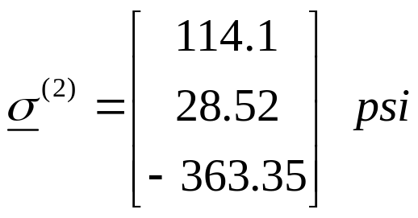
In Element #2
With
Calculate
Notice that the stresses are constant in each element

