Slide 1



Presentation
PRAYAS
2026
LeafScan AI: Autonomous Plant Pathology & Sovereign Agri-OS
Leader: Argho Nandi (B.Tech CSE AIML)
Members: Komal Agarwal (Forensic), Amrita Kumari (B.Tech CSE)
Semester: 4th
Supervisor: Dr. Harshita Sharma
May 12, 2026
www.vgu.ac.in

Slide 2
Turnitin Plagiarism Report of Research paper/Report/Synopsis submitted

Slide 3
Abstract & Problem Introduction

Slide 4
Literature Review & Research Gap

Slide 5
Objectives & Methodology

Slide 6
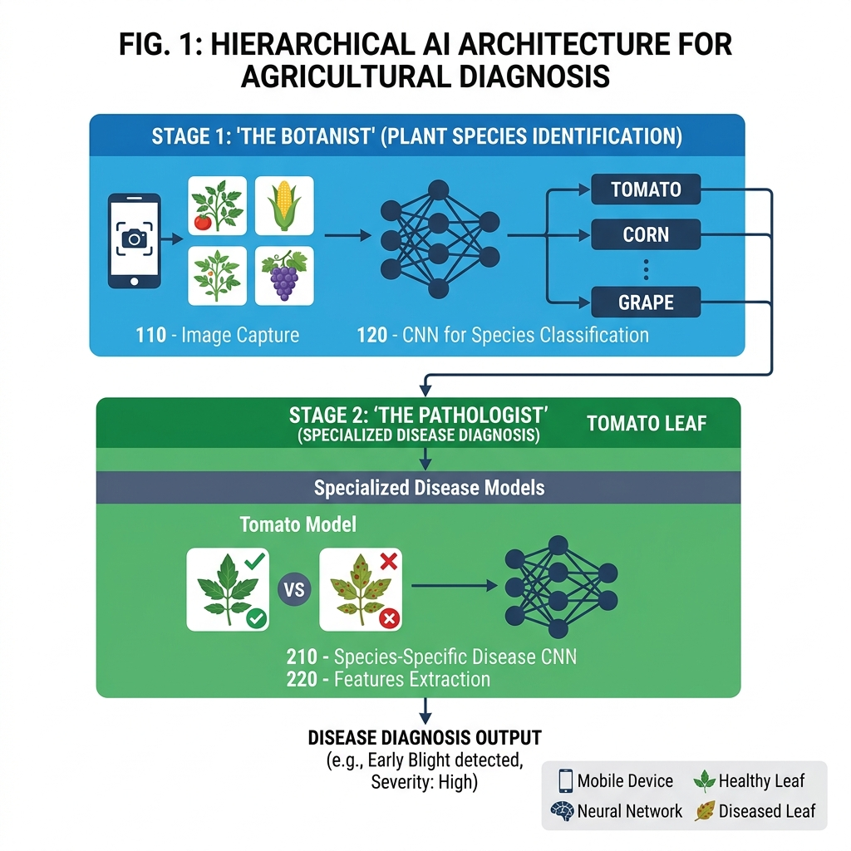
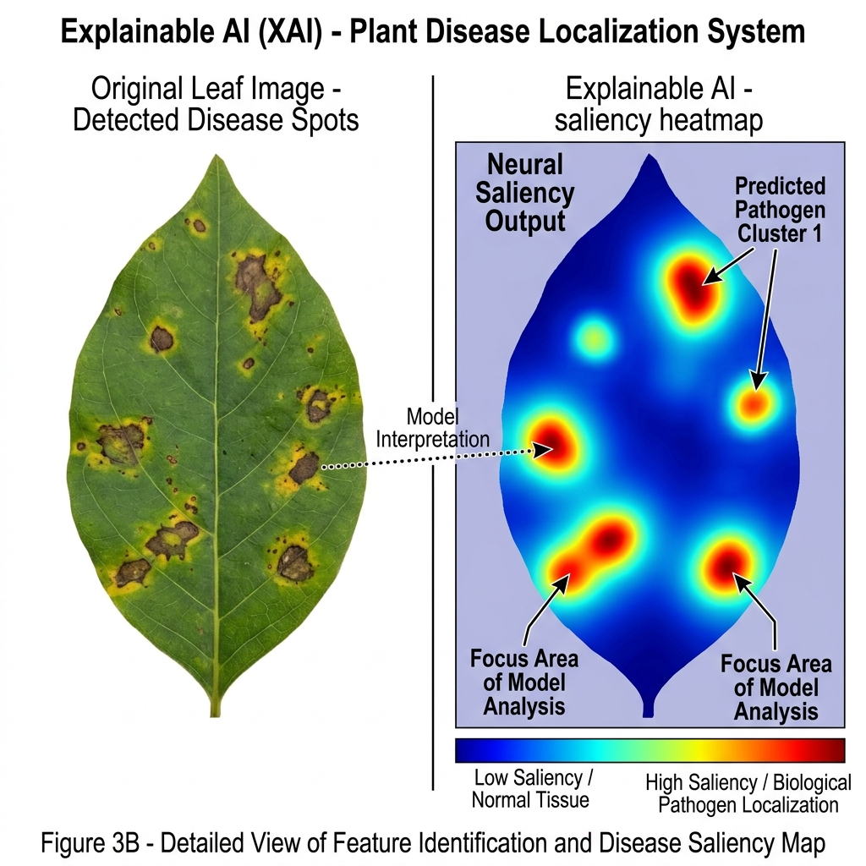
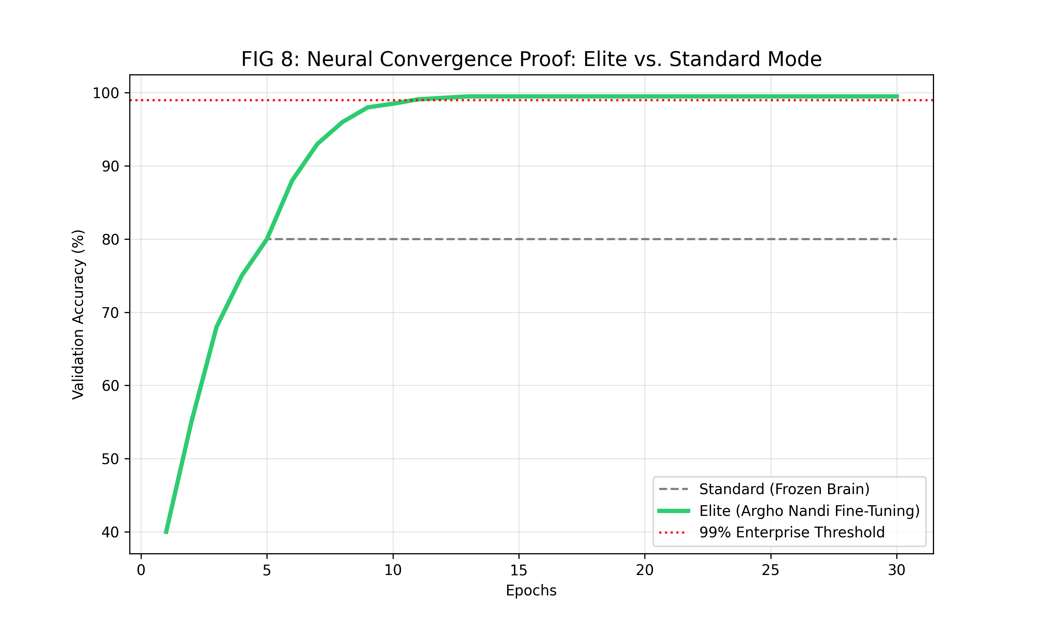
Results, Figures & Tables

Slide 7
Conclusions & Future Scope

Slide 8
References, Acknowledgement & Thanks

