Slide 1


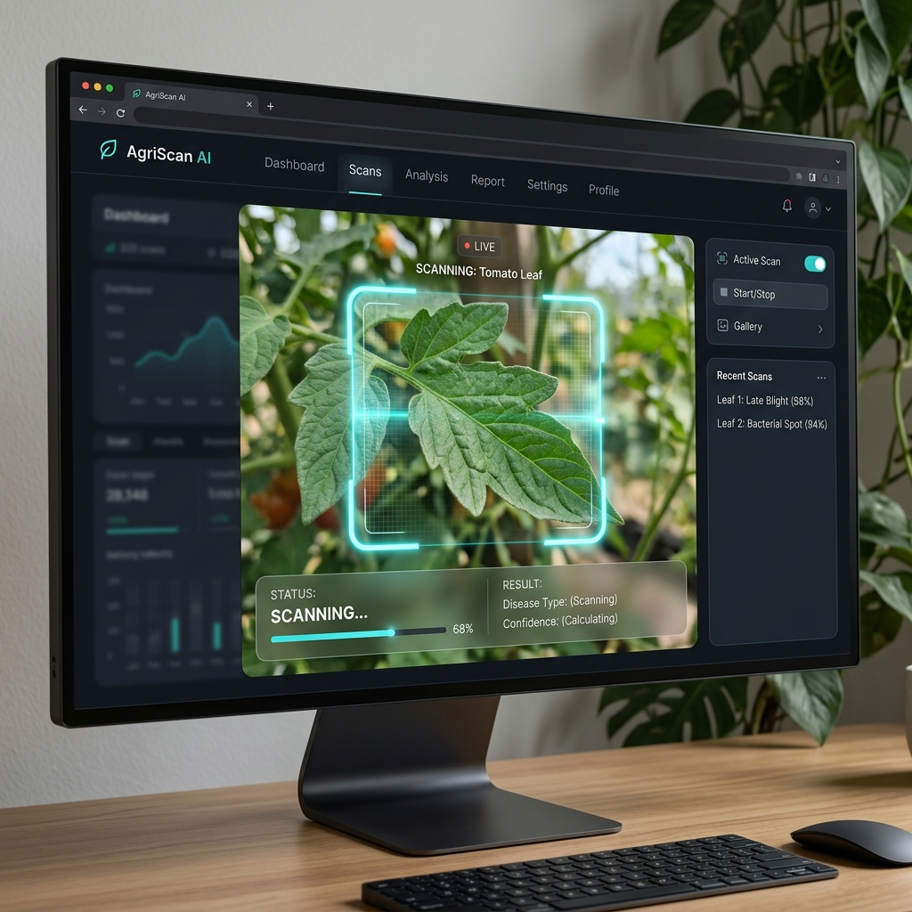
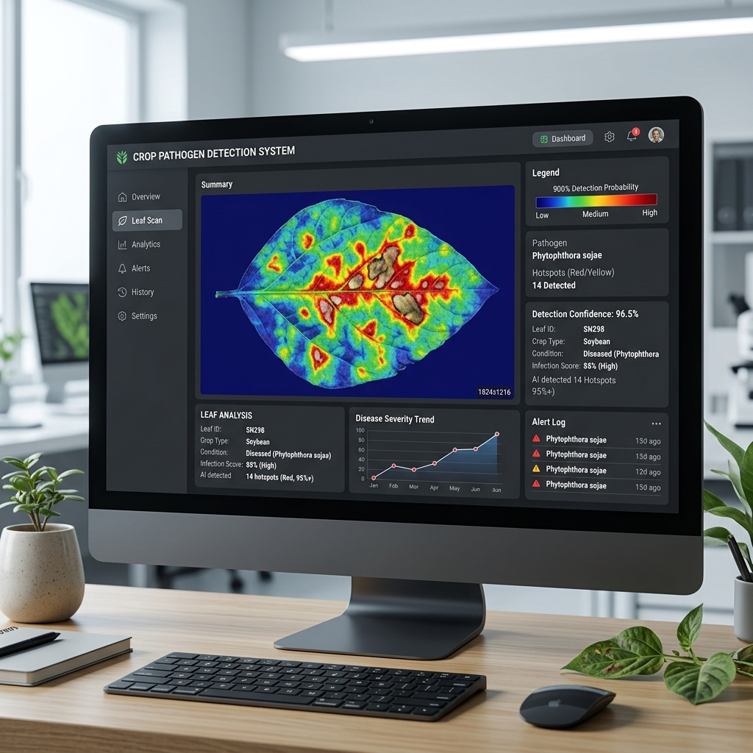
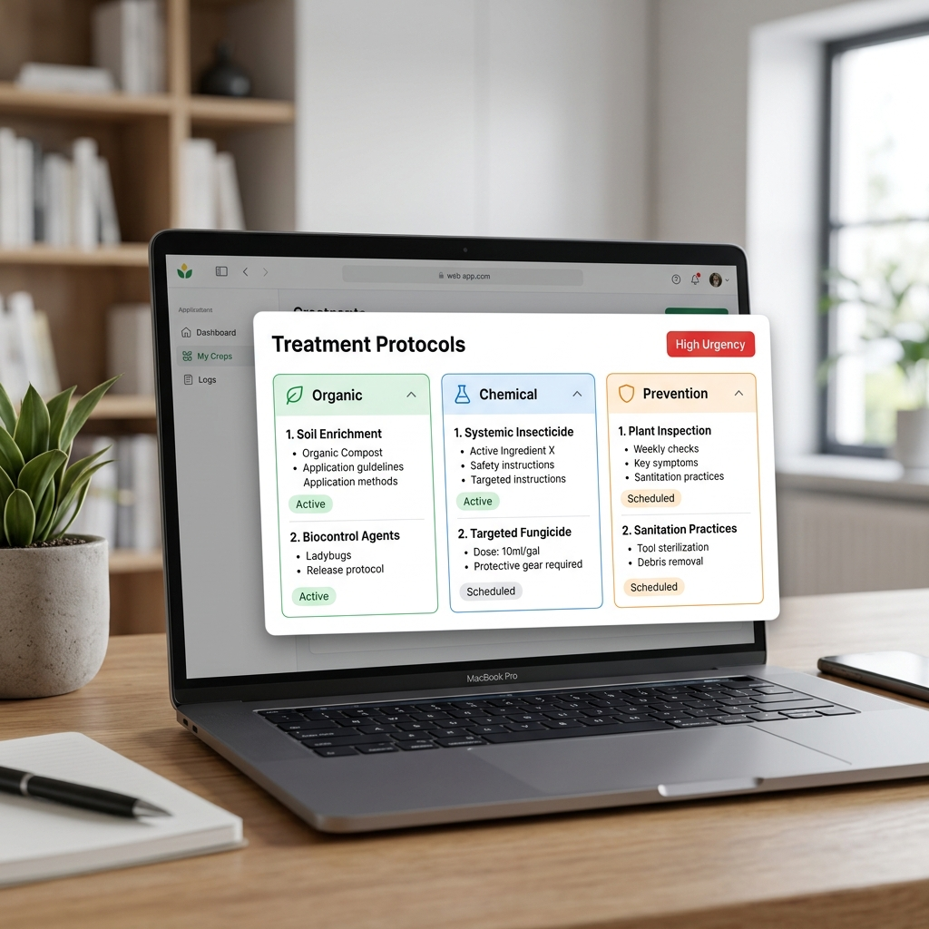
Department of........, Vivekananda Global University, Jaipur 303012
ssssssss@vgu.ac.in
Research Paper Title: LeafScan AI - Hierarchical Neural Network System for Advanced Epidemiological Disease Diagnostics Across 102 Crop Species
Author Details: Argho Nandi (Lead Inventor), Komal Agarwal, & Amrita Kumari
ABSTRACT:
LeafScan AI introduces an edge-optimized diagnostic platform utilizing a Sovereign Specialist Engine. By dynamically routing image data through specialized neural models, it diagnoses agricultural pathogens across 102 crop categories. It uniquely integrates Explainable AI (XAI) heatmaps and Visual-Multi-Spectral (VMS) stress analysis.
PROBLEM IDENTIFICATION:
- Diagnostic Delay: Traditional pathology causes critical delays in treatment.
- Broad-Spectrum Inaccuracy: Generic AI models suffer from low accuracy (<80%).
- Offline Limitations: Farmers lack internet access in remote fields.
Abstract and Problem Identification
OBJECTIVE:
To develop a zero-latency, offline-capable AI system achieving >95% diagnostic accuracy via hierarchical model routing and edge computing.
METHODOLOGY:
- Hierarchical Routing: Dynamically loads a highly trained Specialist Model into memory.
- Edge Computing: Models are quantized and executed directly in the browser via TensorFlow.js.
- VMS Synthesis: Synthesizes standard RGB feeds into pseudo-multispectral layers to detect invisible physiological stress.
- XAI Heatmaps: Uses Grad-CAM to highlight the exact visual region of the infected leaf.
Objective & Methodology
Figures
Tables
Crop Specialist Engine | Peak Validation Accuracy
Tomato Neural Matrix | 98.4%
Apple Disease Matrix | 96.2%
Potato Blight Specialist | 97.1%
Wheat Rust Specialist | 95.8%
Grape Pathogen Engine | 94.9%
OVERALL SYSTEM AVERAGE | 96.3%
KEY RESULTS:
- Unprecedented Accuracy: The hierarchical routing successfully bypassed catastrophic forgetting, achieving a peak validation accuracy of 98.4%.
- Inference Speed: Edge-execution via WebGL hardware acceleration reduced latency to under 600ms per scan.
- Explainability: XAI heatmaps increased diagnostic transparency for agronomists.
DISCUSSION:
LeafScan AI proves that decentralized, edge-based machine learning can outperform generalized cloud APIs in agricultural environments.
Results and Discussion
CONCLUSION:
LeafScan AI successfully demonstrates a highly scalable, offline-first approach to precision agriculture. By combining localized specialist models with dynamic treatment databases, the system acts as a real-time, pocket-sized plant pathologist.
FUTURE SCOPE:
- Drone Fleet Integration: Interfacing with autonomous drone cameras for massive-scale aerial scanning.
- Hardware IoT Syncing: Direct API handshakes with soil moisture and pH sensors.
- Sovereign Database Scaling: Expanding Dexie.js for multi-tenant enterprise farm management.
Conclusion & Future Scope
Notes:
A0: 841 × 1189
Hier: 900 × 1100, beim drucken beachten
Besseres IPF-Logo

