Slide 1
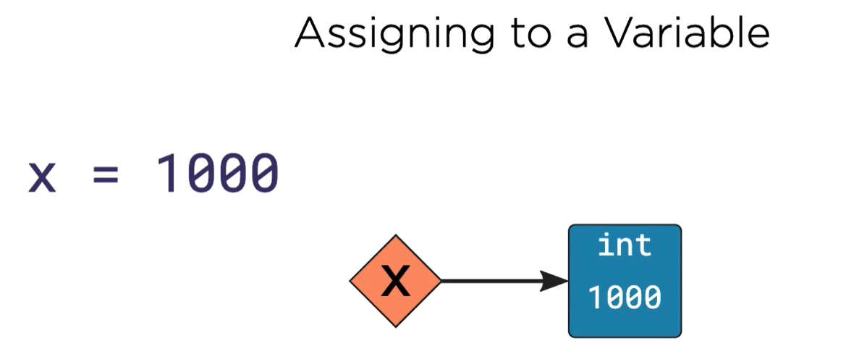
Variable is a pointer
The pointer points to a box
Whatever you put in the box, is the value of the variable

