Slide 1
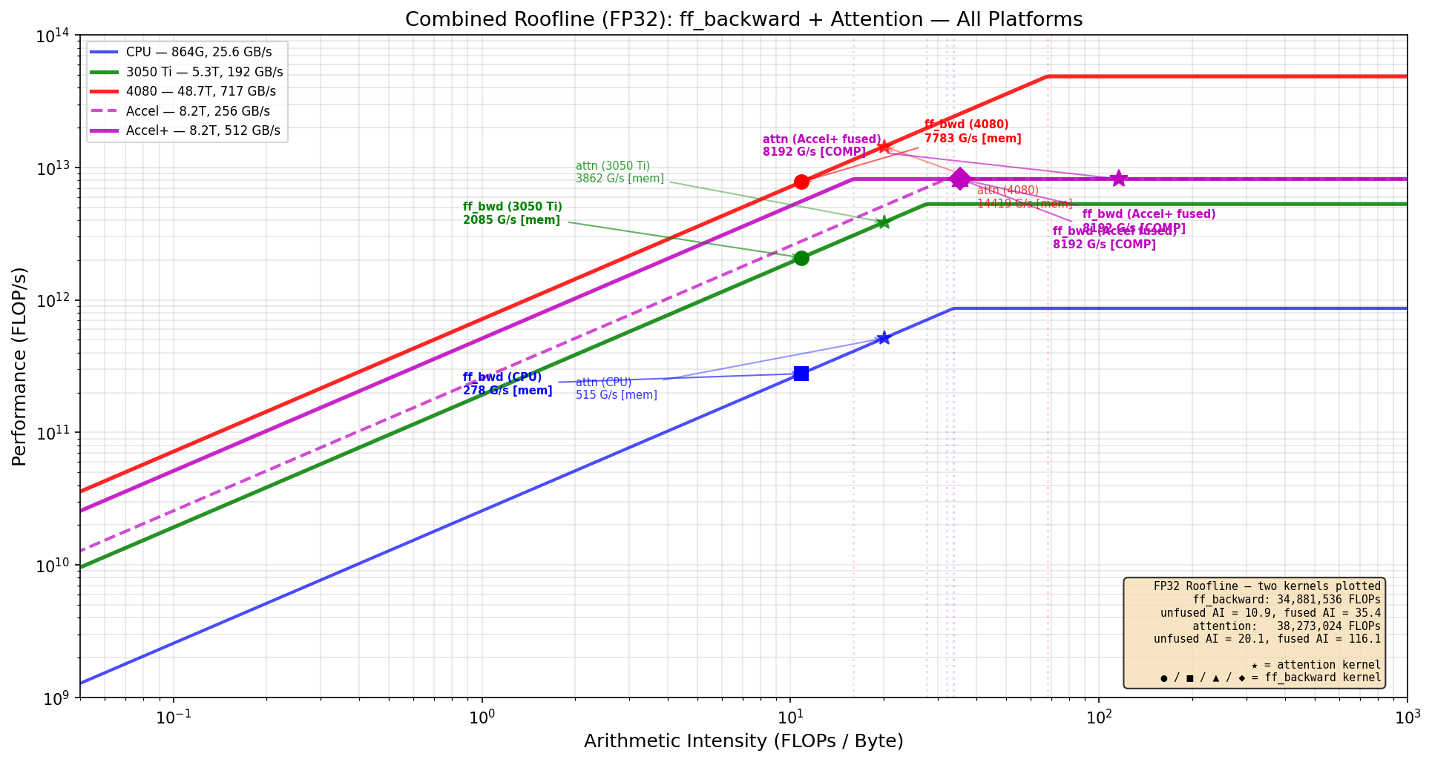
Dataflow-Fused Transformer Training Accelerator Chiplet
End-to-end fusion of FFN + attention sublayers to eliminate intermediate SRAM traffic | ECE 510 | Spring 2026 | David Boss
The Approach: Fuse & Accelerate 80% of Training
Accelerated: ff_backward (32.5%) + ff_forward (23.5%) + attention (24.8%)
Combined: 80% of training runtime on hardware
ff_forward reuses same systolic array + gelu circuit (zero extra area)
Operator fusion eliminates intermediate memory traffic
ff_backward fused AI: 10.86 → 35.4 | attn fused AI: 20.1 → 116.1
Chiplet Architecture (building block)
Host CPU (i5-10500H) ← 20% of workload
| UCIe x16 (8 GB/s bidir)
v
+───── Accelerator+ Chiplet ──────+
│ │
│ 64x64 Systolic Array @ 500 MHz │
│ 4,096 MACs, tiled GEMM engine │
│ | │
│ [MUX: GELU|GELU'|softmax] │
│ Fused at output stage │
│ │
│ SRAM Scratchpad (512 GB/s) │
│ ~11.5W est. │
+─────────────────────────────────+
FP32 Roofline Estimates (ff_backward kernel)
Platform Peak BW Attain. Bound
──────────────────────────────────────────────────────────
i5-10500H CPU 864G 25.6 GB/s 278 G/s mem
RTX 3050 Ti 5.3T 192 GB/s 2,085 G/s mem
RTX 4080 48.7T 717 GB/s 7,783 G/s mem
Accel+ (fused) 8.2T 512 GB/s 8,192 G/s COMP
Fusion shifts AI from 10.86 → 35.4 FLOP/B, crossing the
ridge point. Accelerator becomes compute-bound, hitting
the full 8.2 TFLOP/s systolic peak.
Note: estimates from roofline model, not measured silicon.
Config: B=4, T=64, d_model=64, d_ff=256, 2 layers, FP32.
Fused Datapath: Tile Flow Through Systolic Array
SRAM Systolic Array SRAM
───── ────────────── ─────
┌──────────────────┐
Tile A (64x64) ──>│ │
│ 64x64 MAC grid │──> partial
Tile B (64x64) ──>│ (tiled GEMM) │ sums
└────────┬─────────┘
│ (in registers, NOT to SRAM)
v
┌──────────────────┐
│ Fused Activation │
│ MUX: GELU|GELU' │
│ |softmax │
└────────┬─────────┘
│ (still in registers)
v
┌──────────────────┐
│ Next tiled GEMM │──> final
│ (reuses array) │ output ──> SRAM
└──────────────────┘
Memory avoided: intermediate tensors (dh_act, gelu_grad
result, scores, attn) never written to / read from SRAM.
FP32 Roofline: ff_backward + attention on all platforms (roofline model)
Power Efficiency (estimated)
Platform Power Perf Eff. (est.)
─────────────────────────────────────────────────
i5-10500H CPU 45W 278 G/s 6.2 G/s/W
RTX 4080 320W 7,783 G/s 24.3 G/s/W
Accel+ (est.) ~11.5W 8,192 G/s ~712 G/s/W
Power est. from component analysis, not synthesis.
Dataflow fusion across FFN + attention sublayers | AI: 10.86 → 35.4 (mem→compute bound) | ~80% coverage, 3.6x Amdahl's | Chiplet building block, scalable via UCIe mesh

