Slide 1
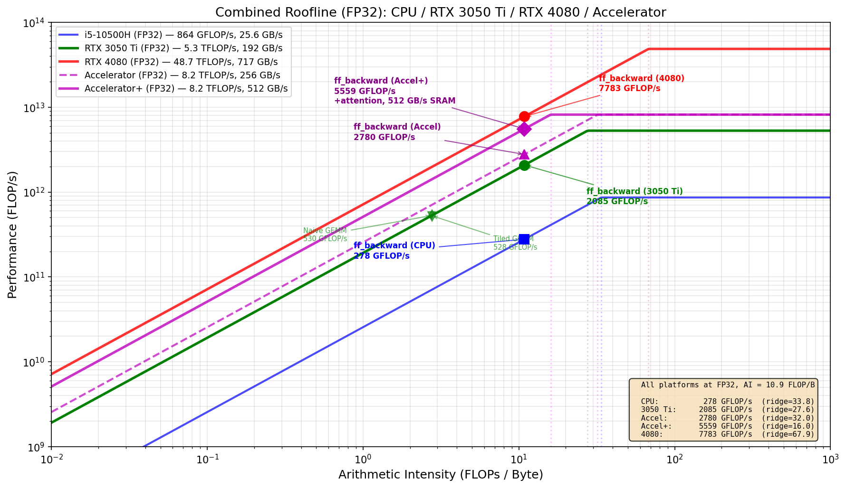
Accelerating Transformer ff_backward: CPU vs GPU vs Custom Systolic Accelerator
ECE 510 - HW4AI | Spring 2026 | David Boss
The Problem: Memory-Bandwidth Bottleneck
Dominant kernel: ff_backward (32.5% of training runtime)
Includes 4 matmuls + GELU gradient (18.1% alone)
Memory-bound at AI = 10.86 FLOP/B (FP32)
Profiled over 1,000 iterations on i5-10500H CPU
Python → Hardware Translation
Python Concept Hardware Equivalent
──────────────────────────────────────────────
@ (matmul) 64x64 systolic array (4096 MACs)
gelu_grad() Pipelined LUT + multipliers
* (elementwise) Single-cycle multiplier
.sum() (reduction) Adder tree
Variable assignment SRAM read/write (256 GB/s)
Function call order FSM state transitions
Key: gelu_grad is FUSED at systolic output.
Intermediates never touch memory — they flow
through the pipeline in registers.
dout → [systolic: @W2.T] → [gelu_grad] → [systolic: x.T@]
no memory write no memory no memory write
between stages round-trip between stages
FP32 Performance Comparison
Platform Peak BW Attainable Status
─────────────────────────────────────────────────────────
i5-10500H CPU 864G 25.6 GB/s 278 G/s mem-bound
RTX 3050 Ti GPU 5.3T 192 GB/s 2,085 G/s mem-bound
Accelerator 8.2T 256 GB/s 2,780 G/s mem-bound
Speedup vs CPU: GPU = 7.5x | Accelerator = 10x
FP32 Roofline: CPU / 3050 Ti / 4080 / Accelerator / Accelerator+
Accelerator Architecture
Host CPU (i5-10500H) ← runs 67.5% of workload
| UCIe x16 (8 GB/s bidir)
v
+─────── Accelerator Chiplet ───────+
│ 64x64 Systolic Array @ 500 MHz │
│ 4,096 MACs → 8.2 TFLOP/s FP32 │
│ │
│ [gelu_grad] ← fused at output │
│ [softmax] ← future addition │
│ │
│ SRAM Scratchpad (256 GB/s) │
+───────────────────────────────────+
Future: Adding Attention (+15% area, +1.5W)
Attention uses the SAME systolic array for Q@K.T and attn@V.
Only new hardware: softmax unit (exp LUT + divider + comparators)
and causal mask logic (trivial).
Before After
Area: 1.0x ~1.15x
Power: ~10W ~11.5W
Runtime: 32.5% ~80% accelerated
Amdahl's: 1.4x 3.6x end-to-end
15% more area → 2.6x more end-to-end speedup.
Power & Efficiency
Platform Power Perf Efficiency
─────────────────────────────────────────────────
i5-10500H CPU 45W 278 G/s 6.2 GFLOP/s/W
RTX 3050 Ti 80W 2,085 G/s 26.1 GFLOP/s/W
Accelerator ~10W 2,780 G/s 278.0 GFLOP/s/W
Accelerator: 10x perf at 1/4 power → 45x efficiency vs CPU
Dominant kernel: ff_backward (32.5%) | AI = 10.86 FLOP/B (FP32) | 10x speedup at 45x power efficiency | Amdahl's end-to-end: 1.4x → 3.6x with attention

