Slide 1
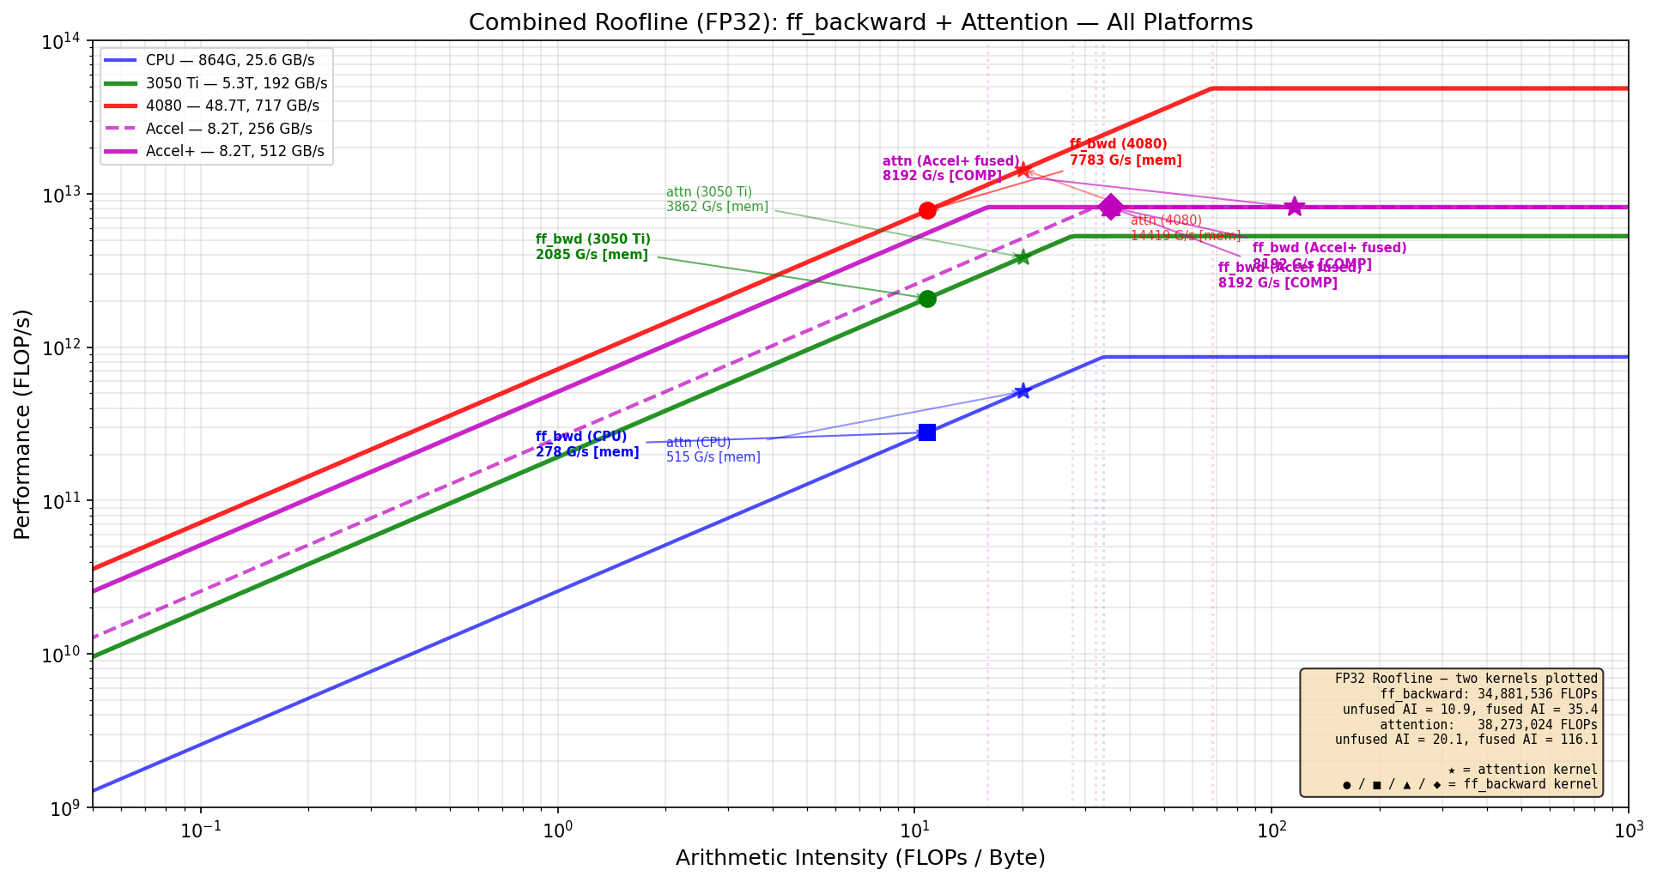
Dataflow-Fused Transformer Training Accelerator Chiplet
ECE 510 - HW4AI | Spring 2026 | David Boss
The Approach: Fuse & Accelerate 80% of Training
Accelerated: ff_backward (32.5%) + ff_forward (23.5%) + attention (24.8%)
Combined: 80% of training runtime on hardware
ff_forward reuses same systolic array + gelu circuit (zero extra area)
Operator fusion eliminates intermediate memory traffic
ff_backward fused AI: 10.86 → 35.4 | attn fused AI: 20.1 → 116.1
Python → Hardware Translation
Python Concept Hardware Equivalent
──────────────────────────────────────────────
@ (matmul) 64x64 systolic array (4096 MACs)
gelu_grad() Pipelined LUT + multipliers
softmax() Exp LUT + divider + comparators
* (elementwise) Single-cycle multiplier
.sum() (reduction) Adder tree
Variable assignment SRAM read/write (512 GB/s)
Function call order FSM state transitions (~25 states)
FUSION: intermediates never touch memory.
systolic → [gelu_grad/softmax] → systolic
Results flow through registers, not SRAM.
Eliminates 69% of ff_bwd memory traffic
Eliminates 83% of attention memory traffic
FP32 Performance Comparison (ff_backward)
Platform Peak BW Attain. Status
──────────────────────────────────────────────────────────
i5-10500H CPU 864G 25.6 GB/s 278 G/s mem-bound
RTX 3050 Ti GPU 5.3T 192 GB/s 2,085 G/s mem-bound
RTX 4080 GPU 48.7T 717 GB/s 7,783 G/s mem-bound
Accel+ (fused) 8.2T 512 GB/s 8,192 G/s COMP-BOUND
Fusion shifts AI from 10.86 → 35.4 FLOP/B, crossing the
ridge point (16.0). Accel+ becomes COMPUTE-BOUND, hitting
the full 8.2 TFLOP/s peak — beating even the RTX 4080.
FP32 Roofline: ff_backward + attention — all platforms
Future Enhancements
1. Mixed-precision (FP16/BF16 accumulate to FP32)
→ 2x MACs per cycle, 2x effective bandwidth
→ Peak jumps to 16.4 TFLOP/s at same area/power
2. Accelerate layer_norm (~11% runtime)
→ Coverage: 80% → ~91%, Amdahl's: 3.6x → 5.3x
3. Double-buffered SRAM for overlapping compute + DMA
→ Hides UCIe transfer latency completely
4. Configurable array partitioning (2x 32x64)
→ Run two matmuls concurrently for smaller dims
Accelerator+ Architecture
Host CPU (i5-10500H) ← runs 20% of workload
| UCIe x16 (8 GB/s bidir)
v
+──────── Accelerator+ Chiplet ────────+
│ 64x64 Systolic Array @ 500 MHz │
│ 4,096 MACs → 8.2 TFLOP/s FP32 │
│ │
│ [gelu_grad] ← fused at output │
│ [softmax] ← fused at output │
│ [causal mask] ← gate logic │
│ │
│ SRAM Scratchpad (512 GB/s) ~11.5W │
+──────────────────────────────────────+
Power & Efficiency
Platform Power Perf Efficiency
─────────────────────────────────────────────────
i5-10500H CPU 45W 278 G/s 6.2 GFLOP/s/W
RTX 4080 320W 7,783 G/s 24.3 GFLOP/s/W
Accel+ ~11.5W 8,192 G/s 712.3 GFLOP/s/W
Accel+: beats 4080 at 1/28 power → 29x efficiency
80% of training accelerated | Fusion: AI 10.86 → 35.4 (compute-bound) | 8,192 GFLOP/s @ 11.5W | 29x more efficient than RTX 4080 | Amdahl's: 3.6x end-to-end
Notes:
This chiplet will accelerate the transformer algorithm that was provided. The ff_backward was the most runtime intensive kernal at 32.5% of runtime, so that initially chosen as the kernal to be accelerated. However, I noticed the ff_forward and attention kernals could be also be implemented with extremely minimal additions to hardware, so the chiplet will also accelerate those kernals. This means over 80% of the original runtime will be accelerated by this chiplet.
The main hardware in this chiplet is the systolic array, which is 4000 MAC units used for matrix multiplication. This is by far the most dominant feature area wise, all the other components take a fraction of a percent of the area consumed by the systolic array. Gelu is for ff, softmax is for attention. LUTs will be used for non-linear portions of gelu and softmax; other operations will be implemented with multipliers, dividers, and comparators. The original accelerator implemented this hardware with FSM sequencing to SRAM between stages. The improved accelerator (accelerator +) uses pipeline registers with handshake control between stages, which is called fusion. This keeps intermediate values in pipeline registers. Fusion allows the accelerator to move from memory-bound to compute-bound.

