Slide 1
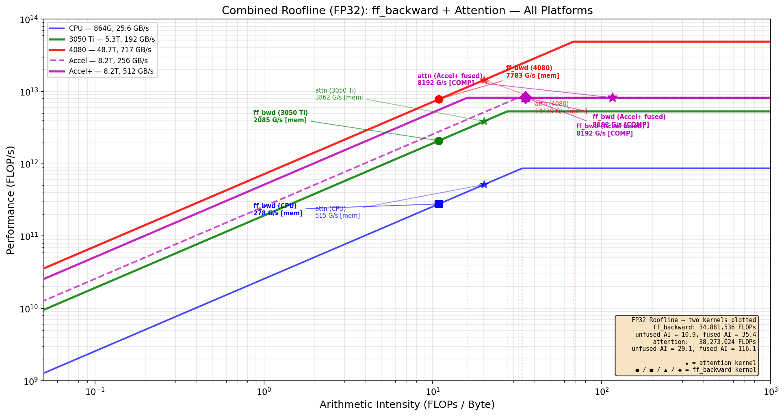
Dataflow-Fused Transformer Training Accelerator Chiplet
End-to-end fusion of FFN + attention sublayers to eliminate intermediate SRAM traffic | ECE 510 | Spring 2026 | David Boss
Core Idea: Dataflow Fusion Eliminates Memory Traffic
End-to-end fusion of transformer sublayers (FFN forward,
FFN backward, multi-head attention) to eliminate intermediate
SRAM traffic. All GEMMs execute on a 64x64 systolic array
with tiled dataflow; activations (GELU, softmax) are fused
at the array output — intermediates stay in registers.
Targets ~80% of training runtime (B=4, T=64, D=64, 2 layers).
Accelerator Dataflow
Full FFN + attention pipeline on systolic array via tiling:
GEMMs tiled as 64x64 blocks through the array (D=64
maps directly; F=256 requires 4 passes per tile dim).
Fused activation units at systolic output stage:
MUX selects GELU, GELU', or softmax per FSM state.
Intermediates flow through registers, never to SRAM.
Attention uses FlashAttention-style streaming/tiling:
Q*K^T computed in blocks, softmax applied per-block,
avoids materializing the full T*T score matrix.
Memory traffic reduction (vs unfused):
ff_backward: 3.2 MB → 0.98 MB (69% reduction)
attention: 1.9 MB → 0.33 MB (83% reduction)
FP32 Roofline Estimates (ff_backward kernel)
Platform Peak BW Attain. Bound
──────────────────────────────────────────────────────────
i5-10500H CPU 864G 25.6 GB/s 278 G/s mem
RTX 3050 Ti 5.3T 192 GB/s 2,085 G/s mem
RTX 4080 48.7T 717 GB/s 7,783 G/s mem
Accel+ (fused) 8.2T 512 GB/s 8,192 G/s COMP
Fusion shifts AI from 10.86 → 35.4 FLOP/B, crossing the
ridge point. Accelerator becomes compute-bound, hitting
the full 8.2 TFLOP/s systolic peak.
Note: estimates from roofline model, not measured silicon.
Config: B=4, T=64, d_model=64, d_ff=256, 2 layers, FP32.
Scaling & Future Work
This is a chiplet building block, not a GPU replacement.
Scaling strategies for larger models:
1. Mixed-precision (FP16/BF16 accumulate to FP32)
→ 2x MACs/cycle, peak → 16.4 TFLOP/s, same area
2. Multi-chiplet: UCIe mesh of N chiplets for N× batch
→ Linear scaling for data-parallel training
3. Accelerate layer_norm (~11% runtime)
→ Coverage ~80% → ~91%, Amdahl's 3.6x → 5.3x
4. Configurable array partitioning (2x 32x64)
→ Concurrent matmuls for smaller dimensions
FP32 Roofline: ff_backward + attention on all platforms (roofline model)
Chiplet Architecture (building block)
Host CPU (i5-10500H) ← 20% of workload
| UCIe x16 (8 GB/s bidir)
v
+───── Accelerator+ Chiplet ──────+
│ │
│ 64x64 Systolic Array @ 500 MHz │
│ 4,096 MACs, tiled GEMM engine │
│ | │
│ [MUX: GELU|GELU'|softmax] │
│ Fused at output stage │
│ │
│ SRAM Scratchpad (512 GB/s) │
│ ~11.5W est. │
+─────────────────────────────────+
Power Efficiency (estimated)
Platform Power Perf Eff. (est.)
─────────────────────────────────────────────────
i5-10500H CPU 45W 278 G/s 6.2 G/s/W
RTX 4080 320W 7,783 G/s 24.3 G/s/W
Accel+ (est.) ~11.5W 8,192 G/s ~712 G/s/W
Power est. from component analysis, not synthesis.
Dataflow fusion across FFN + attention sublayers | AI: 10.86 → 35.4 (mem→compute bound) | ~80% coverage, 3.6x Amdahl's | Chiplet building block, scalable via UCIe mesh

