Slide 1
PE
By BOSS and OHH
Pong Game

Slide 2
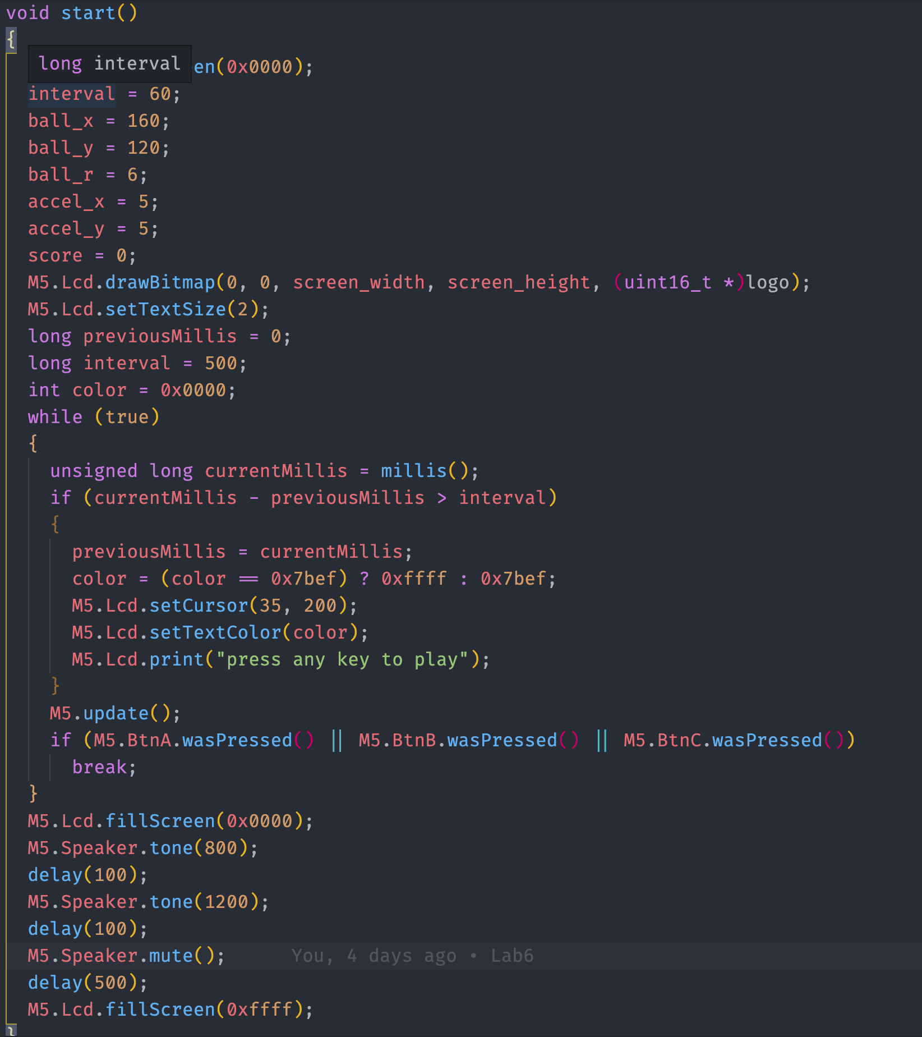
dda
One Player
Start() Function

Slide 3
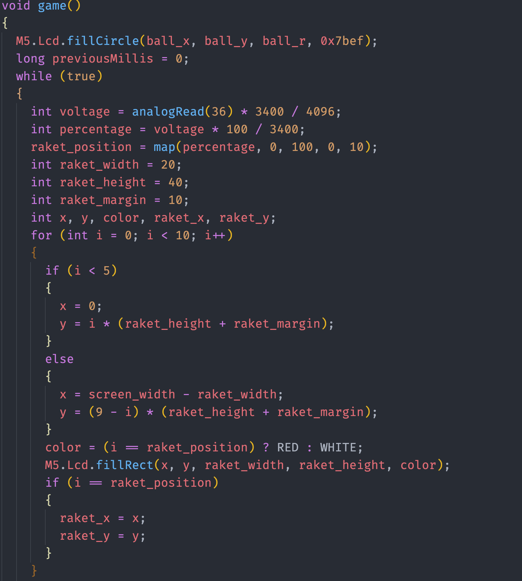
dda
One Player
Game() Function

Slide 4
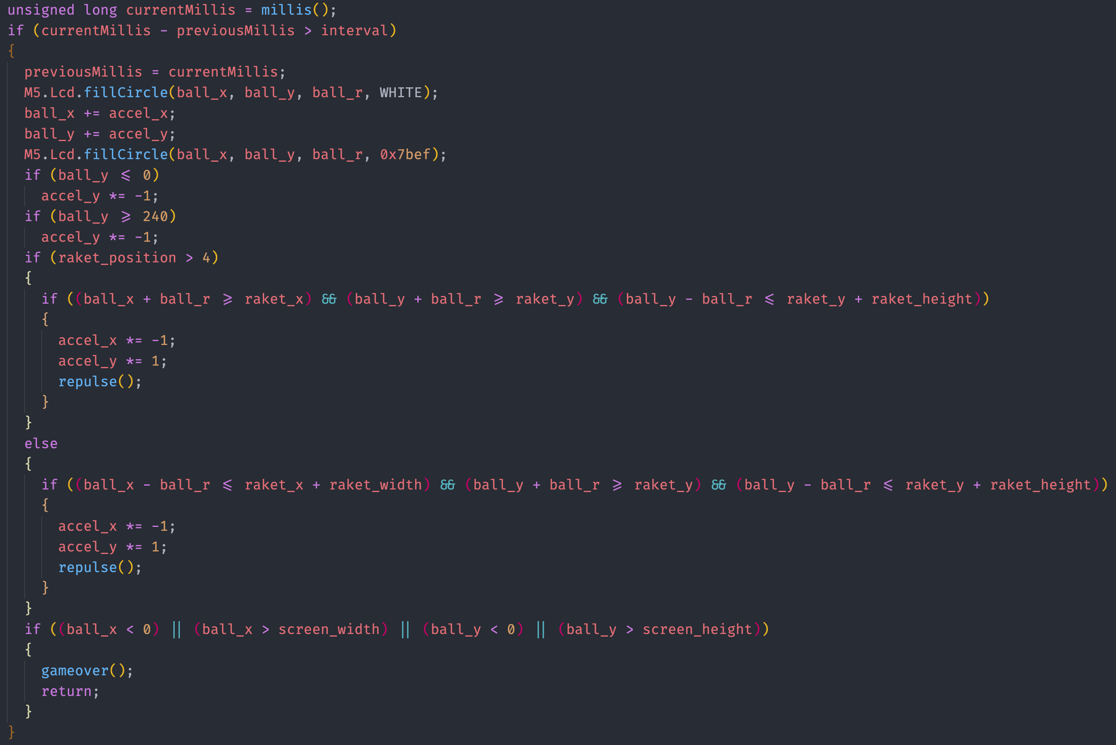
dda
One Player
Game() Function

Slide 5
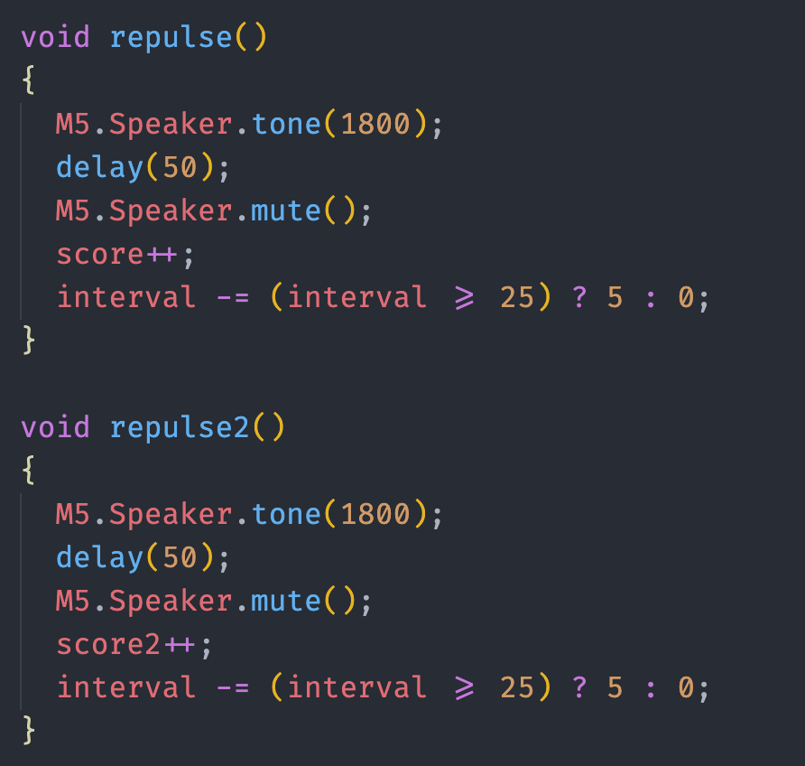
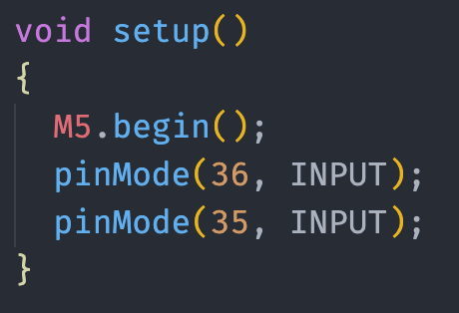
dda
One Player
Repulse() Function
Setup() Function

Slide 6
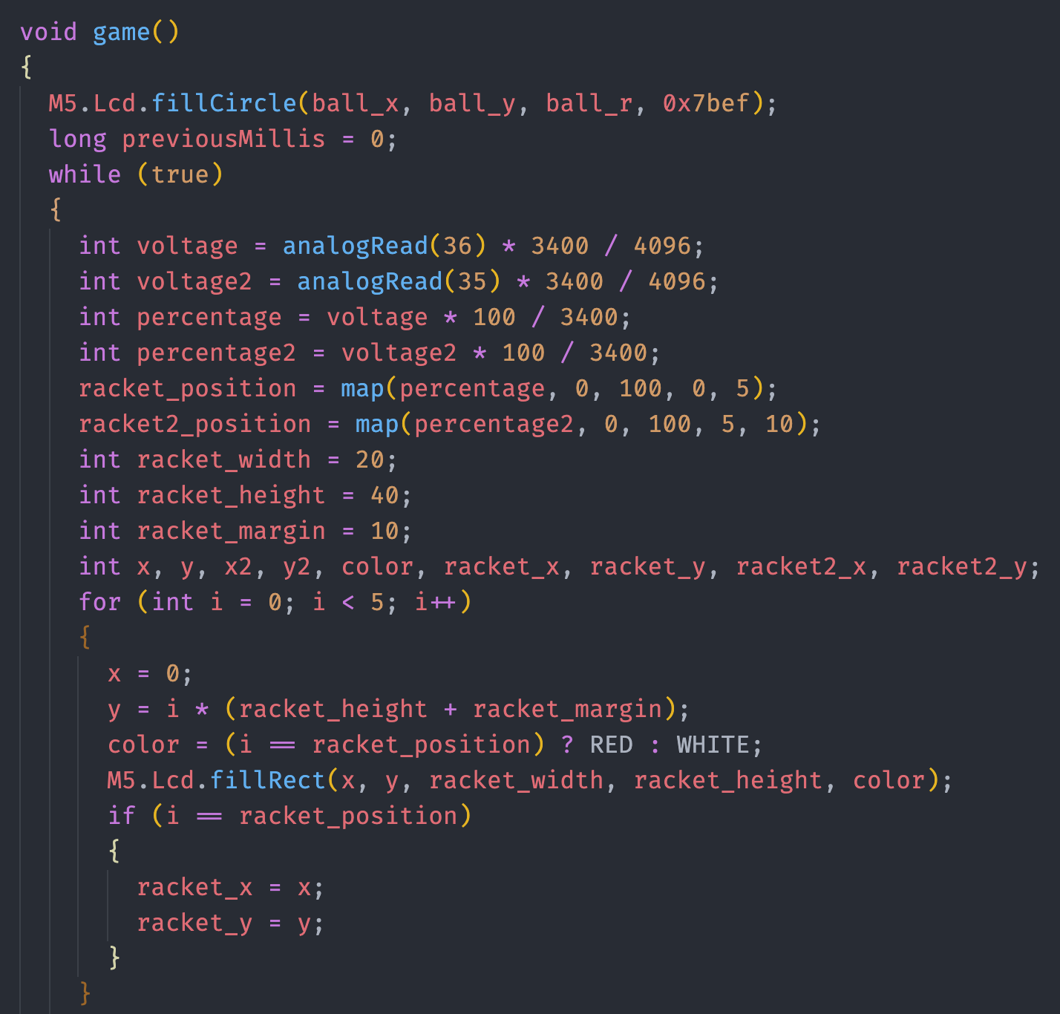
dda
Two Player
Game() Function

Slide 7
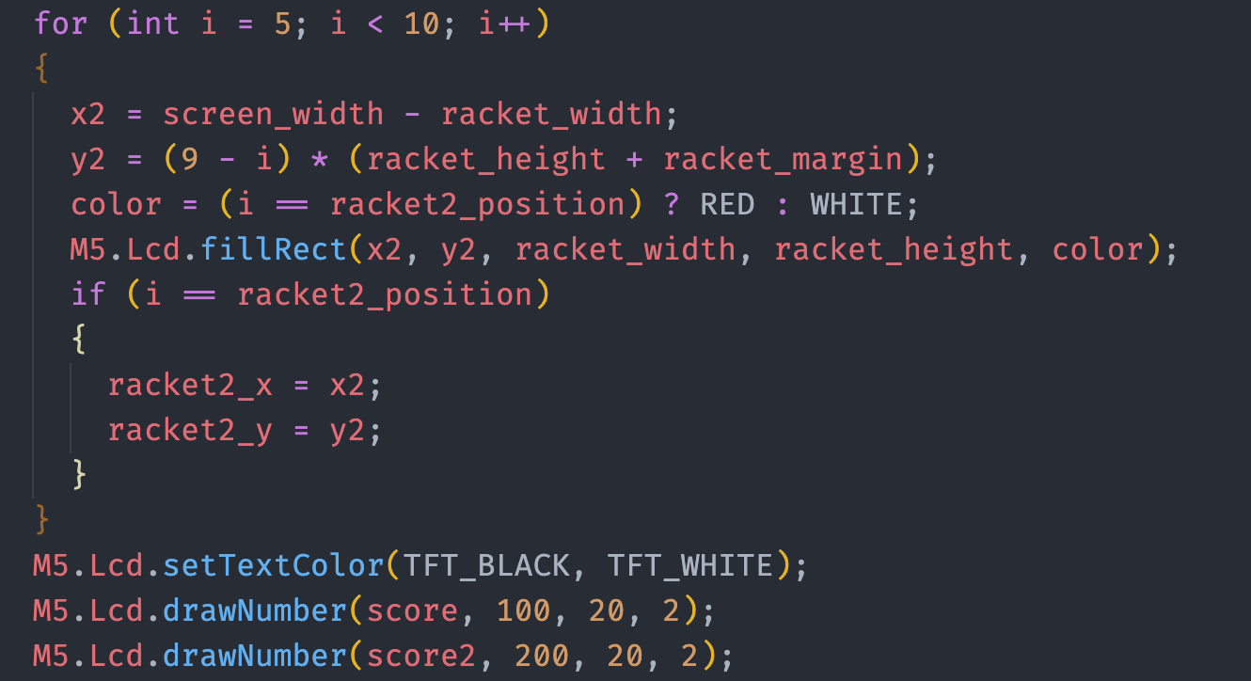
dda
Two Player
Game() Function

Slide 8
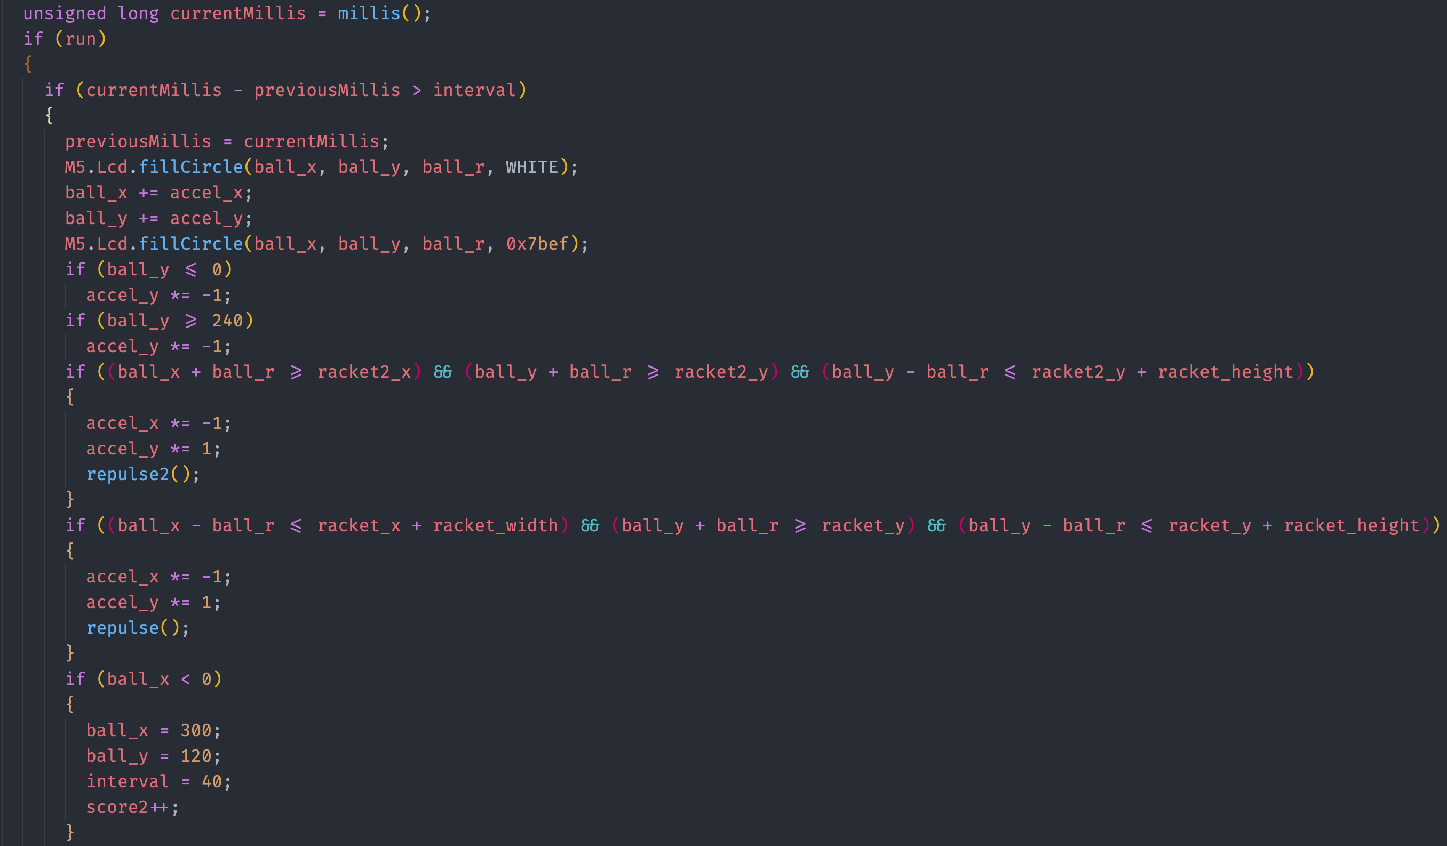
dda
Two Player
Game() Function

Slide 9
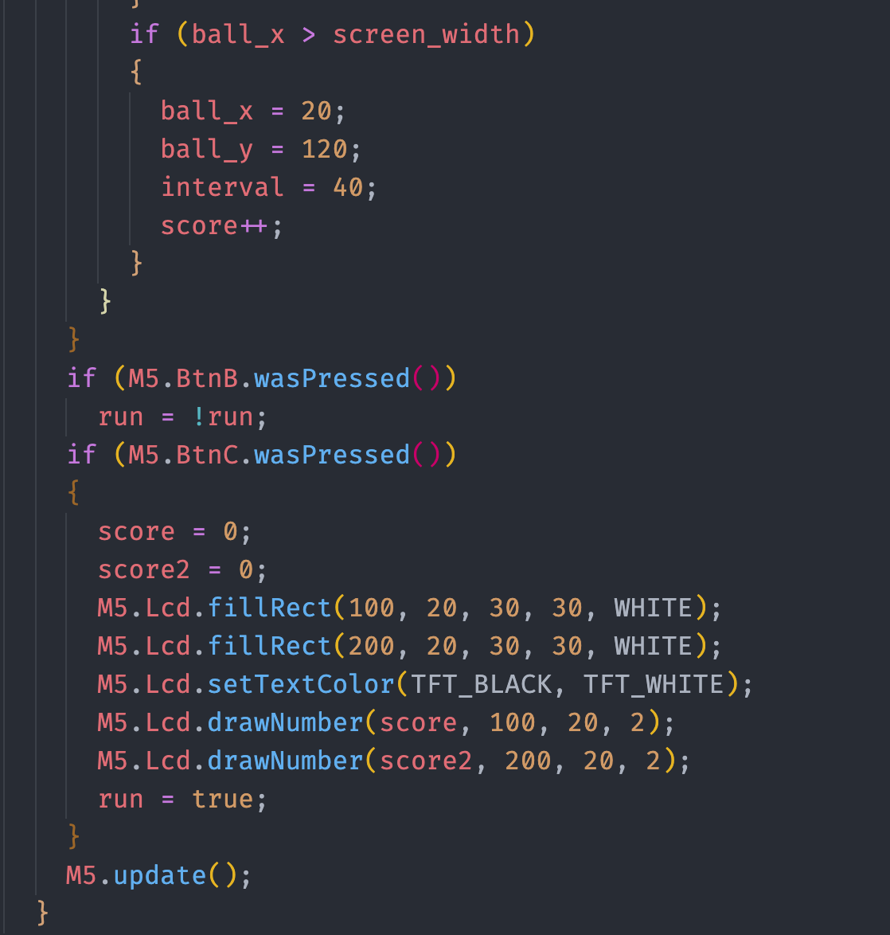
dda
Two Player
Game() Function

Slide 10
dda
Two Player
Repulse() Function

Slide 11
dda
Two Player
Setup() Function

Slide 12
T
Thank you

