Slide 1
Lab 5
By Boss and Ohh
Lab 05 : Digtal Clock and Stopwatch

Slide 2
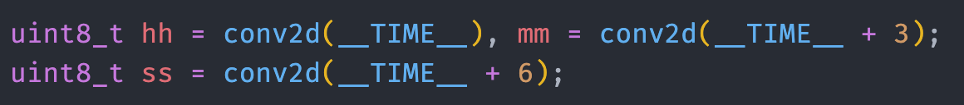
Task 1 : Digital clock
Task 1 : Digital Clock

Slide 3
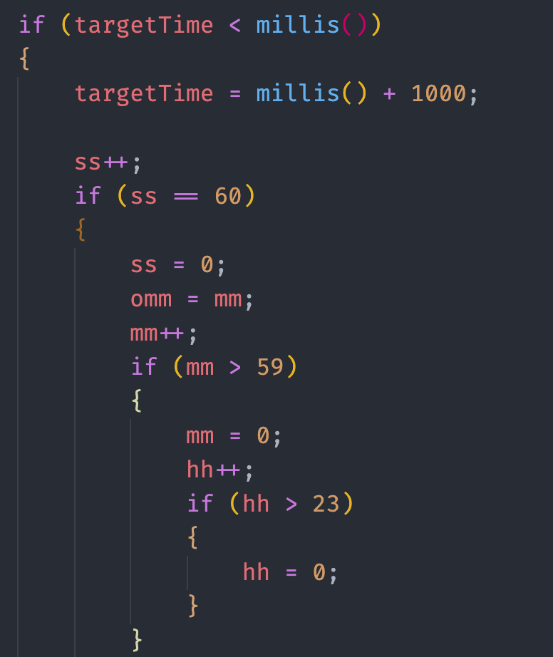
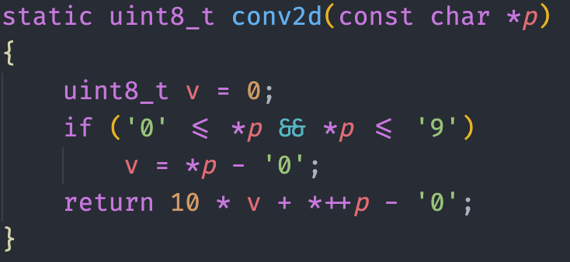
Task 1 : Digital clock
Task 1 : Digital Clock

Slide 4
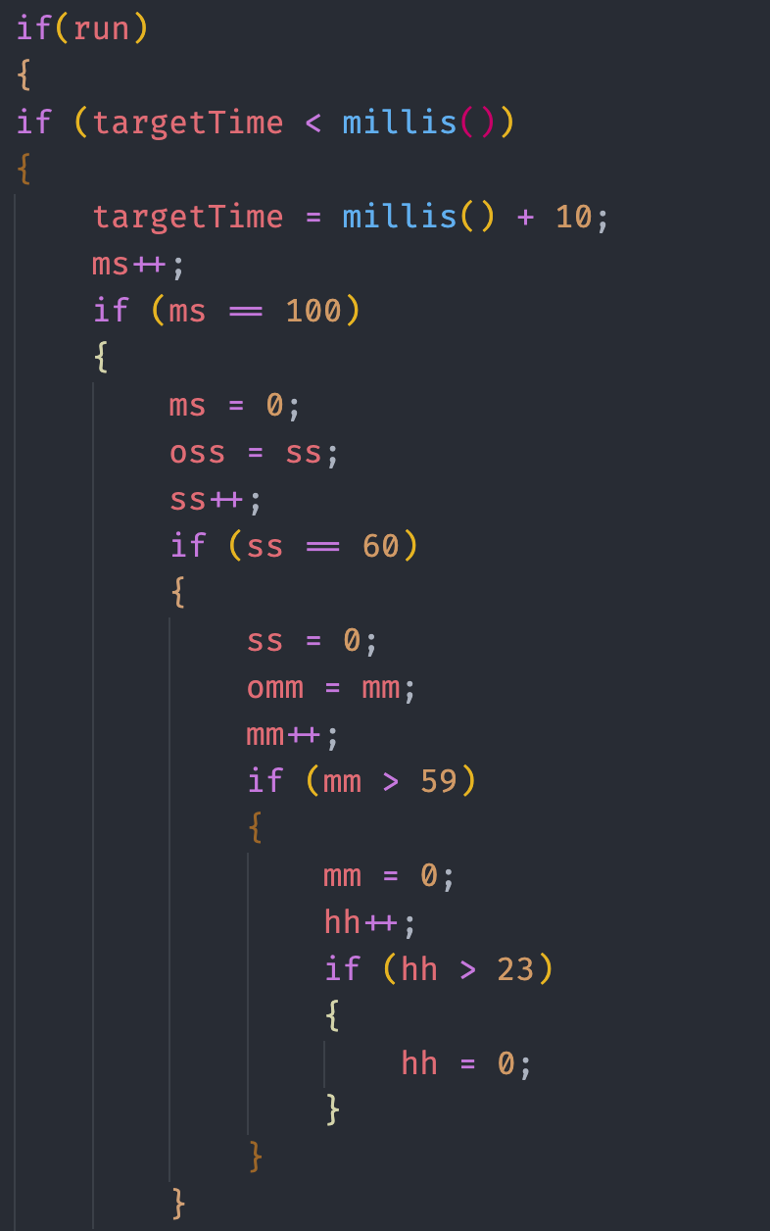
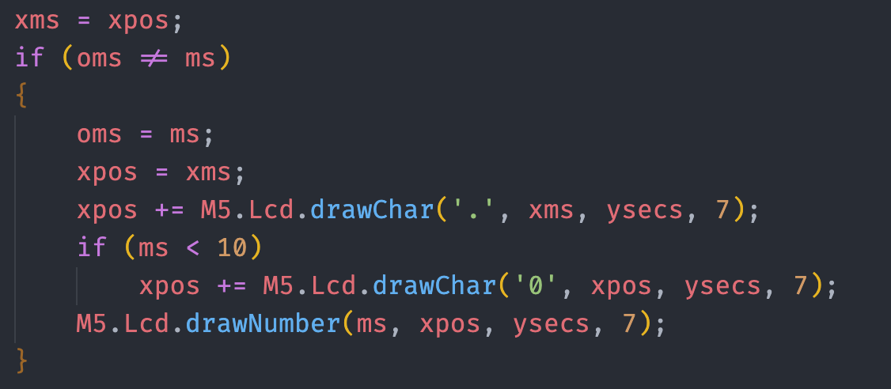
Task 2 : Stopwatch

Slide 5
T
THANK YOU

