Slide 1
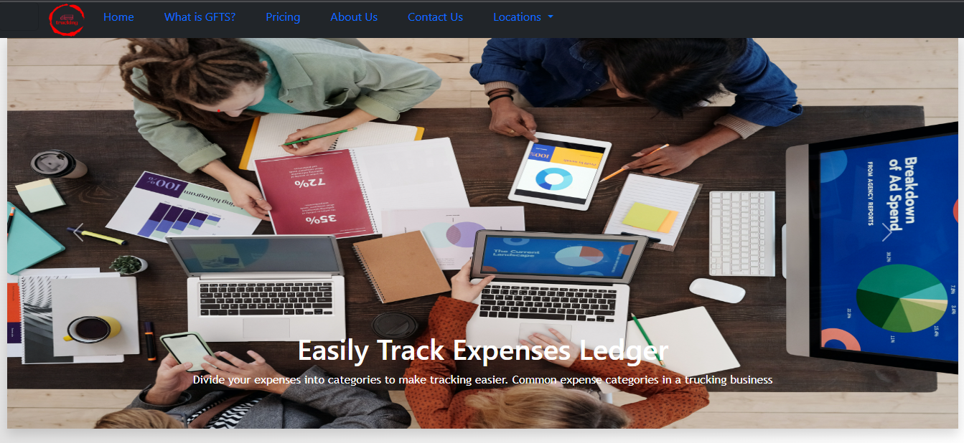
Global fast tracking services GPTS

Slide 2

Purpose of this website
"GPTS," is a website system solution designed to assist companies in efficiently managing their receipt documents ,expenses Systems booking system and payroll system for sub contractors and operators within their tracking operation systems. This system offers a wide range of benefits and functionalities to streamline various aspects of document and expense management:

Slide 3

Key features and benefits of GPTS
1:Streamlined Document Management-It allows companies to effortlessly capture, organize, and Receiving receipts.
2:Expense Tracking and Booking: GPTS offers a comprehensive expense tracking and booking system that ensures meticulous record-keeping and compliance with financial regulations. It automates the recording of expenses, making it easier for employees to submit expenses and for managers to approve them.
3:Payroll Management: For businesses dealing with subcontractors and operators, managing payroll of their employee can be a complex task. 4:Enhanced Tracking Operations: It provides real-time visibility into various aspects of operations, allowing businesses to make informed decisions and respond swiftly to changing circumstances.
5:Cost Reduction: By automating and streamlining these critical business processes, GPTS helps reduce manual labor, administrative errors, and the associated costs.

Slide 4

The tech stack
Html
CSS
Bootstrap5
Little bit JavaScript

