Slide 1



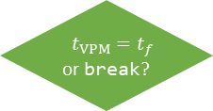


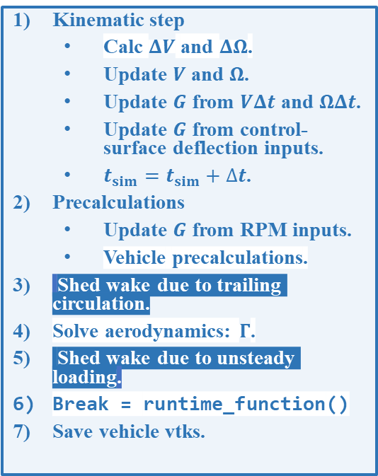
INPUTS
VPM SOLVER
or
Control surface deflections
FLOWUnsteady Engine
DYNAMICS
Integrate forces and moments at CG
Calculate $\dot{V}$ and $\dot{Ω}$
Rotor system RPMs
Calculate embedded particles.
Convection, diffusion, and stretching of particles.
VPM relaxation.
If too much spreading
Resize particles.
RBF interpolation.
break = runtime_function()
Save pfield vtks. (including embedded particles calculated in (1))
Kinematic step
Calc $ΔV$ and $ΔΩ$.
Update $V$ and $Ω$.
Update $G$ from $VΔt$ and $ΩΔt$.
Update $G$ from control-surface deflection inputs.
$t_{sim}=t_{sim}+∆t$.
Precalculations
Update $G$ from RPM inputs.
Vehicle precalculations.
Shed wake due to trailing circulation.
Solve aerodynamics: $Γ$.
Shed wake due to unsteady loading.
Break = runtime_function()
Save vehicle vtks.
STATE VARIABLES
$∆V$, $∆Ω$
USER-PRESCRIBED KINEMATICS
Spatial information (Geometry)
Vehicle velocity $V$
Vehicle angular velocity $Ω$
COLOR CODE
Unsteady solver.
Quasi-steady solver.
$$t_{VPM}=t_{VPM}+∆t$$
no
${t_{VPM}=t}_{f}$ or break?
break
MONITORS AND POST-PROCESSING
break
yes
END

Slide 2
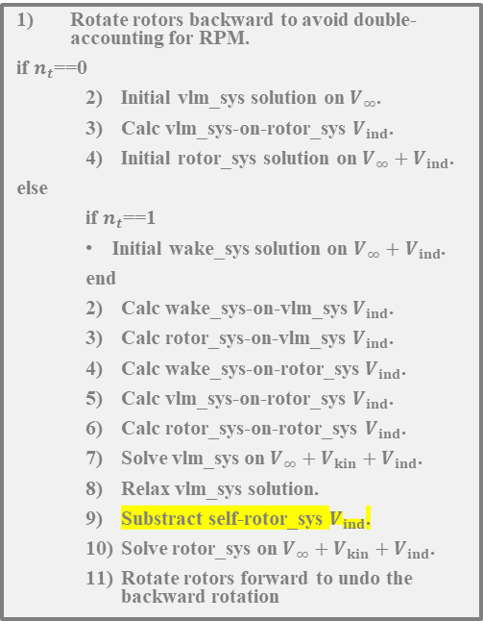
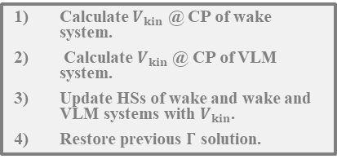
INPUTS
VPM SOLVER
or
Control surface deflections
FLOWUnsteady Engine
DYNAMICS
Integrate forces and moments at CG
Calculate $\dot{V}$ and $\dot{Ω}$
Rotor system RPMs
Calculate embedded particles.
Convection, diffusion, and stretching of particles.
VPM relaxation.
If too much spreading
Resize particles.
RBF interpolation.
break = runtime_function()
Save pfield vtks. (including embedded particles calculated in (1))
Kinematic step
Calc $ΔV$ and $ΔΩ$.
Update $V$ and $Ω$.
Update $G$ from $VΔt$ and $ΩΔt$.
Update $G$ from control-surface deflection inputs.
$t_{sim}=t_{sim}+∆t$.
Precalculations
Update $G$ from RPM inputs.
Vehicle precalculations.
Shed wake due to trailing circulation.
Solve aerodynamics: $Γ$.
Shed wake due to unsteady loading.
Break = runtime_function()
Save vehicle vtks.
STATE VARIABLES
$∆V$, $∆Ω$
USER-PRESCRIBED KINEMATICS
Spatial information (Geometry)
Calculate $V_{kin}$ @ CP of wake system.
Calculate $V_{kin}$ @ CP of VLM system.
Update HSs of wake and wake and VLM systems with $V_{kin}$.
Restore previous $Γ$ solution.
Vehicle velocity $V$
Vehicle angular velocity $Ω$
COLOR CODE
Unsteady solver.
Quasi-steady solver.
Rotate rotors backward to avoid double-accounting for RPM.
if $n_{t}$==0
Initial vlm_sys solution on $V_{∞}$.
Calc vlm_sys-on-rotor_sys $V_{ind}$.
Initial rotor_sys solution on $V_{∞}+V_{ind}$.
else
if $n_{t}$==1
Initial wake_sys solution on $V_{∞}+V_{ind}$.
end
Calc wake_sys-on-vlm_sys $V_{ind}$.
Calc rotor_sys-on-vlm_sys $V_{ind}$.
Calc wake_sys-on-rotor_sys $V_{ind}$.
Calc vlm_sys-on-rotor_sys $V_{ind}$.
Calc rotor_sys-on-rotor_sys $V_{ind}$.
Solve vlm_sys on $V_{∞}+V_{kin}+V_{ind}$.
Relax vlm_sys solution.
Substract self-rotor_sys $V_{ind}$.
Solve rotor_sys on $V_{∞}+V_{kin}+V_{ind}$.
Rotate rotors forward to undo the backward rotation
$$t_{VPM}=t_{VPM}+∆t$$
no
${t_{VPM}=t}_{f}$ or break?
break
yes
END

Slide 3
INPUTS
VPM SOLVER
or
Control surface deflections
FLOWUnsteady Engine
DYNAMICS
Integrate forces and moments at CG
Calculate $\dot{V}$ and $\dot{Ω}$
Rotor system RPMs
Calculate embedded particles.
Convection, diffusion, and stretching of particles.
VPM relaxation.
If too much spreading
Resize particles.
RBF interpolation.
break = runtime_function()
Save pfield vtks. (including embedded particles calculated in (1))
Kinematic step
Calc $ΔV$ and $ΔΩ$.
Update $V$ and $Ω$.
Update $G$ from $VΔt$ and $ΩΔt$.
Update $G$ from control-surface deflection inputs.
$t_{sim}=t_{sim}+∆t$.
Precalculations
Update $G$ from RPM inputs.
Vehicle precalculations.
Shed wake due to trailing circulation.
Solve aerodynamics: $Γ$.
Shed wake due to unsteady loading.
Break = runtime_function()
Save vehicle vtks.
STATE VARIABLES
$∆V$, $∆Ω$
USER-PRESCRIBED KINEMATICS
Spatial information (Geometry)
Calculate $V_{kin}$ @ CP of wake system.
Calculate $V_{kin}$ @ CP of VLM system.
Update HSs of wake and wake and VLM systems with $V_{kin}$.
Restore previous $Γ$ solution.
Vehicle velocity $V$
Vehicle angular velocity $Ω$
COLOR CODE
Unsteady solver.
Quasi-steady solver.
Rotate rotors backward to avoid double-accounting for RPM.
if $n_{t}$==0
Initial vlm_sys solution on $V_{∞}$.
Calc vlm_sys-on-rotor_sys $V_{ind}$.
Initial rotor_sys solution on $V_{∞}+V_{ind}$.
else
if $n_{t}$==1
Initial wake_sys solution on $V_{∞}+V_{ind}$.
end
Calc wake_sys-on-vlm_sys $V_{ind}$.
Calc rotor_sys-on-vlm_sys $V_{ind}$.
Calc wake_sys-on-rotor_sys $V_{ind}$.
Calc vlm_sys-on-rotor_sys $V_{ind}$.
Calc rotor_sys-on-rotor_sys $V_{ind}$.
Solve vlm_sys on $V_{∞}+V_{kin}+V_{ind}$.
Relax vlm_sys solution.
Substract self-rotor_sys $V_{ind}$.
Solve rotor_sys on $V_{∞}+V_{kin}+V_{ind}$.
Rotate rotors forward to undo the backward rotation
$$t_{VPM}=t_{VPM}+∆t$$
no
${t_{VPM}=t}_{f}$ or break?
yes
END

