Slide 1


Bakery Sales Prediction
Janine Berndt, Jonna Lauther, Marten Drews ⎯ Data Science Group 12

Slide 2
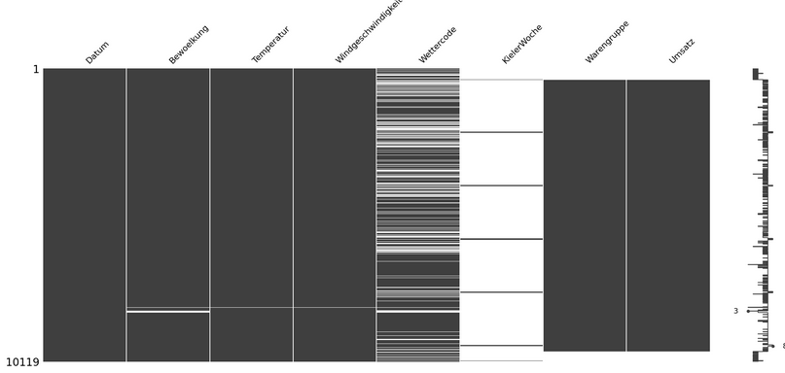
1.1 ⎯ Dataset Characteristics – General Evaluation
Preparation of dataset
Merging the given data sets and removing all data without sales + adding additional features
Exploring the dataset
24S | Einführung in Data Science & maschinelles Lernen 27.06.2024
Notes:
Source: DataAnalyse_MissingValues.ipynb
msno.matrix(df)
MAR – Missing At Random
MNAR – Missing Not At Random
1. Bewoelkung: The pattern suggests it might be MAR or MNAR, depending on whether its missingness can be related to other observed variables or itself.
2. Temperatur: The missingness seems somewhat random but might be MAR if related to other weather variables.
3. Windgeschwindigkeit: Similar to Temperatur, it could be MAR if missingness correlates with other weather-related data.
4. Wettercode: The large number of missing values suggests it could be MAR, related to other weather data, or MNAR if it is dependent on specific unobserved conditions.
5. KielerWoche: The missing values follow a pattern, which suggests MNAR.
6. Warengruppe: There is no missing data for overall group Warengruppe.
7. Umsatz: There is no missing data for overall group Umsatz.
Please note: The missing data for Umsatz und Warengruppe at the end of the CSV file suggests that there was simply no data, and therefore, we come to the conclusion that these dates are not of interest for our survey.

Slide 3
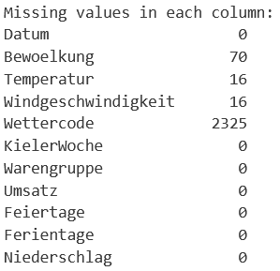
1.1 ⎯ Dataset Characteristics
New Features:
Niederschlag
Temperature deviation
Date (weekday, month, day of month, season)
Wetterklasse (aggregated Wettercode) → dropped
Missing value imputation:
Cloudiness: Mode imputation
Temperature, windspeed, precipitation: linear interpolation
Wettercode: KNN (dependent on other weather variables)
24S | Einführung in Data Science & maschinelles Lernen 27.06.2024
Notes:
Source: DataAnalyse_MissingValues.ipynb
msno.matrix(df)
MAR – Missing At Random
MNAR – Missing Not At Random
1. Bewoelkung: The pattern suggests it might be MAR or MNAR, depending on whether its missingness can be related to other observed variables or itself.
2. Temperatur: The missingness seems somewhat random but might be MAR if related to other weather variables.
3. Windgeschwindigkeit: Similar to Temperatur, it could be MAR if missingness correlates with other weather-related data.
4. Wettercode: The large number of missing values suggests it could be MAR, related to other weather data, or MNAR if it is dependent on specific unobserved conditions.
5. KielerWoche: The missing values follow a pattern, which suggests MNAR.
6. Warengruppe: There is no missing data for overall group Warengruppe.
7. Umsatz: There is no missing data for overall group Umsatz.
Please note: The missing data for Umsatz und Warengruppe at the end of the CSV file suggests that there was simply no data, and therefore, we come to the conclusion that these dates are not of interest for our survey.

Slide 4
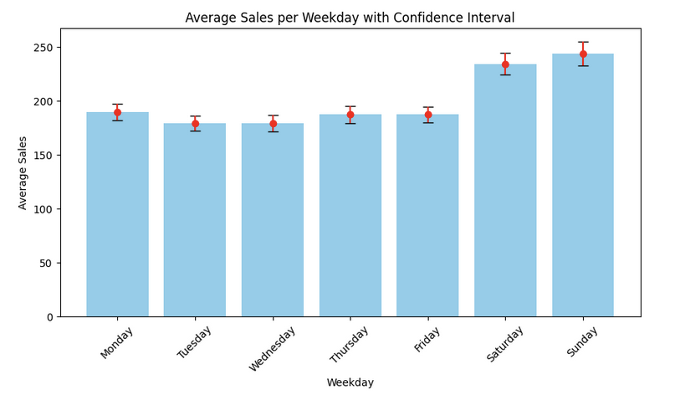
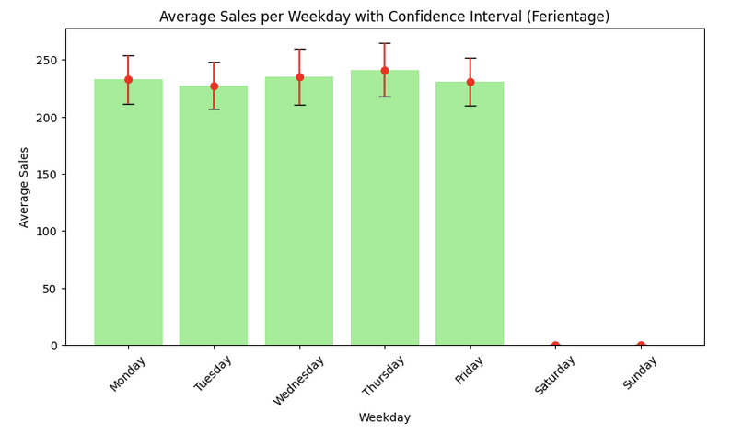
1.2 ⎯ Dataset Characteristics – Feature Ferientage
Note: Weekends are not considered Ferientage by default.
The plot just taking the time frame Ferientage into acount shows a reasonable increase of sales. However, there are no outlier.
24S | Einführung in Data Science & maschinelles Lernen 27.06.2024
Notes:
Source: DataAnalyse4AditionalFeatures.ipynb

Slide 5
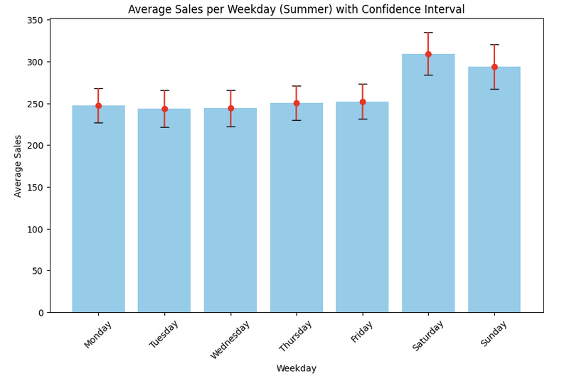
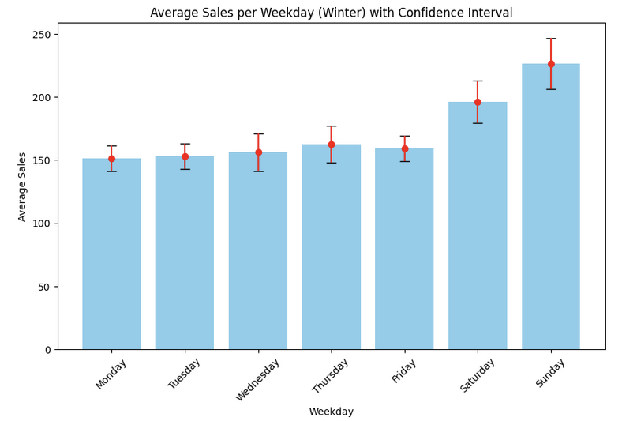
1.3 ⎯ Dataset Characteristics – Feature Season
Note: Only Summer and Winter are shown here as Spring matches Summer and Autumn is showing similar behaviour like Winter.
The plots indicate that the average number of sales is definitely higher in summer (spring) assuming weather conditions are having an impact in purchase behaviour.
24S | Einführung in Data Science & maschinelles Lernen 27.06.2024
Notes:
Source: DataAnalyse4AditionalFeatures.ipynb

Slide 6
2 ⎯ Baseline Model
Model
Linear Regression (OLS from statsmodel)
Features
Continuous variables: Temperatur, Niederschlag, Bewölkung, Windgeschw., Temp-deviation
Categorical variables: Warengruppe, Wettercode, Wochentag, Monatstag, Monat, Jahr, Jahreszeit, Ferientage, Feiertage, KielerWoche
Output
R-squared: 0.869
Adj. R-squared: 0.854
F-statistic: 54.82
Prob (F-statistic): 0.00
Cross-Validation R-squared Scores: [0.7831129910709567, 0.8690670919135706, 0.856027214024433, 0.7263895318087165, 0.8454007611017007]
Mean Cross-Validation R-squared: 0.8159995179838754
Conclusion
R2 score is considered good (>0.8) → Baseline Model is reliable and effective predicting Umsatz.
model = smf.ols('Umsatz ~ Temperatur * Niederschlag * C(Wettercode) * Bewoelkung * Windgeschwindigkeit * temp_dv + C(Warengruppe) * C(weekday) * C(month) + C(day_month) + C(year) + C(season) + C(Ferientage) + C(Feiertage) + C(KielerWoche)', data=umsatzdaten).fit()
24S | Einführung in Data Science & maschinelles Lernen 27.06.2024
Notes:
Source: BaseLine_RandomForest.ipynb
Notes:
Removing 'Temperatur' has led to a significant decrease in model performance, indicating that 'Temperatur' is an important feature for predicting 'Umsatz'. It is advisable to keep 'Temperatur' in the model to maintain better predictive accuracy!
Removing 'KielerWoche' did not significantly impact the model's performance. The slight differences in the metrics indicate that 'KielerWoche' may not be a crucial feature for predicting 'Umsatz’.
Removing 'Feiertage' and 'Ferientage' has resulted in a minor decrease in model performance. These features appear to provide some useful information for predicting 'Umsatz'. Hence, it might be beneficial to keep 'Feiertage' and 'Ferientage' in the model.
Including 'Niederschlag' has resulted in a slight improvement in the Mean R2 score, indicating that it might have some predictive power. Based on these observations, including 'Niederschlag' seems to add some value to the model. Therefore, it can be beneficial to include 'Niederschlag' in the feature set.

Slide 7
2 ⎯ Baseline Model
Model
Random Forest Regressor and incorporating polynomial features
Features
'Temperatur', 'KielerWoche', 'Warengruppe', 'Bewoelkung', 'Windgeschwindigkeit', 'Feiertage', 'Ferientage', 'Wetterklasse', 'Niederschlag'
Output
Cross-validated R2 scores: array([0.7297873 , 0.6889417 , 0.65568813, 0.59231637, 0.61656247])
Mean R2 score: 0.6566591945000697
R2 score: 0.6954848698278695
Mean squared error: 6038.842551516265
Mean absolute error: 44.857032558501054
Conclusion
R2 score: 0.6954848698278695 is considered good → Baseline Model is reliable and effective predicting Umsatz.
24S | Einführung in Data Science & maschinelles Lernen 27.06.2024
Notes:
Source: BaseLine_RandomForest.ipynb
Notes:
Removing 'Temperatur' has led to a significant decrease in model performance, indicating that 'Temperatur' is an important feature for predicting 'Umsatz'. It is advisable to keep 'Temperatur' in the model to maintain better predictive accuracy!
Removing 'KielerWoche' did not significantly impact the model's performance. The slight differences in the metrics indicate that 'KielerWoche' may not be a crucial feature for predicting 'Umsatz’.
Removing 'Feiertage' and 'Ferientage' has resulted in a minor decrease in model performance. These features appear to provide some useful information for predicting 'Umsatz'. Hence, it might be beneficial to keep 'Feiertage' and 'Ferientage' in the model.
Including 'Niederschlag' has resulted in a slight improvement in the Mean R2 score, indicating that it might have some predictive power. Based on these observations, including 'Niederschlag' seems to add some value to the model. Therefore, it can be beneficial to include 'Niederschlag' in the feature set.

Slide 8
3.1 ⎯ Definition and EvaluationModel
To do
24S | Einführung in Data Science & maschinelles Lernen 27.06.2024
Notes:
Source:

Slide 9
3.2 ⎯ Definition and EvaluationModel
To do
24S | Einführung in Data Science & maschinelles Lernen 27.06.2024
Notes:
Source:

Slide 10
3.3 ⎯ Definition and EvaluationModel
To do
24S | Einführung in Data Science & maschinelles Lernen 27.06.2024
Notes:
Source:

Slide 11
4 ⎯ Results
To do
24S | Einführung in Data Science & maschinelles Lernen 27.06.2024
Notes:
Source:

Slide 12
5 ⎯ Challenges and Errors
Baseline Model
Linear Regressions output was simply wrong and we could not get it sorted.
Instead, we used Random Forest Regressor and incorporating polynomial features which worked just fine and allowed us to find dependencies etc.
Xxx
24S | Einführung in Data Science & maschinelles Lernen 27.06.2024
Notes:
Source:

Slide 13
Thank you for your attention! – Any questions?

