Slide 1
“Higher Prices for Larger Quantities? Nonmonotonic Price–
Quantity Relations in B2B Markets”
By Karan Uppal
Wei Zhang, Sriram Dasu, Reza Ahmadi (2016) Higher Prices for Larger Quantities? Nonmonotonic Price–Quantity Relations in B2B Markets. Management Science 63(7):2108-2126.

Slide 2
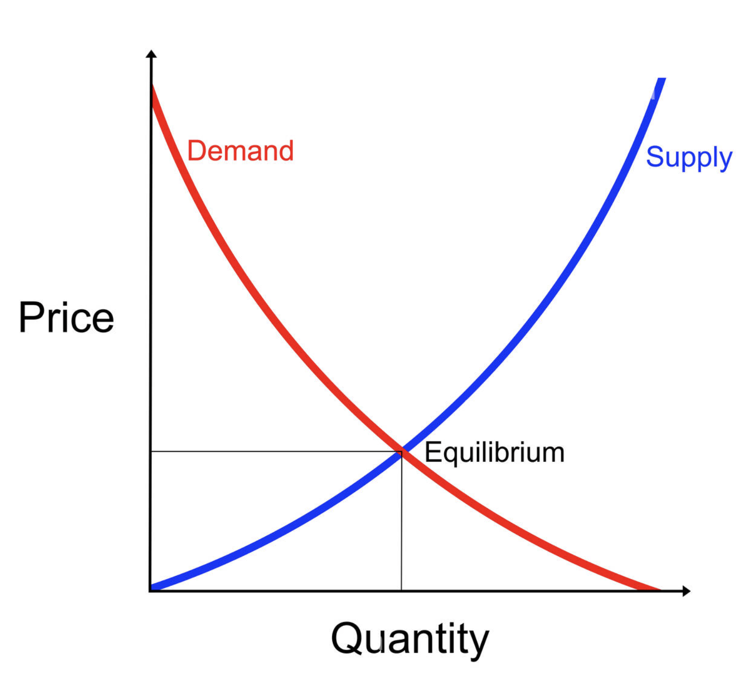
Case Study Significance
Conventional wisdom suggests that larger purchase quantities are generally associated with lower prices
Nonmonotonic price patterns noticed
Managerial implications associated with these pricing patterns

Slide 3
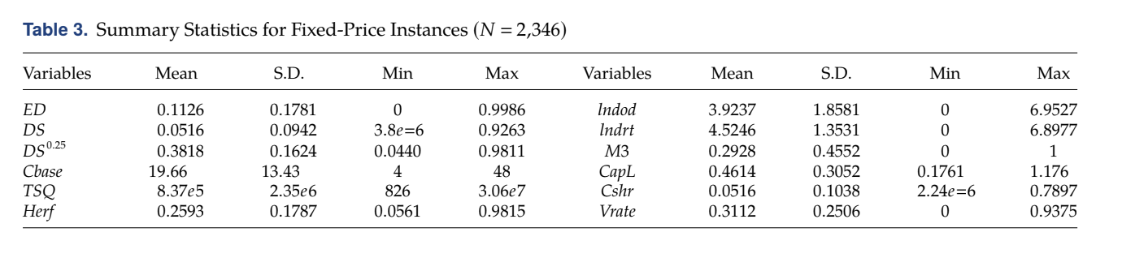
Data preparation
ED is an inverse measure of price level to the highest price ever paid for the product.
DS is the ratio of the total quantity purchased to the market size for that product.
Cbase measures product’s popularity
TSQ is the total sales quantity
Herf is the Herfindahl index or a measure of the degree of demand concentration for the product

Slide 4
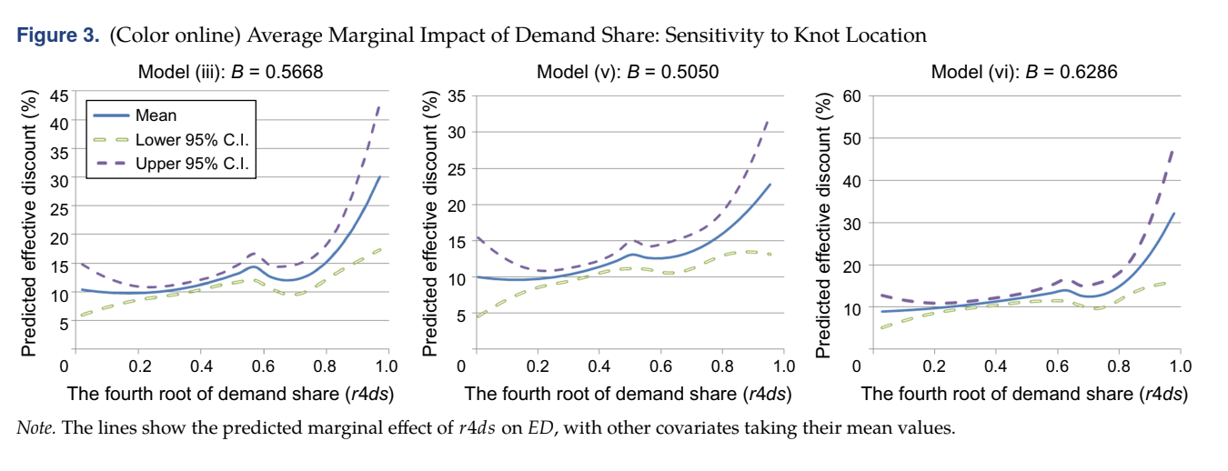
Piecewise Regression Models
“Created model using same data with product life cycle is short, capacity is inflexible, and prices are set through one-shot negotiations.”

Slide 5
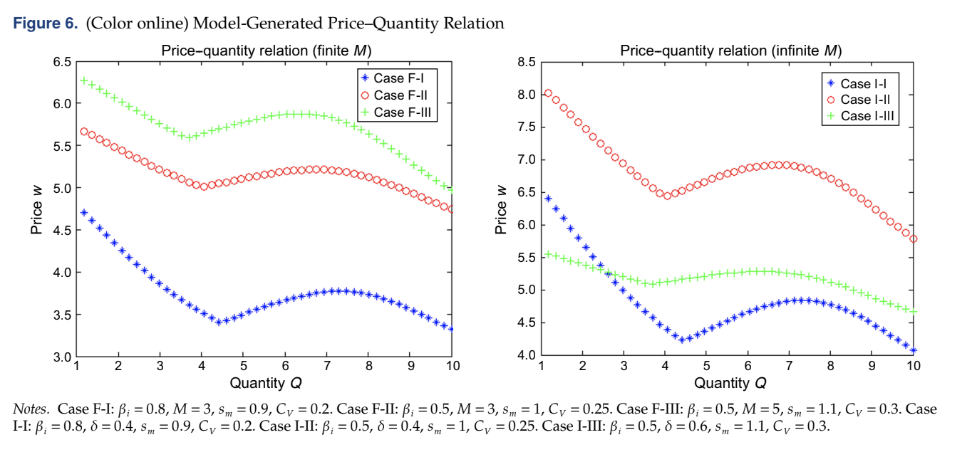
Interpretations
The nonmonotonic price–quantity relation is rooted in how the seller values her capacity when negotiating with a buyer.
Large buyers accelerate the selling process while small buyers are helpful in consuming the residual capacity.
However, satisfying midsized buyers may be costly because residual capacity can’t be sold.
Analysis shows that it is important for the seller to control the capacity allocated to each buyer before price negotiations, if possible.

Slide 6

How is this relevant?

Slide 7
Limitations of study
Selected only 2346 data entries(24.3% of data) due to…
-Effects of truncation from old processors sold(data before January 1, 2009)
-Eliminate single purchases from buyer
-Products only with more than three buyers(to avoid single product bias)
Variables omitted (net cost of switching to an alternative product and contract terms other than price and quantity for a buyer).
Applications and Conclusions
Regression analysis is inconsistent with conventional
wisdom

Slide 8
Nonlinear Neural Network Based Forecasting Model for Predicting COVID‑19 Cases
Zeju Li
Namasudra, S., Dhamodharavadhani, S., & Rathipriya, R. (2021, April 1). Nonlinear Neural Network based forecasting model for predicting COVID-19 cases - neural processing letters. SpringerLink. Retrieved September 29, 2022, from https://link.springer.com/article/10.1007/s11063-021-10495-w

Slide 9

Introduction
Covid-19
  Raised exponentially
  Low accuracy for single prediction model
  Traditional models — fail to support long-term prediction
Neural Networks
  Existing models
    Random forest model (AdaBoost calculation)
    Convolutional neural network
  NAR-NNTS: Nonlinear Autoregressive - Neural Network Time Series

Slide 10
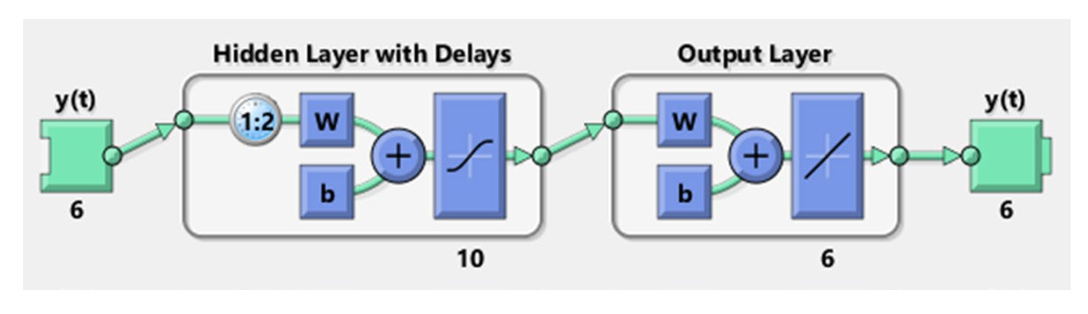

NAR-NNTS

Slide 11

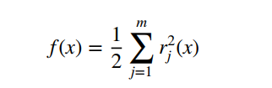

Optimal training algorithm
LM algorithm
Nonlinear data and optimization
Nonlinear least-square minimization
BR algorithm
Update of LM’s Weight and bias
Reduce squared error and weights
SCG algorithm
automated

Slide 12
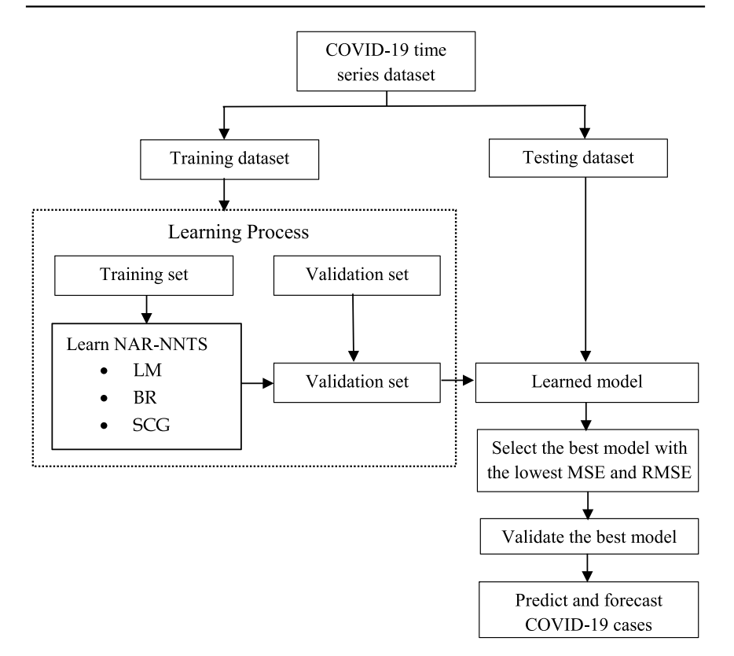
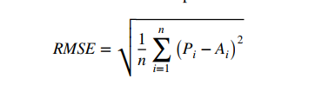


Qualitative Performance Measures
RMSE (Root mean square error)
MSE(Mean square error)
R-value(correlation coefficient value)

Slide 13
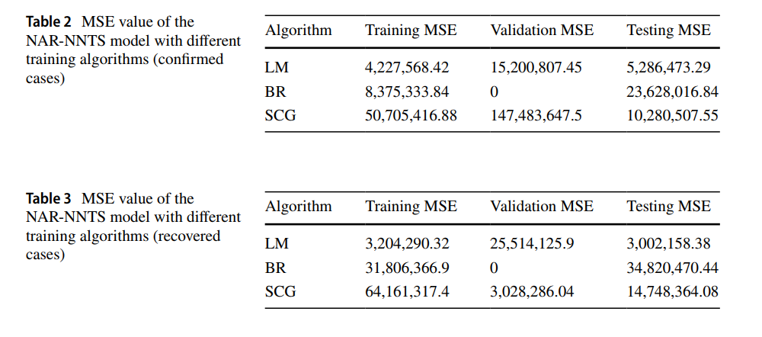
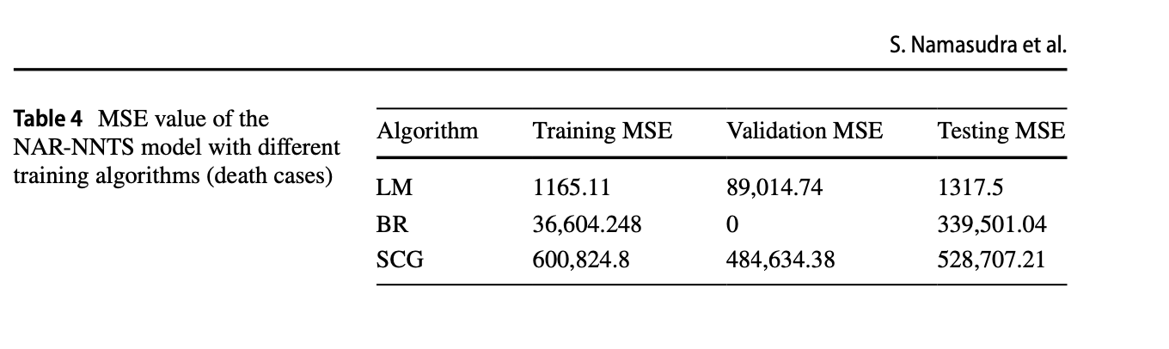
Performance Analysis -MSE

Slide 14
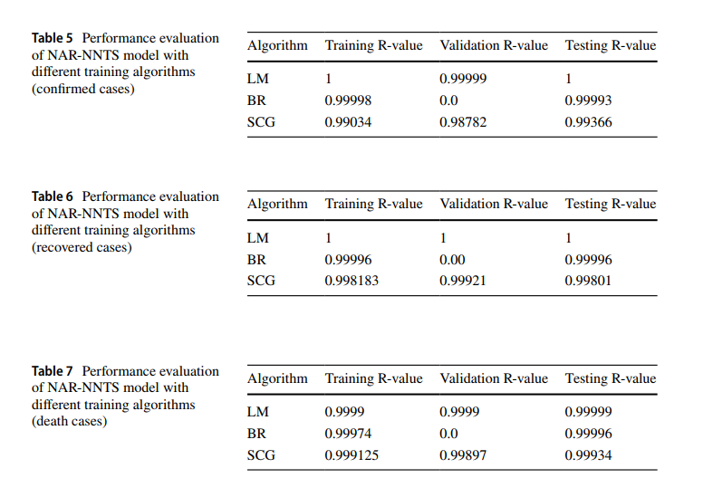
Performance Analysis – R value

Slide 15
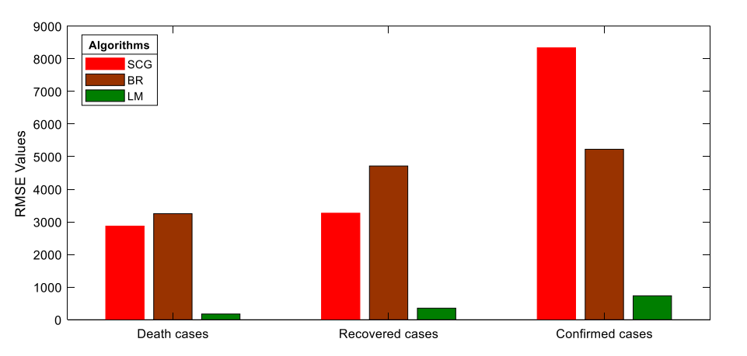
Performance Analysis – RMSE

Slide 16
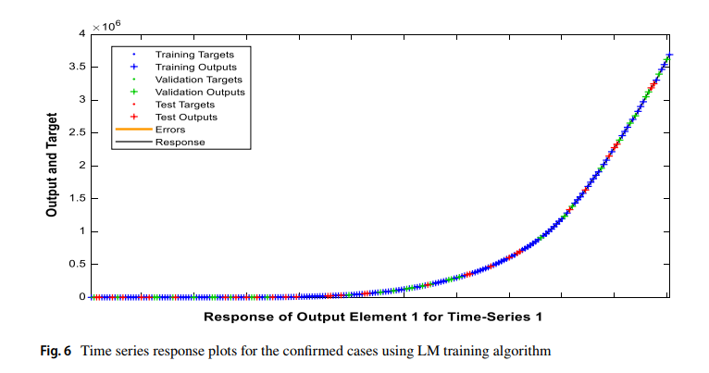
Time Series Response – Confirmed Cases

Slide 17
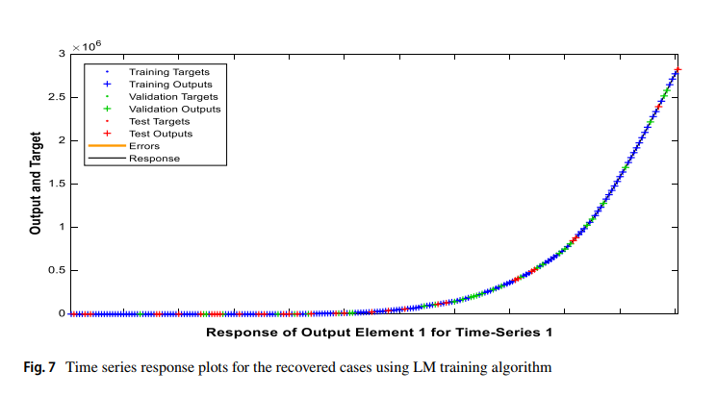
Time Series Response – Recovered Cases

Slide 18
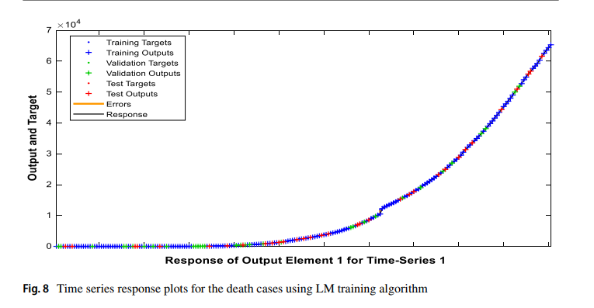
Time Series Response – Death Cases

Slide 19
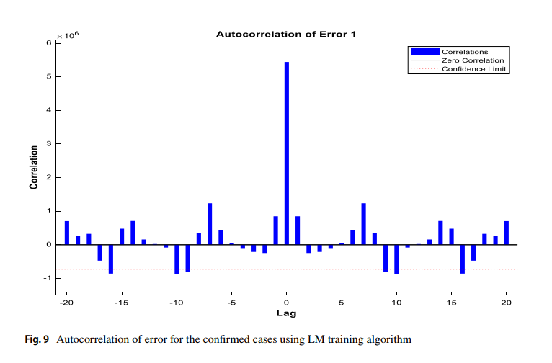
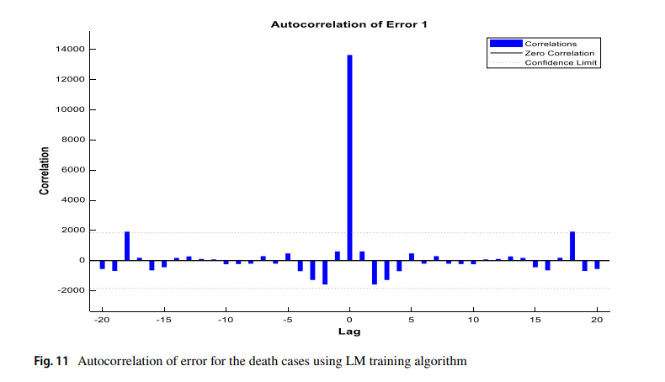
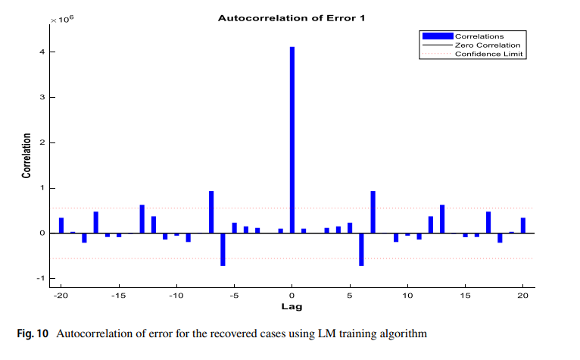
Correlation plot

Slide 20
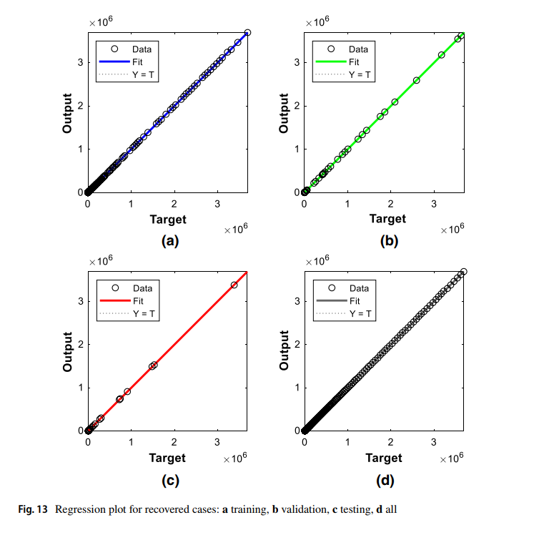
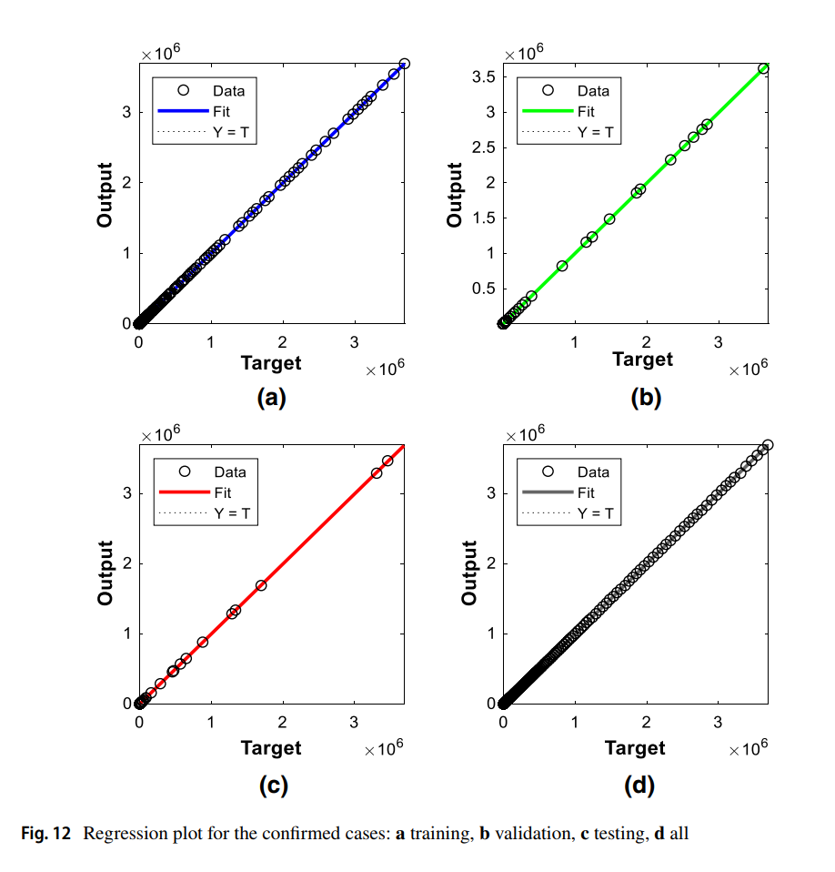
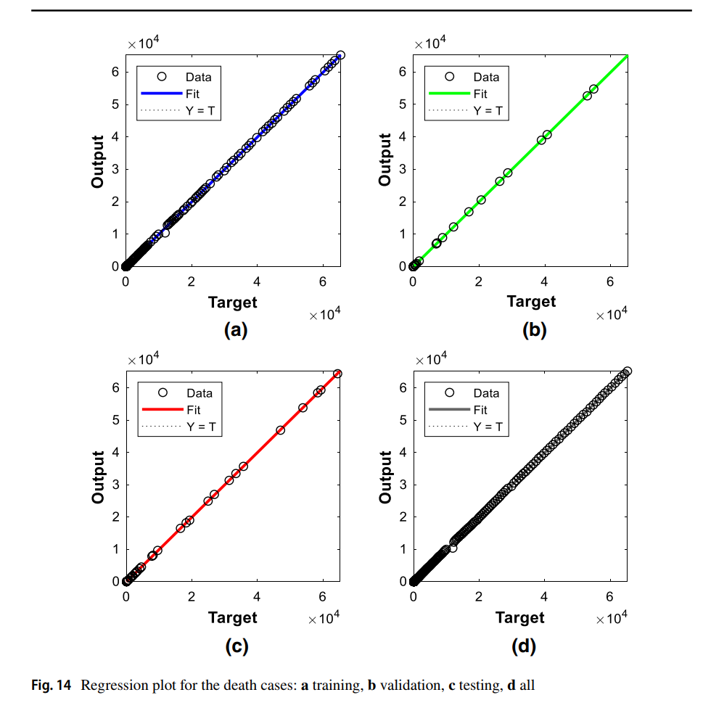
Regression plot (with R value)

Slide 21
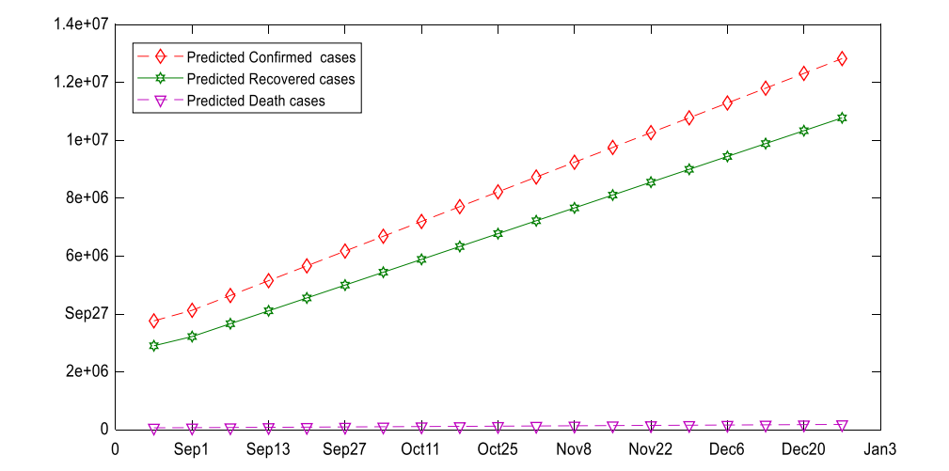
Prediction

Slide 22
Limitations
Time consumption
Single Algorithm → combinations of different algorithms

