Slide 1
AD698 - Applied Generative AI
From Words to Structured Text Nakul R. Padalkar

Slide 2
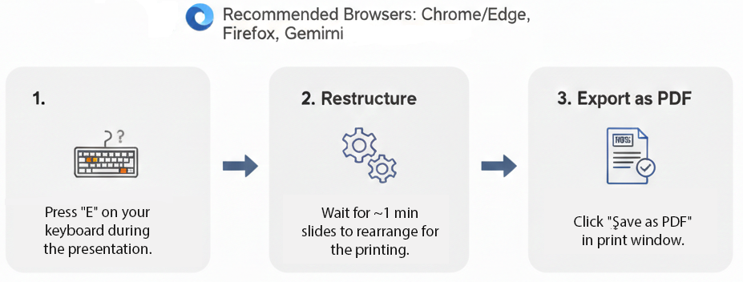
How to print Revealjs slides

Slide 3
Defining the Word

Slide 4
Types, Tokens, and Vocabulary
A token is an individual occurrence of a word in a document: $w=(w_{1},w_{2},…,w_{M})$, where each $w_{m}∈V$.
A type is a unique word in the vocabulary.
A document’s type‑count vector is
$$\begin{matrix}x_{j}∈\{0,1,2,…,M\}\end{matrix}$$
where $x_{j}$ counts how many times type $j$ appears.
Order matters for tokens; order is lost in type counts.
Many token sequences map to the same type‑count vector.
Multinomial Naïve Bayes uses type counts, but an equivalent generative model can produce tokens directly.

Slide 5
Naïve Bayes for Word Classification
Goal: classify a document $x$ into a label $y∈\{1,…,K\}$.
Bayes rule:
$$\begin{matrix}\hat{y}=arg\max_{y} p(y∣x)=arg\max_{y} p(x∣y) p(y)\end{matrix}$$
Naïve assumption: features (words) are conditionally independent given the class.
Prior:
$$\begin{matrix}p(y=k)=μ_{k}\end{matrix}$$
Likelihood factorizes across features.

Slide 6
Multinomial Naïve Bayes
Represent document as type‑count vector
$$\begin{matrix}x=(x_{1},x_{2},…,x_{V})\end{matrix}$$
Generative process:
Draw class $y∼\text{Categorical}(μ)$.
Draw counts from a multinomial: $x∣y∼\text{Multinomial}(M,ϕ_{y})$
Likelihood:
$$\begin{matrix}p(x∣y)=B(x)\prod_{j=1}^{V}{ϕ_{y,j}^{x_{j}}}\end{matrix}$$
where $B(x)=\frac{M!}{x_{1}!x_{2}!⋯x_{V}!}$ is the multinomial coefficient.

Slide 7
Token‑Level Generative Model
Alternative generative process (Algorithm 2):
$$\begin{aligned}y^{(i)}&∼\text{Categorical}(μ) \\ w_{m}^{(i)}&∣y^{(i)}∼\text{Categorical}(ϕ_{y^{(i)}})\end{aligned}$$
Conditional independence:
$$\begin{matrix}w_{m}^{(i)}⟂w_{m^{′}}^{(i)}∣y^{(i)}\end{matrix}$$
Probability of sequence:
$$\begin{matrix}p(w∣y)=\prod_{m=1}^{M}{ϕ_{y, w_{m}}}\end{matrix}$$
Equivalent to multinomial NB up to the multinomial coefficient $B(x)$.

Slide 8
Why the Two Models Are Equivalent
Many token sequences correspond to the same type‑count vector.
Relationship:
$$\begin{matrix}p(w∣y)=\frac{1}{B(x)} p(x∣y)\end{matrix}$$
Since $B(x)≥1$,
$$\begin{matrix}p(x∣y)≥p(w∣y)\end{matrix}$$
Classification decisions identical because $B(x)$ does not depend on $y$.
Order adds no information under the Naïve Bayes independence assumption.

Slide 9
Tokenization
Converts raw character sequences into discrete units.
English: whitespace + punctuation rules often suffice.
Other languages: segmentation is non‑trivial (e.g., Chinese, Japanese).
Challenges:
Ambiguity: “Isn’t Ahab, Ahab? ;)” → different tokenizers produce different segmentations.
Languages without spaces require statistical segmentation.
Social media, hashtags, emojis, and code‑switching complicate boundaries.
Algorithmic Approaches
Rule‑based (regex, dictionaries).
Supervised sequence labeling (e.g., logistic regression, CRF).
Neural models (LSTM‑CRF, CNN‑based encoders).

Slide 10
Out‑of‑Vocabulary (OOV) Words
Closed vs. open vocabulary
Closed vocabulary: fixed $V$.
Real text introduces new names, slang, technologies, numbers, and morphological variants.
Basic OOV handling
Replace unseen types with a special token: ⟨UNK⟩.
Option: mark first occurrence of each type as ⟨UNK⟩.
Better OOV modeling
Character‑level models (n‑grams, RNNs, CNNs).
Subword segmentation (morphemes, BPE, unigram LM).
Helps with morphologically rich languages (e.g., Portuguese verb paradigms).

Slide 11
Vocabulary Size and Coverage
Larger vocabulary → higher coverage but larger models.
English movie reviews: ~4k types cover ~90% of tokens.
Portuguese (MAC‑Morpho): >10k types needed for similar coverage.
Design decisions
Limit vocabulary to top‑K types.
Consider stemming/lemmatization.
Avoid over‑aggressive stopword removal in supervised tasks.
Feature hashing for fixed‑size representations.

Slide 12
Vector Semantics

Slide 13
Distributional Semantics: The Core Idea
Meaning emerges from contextual usage.
Harris (1954), Firth (1957): “You shall know a word by the company it keeps.”
Represent words as vectors in a high‑dimensional space.
Similarity = geometric closeness.
Foundation for all modern embeddings.

Slide 14
Static Embeddings: word2vec & GloVe
word2vec
Learns embeddings by predicting context.
Two architectures:
CBOW: predict target from context.
Skip‑gram: predict context from target.
Objective (skip‑gram):
maxθt=1Tc∈C(t)​logp(wc∣wt)
GloVe
Global co‑occurrence matrix factorization.
J=i,j​f(Xij)wi⊤wj+bi+bj−logXij2

Slide 15
Geometry of Embedding Spaces
Embedding space = semantic geometry.
Cosine similarity:
Cosine: angle → semantic similarity.
$$\begin{matrix}\text{cos}(u,v)=\frac{u⋅v}{∥u∥∥v∥}\end{matrix}$$
Euclidean distance:
Euclidean: magnitude + direction → sensitive to frequency effects.
$$\begin{matrix}d(u,v)=∥u−v∥\end{matrix}$$

Slide 16
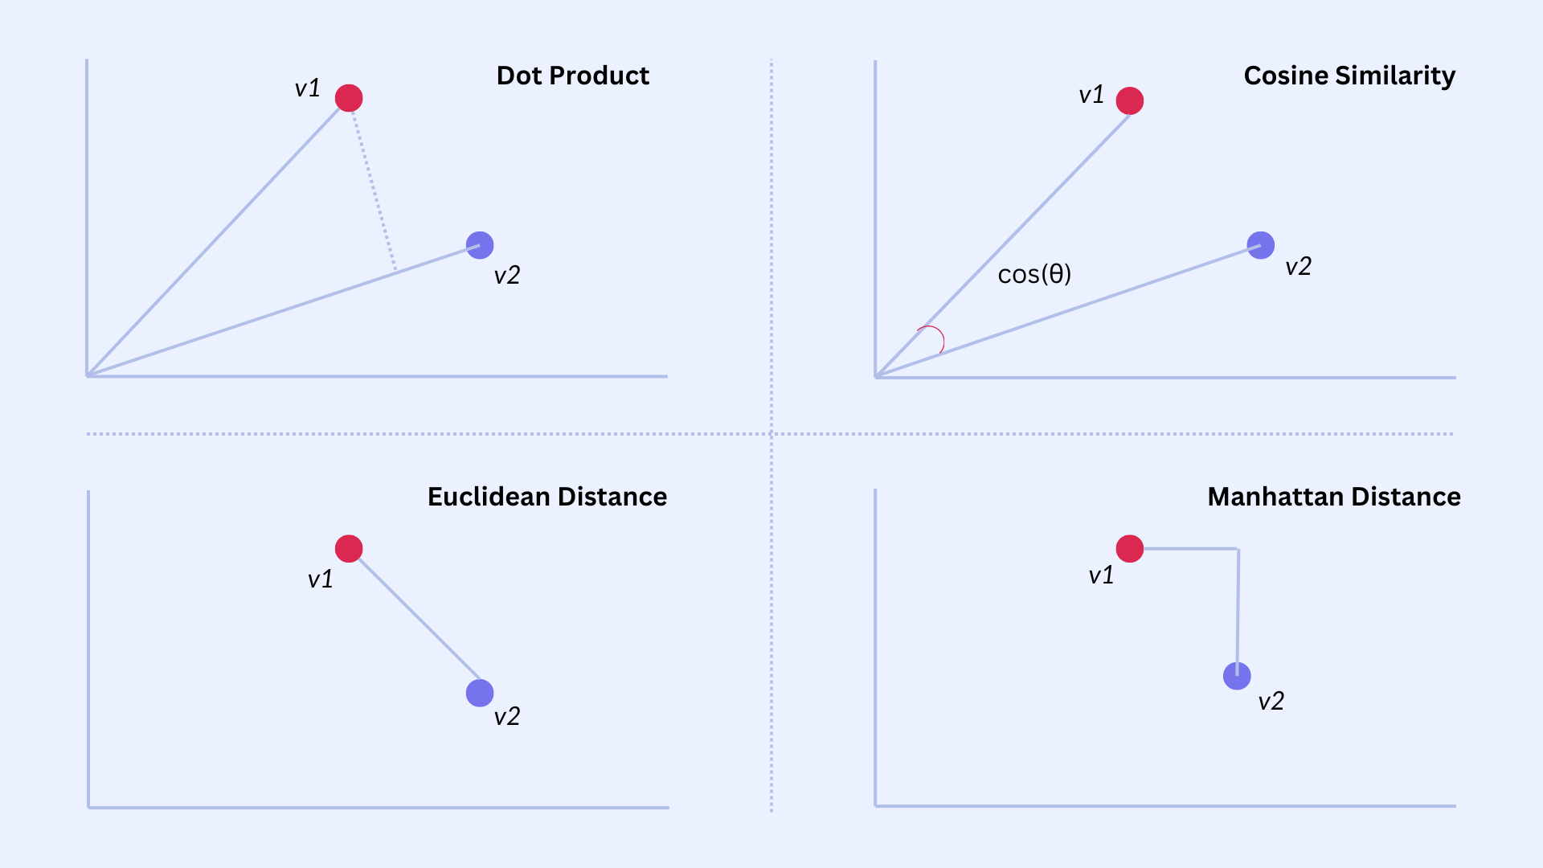
Distance Metrics in Embedding Space
Figure 1. Distance Metrics

Slide 17
Mahalanobis Distance: Covariance‑Aware Similarity
Accounts for correlated dimensions.
Generalized distance:
$$\begin{matrix}d_{M}(u,v)=\sqrt{(u−v)^{⊤}Σ^{−1}(u−v)}\end{matrix}$$
$Σ$ = covariance matrix of embedding distribution.
Benefits:
Downweights noisy or redundant dimensions.
Captures anisotropy in embedding spaces.
Useful in metric learning, clustering, and specialized retrieval tasks.

Slide 18
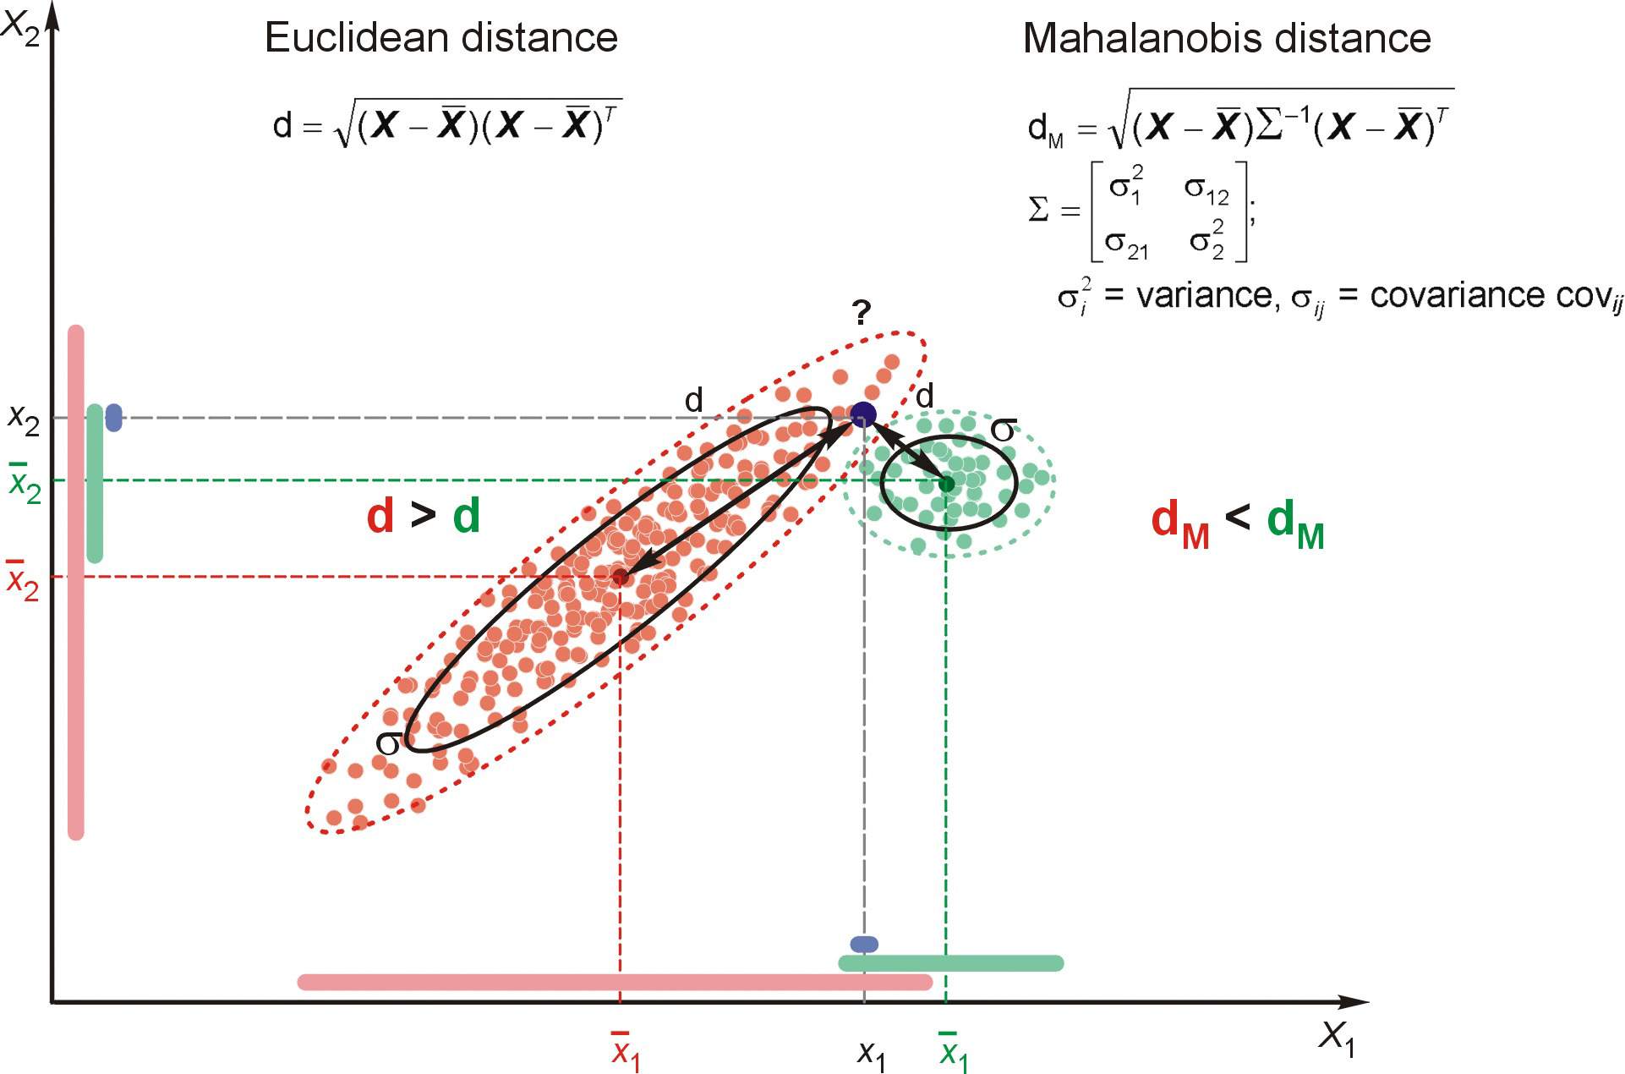
Mahalanobis Distance
Figure 2. Mahalanobis distance

Slide 19
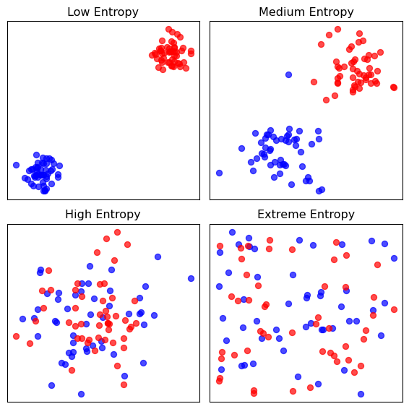
Cross‑Entropy
Figure 3. Different levels of entropy in 2D data

Slide 20
Cross‑Entropy
Cross‑entropy measures how well a predicted distribution matches the true one.
High cross‑entropy → model assigns low probability to the correct class.
Low cross‑entropy → model is confident and correct.
Visual intuition:
When the predicted probability for the true class approaches 1, loss → 0.
When the model is wrong/confident, loss spikes sharply.
This loss underlies softmax classifiers, word prediction, and neural language models.

Slide 21
Representing Meaning

Slide 22

VAKOG: Visual, Auditory, Kinesthetic modalities.
Figure 4. Visual, Auditory, Kinesthetic, Olfactory, and Gustatory Representation

Slide 23
Why Represent Meaning in Vectors?
Words carry meaning through patterns of use.
Distributional hypothesis → represent meaning via co‑occurrence structure.
Vector spaces allow:
Similarity comparisons
Analogy reasoning
Clustering & retrieval
Input to neural models
Meaning becomes geometry.

Slide 24
Static Embeddings
One vector per word type (context‑independent).
Learned from large corpora.
Two major families:
word2vec (predictive)
GloVe (count‑based factorization)
Capture syntactic & semantic regularities.
Limitations:
Polysemy collapsed into one vector
No contextual variation

Slide 25
Contextual Embeddings
Meaning depends on context.
Same word → different vectors in different sentences.
Produced by deep LMs (ELMo, BERT, GPT).
Representations come from hidden states of the model.
Capture:
Word sense
Syntax
Long‑range dependencies
Discourse‑level meaning

Slide 26
Classification Diagnostics & Evaluation

Slide 27
Classification Example
Dataset includes Adelie, Gentoo, Chinstrap penguins.
Features: bill length, bill depth, flipper length, body mass.
For evaluation demos, create a binary task:
Adelie vs Non‑Adelie
Allows clean visualization of:
Class separation
Threshold effects
ROC & PR curves
Imbalance manipulation
More Detailed discussion is in module 8 lecture note 1.

Slide 28
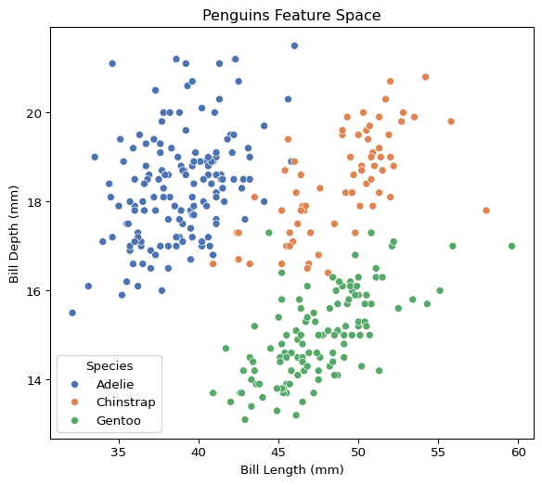
Visualizing the Feature Space
Penguins feature space: bill length vs. bill depth, colored by species.

Slide 29
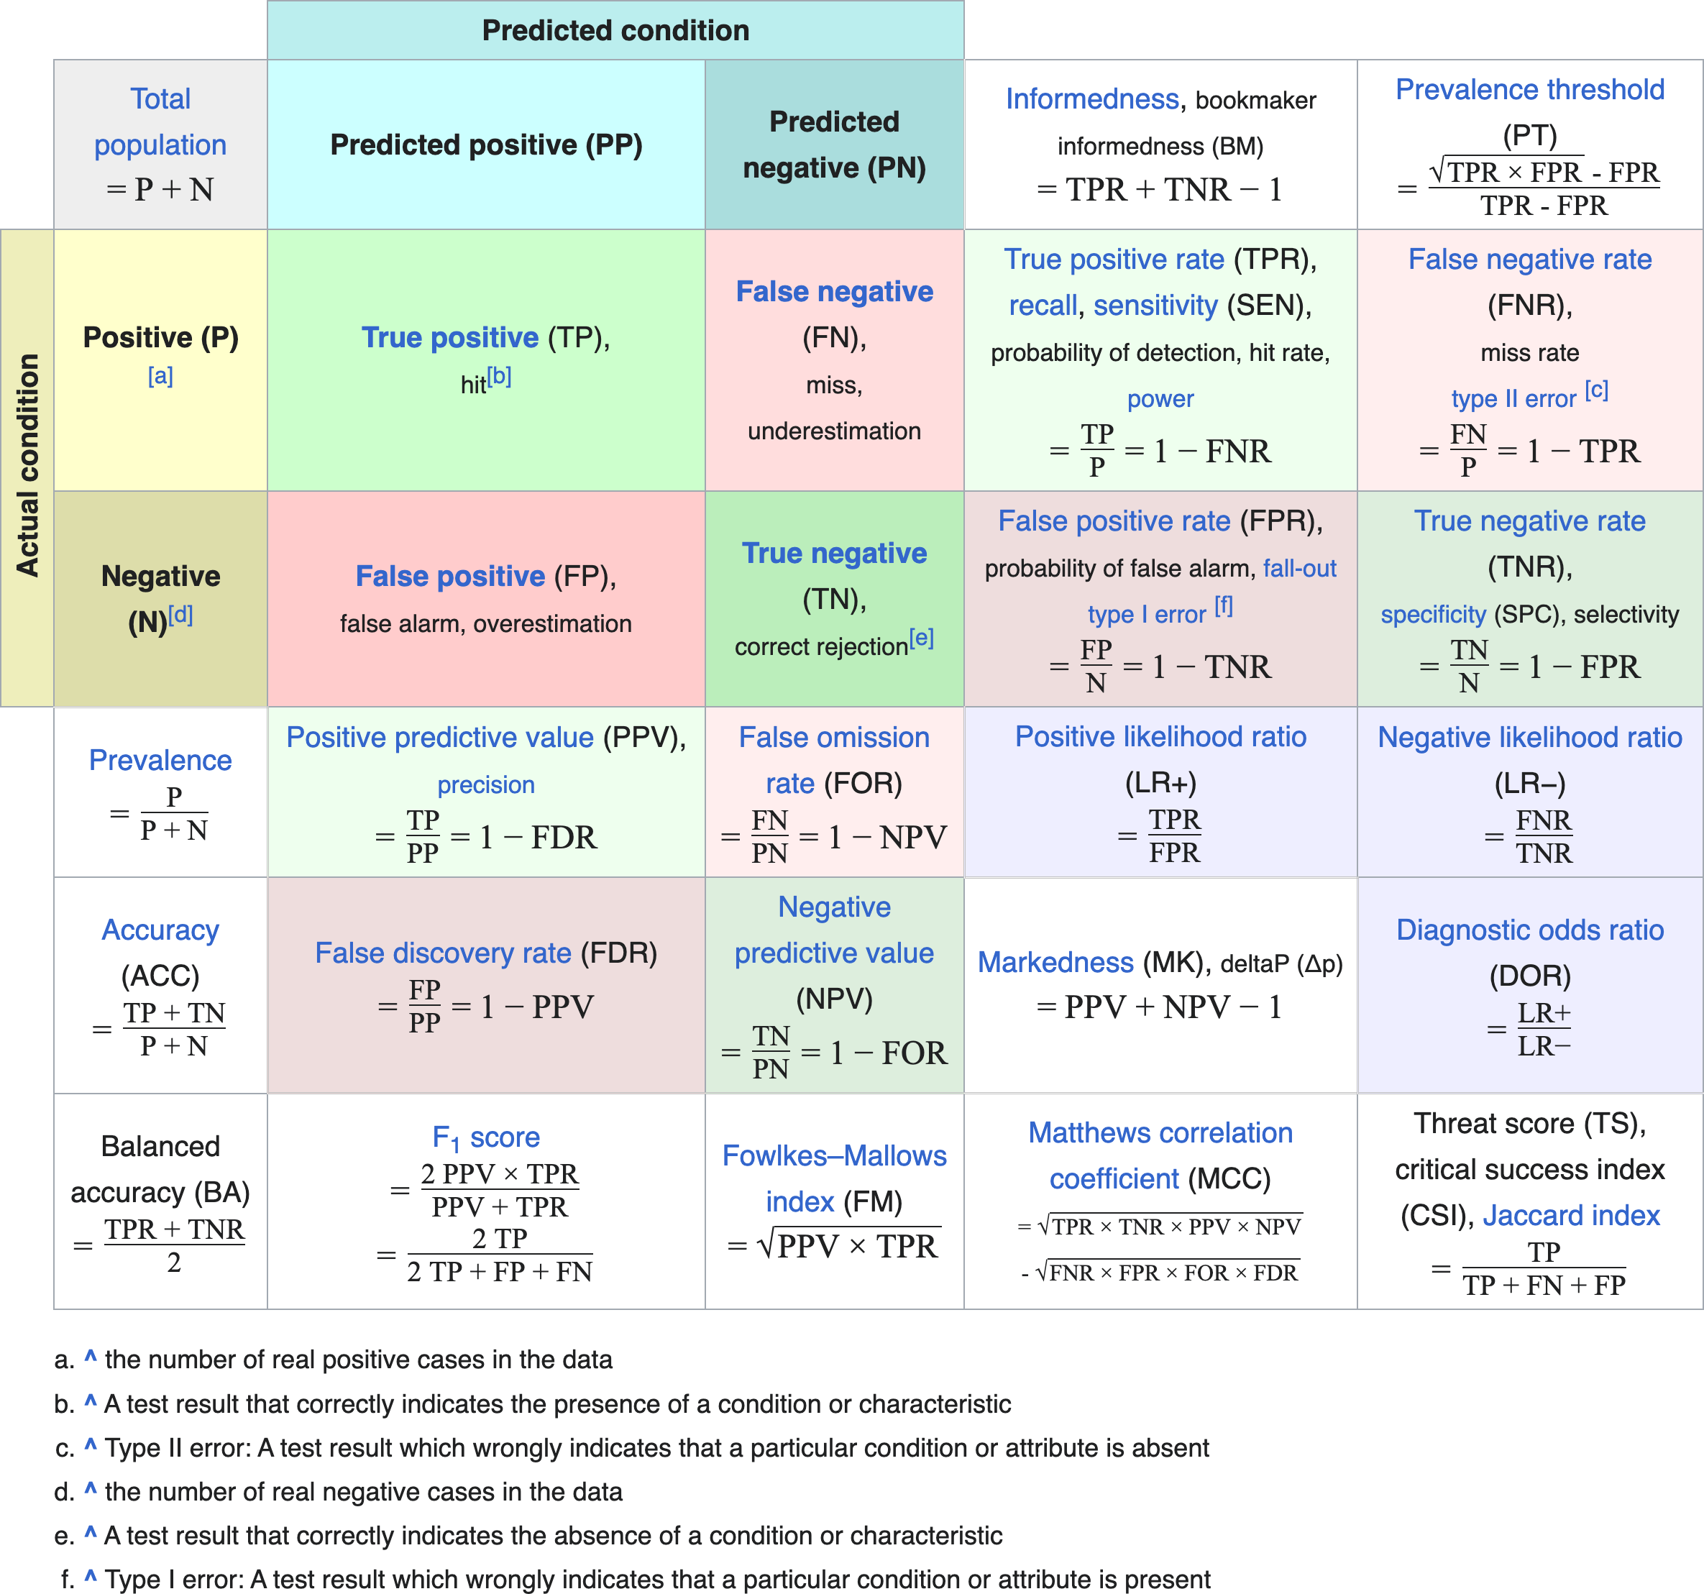
Confusion Matrix & Thresholding
Figure 5. Contingency Table

Slide 30
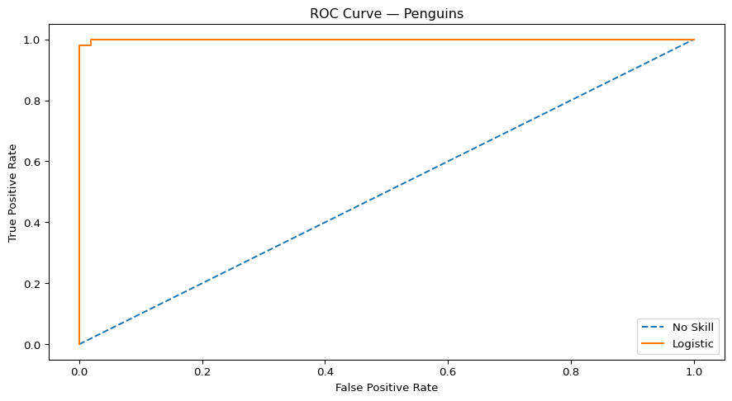
ROC Curve on Penguins
ROC AUC: 0.9995993589743589
ROC = TPR vs FPR across thresholds.
AUC = ranking quality.
Penguins show clear separation → high AUC.
Connects to LLM evaluation:
LLM token ranking ≈ classifier score ranking.
ROC curve for logistic regression on penguin data.

Slide 31
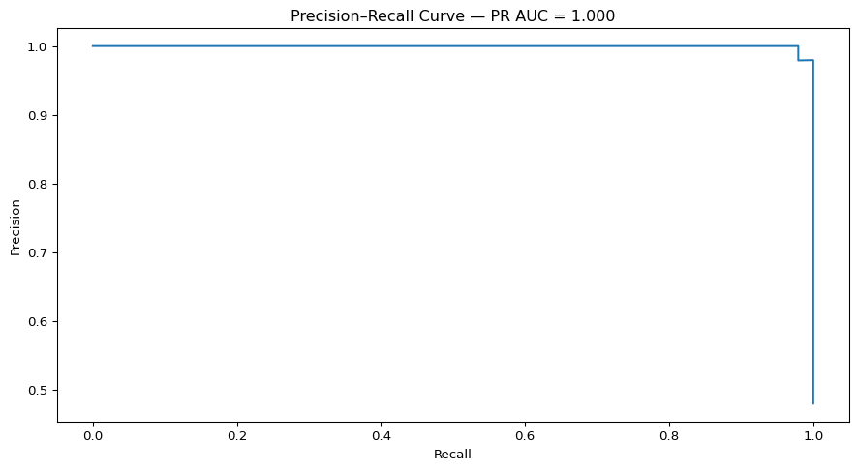
Precision–Recall Curve on Penguins
PR curve focuses on the positive class.
More sensitive to imbalance.
Demonstrates why PR‑AUC is preferred when positives are rare.
Connects to LLM correctness:
Rare correct answers → PR‑AUC is more informative.

Slide 32
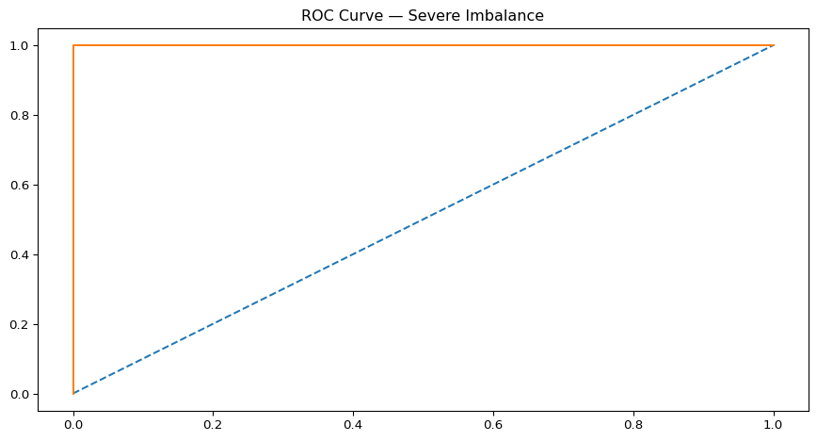
Creating Imbalance in Penguins
Downsample Adelie to simulate 1:10 imbalance.
ROC remains high; PR collapses.
Mirrors the attached document’s insight: > “ROC AUC can be optimistic on severely imbalanced classification problems.”

Slide 33
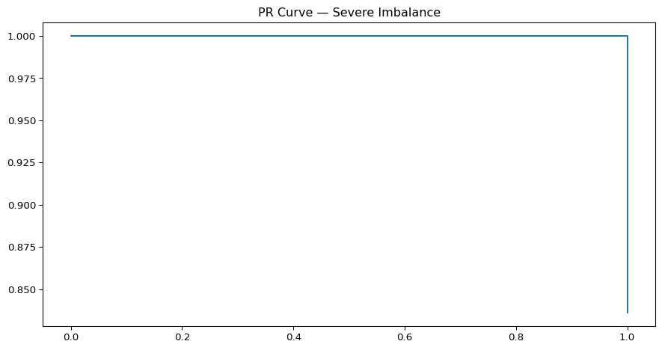

Slide 34
LLM Correctness Evaluation
LLMs output ranked token distributions, not labels.
Evaluation parallels ROC/PR:
Ranking quality → ROC‑AUC
Rare correct answers → PR‑AUC
Calibration → Brier score
Penguins example builds intuition for LLM scoring.

Slide 35
Feedforward Architectures

Slide 36
Feedforward Neural Networks
Check module 8 Lecture note 1 and 2 for details on feedforward architectures and Backpropagation.
Download data for analysis from here

Slide 37
Recurrent Architectures

Slide 38
Recurrent Neural Networks
Check module 8 Lecture note 3 for details on recurrent architectures and LSTM.
Download data for analysis from here

Slide 39
Attention & Long‑Range Dependencies

Slide 40
Why RNNs Struggle With Long‑Range Dependencies
RNNs compress all past information into a single hidden state.
Gradients must flow through many time steps, causing vanishing/exploding gradients.
Sequential processing prevents parallelization.
Even LSTMs/GRUs struggle when dependencies span dozens or hundreds of tokens.
Bottleneck:
$$\begin{matrix}h_{t}=f(h_{t−1},x_{t})\end{matrix}$$
All information must pass through $h_{t}$.

Slide 41
The Need for Direct Access to Context
Many tasks require linking distant tokens:
Coreference (“The book… it…”)
Long sentences
Document‑level reasoning
RNNs force the model to “remember” everything.
We want a mechanism where a token can look up relevant information directly.
Key idea: don’t compress the past — attend to it.

Slide 42
The Attention Mechanism
Each token produces:
Query $Q$
Key $K$
Value $V$
Attention score:
$$\begin{matrix}\text{score}(Q,K)=\frac{QK^{⊤}}{\sqrt{d_{k}}}\end{matrix}$$
Softmax turns scores into weights.
Output is a weighted sum of values:
$$\begin{matrix}\text{Attention}(Q,K,V)=\text{softmax}\left(\frac{QK^{⊤}}{\sqrt{d_{k}}}\right)V\end{matrix}$$
Tokens retrieve information from anywhere in the sequence.

Slide 43
Why Attention Solves Long‑Range Dependencies
No recurrence → no vanishing gradients.
Every token can attend to any other token.
Parallelizable across sequence length.
Learns dynamic context:
Syntax
Semantics
Coreference
Long‑range structure

Slide 44
Multi‑Head Self‑Attention
Instead of one attention pattern, use multiple heads.
Each head learns a different projection of $Q,K,V$.
Heads capture different relationships:
Syntax
Semantic similarity
Positional patterns
Outputs are concatenated and projected:
$$\begin{matrix}\text{MHA}(X)=\text{Concat}({\text{head}}_{1},…,{\text{head}}_{h})W^{O}\end{matrix}$$

Slide 45
Visualizing Multi‑Head Attention
Each head = a different “view” of the sequence.
Some heads track subject–verb agreement.
Some track coreference.
Some track positional offsets.
Combined → rich contextual representation.

Slide 46
Leading to Transformers
Attention removes RNN bottlenecks.
Enables full parallelization.
Scales to long sequences.
Forms the core of:
BERT
GPT
T5
LLaMA
All modern LLMs
This is the key architectural leap from RNNs → Transformers.

Slide 47
Transformer Architectures

Slide 48
Encoder

Slide 49
Decoder

Slide 50
Encoder–decoder

Slide 51
Cross-attention

Slide 52
Pretraining Objectives

Slide 53
Masked language modeling

Slide 54
Causal language modeling

Slide 55
Modern Extensions

Slide 56
Vision transformers

Slide 57
Architectural innovations (MoE, RoPE, Flash Attention)

Slide 58
Multimodal LLMs

