Slide 1
AD698 - Applied Generative AI
Prompting as System Design Nakul R. Padalkar

Slide 2
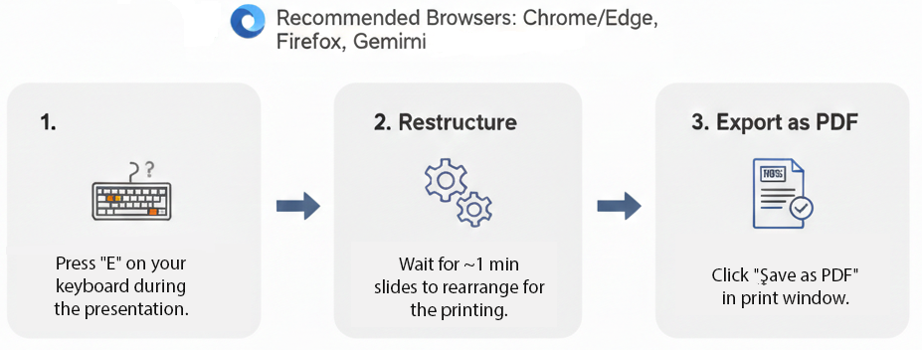
How to print Revealjs slides

Slide 3
The Shift to Prompt-Based Approaches

Slide 4
From Training-Centric AI to Inference-Centric AI
Traditional ML paradigm:
Model behavior determined primarily during training
Deployment phase largely static
Adaptation requires:
retraining
fine-tuning
feature redesign
Large Language Model paradigm:
Model behavior can be modified at inference time
Adaptation occurs through:
prompts
context
task specification
This represents a fundamental architectural shift in AI systems.

Slide 5
Classical Learning vs Generative Conditioning
Classical supervised learning: $y=f_{θ}(x)$
Behavior changes require updating $θ$ through training.
Generative language models: $P(Y∣X,θ)$
Prompt-based control introduces: $P(Y∣X,p,θ)$
Prompting modifies inference distribution, not model weights.

Slide 6
Prompt as an Inference-Time Control Signal
A prompt functions as:
a conditioning signal
a soft constraint
a semantic policy
a probabilistic steering mechanism
Implications:
rapid task adaptation
reduced need for retraining
dynamic behavior shaping
interactive AI workflows

Slide 7
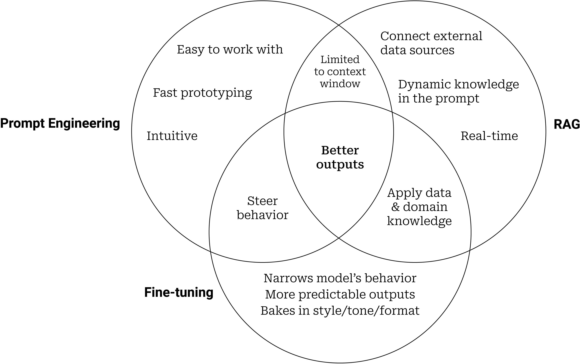
Prompt Engineering, Fine-tuning, and RAG
Figure 1. Venn Diagram of Prompt Engineering, Fine-tuning, and RAG

Slide 8
Why Prompting Works
Prompting works because LLMs are:
trained on diverse linguistic patterns
capable of contextual reasoning
sensitive to semantic structure
internally structured via attention mechanisms
Prompting activates latent capabilities rather than creating new ones.

Slide 9
Transformer Models

Slide 10
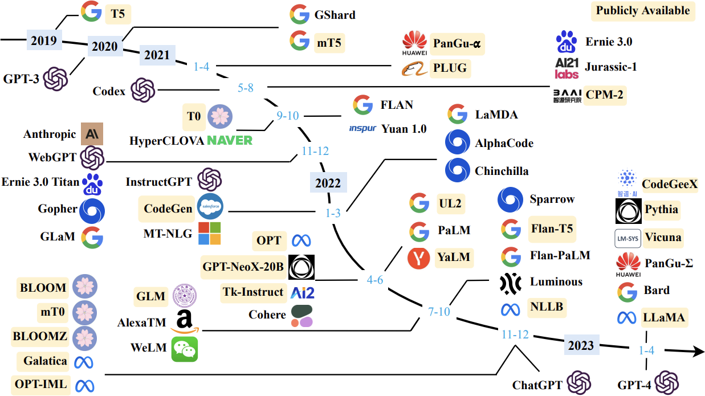
The Transformers Timeline
Figure 2. Timeline of transformer-based models

Slide 11
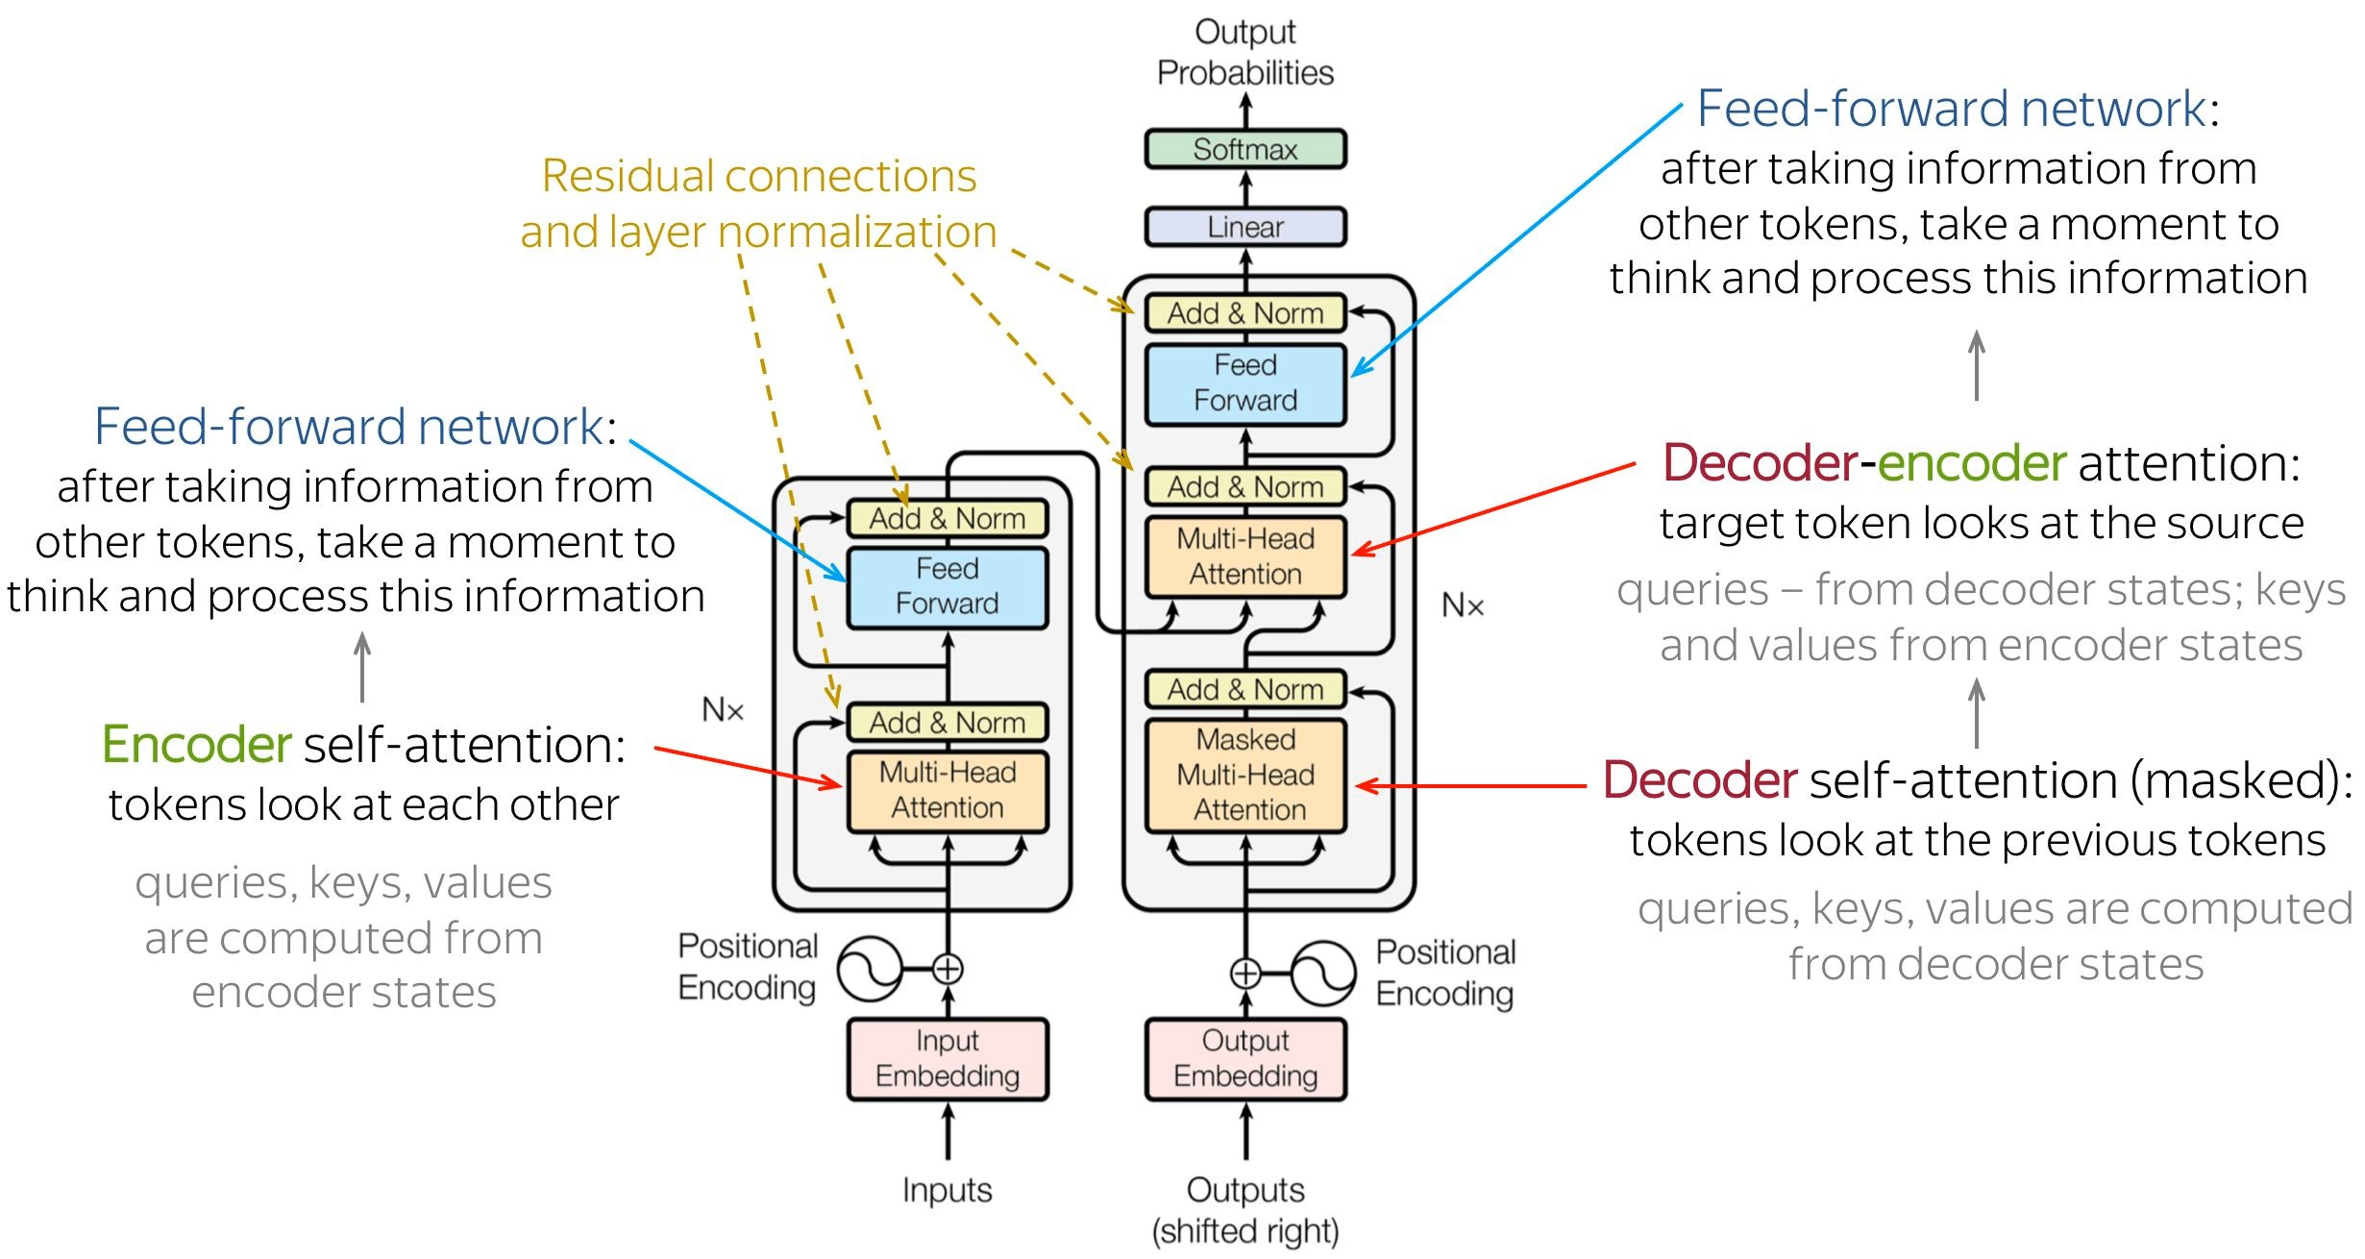
Transformer Models
Figure 3. Transformer Architecture

Slide 12
Encoder and Decoder Models

Slide 13
Language Modeling with RNNs
We will start by revisiting the problem of language modeling.
Informally, given $t−1$ words, we are interested in predicting the $t^{\text{th}}$ word.
More formally, given $y_{1},y_{2},…,y_{t−1}$, we want to find
$$y^{*}=argmaxP(y_{t}∣y_{1},y_{2},…,y_{t−1})$$
Let us see how we model $P(y_{t}∣y_{1},y_{2},…,y_{t−1})$ using an RNN.
We will refer to $P(y_{t}∣y_{1},y_{2},…,y_{t−1})$ using the shorthand notation:
$$P(y_{t}∣y_{1}^{t−1})$$
Figure 4

Slide 14
RNN Probability Computation
We are interested in
$$P(y_{t}=j∣y_{1},y_{2},…,y_{t−1})$$
where $j∈V$ and $V$ is the set of all vocabulary words.
Using an RNN, we compute this as
$$P(y_{t}=j∣y_{1}^{t−1})=softmax(Vs_{t}+c)_{j}$$
In other words, we compute
$$\begin{aligned}P(y_{t}=j∣y_{1}^{t−1})&=P(y_{t}=j∣s_{t}) \\ &=softmax(Vs_{t}+c)_{j}\end{aligned}$$
Notice that the recurrent connections ensure that $s_{t}$ has information about $y_{1}^{t−1}$.
Figure 5. Rnn Probability Computation

Slide 15
Training an RNN Language Model
Note
Data: India, officially the Republic of India, is a country in South Asia. It is the seventh-largest country by area, …..
Data: All sentences from any large corpus (say Wikipedia).
Model:
$$\begin{aligned}s_{t}&=σ(Ws_{t−1}+Ux_{t}+b) \\ P(y_{t}=j∣y_{1}^{t−1})&=softmax(Vs_{t}+c)_{j}\end{aligned}$$
Parameters: $U,V,W,b,c$
Loss:
$$\begin{aligned}L(θ)&=\sum_{t=1}^{T}{L_{t}}(θ) \\ L_{t}(θ)&=−logP(y_{t}=ℓ_{t}∣y_{1}^{t−1})\end{aligned}$$
where $ℓ_{t}$ is the true word at time step $t$.

Slide 16
What Is the Input at Each Time Step?
What is the input at each time step?
It is simply the word that we predicted at the previous time step.
In general,
$$s_{t}=RNN(s_{t−1},x_{t})$$
Let $j$ be the index of the word assigned the maximum probability at time step $t−1$.
$$x_{t}=e(v_{j})$$
$x_{t}$ is essentially a one-hot vector, $e(v_{j})$, representing the $j^{\text{th}}$ word in the vocabulary.
In practice, instead of a one-hot representation, we use a pre-trained word embedding of the $j^{\text{th}}$ word.
Figure 6. Diagram showing the input at each time step in an RNN

Slide 17
Initial Hidden State
Notice that $s_{0}$ is not computed but instead randomly initialized.
We learn it along with the other parameters of the RNN (or LSTM or GRU).
We will return to this later.
Figure 7. Diagram of RNN probability computation

Slide 18
Compact Recurrent Notation
Before moving on, it is useful to write the functions computed by RNNs, GRUs, and LSTMs in a compact form.
We will use these notations going forward.

Slide 19
Compact Form: RNN
$$\begin{aligned}s_{t}&=σ(Ux_{t}+Ws_{t−1}+b) \\ s_{t}&=RNN(s_{t−1},x_{t})\end{aligned}$$
A standard RNN updates its hidden state using:
the current input $x_{t}$
the previous hidden state $s_{t−1}$
This compact notation emphasizes that the hidden state is a function of:
$$(s_{t−1},x_{t})$$
We will use this shorthand repeatedly in later derivations.

Slide 20
Compact Form: Gated Recurrent Unit (GRU)
$$\begin{aligned}\tilde{s_{t}}&=σ​\left(W(o_{t}⊙s_{t−1})+Ux_{t}+b\right) \\ s_{t}&=i_{t}⊙s_{t−1}+(1−i_{t})⊙\tilde{s_{t}} \\ s_{t}&=GRU(s_{t−1},x_{t})\end{aligned}$$
A GRU modifies the standard recurrent update with gating.
These gates regulate how much past information is preserved and how much new information is incorporated.
In compact form, we treat the whole gated update as:
$$GRU(s_{t−1},x_{t})$$

Slide 21
Compact Form: LSTM
$$\begin{aligned}\tilde{s_{t}}&=σ(Wh_{t−1}+Ux_{t}+b) \\ s_{t}&=f_{t}⊙s_{t−1}+i_{t}⊙\tilde{s_{t}} \\ h_{t}&=o_{t}⊙σ(s_{t}) \\ h_{t},s_{t}&=LSTM(h_{t−1},s_{t−1},x_{t})\end{aligned}$$
The LSTM maintains two recurrent quantities:
the cell state $s_{t}$
the hidden state $h_{t}$
This allows the model to preserve long-range information more effectively than a standard RNN.
In compact notation, the update is written as:
$$(h_{t},s_{t})=LSTM(h_{t−1},s_{t−1},x_{t})$$

Slide 22
Guiding Questions for Sequence Modeling Tasks
What kind of network can we use to encode the input(s)?
What kind of a network can we use to decode the output?
What are the parameters of the model?
What is an appropriate loss function?

Slide 23

Example: Image Captioning
Figure 8

Slide 24
Example: Image Captioning
Algorithm: Gradient descent with backpropagation
Model:
Encoder:
$$s_{0}=CNN(x_{i})$$
Decoder:
$$\begin{aligned}s_{t}&=RNN(s_{t−1},e({\hat{y}}_{t−1})) \\ P(y_{t}∣y_{1}^{t−1},I)&=softmax(Vs_{t}+b)\end{aligned}$$
Parameters:
$$U_{\text{dec}}, V, W_{\text{dec}}, W_{\text{conv}}, b$$
Loss:
$$\begin{aligned}L(θ)&=\sum_{t=1}^{T}{L_{t}}(θ)=−\sum_{t=1}^{T}{log}P(y_{t}=ℓ_{t}∣y_{1}^{t−1},I)\end{aligned}$$

Slide 25
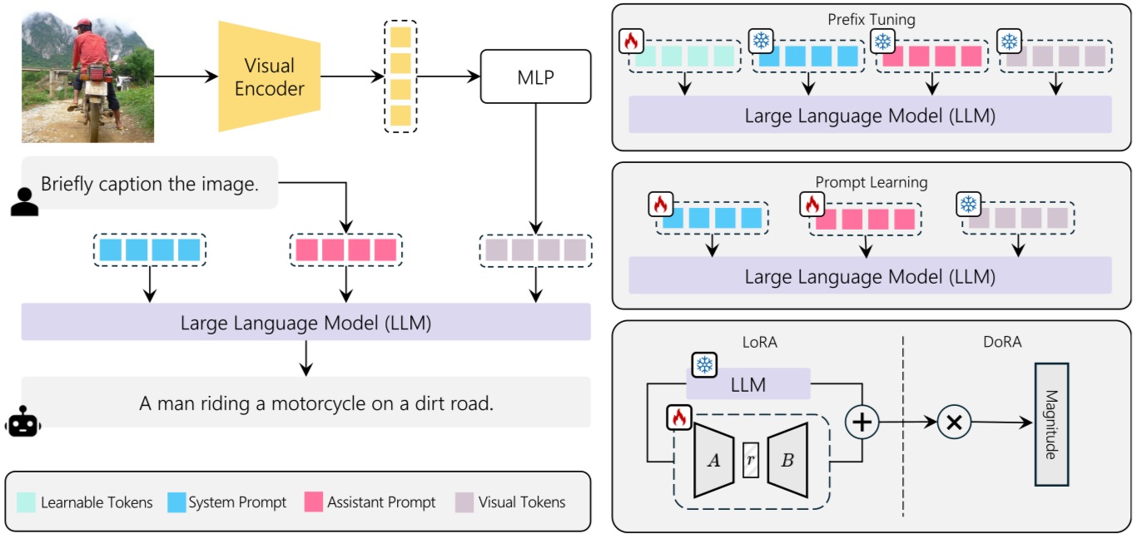
Image Captioning
Figure 9. Image Captioning Model

Slide 26
Other Tasks
Textual entailment
Machine translation
Transliteration (e.g., English to Hindi)
Image generation from text
Code generation from text
Speech recognition
etc.

Slide 27
Attention Mechanisms

Slide 28
Why Do We Need Attention?
Let us motivate the task of attention with the help of machine translation.
The encoder reads the source sentence only once and produces an encoding.
At each time step, the decoder uses this encoding to produce a new word.
But is this how humans translate a sentence? Not really.
Figure 10. Machine Translation Example

Slide 29
Human Intuition Behind Attention
Output: I am going home
$$\begin{matrix}t_{1}:[1, 0, 0, 0, 0] \\ t_{2}:[0, 0, 0, 0, 1] \\ t_{3}:[0, 0, 0.5, 0.5, 0] \\ t_{4}:[0, 1, 0, 0, 0]\end{matrix}$$
Input: Main ghar ja raha hoon
Humans often produce each output word by focusing only on certain words in the input.
At each time step, we can think of the translator as forming a distribution over the input words.
This distribution tells us how much attention to pay to each input word at that time step.
Ideally, the decoder should receive primarily the relevant information, rather than the entire source representation uniformly.

Slide 30
More Complex Attention Patterns
Note
We will cover these in video lectures in Module 8

Slide 31
Prompt Engineering as System Design

Slide 32
Two Sea Changes in NLP
Fully supervised learning Models trained only on task-specific labeled data → heavy reliance on feature engineering (e.g., )
Neural supervised learning Features learned jointly through architecture engineering (e.g., CNNs, RNNs, attention models) (e.g., )
Pre-train → Fine-tune paradigm (2017–2019) Large language models trained on massive corpora, then adapted via objective engineering (e.g., )
Pre-train → Prompt → Predict (current paradigm) Tasks reformulated as language modeling problems using textual prompts (e.g., )

Slide 33
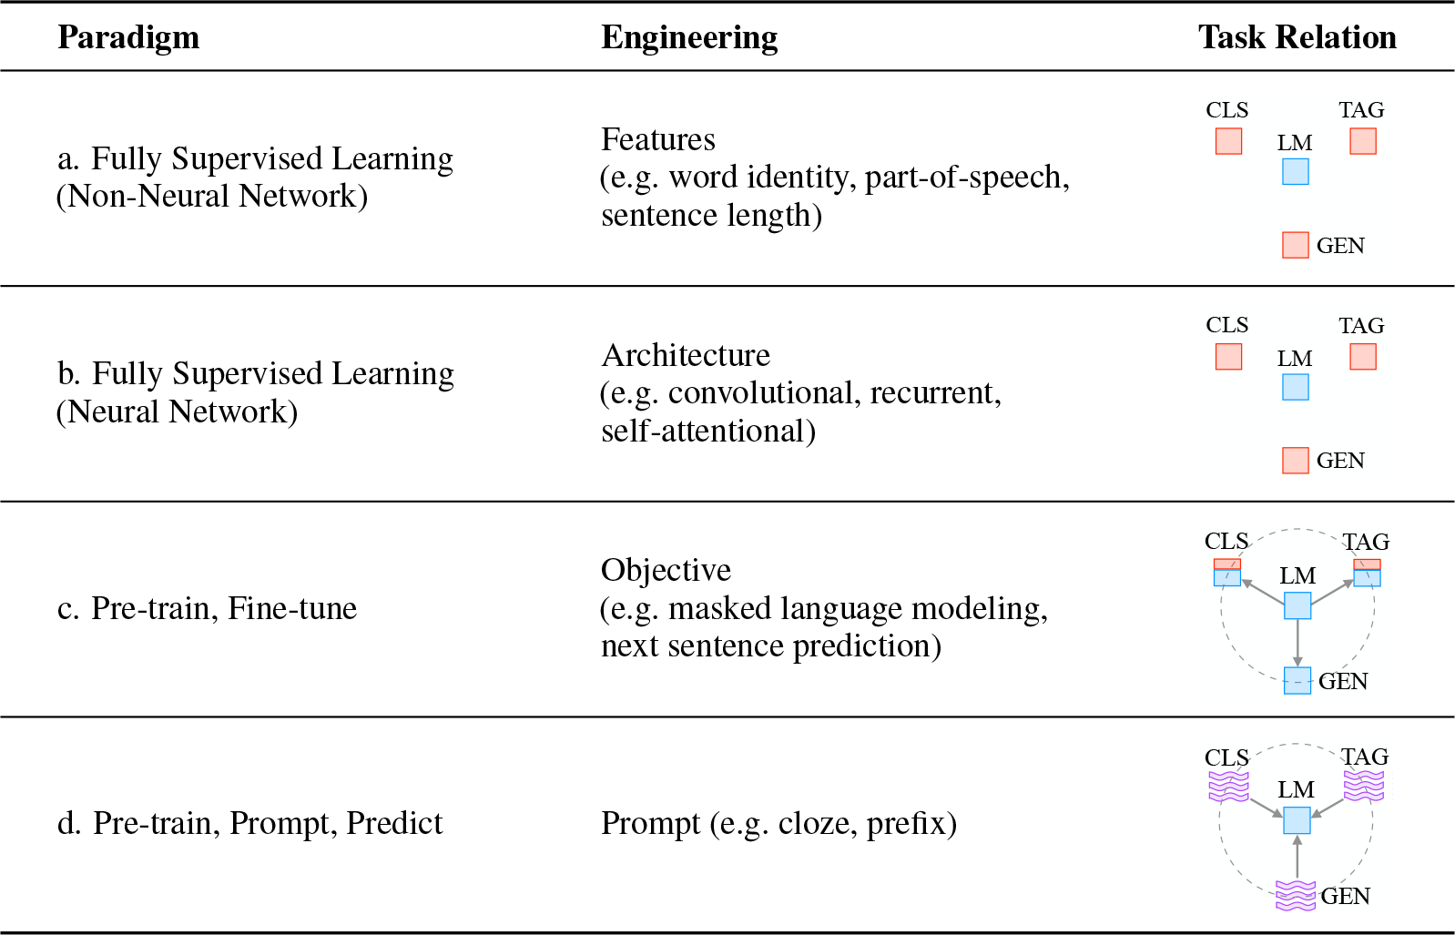
Four Paradigms in NLP

Slide 34
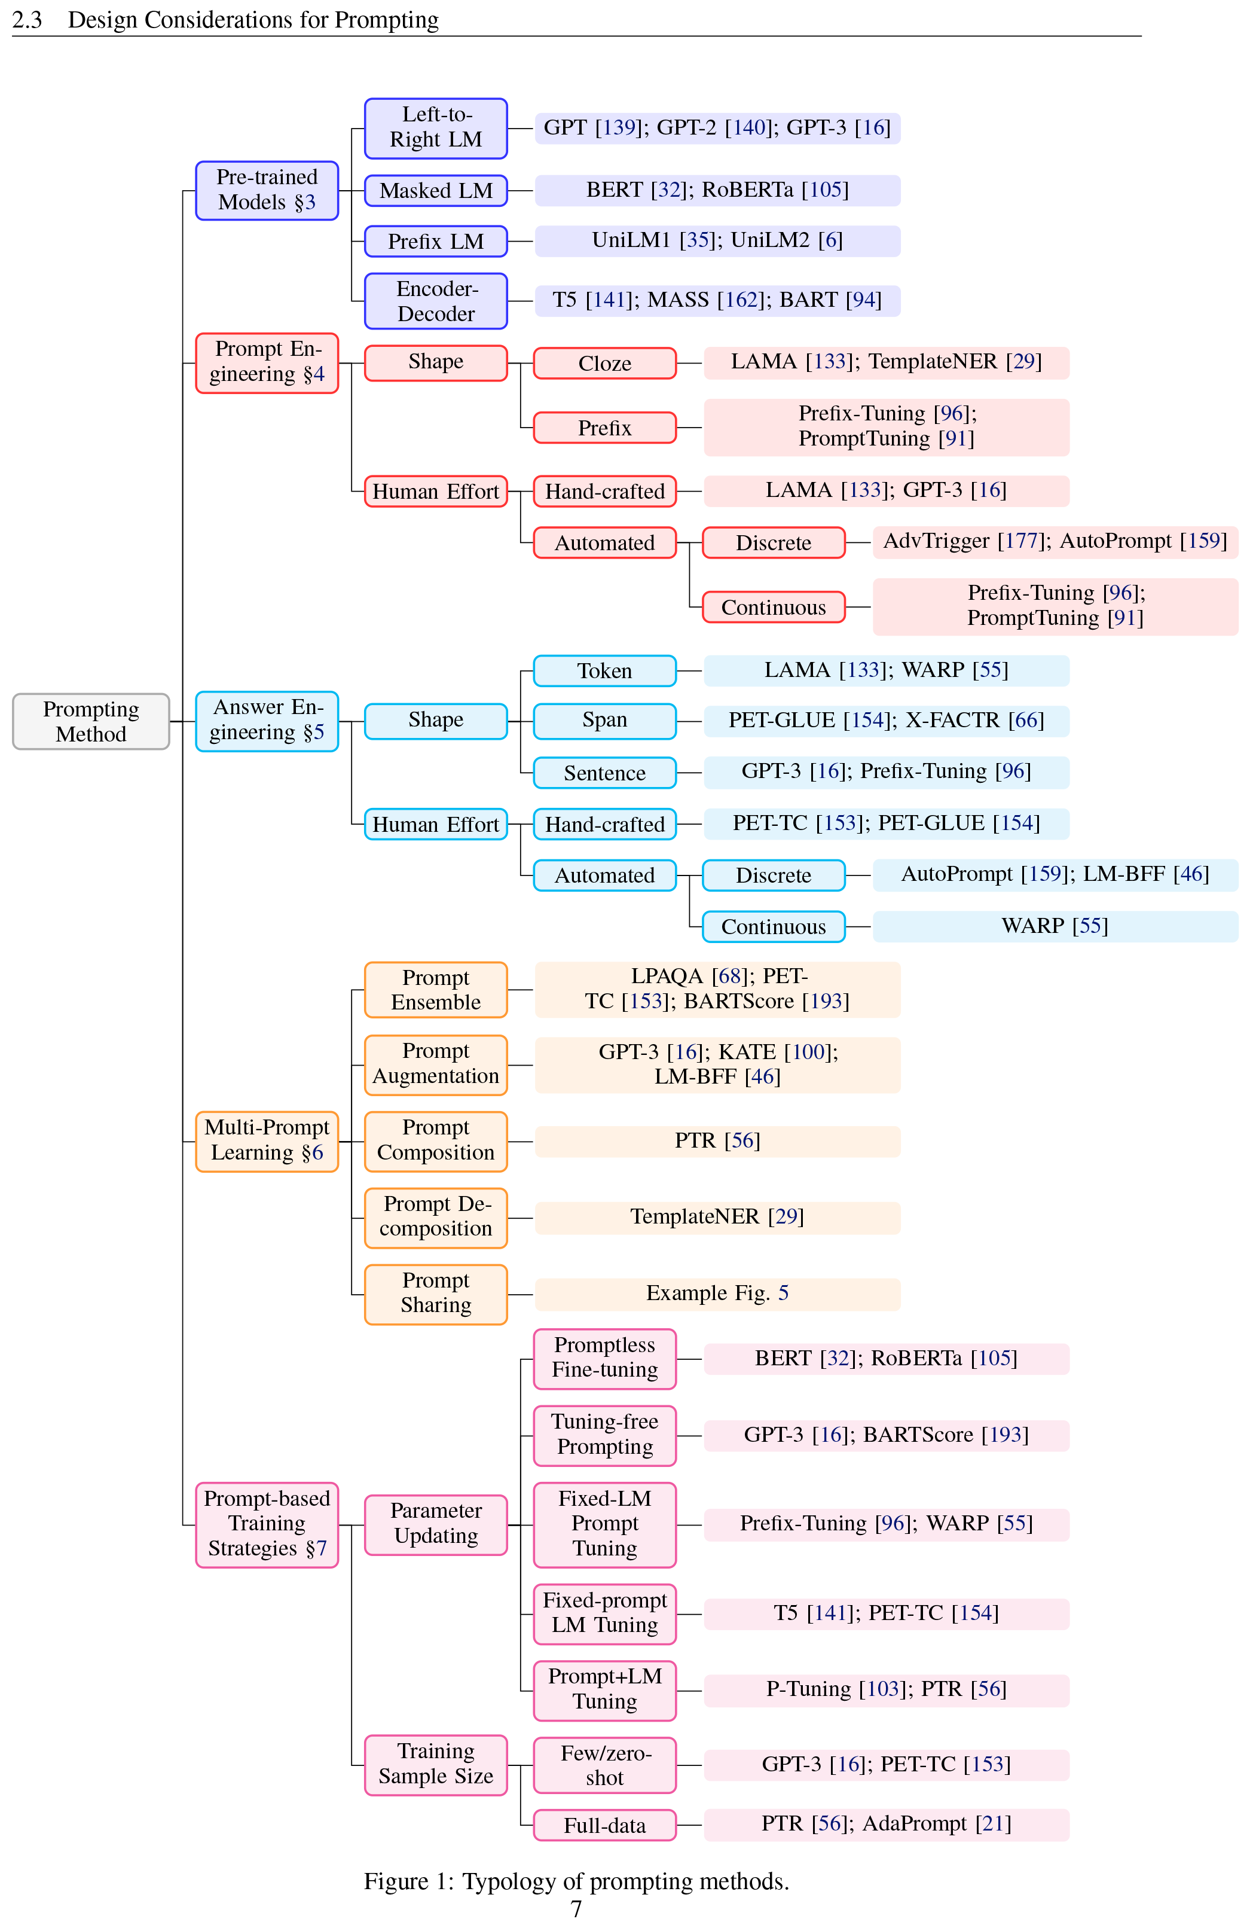
Typology of Prompting Methods
Figure 11. Typology of prompting methods

Slide 35
Language Modeling Perspective
Instead of modeling:
$$P(y∣x)$$
we train a model to learn:
$$P(x)$$
over large text corpora.
This allows models to learn:
syntax
semantics
discourse structure
world knowledge
Prompting uses this learned distribution to solve tasks.

Slide 36
Prompting Concept
Prompt-based learning reformulates tasks as language modeling.
Instead of:
training a task-specific model
we:
Convert input into a structured textual form
Ask the language model to complete it
This reduces dependence on supervised data.

Slide 37
Prompting Terminology
Concept | Notation | Example | Description
Input | $x$ | I love this movie. | Raw input text
Output | $y$ | ++ | Final task output
Prompting Function | $f_{\text{prompt}}(x)$ | [X] Overall it was a [Z] movie | Converts input into prompt form
Prompt | $x^{′}$ | I love this movie. Overall it was a [Z] movie | Input inserted, answer slot open
Filled Prompt | $f_{\text{fill}}(x^{′},z)$ | Overall it was a bad movie | Candidate answer inserted
Answered Prompt | $f_{\text{fill}}(x^{′},z^{*})$ | Overall it was a good movie | True answer inserted
Answer | $z$ | good / bad / fantastic | Token or phrase used to solve task

Slide 38
Prompt Construction
Prompting transforms input:
$$x^{′}=f_{\text{prompt}}(x)$$
Typical template structure:
input slot: [X]
answer slot: [Z]
Example (sentiment):
$$[X] \text{Overall it was a [Z] movie}$$
Example (translation):
$$\text{Finnish: [X] English: [Z]}$$

Slide 39
Types of Prompts
Two common forms:
Cloze prompts - answer slot inside sentence
Example:
The movie was [Z].
Prefix prompts - answer follows entire input
Example:
Translate: [X]
Prompts may also:
use virtual tokens
use continuous embeddings
contain multiple input or output slots
–

Slide 40
Answer Search
We define:
$$Z=\text{set of possible answers}$$
Then compute:
$$\hat{z}=arg\max_{z∈Z}P(f_{\text{fill}}(x^{′},z);θ)$$
Search strategies:
argmax decoding
probabilistic sampling

Slide 41
Mapping Answers to Outputs
In some tasks:
$$\hat{y}=\hat{z}$$
In others:
multiple answers correspond to same label
Example:
excellent, amazing → positive
Thus we define:
$$g:z→y$$

Slide 42
Design Considerations in Prompting
Key dimensions:
Choice of pre-trained model
Prompt engineering
Answer engineering
Multi-prompt learning
Prompt-based training strategies
Prompting is not just inference — it is a full modeling paradigm.

Slide 43
Prompting Design Space
Prompting methods vary across:
Pre-trained model type
Prompt construction method
Answer representation
Training strategy
Multi-prompt composition
This defines a rich design space for LLM control.

Slide 44
Implications for AI Engineering
The shift to prompt-based approaches enables:
faster prototyping cycles
lower development costs
human-in-the-loop interaction
dynamic system reconfiguration
probabilistic software architectures
This marks a transition from:
Static Models → Interactive Generative Systems

