Slide 1
AD698 - Applied Generative AI
Language Modeling Foundations, Transformer Mechanics, and Semantic Geometry Nakul R. Padalkar

Slide 2
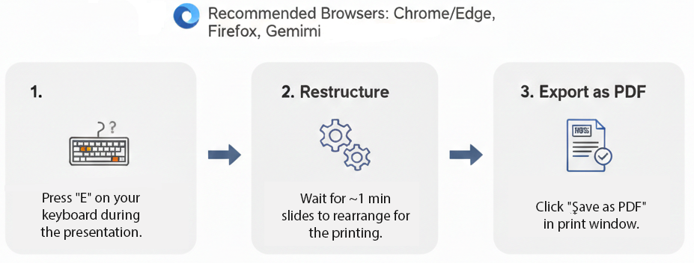
How to print Revealjs slides

Slide 3
Language Modeling

Slide 4
Language Modeling as Next-Token Prediction
Modern generative AI is built on language modeling.
Instead of learning a task-specific mapping
$$P(y∣x)$$
we model the probability of a text sequence itself:
$$P(x_{1},x_{2},…,x_{T})$$

Slide 5
From Joint Probability to Sequential Prediction
Using the chain rule of probability, we can rewrite the probability of a sequence as:
$$P(x_{1},x_{2},…,x_{T})=\prod_{t=1}^{T}{P}(x_{t}∣x_{1},…,x_{t−1})$$

Slide 6
Example of Sequence Factorization
For a short sentence such as:
deep learning is fun
the joint probability becomes:
$$\begin{aligned}P(\text{deep},\text{learning},\text{is},\text{fun})&=P(\text{deep}) \\ & ×P(\text{learning}∣\text{deep}) \\ & ×P(\text{is}∣\text{deep},\text{learning}) \\ & ×P(\text{fun}∣\text{deep},\text{learning},\text{is})\end{aligned}$$
Language generation is therefore a probabilistic unfolding of tokens through context. :contentReferenceoaicite:6

Slide 7
Supervised NLP vs Language Modeling
Supervised NLP
$$P(y∣x;θ)$$
input text mapped to task-specific output
requires labeled examples
separate model or head for each task
Language Modeling
$$P(x_{1},x_{2},…,x_{T};θ)$$
learns general text structure
uses abundant unlabeled text
supports generation, adaptation, and prompting

Slide 8
Why This Matters for Generative AI
If a model learns:
$$P(x_{t}∣x_{<t})$$
well enough, then it can:
generate coherent text
continue instructions
answer questions
translate between languages
simulate task performance through prompting
This is the conceptual bridge from language models to large language models.

Slide 9
Evaluation Intuition: How Good Is a Language Model?
A good language model should assign high probability to the actual next token.
For a sequence of length $n$, the average cross-entropy is:
$$\frac{1}{n}\sum_{t=1}^{n}{−}logP(x_{t}∣x_{<t})$$
A smaller value means:
less surprise
better prediction
more accurate modeling of language structure. :contentReferenceoaicite:8

Slide 10
Perplexity
Perplexity is the exponential of average cross-entropy:
$$Perplexity=exp\left(−\frac{1}{n}\sum_{t=1}^{n}{log}P(x_{t}∣x_{<t})\right)$$

Slide 11
Interpreting Perplexity
Perplexity can be understood as the model’s effective uncertainty over the next token.
Best case: model assigns probability 1 to the correct token → perplexity = 1
Worst case: model assigns probability 0 to the correct token → perplexity approaches infinity
Uniform baseline: model spreads probability equally across all tokens → perplexity equals vocabulary size.

Slide 12
Why Perplexity Is Useful
Perplexity gives us:
a length-normalized measure of prediction quality
comparability across different text sequences
an information-theoretic interpretation of model uncertainty
But it does not directly measure:
usefulness
factuality
helpfulness
alignment with human preferences
That is why later LLM systems require additional control layers such as instruction tuning and RLHF.

Slide 13
Bridge to Transformers and Prompting
Language modeling gives us the foundational objective:$P(x_{t}∣x_{<t})$
Transformers give us a scalable architecture for estimating it.
Prompting then becomes a way to shape the context so that the next-token distribution produces useful outputs.

Slide 14
Sequence Learning Problems

Slide 15
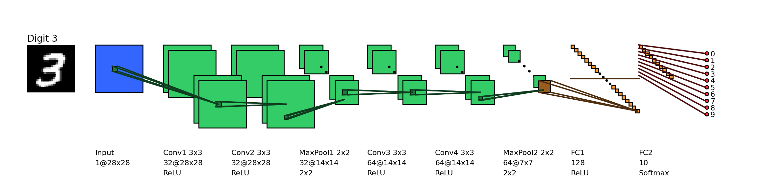
Fixed-size inputs in earlier models
In feedforward and convolutional neural networks the size of the input was always fixed.

Slide 16

For example, we fed fixed size ($28×28$) images to convolutional neural networks for image classification (MNIST).
Similarly in word2vec, we fed a fixed window ($k$) of words to the network.

Slide 17

Further, each input to the network was independent of the previous or future inputs.

Slide 18

For example, the computations, outputs and decisions for two successive images are completely independent of each other.

Slide 19
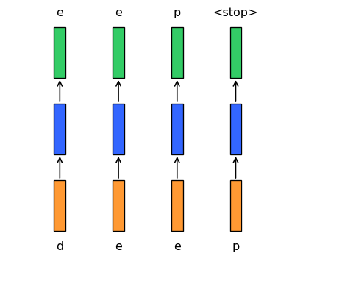
Auto-completion as a sequence problem
In many applications the input is not of a fixed size.
Further successive inputs may not be independent of each other.
For example, consider the task of auto completion.
Given the first character d you want to predict the next character e and so on.
Figure 1. Diagram showing a sequence of inputs and outputs for an auto-completion task.

Slide 20
Properties of sequence inputs
Successive inputs are no longer independent (while predicting e you would want to know what the previous input was in addition to the current input).
The length of the inputs and the number of predictions you need to make is not fixed (for example, “learn”, “deep”, “machine” have different number of characters).
Each network (orange–blue–green structure) is performing the same task (input: character, output: character).
These are known as sequence learning problems.
We need to look at a sequence of (dependent) inputs and produce an output (or outputs).
Each input corresponds to one time step.
Figure 2. “Diagram showing a sequence of inputs and outputs for an auto-completion task.”

Slide 21
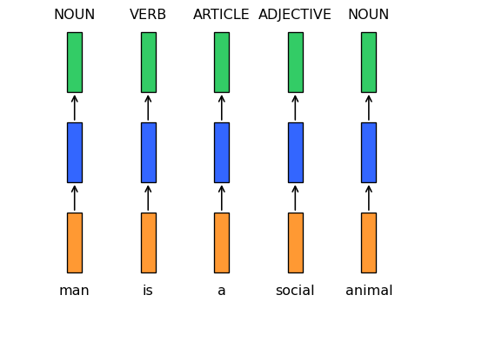
Part-of-speech tagging as a sequence task
Consider the task of predicting the part of speech tag (noun, adverb, adjective, verb) of each word in a sentence.
Once we see an adjective (social) we are almost sure that the next word should be a noun (man).
Thus the current output (noun) depends on the current input as well as the previous input.
Further the size of the input is not fixed (sentences could have arbitrary number of words).
Notice that here we are interested in producing an output at each time step.
Each network is performing the same task (input: word, output: tag).
Figure 3. Diagram showing a sequence of inputs and outputs for a part-of-speech tagging task.

Slide 22
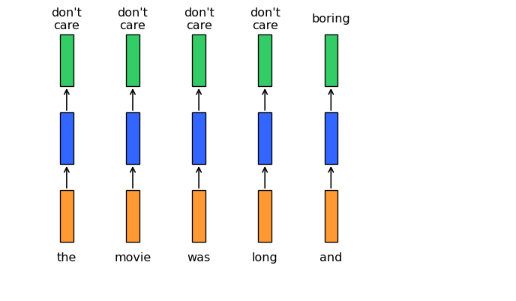
Sentiment as a sequence-to-label problem
Consider sentiment classification for a sentence like “The movie was boring and …”.
The final sentiment depends on the entire sequence of words.
Intermediate words like “boring” strongly influence the final decision.
Again, the input length is variable, but we may only need a single output label at the end.
Sequences could be composed of anything (not just words)
For example, a video could be treated as a sequence of images
We may want to look at the entire sequence and detect the activity being performed
Figure 4. Diagram showing a sentiment as a sequence to label problem

Slide 23
Recurrent Neural Networks

Slide 24
Modeling sequences with recurrent neural networks
Important
How do we model such tasks involving sequences?
Account for dependence between inputs
Account for variable number of inputs
Make sure that the function executed at each time step is the same
We will focus on each of these to arrive at a model for dealing with sequences

Slide 25
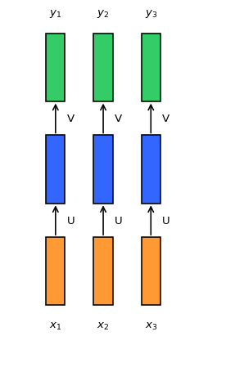
Functional Model of Sequence
What is the function being executed at each time step ($i$)?
$$\begin{matrix}s_{i}=σ(Ux_{i}+b) \\ y_{i}=O(Vs_{i}+c)\end{matrix}$$
Since we want the same function to be executed at each time step, we should share the same network parameters across time
Diagram showing a sequence of inputs and outputs for an auto-completion task.

Slide 26
Parameter Sharing Across Time
Parameter sharing ensures that the network becomes agnostic to the length of the input sequence
Since we compute the same function with the same parameters at every time step, the number of time steps does not change the model definition
We can view this as creating multiple copies of the same network and applying them across the sequence

Slide 27
A First Attempt at Modeling Dependence
How do we account for dependence between inputs?
A first, but infeasible, idea is to feed all previous inputs into the network at each time step
At time step $i$, the model would receive:
$x_{1}$
$x_{2}$
$…$
$x_{i}$
Is this a good solution?
No, because it violates the other requirements in our wishlist

Slide 28
Why the Naive Dependence Strategy Fails
The function being computed at each time step is now different
$$\begin{matrix}y_{1}=f_{1}(x_{1}) \\ y_{2}=f_{2}(x_{1},x_{2}) \\ y_{3}=f_{3}(x_{1},x_{2},x_{3})\end{matrix}$$
The network becomes sensitive to sequence length
A sequence of length 10 would require $f_{1},…,f_{10}$, while a sequence of length 100 would require $f_{1},…,f_{100}$

Slide 29
The Recurrent Solution
The solution is to add a recurrent connection to the network
$$s_{i}=σ(Ux_{i}+Ws_{i−1}+b)$$
$$y_{i}=O(Vs_{i}+c)$$
or more generally,
$$y_{i}=f(x_{i},s_{i−1},W,U,V,b,c)$$
$s_{i}$ is the state of the network at time step $i$
The parameters $W,U,V,b,c$ are shared across time steps
The same model can process sequences of length 10, 100, or more

Slide 30
A More Compact View of Recurrence
We can represent recurrence more compactly
The hidden state is updated by combining:
the current input $x_{i}$
the previous state $s_{i−1}$
This compact view emphasizes that the network carries information forward through time

Slide 31
Revisiting Sequence Learning Problems
Let us revisit the sequence learning problems that we saw earlier
We now have recurrent connections between time steps, which account for dependence between inputs
This gives us a principled architecture for modeling sequential data

Slide 32
Prompt Engineering and Prompt-Based Learning

Slide 33
Why Prompt Engineering Matters
Prompt-based learning reframes downstream tasks as language modeling problems. This means performance depends not only on:
the pre-trained model
the data
the decoding strategy
but also on:
how the prompt is structured
how the answer space is designed
how prompts are combined or tuned

Slide 34
Prompt Shape
Two major prompt shapes are commonly used:
Cloze prompt - the answer slot appears inside the text
Example:
I love this movie. Overall, it was a [Z] movie.
Prefix prompt
the input appears before the answer slot
Example:
French: Je vous aime. English: [Z]
Prompt shape affects:
what the model is asked to do
how naturally the task aligns with pretraining
which model families work best.

Slide 35
Manual Template Engineering
A manually designed prompt template specifies:
where the input is inserted
what linguistic context surrounds it
what kind of answer is expected
Examples:
Sentiment:
[X] The movie is [Z].
Topic classification:
[X] The text is about [Z].
Translation:
French: [X] English: [Z]
Manual template design is intuitive and interpretable, but it is often brittle and task-sensitive.

Slide 36
Automated Template Learning
Instead of hand-writing prompts, we can learn them.
Two major approaches:
Discrete prompt learning
Continuous prompt learning
This shifts prompting from:
prompt writing
to
prompt optimization
The central idea is that the prompt itself can become an object of search or training.

Slide 37
Discrete Prompts
Discrete prompt learning searches over actual tokens or phrases.
Examples:
selecting better trigger words
searching candidate templates
optimizing label words
Advantages:
interpretable
human-readable
easy to inspect
Limitations:
combinatorial search space
token-level optimization is difficult
may remain brittle across tasks.

Slide 38
Continuous Prompts
Continuous prompts replace natural-language templates with learnable vectors.
Instead of writing:
The movie is [Z].
we learn soft prompt embeddings that steer the model.
Advantages:
highly flexible
easier to optimize than discrete token search
often performs well with frozen language models
Limitations:
less interpretable
not directly human-readable
can behave like hidden task-specific parameters.

Slide 39
Answer Engineering
Prompting does not end with the prompt itself.
We must also decide:
what form the answer takes
what answer space is allowed
how answers map back to task outputs
Examples:
token answer
span answer
sentence answer
Answer engineering is especially important in classification-style prompting, where many different words may correspond to the same label.

Slide 40
Answer Shape and Answer Space Design
Three common answer shapes:
Token
Span
Sentence
Answer space design can be:
Manual - choose verbalizers such as: - positive → great - neutral → okay - negative → terrible
Discrete search - search over candidate answer tokens
Continuous search - learn answer representations in embedding space
This choice strongly affects accuracy, calibration, and task fit.

Slide 41
Multi-Prompt Learning
A single prompt is rarely sufficient.
Multi-prompt learning extends the framework through:
Prompt ensembling
Prompt augmentation
Prompt composition
Prompt decomposition
This helps reduce prompt sensitivity and improve robustness across tasks.

Slide 42
Multi-Prompt Strategies
Prompt ensembling
combine predictions from multiple prompts
Prompt augmentation
vary demonstrations or examples
generate multiple contextual prompt versions
Prompt composition
combine multiple sub-prompts into a larger task structure
Prompt decomposition
break a complex task into simpler prompted subtasks
These strategies move prompting from a single-template method to a small inference system.

Slide 43
Training Strategies for Prompting
Prompt-based learning can be used with different training regimes.
Common settings include:
zero-shot or few-shot prompting
full-data prompting
instruction tuning
prompt tuning
The important question is:
Which parameters are actually updated?

Slide 44
Parameter Update Methods
Five major strategies:
Promptless fine-tuning
fine-tune the model directly without prompts
Tuning-free prompting
use prompts only at inference time
Fixed-LM prompt tuning
freeze the model, learn the prompt
Fixed-prompt LM tuning
keep prompt fixed, update model parameters
Prompt + LM tuning
jointly optimize both prompt and model
These strategies differ in:
cost
interpretability
flexibility
performance.

Slide 45
Big Picture
Prompt-based learning is not one method.
It is a family of design choices involving:
prompt structure
answer structure
multiple prompt coordination
parameter update strategy
So when we say “prompt engineering,” we are really talking about a broader inference and adaptation framework for large language models.

Slide 46
Transition
We now have a richer picture of prompting:
prompts specify tasks
answers define decision spaces
multiple prompts improve robustness
tuning strategies determine what adapts
The next question is:
How do these prompt-based methods connect to transformer computation, in-context learning, and alignment?

