Slide 1
AD698 - Applied Generative AI
Transformers, Attention, and Context Nakul R. Padalkar

Slide 2
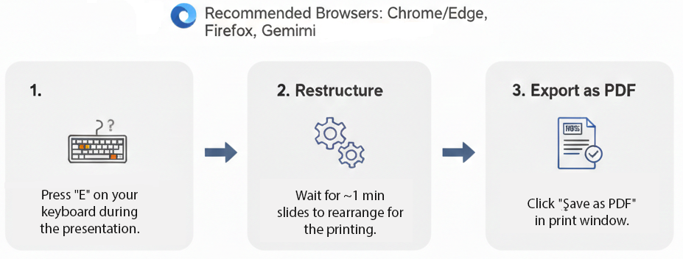
How to print Revealjs slides

Slide 3
Attention Mechanism and Transformers

Slide 4
From Classic Deep Learning to the Edge of Its Limits
The 2010s: Deep Learning’s First Boom
Breakthroughs driven by MLPs, CNNs, and RNN/LSTMs
Architectures changed little from their 1980s–1990s origins
Gains came mostly from:
GPUs + parallel computing
Massive datasets + cheap storage
Training innovations (ReLU, batch norm, dropout, residuals, Adam)
Why These Models Plateaued
CNNs dominated vision; LSTMs dominated NLP
Thousands of alternative architectures proposed, but few displaced the classics
Progress felt like scaling, not rethinking
By mid‑2010s, the field was primed for a new architectural paradigm

Slide 5
The Transformer Era
Originally added to encoder–decoder RNNs for machine translation
Allowed models to focus selectively on different input tokens
Replaced the “single compressed vector” bottleneck
Enabled differentiable, learnable weighting over the entire input sequence
Transformers: The Architectural Breakthrough
Vaswani et al. (2017): no recurrence, all attention
Rapidly outperformed RNNs across NLP tasks
Became the foundation for large-scale pretraining (BERT, RoBERTa, GPT‑2/3)
Expanded beyond NLP:
Vision Transformers (image recognition, detection, segmentation)
Speech, reinforcement learning, graph neural networks
The New Landscape
Transformers + large-scale pretraining → foundation models
Default approach: start with a pretrained Transformer, fine‑tune for downstream tasks
Represents a true architectural shift, not just bigger models

Slide 6
Why Attention? A Human Translation Story

Slide 7
Why Attention? A Human Translation Story
When we translate a sentence, we don’t memorize the entire thNew chating at once.
We look back and forth, focusing on the specific words we need at each moment.
Early sequence‑to‑sequence models (Sutskever et al. 2014) didn’t do this.
The encoder read the whole sentence once, compressed it into a single vector, and handed that to the decoder.
The decoder then tried to generate the entire translation from that one vector.
Figure 1

Slide 8
The Problem With Single‑Vector Encodings
Compressing a long, information‑rich sentence into one vector is a bottleneck.
RNNs struggle to retain all details, especially for long sequences.
Even improved architectures (Kalchbrenner et al., 2014; Yang et al., 2016) only partially help.
The decoder has no way to “look back” at specific words.
This mismatch between human translation and RNN translation motivates a new idea.
Figure 2

Slide 9
The Key Insight: Focus Selectively
Humans translate by focusing on different input words at different times.
At each decoding step, we implicitly form a distribution over the input words:
some words matter a lot,
some matter a little,
some don’t matter at all.
Ideally, the decoder should receive only the relevant information for the word it is about to produce.

Slide 10
From Human Intuition to a Formal Mechanism
Bahdanau et al. (2014) formalized this intuition:
Treat the encoder outputs as a set of key–value pairs $(k_{i},v_{i})$.
At each decoding step, compute a query $q$.
Compare the query to each key to produce attention weights $α(q,k_{i})$.
Use these weights to form a weighted sum of values:
Attention(q,D)=i​α(q,ki)vi.

Slide 11
Why Queries, Keys, and Values Work So Well
This mechanism has several powerful properties:
Works for any input length — no architectural changes needed.
The “program” (the query) is small, but it operates over a large state space.
The model learns what to retrieve and how strongly.
Special cases include:
exact lookup (one weight = 1),
uniform averaging,
convex combinations (soft attention).
Softmax normalization ensures weights are nonnegative and sum to 1.

Slide 12
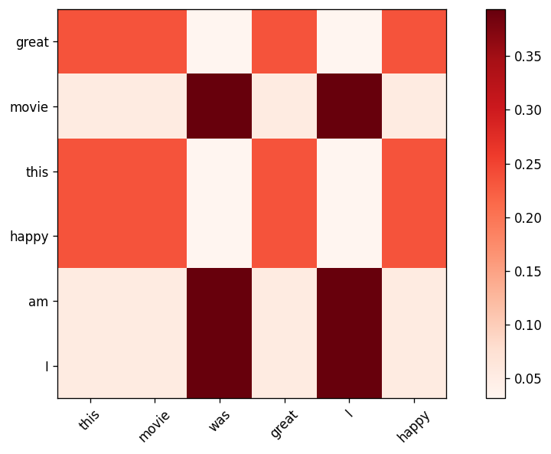
The Bridge to Transformers
Once we have queries, keys, and values, we can drop recurrence entirely.
Vaswani et al. (2017) showed that attention alone can model all relationships in a sequence.
This leads directly to the Transformer architecture.
Q/K/V attention becomes the fundamental building block for:
machine translation,
language modeling (GPT‑2/3),
masked language modeling (BERT),
vision transformers,
speech, RL, and graph models.
Figure 3

Slide 13
Attention Pooling by Similarity

Slide 14
Motivation: Why Attention Pooling?
Before Transformers, attention already existed in classical statistics
Nadaraya–Watson regression is one of the earliest “attention‑like” mechanisms
It uses similarity between a query and keys to compute a weighted average of values
This gives us a clean bridge from classical kernels → modern attention

Slide 15
The Core Idea
This is attention pooling in its purest form
No training, no parameters, no deep nets
Just:
Compute similarity
Normalize
Weighted sum
f(q)=i​viα(q,ki)j​α(q,kj)

Slide 16
Kernels as Similarity Functions
$$α(q,k)=\left\{\begin{matrix}exp(−∥q−k∥^{2}/2) & \text{Gaussian} \\ 1 & \text{if }|q−k|<1 \\ max(0,1−|q−k|) & \text{Epanechikov}\end{matrix}\right.$$
Figure 4. Common kernels used in Nadaraya–Watson regression.

Slide 17
Generating Synthetic Data
A simple nonlinear function
Add noise to simulate real data
We’ll use kernel regression to approximate it
Nadaraya–Watson Attention Pooling
Each validation point is a query
Each training point is a key–value pair
The normalized kernel weights are attention weights

Slide 18
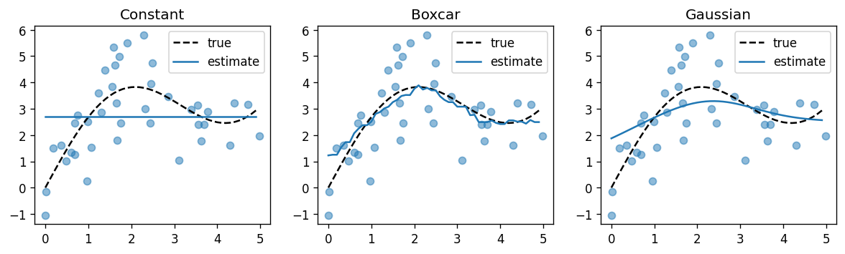
Regression Results
All kernels except “constant” produce reasonable fits
Gaussian is smoothest
Boxcar is sharpest

Slide 19
Attention Weights as Heatmaps
Each column = a query
Each row = a training point
Bright = high attention weight
Gaussian, Boxcar, Epanechikov → very similar patterns
Figure 5

Slide 20
Kernel Width Matters
Narrow kernels → sharp, local attention
Wide kernels → smooth, global attention
Small $σ$ → attention collapses to nearest neighbors
Large $σ$ → attention spreads across many points
Figure 6

Slide 21
Why This Matters for Transformers
Nadaraya–Watson is a precursor to modern attention
Same structure:
similarity → softmax → weighted sum
But:
kernels are hand‑crafted
representations are fixed
no learning
Transformers replace kernels with learned Q/K/V projections

Slide 22
Motivation for Attention Scoring Functions
Goal: Understand how we compute the compatibility between a query and a set of keys.
Attention pooling requires a score $a(q,k_{i})$ for each key.
These scores determine how much each value contributes to the output.
We want scoring functions that are:
computationally efficient
numerically stable
expressive enough to model interactions
Two dominant families:
Dot‑product attention
Additive attention

Slide 23
From Distance Kernels to Learnable Scoring
Context: Earlier, we used Gaussian kernels to model similarity.
Issue: Distance computations are more expensive than dot products.
Terms depending only on $q$ cancel out after softmax normalization.
Layer normalization often keeps $∥k_{i}∥$ roughly constant.
This motivates dropping norm‑dependent terms and focusing on dot products.

Slide 24
Dot‑Product Attention
Measures alignment between query and key.
Works best when $q$ and $k_{i}$ have similar scale.
If $q,k_{i}∈R^{d}$ with i.i.d. components, $Var(q^{⊤}k_{i})=d$.
Large $d$ → large variance → unstable softmax.
$$a(q,k_{i})=q^{⊤}k_{i}$$

Slide 25
Scaled Dot‑Product Attention
Fix: Rescale by $1/\sqrt{d}$.
Keeps logits in a stable range.
Prevents softmax from saturating.
Used in Transformers and nearly all modern architectures.
$$\begin{matrix}a(q,k_{i})=\frac{q^{⊤}k_{i}}{\sqrt{d}} \\ α(q,k_{i})=softmax(a(q,k_{i}))\end{matrix}$$

Slide 26
Batched Scaled Dot‑Product Attention
For queries $Q∈R^{n×d}$, keys $K∈R^{m×d}$, values $V∈R^{m×v}$:
$$\begin{matrix}Attention(Q,K,V)=softmax​\left(\frac{QK^{⊤}}{\sqrt{d}}\right)V\end{matrix}$$

Slide 27
Masked Softmax
NLP sequences have variable lengths.
Padding tokens should not contribute to attention.
Mechanism:
Replace padded positions with a large negative value (e.g., $−{10}^{6}$).
After softmax, these positions contribute zero.

Slide 28
Additive Attention
Dot‑product attention requires $q$ and $k_{i}$ to have the same dimension.
Additive attention handles mismatched dimensions naturally.
A small MLP computes compatibility.
Often used in early seq2seq models (Bahdanau attention).
$$\begin{matrix}a(q,k_{i})=w_{v}^{⊤}tanh(W_{q}q+W_{k}k_{i})\end{matrix}$$

Slide 29
Comparing Dot‑Product and Additive Attention
– Dot‑Product Attention - Fast (matrix multiplications) - Scales well to large models - Standard in Transformers - Additive Attention - More flexible with dimensionality - Slightly more expensive - Historically important in seq2seq models

Slide 30
When to Use Which Scoring Function
dot‑product attention when:
Query and key dimensions match
You need speed and scalability
You’re building Transformer‑style models
additive attention when:
Query and key dimensions differ
You want a more expressive scoring function
Model size is small enough that cost is negligible

Slide 31
Summary
Attention scoring functions compute compatibility between queries and keys.
Scaled dot‑product attention is the default in modern architectures.
Additive attention is more flexible but slower.
Masked softmax is essential for variable‑length sequences.
Efficient implementations rely on batch matrix multiplication.

Slide 32
References
Bahdanau, D., Cho, K., and Bengio, Y. 2014. “Neural Machine Translation by Jointly Learning to Align and Translate,” ArXiv:1409.0473.
Sutskever, I., Vinyals, O., and Le, Q. V. 2014. “Sequence to Sequence Learning with Neural Networks,” in Advances in Neural Information Processing Systems, pp. 3104–3112.
Vaswani, A., Shazeer, N., Parmar, N., and others. 2017. Attention Is All You Need, (30). (https://arxiv.org/abs/1706.03762).

