Slide 1
AD698 - Applied Generative AI
Training Paradigms and Fine-Tuning Pipelines

Slide 2
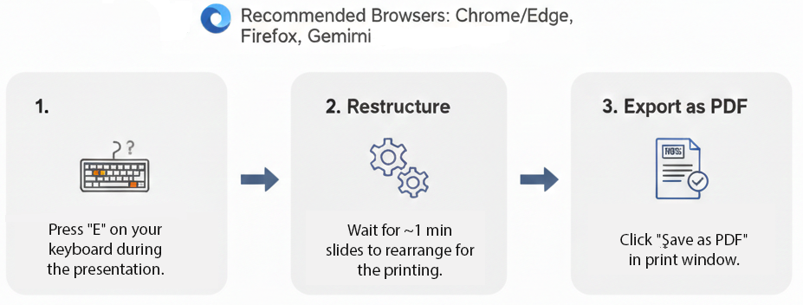
How to print Revealjs slides

Slide 3
From Pretraining to Deployment

Slide 4
The Modern AI Development Lifecycle
Most production AI systems today are built in two stages:
Pretraining — learn general language representations from a massive corpus
Adaptation — specialise the pretrained model for a target task or domain
The adaptation stage can take many forms: full fine-tuning, instruction tuning, RLHF, or PEFT.

Slide 5
Pretraining Objectives
Objective | Architecture | Example
Masked Language Modeling (MLM) | Encoder | BERT
Causal Language Modeling (CLM) | Decoder | GPT
Sequence-to-Sequence (Span Corruption) | Encoder-Decoder | T5, BART

Slide 6
The objective shapes what the model learns to do: fill gaps (BERT) vs predict continuations (GPT).

Slide 7
Masked Language Modeling (MLM)
BERT randomly masks 15% of tokens and trains the model to predict the missing words.
Input: "The company reported strong [MASK] growth in Q3." Target: ↑ "revenue"
Note
MLM forces bidirectional context — the model sees tokens on both sides of each mask. This makes BERT excellent for classification, NER, and QA but not text generation.

Slide 8
Causal Language Modeling (CLM)
GPT-style models predict the next token, seeing only past context (autoregressive).
Input: "The company reported strong" Predict: "revenue" → "growth" → "in" → "Q3"
Note
CLM enables open-ended text generation but limits direct use of future context during encoding.

Slide 9
Transfer Learning Paradigm

Slide 10
Why Transfer Learning Works
Pretraining on large text corpora gives the model:
Syntactic knowledge — sentence structure and grammar
Semantic knowledge — word meaning and relationships
World knowledge — facts encoded in training text
Task-adjacent skills — reading comprehension, reasoning patterns
Fine-tuning on a small labelled dataset then steers this knowledge toward the target task.

Slide 11
The Fine-Tuning Spectrum
← Less compute More compute → Zero-shot Few-shot Prompt PEFT Full Fine-Tune prompting Tuning (LoRA) ← Less data needed More data needed →
The right approach depends on: data availability, compute budget, and task difficulty.

Slide 12
Full Fine-Tuning

Slide 13
What is Full Fine-Tuning?
Update all model parameters on labelled task data.
Procedure:
Start from a pretrained checkpoint (e.g., bert-base-uncased)
Add a task-specific head (e.g., linear classifier)
Train on labelled data with a small learning rate
Evaluate on held-out test set

Slide 14
PyTorch: Classification Head
import torch.nn as nn class BertClassifier(nn.Module): def __init__(self, bert_hidden: int = 768, num_classes: int = 3): super().__init__() # In practice: load from transformers.BertModel self.encoder = nn.Identity() # placeholder self.dropout = nn.Dropout(0.1) self.classifier = nn.Linear(bert_hidden, num_classes) def forward(self, cls_embedding): return self.classifier(self.dropout(cls_embedding))

Slide 15
Challenges of Full Fine-Tuning
Catastrophic forgetting — model loses general capabilities
Compute cost — updating billions of parameters is expensive
Data requirements — needs thousands of labelled examples
Storage — one full copy of weights per fine-tuned task

Slide 16
Instruction Tuning

Slide 17
What is Instruction Tuning?
Fine-tune on (instruction, response) pairs to teach the model to follow natural language commands.
Instruction: "Classify the sentiment of the following review as POSITIVE or NEGATIVE." Input: "The product broke after two days of use." Response: "NEGATIVE"
Examples: FLAN-T5, InstructGPT, Alpaca.

Slide 18
Why Instruction Tuning Matters
Models become far more useful for end users without programming
A single model can handle hundreds of tasks (zero-shot generalisation)
Enables natural language as the interface to AI systems

Slide 19
RLHF: Reinforcement Learning from Human Feedback

Slide 20
The RLHF Pipeline
RLHF (Ouyang et al., 2022 — InstructGPT) aligns models with human preferences:
Supervised Fine-Tuning (SFT) — fine-tune on human-written demonstrations
Reward Model Training — train a model to predict human preference scores
PPO Optimisation — use RL to maximise reward while staying close to the SFT baseline

Slide 21
Why RLHF is Hard
Human labellers must rank thousands of output pairs
Reward models can be gamed (reward hacking)
PPO is computationally expensive and unstable
Alternative: Direct Preference Optimization (DPO) — simpler, no reward model needed

Slide 22
Parameter-Efficient Fine-Tuning (PEFT)

Slide 23
The Key Idea
Instead of updating all parameters, inject a small number of trainable adapter parameters. The pretrained weights are frozen.
LoRA — learn low-rank updates to weight matrices: $W^{′}=W+ΔW=W+BA$
Prefix Tuning — prepend learnable tokens to the input sequence
Prompt Tuning — learn soft prompt embeddings only

Slide 24
LoRA: Low-Rank Adaptation
$$ΔW=B⋅A \text{where }B∈R^{d×r}, A∈R^{r×k}, r≪min(d,k)$$
Rank $r$ controls the number of trainable parameters
Typical $r∈\{4,8,16\}$ — reduces parameters by 100–10,000×
At inference: merge $ΔW$ back into $W$ — no latency overhead

Slide 25
Summary

Slide 26
Key Takeaways
Pretraining objectives (MLM, CLM, seq2seq) determine model strengths and weaknesses
Transfer learning = leverage pretrained representations for downstream tasks
Full fine-tuning is powerful but expensive; instruction tuning improves usability
RLHF aligns models with human preferences — but at significant cost
PEFT methods (LoRA, adapters) offer 90%+ of the fine-tuning benefit at 1–10% of the compute

Slide 27
What’s Next?
Lab: Implement a fine-tuning training loop in PyTorch with a classification head
Tutorial: Build a LoRA-style adapter from scratch
Assignment: Fine-tune a model on SEC 10-K risk classification

