Slide 1
AD698 - Applied Generative AI
M07 P2 Nakul R. Padalkar Author Two

Slide 2
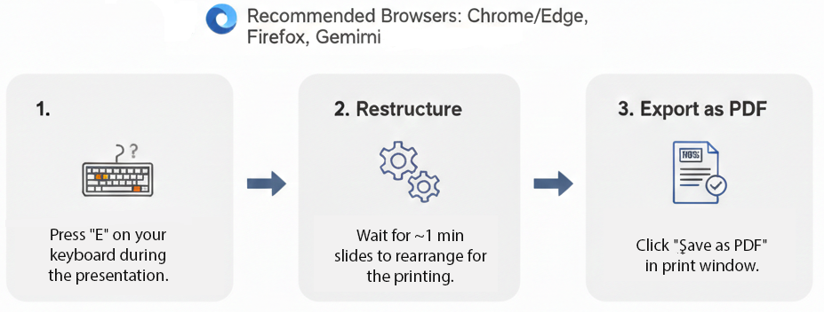
How to print Revealjs slides

