Slide 1
AD698 - Applied Generative AI
Neural Networks for Classification and Regression Nakul R. Padalkar

Slide 2
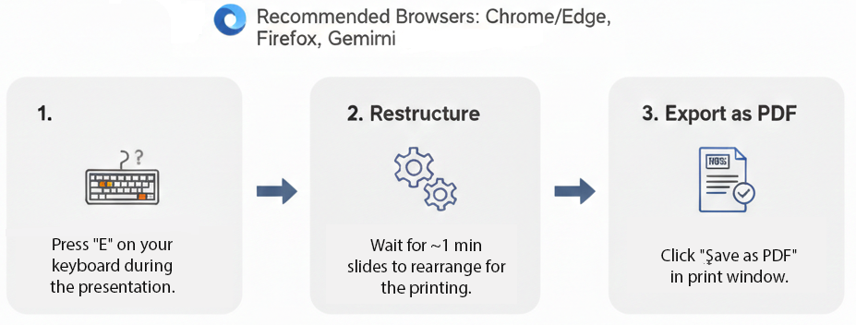
How to print Revealjs slides

