Slide 1
AD698 - Applied Generative AI
Language Modeling, Structured Prediction, & Evaluation Nakul R. Padalkar

Slide 2
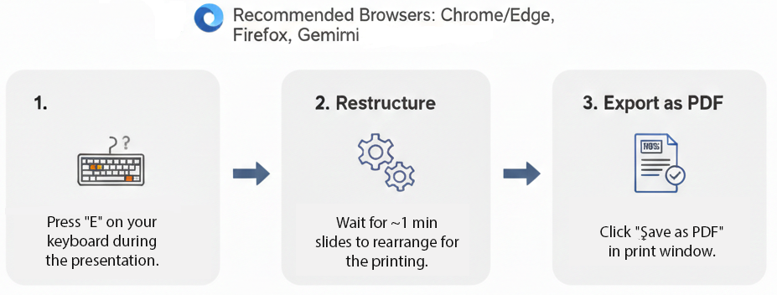
How to print Revealjs slides

