Slide 1
M07: Presentation
AI-Powered Business Dashboards Nakul R. Padalkar Author Two

Slide 2
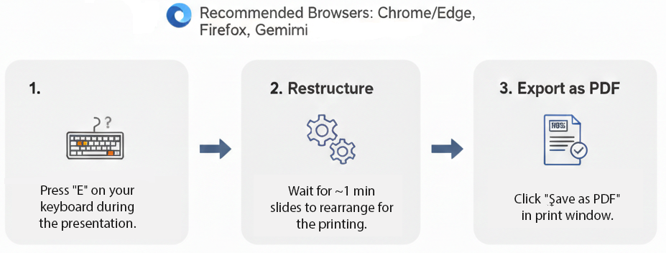
How to print Revealjs slides

