Slide 1
Power Drone Flight Simulation
Jaden Cho, Henry Bojanowski, Stephanie Pellicane, Christopher Lemus, Brendan Slabe
Image credit: Brian Maccleery of FlyJusTM

Slide 2
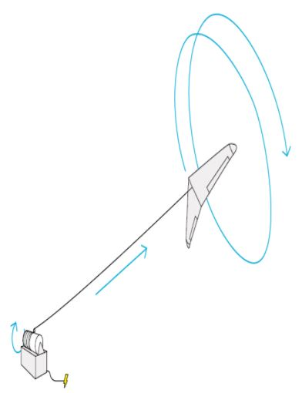
Project Intro
Create a software program that will run alongside the X-Plane simulation which will calculate the power generated by a tethered drone during a given flight path in any weather conditions.
The program will have real-time graphical data that depicts the current power generation while the simulation is in progress.

Slide 3

Completed Work
Minimum Viable Product
  Extracting data from X-Plane via Ardupilot/Mission Planner
  Extracting data from X-Plane via Node.js
  Python script to read extracted data
  Python script to calculate necessary parameters from data
  Python script to create real-time graphic
  Estimations of the power generated by the tethered drone based on different flight paths, weather, etc.

Slide 4
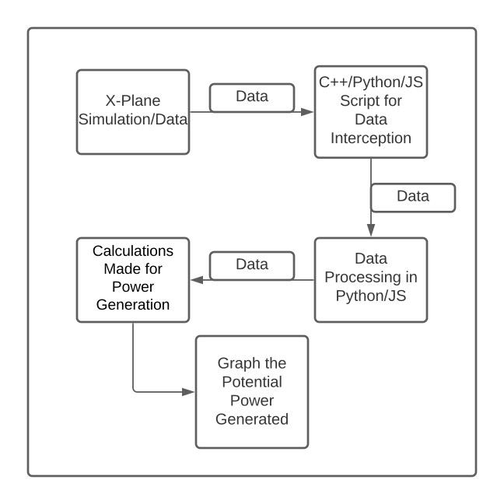
Flowchart

Slide 5
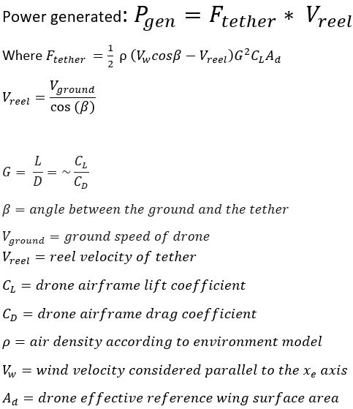
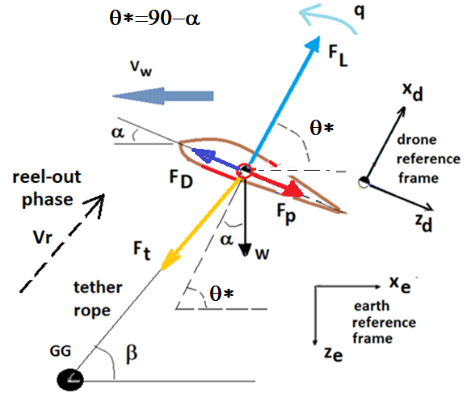
Progress: Forces

Slide 6
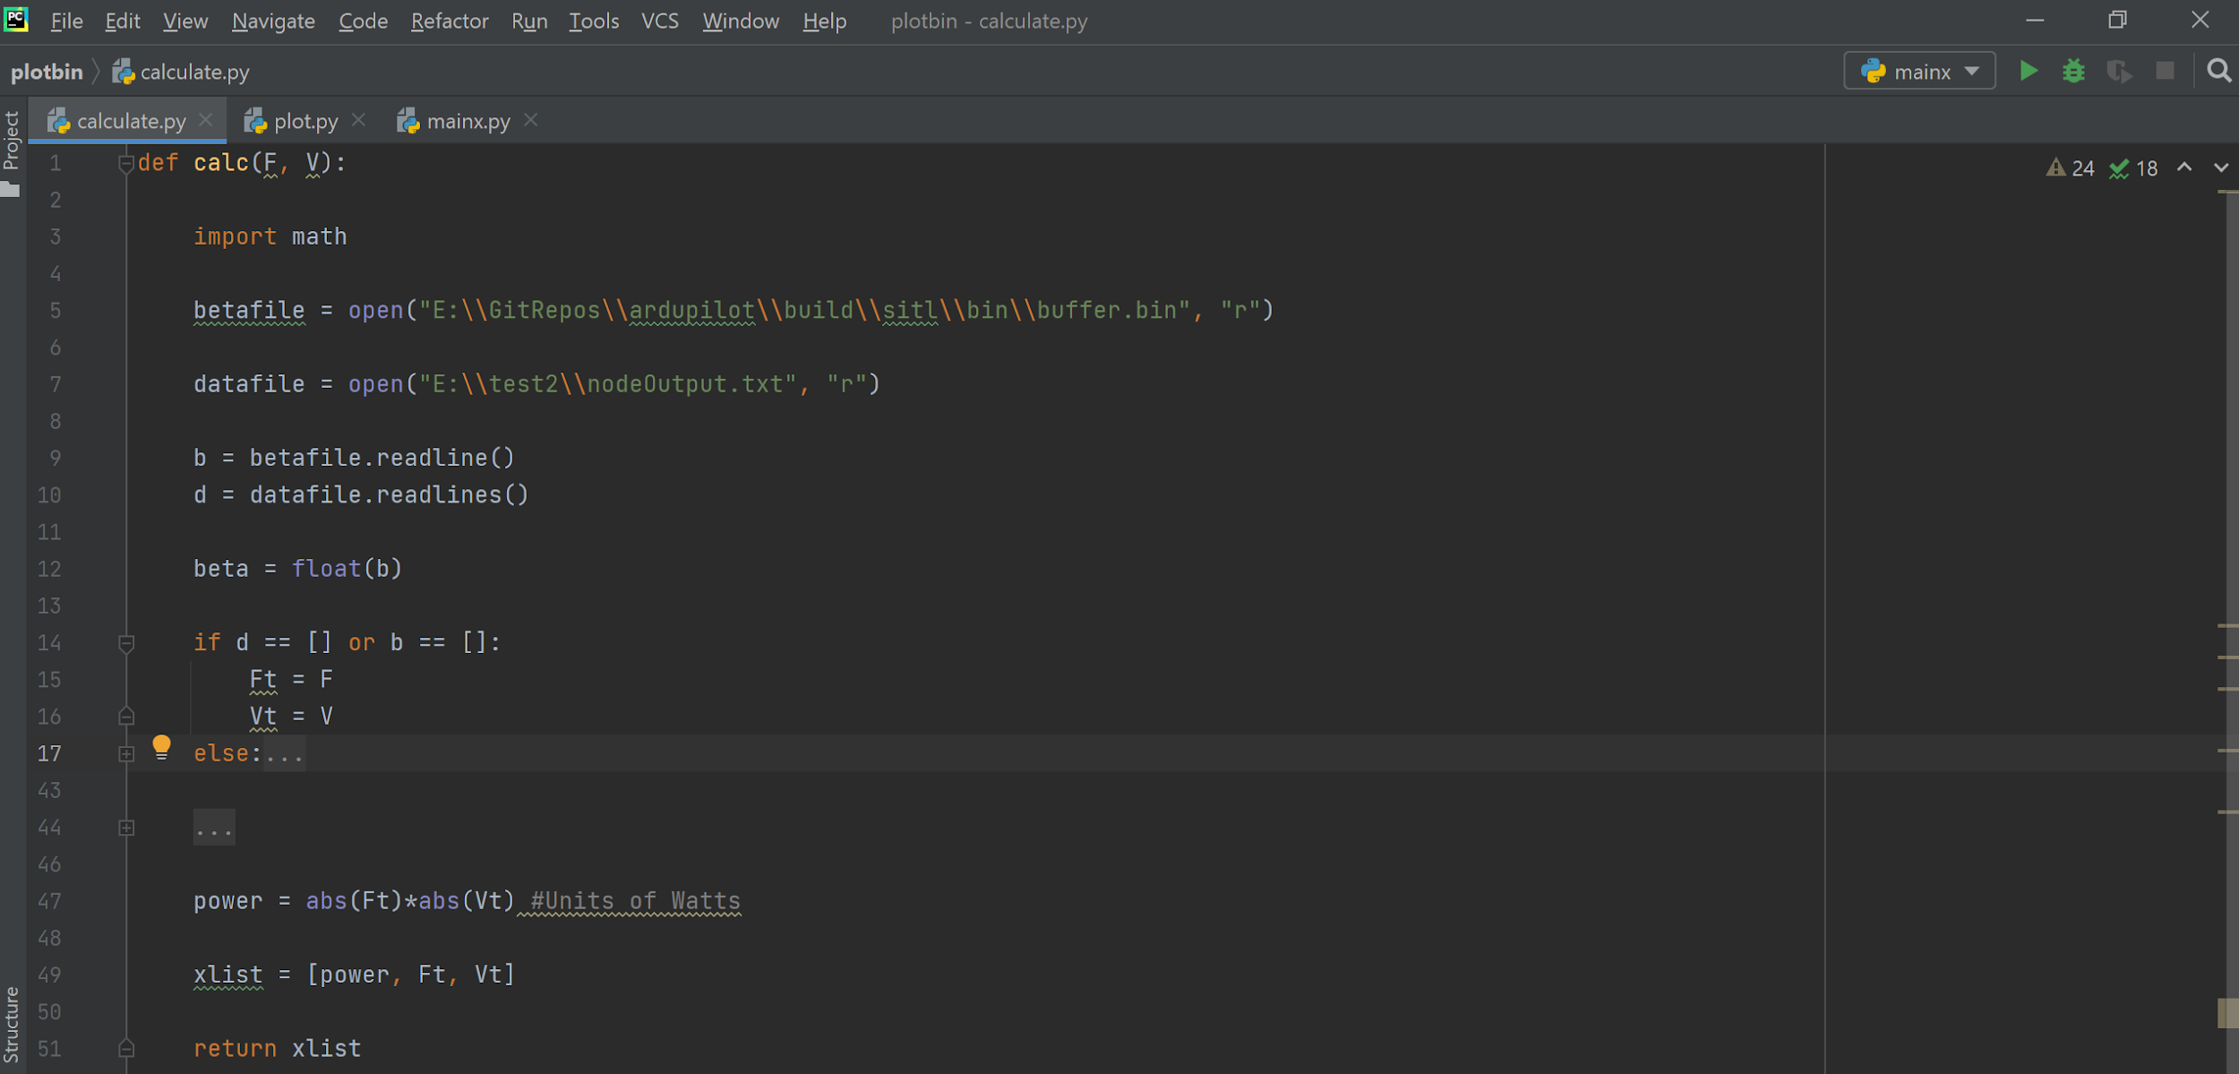
Progress: Calculations

Slide 7
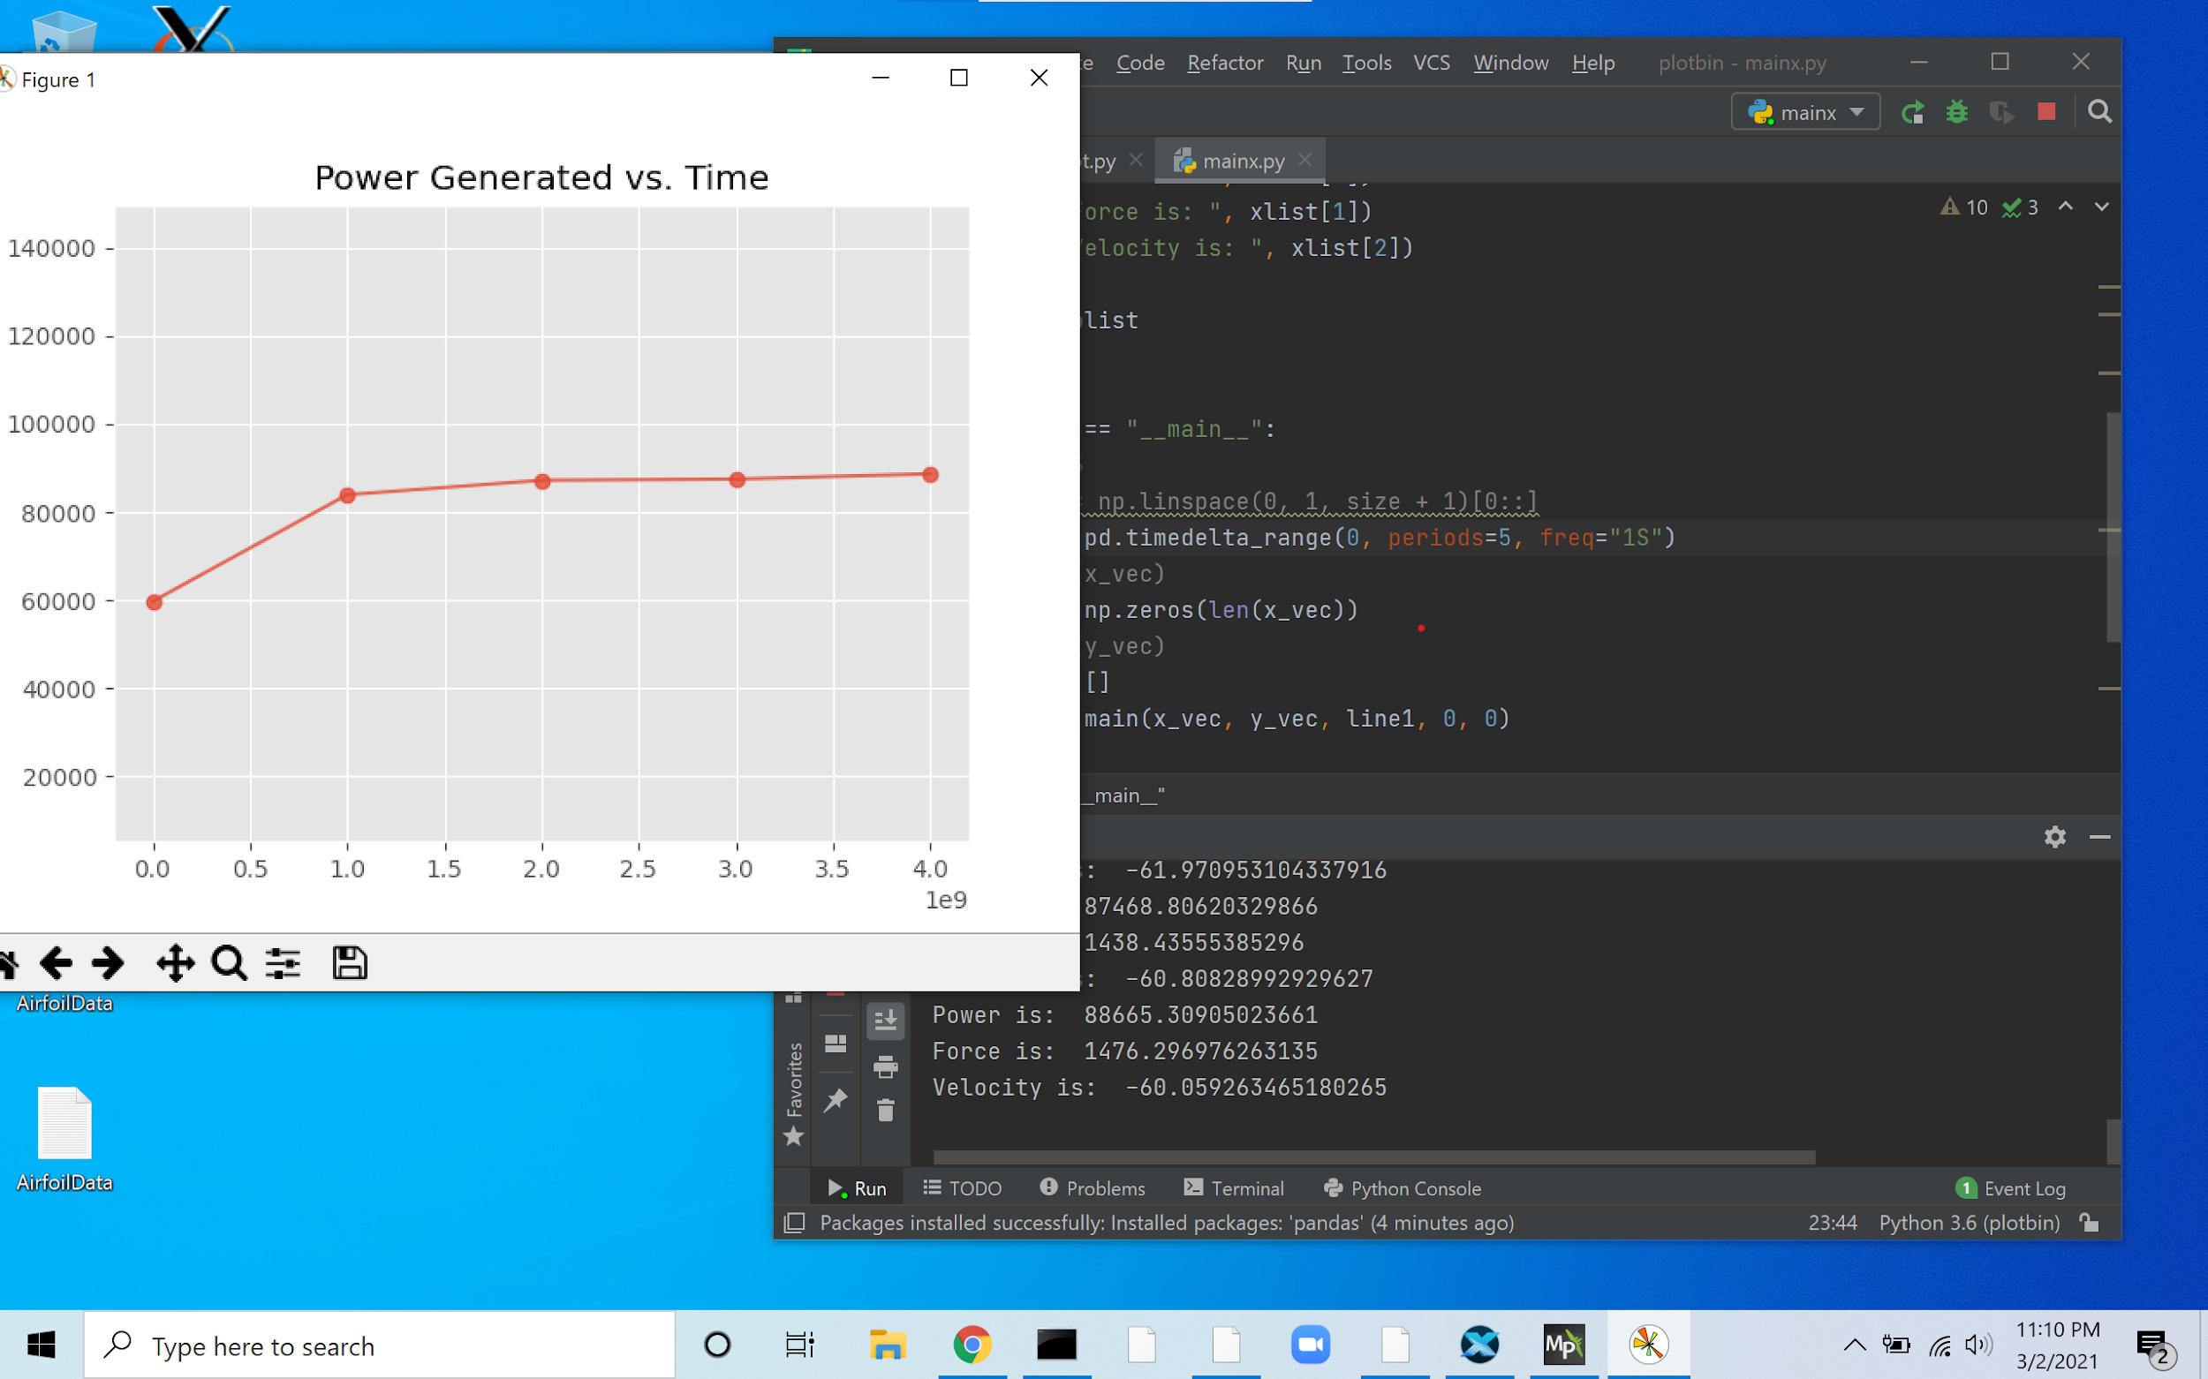
Progress: Graphical

Slide 8
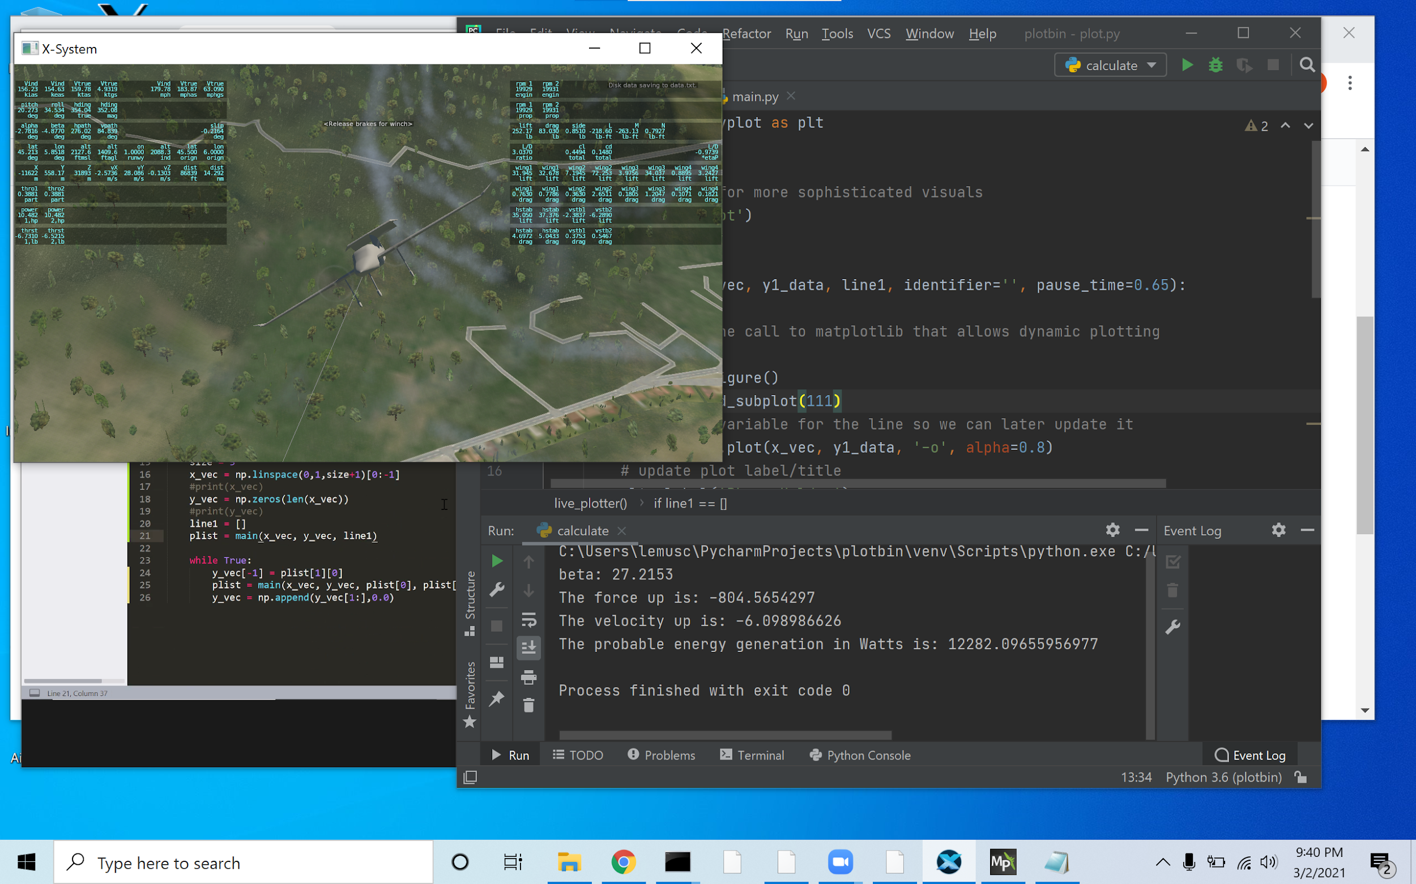
Progress: System All Together

Slide 9
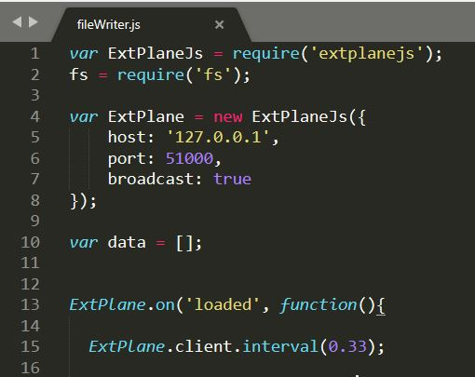
More Specifics on Progress
filewriter.js gathers all data for drone except data for the beta angle, uses ExtPlane extension
Python code calculates power generation by reading data from buffer files

Slide 10
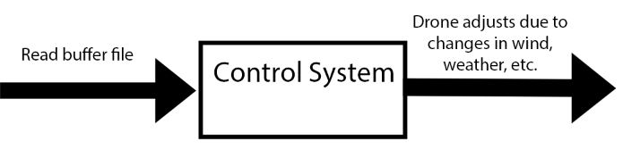
Additional Items
Implement Control System
Add other parameters to be shown/graphed including the power generation. i.e AVG Potential Power Gen.
Ease of using programs
General testing of code so it’s error-free
Alternate programmed flight paths
Additional factors which reduce power generation

Slide 11
Milestones
Due to finishing the MVP sooner than expected, we have now begun work on adding the additional items from the previous slide.
The next milestone would be to integrate all of the programs into one so that the software is easier to use and execute
Afterwards, implementing a control system would be the next step as this would greatly benefit our client in not only finding viable flight paths but also adjusting the path during flight to maximize the power generated.

Slide 12
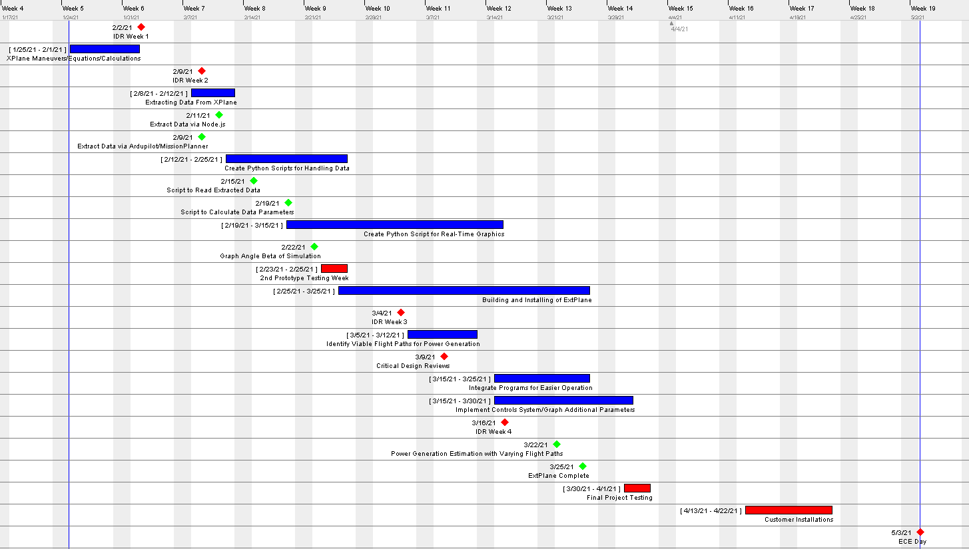

Slide 13
Thank you for listening!
Any questions?

