Slide 1
Brain Force
An EEG-Based Brain-Computer Interface
By Alexander Johnson, Brendan Shortall, Dayanna De La Torres, Jonathan Mikalov, Mitchell Gilmore
Client: Alan Pisano
Team 04

Slide 2
Project Goal
To use a brain computer interface to aid disabled individuals in using a computer by reading neural activity related to thoughts of motion and translating these thoughts into distinct commands.
Notes:
“Tweetable” summary of your project - 30 seconds or less

Slide 3
System Requirements & Components
01
Comfortable, easily removable, dry EEG sensors.
Lightweight, feasible to wear for long periods of time.
Structural integrity will hold over multiple uses.
3D Printed Headset
02
Biosampling, Filters.
12+ Channels
USB Connectivity
EEG Sampling Board
03
LSTM Neural Network
4+ classifiable states
60+% accuracy
Machine Learning Model
04
Translate ML output into distinct actions.
Small tasks for users to complete.
Make a scoreboard for ECE day competition.
Virtual 3D Environment

Slide 4
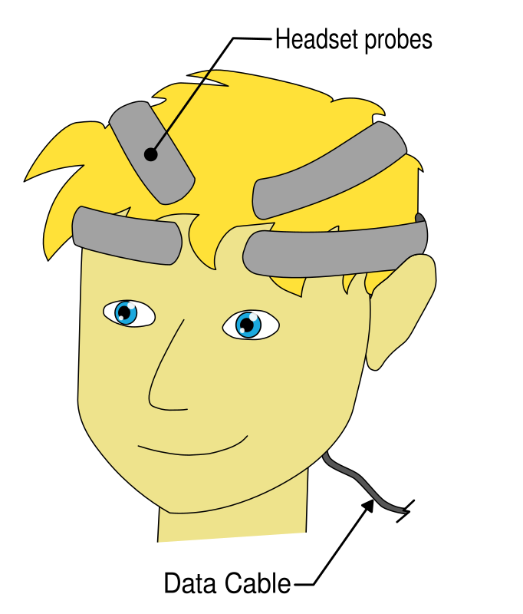
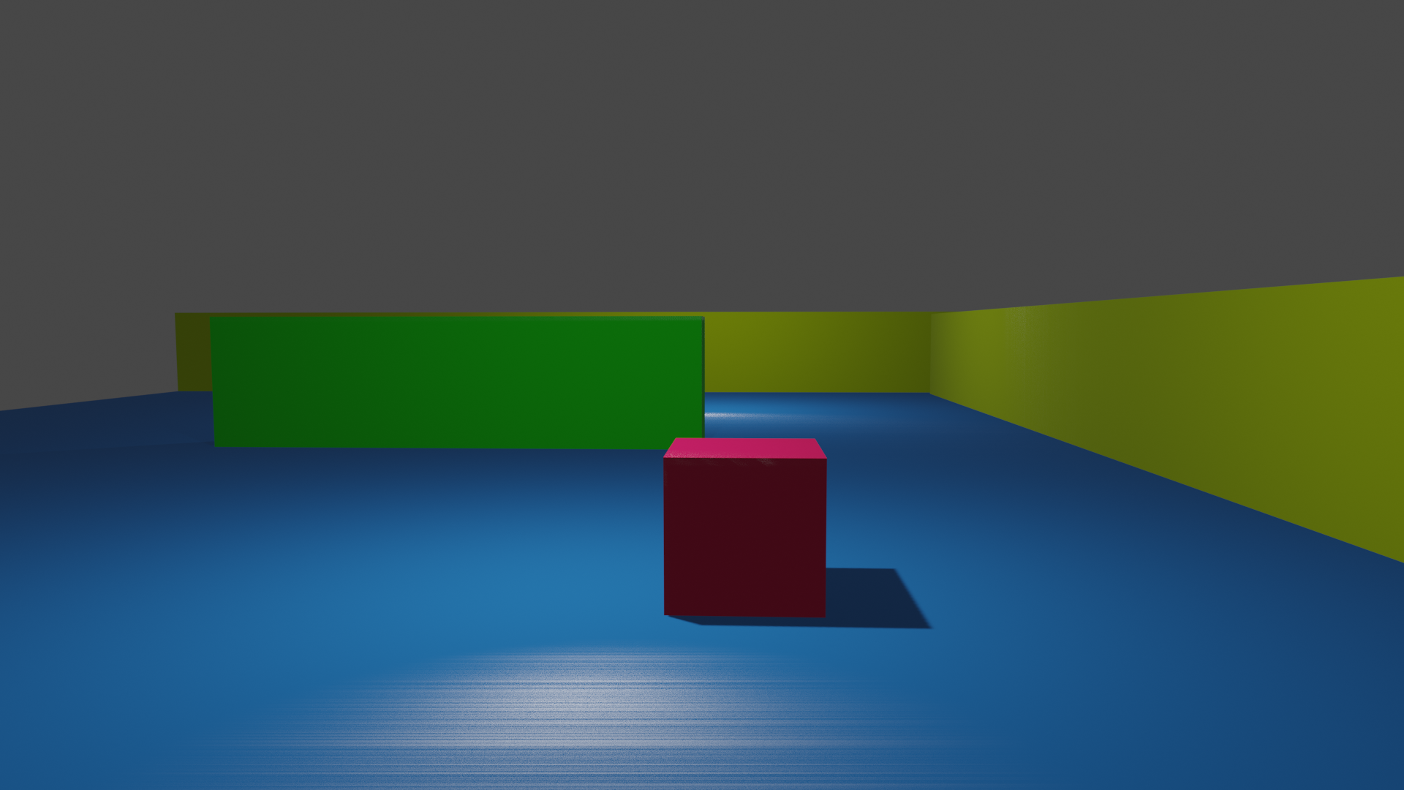
Usability of Product
Notes:
How would someone use your project? This is a non-technical, and functional overview of usability.

Slide 5
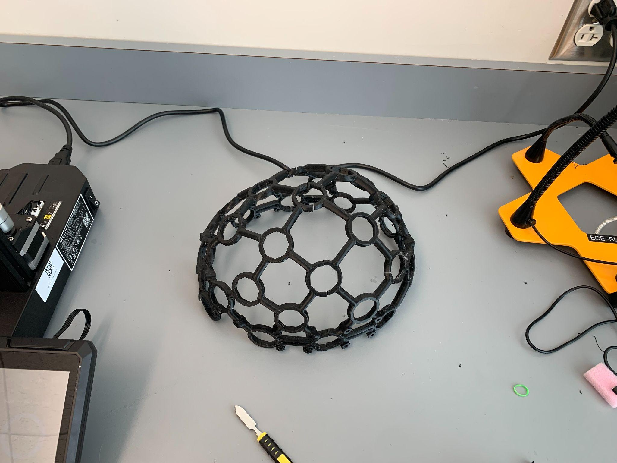
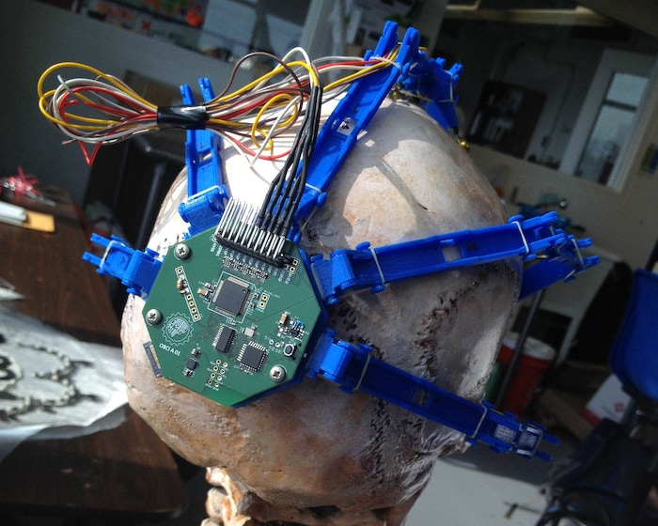

Slide 6
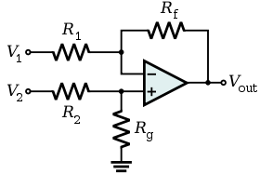
Initial Prototype Test
Notes:
“Tweetable” summary of your project - 30 seconds or less

Slide 7
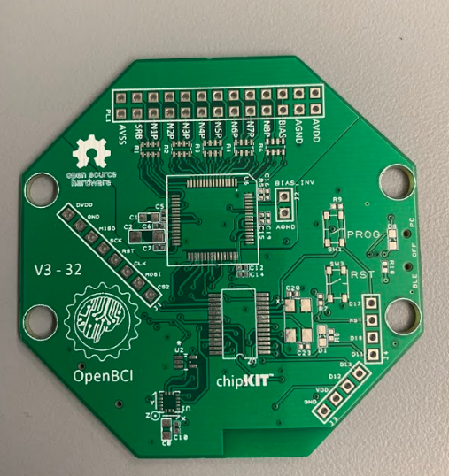

Slide 8
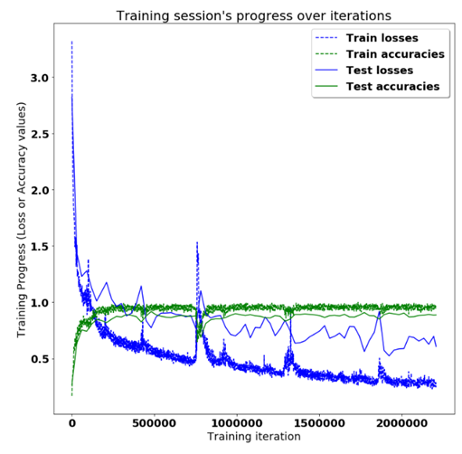
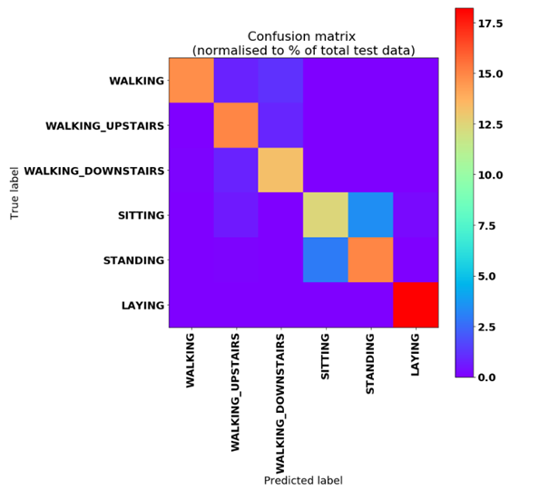

Slide 9
Last Stage/ Working Product
Fully integrate the headset, neural network, and virtual environment to function seamlessly in real time.

